Slide 1


We enable every
restaurant to deliver!

Slide 2



Team
Dheeraj
Achintya
Yujata

Slide 3
Agenda
Problem Statement
Methodology
Infrastructure Setup
Dataset Selection
Data Split & Preparation
Exploratory Data Analysis
Model Pipeline & Training
Pipeline Working Demo
Model Performance Monitoring
Feature Modification Impact
Conclusion
Contributions

Slide 4
Problem Statement
Goal
Challenges
Expected Outcomes
DoorDash seeks to enhance customer satisfaction by improving delivery time estimates
Current inaccuracies cause frustration and resource waste
This project deploys a machine learning pipeline to predict delivery times accurately and maintain consistency through continuous monitoring
Data Quality Issues
Target Variable Calculation
Improved ETA Accuracy
Improved Experience and Efficiency
Model Deployment and Monitoring

Slide 5
Methodology

Slide 6
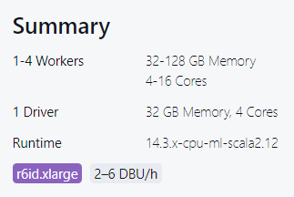
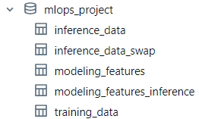
Infrastructure Setup
1. Cluster Setup - for executing AutoML & Workflows
2. Unity Catalog - Delta Tables - Feature Store
training_data, version 0 → raw training data
training_data, latest version → processed training data
modeling_features (feature store) → final features for modeling
inference_data, version 0 → raw inference data
inference_data, latest version → processed inference data
modeling_features_inference → final features for predicting during inference
DataBricks runtime 14.3 ML makes it possible to execute AutoML and WorkFlows
Runtimes greater than 14.3 ML has Python version 3.11 with which Evidently AI is not compatible.

Slide 7
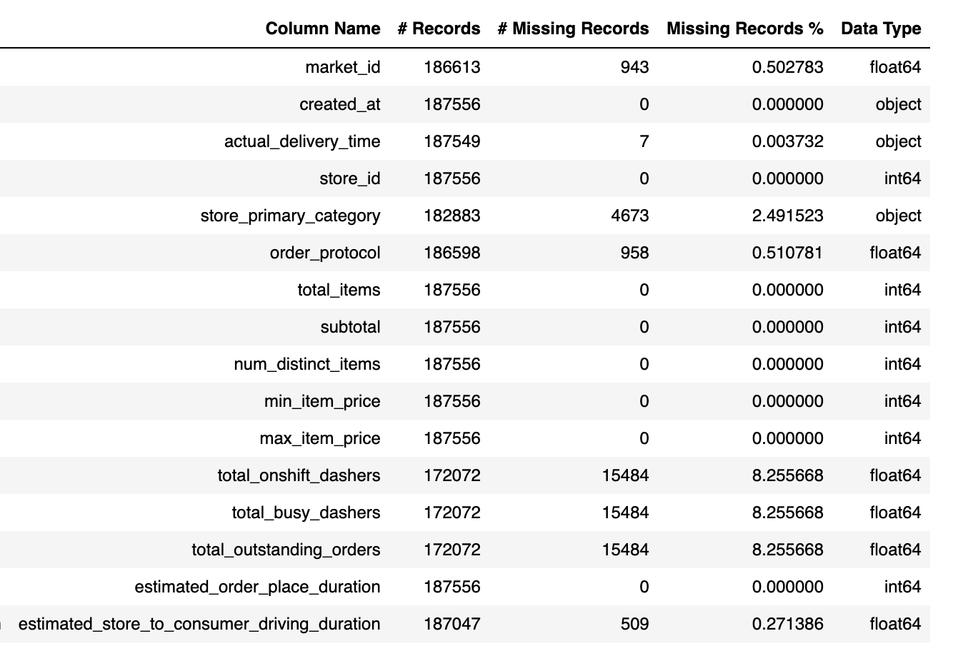
Data Overview
Data Source: kaggle
About: DoorDash Deliveries
Duration: 4 Months
Features: 16
Rows: ~190K

Slide 8
Data Preparation
Used for EDA and model training
95 %
5 %
Used for inference
Made a copy of the inference data and swapped ‘total_items’ and ‘subtotal’ to create inference data swapped.

Slide 9
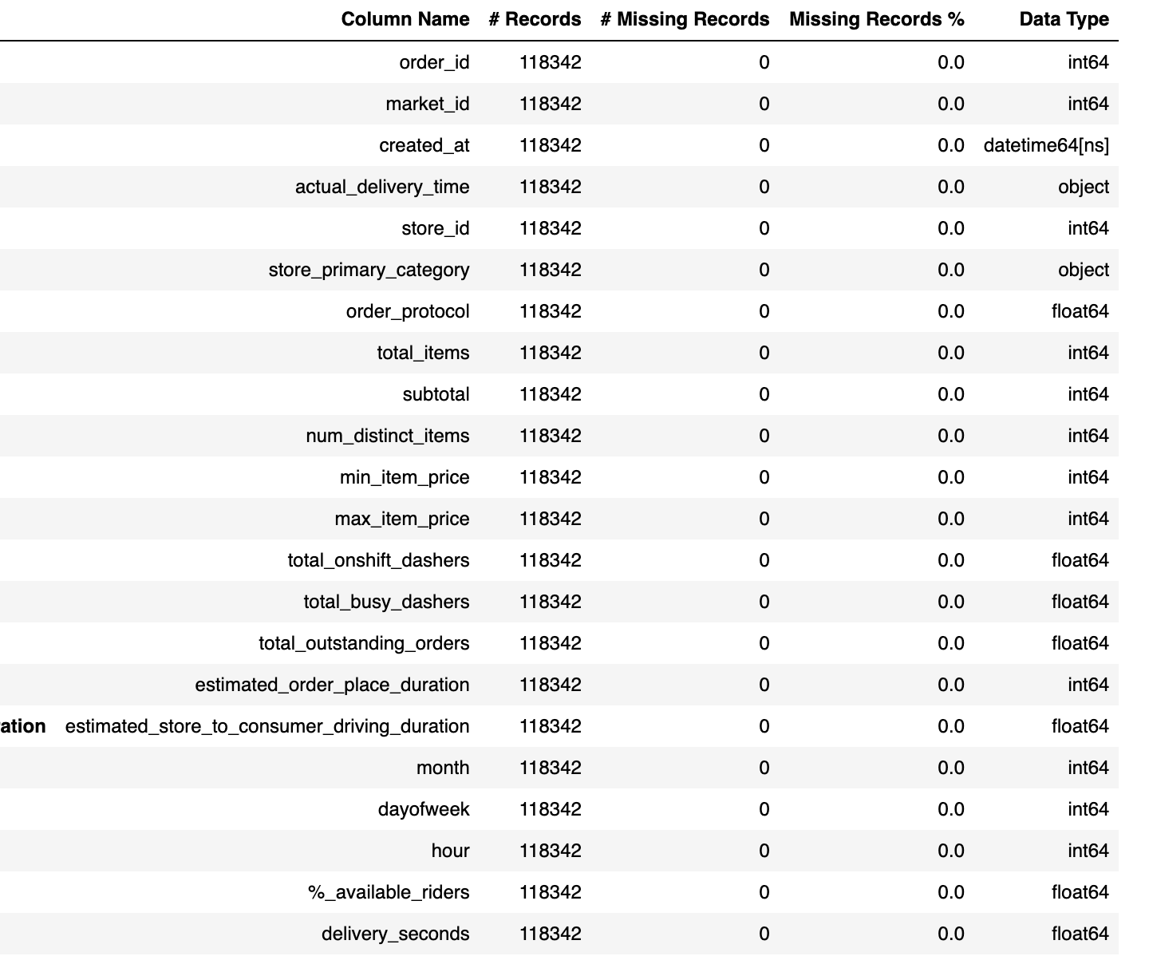
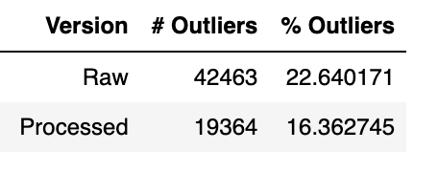
Preprocessed and Engineered 95% of Original Dataset: 34% Reduction from 180K to 118K Records
Data Preprocessing
Missing value treatment
Fills missing store_primary_category values based on the most common category per store_id
Fills missing market_id values based on the most common market_id per store_id
Data sanity check
Outlier removal('delivery_seconds', 'subtotal', 'max_item_price')
Using IQR approach
Feature engineering
(month, dayofweek, hour, %_available_riders, delivery_seconds)

Slide 10
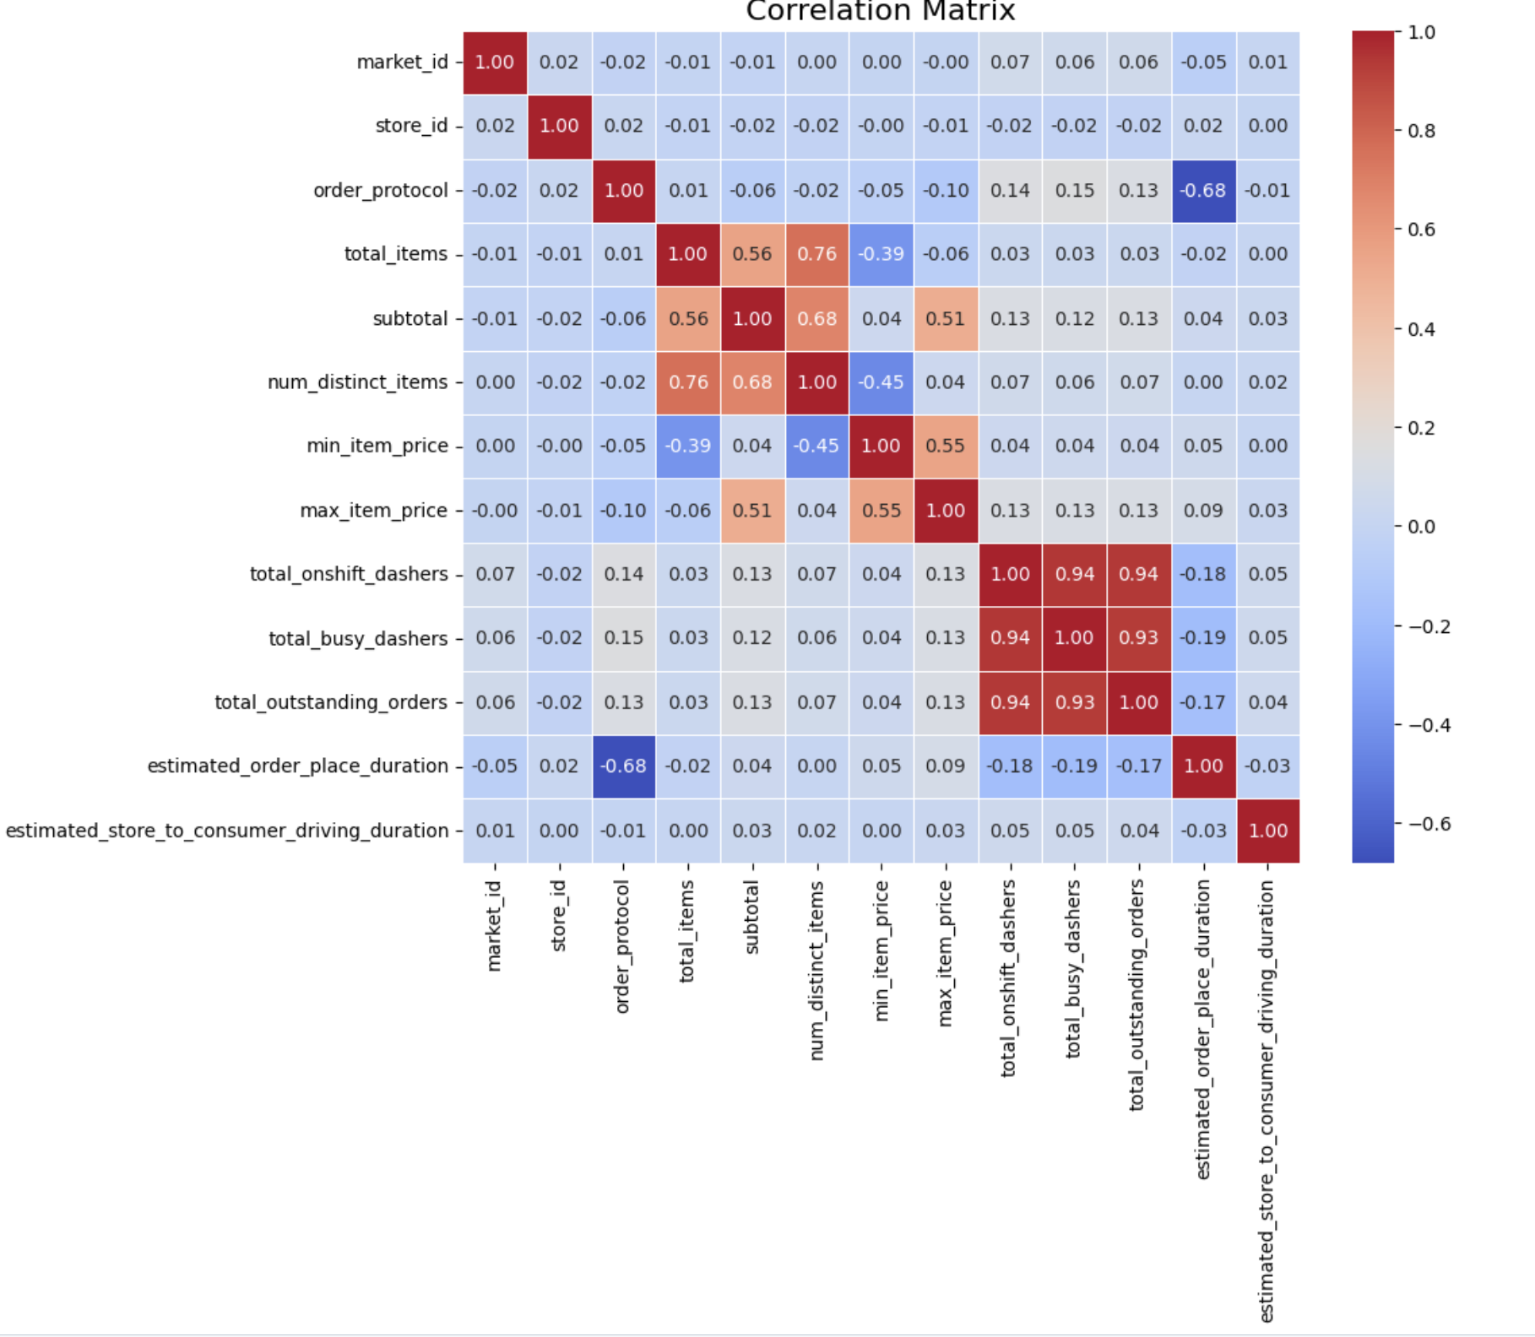
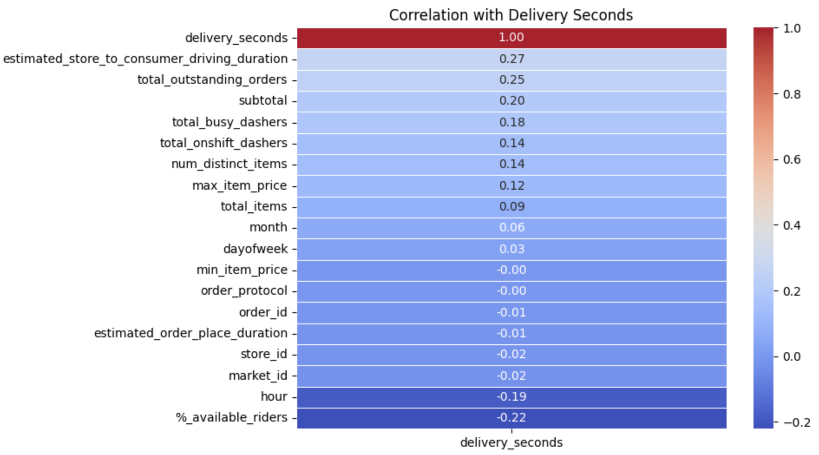
Delivery Seconds: Strongly Affected by Driving Duration and Outstanding Orders
Correlation Matrix:
The total_onshift_dashers, total_busy_dashers, and total_outstanding_orders are highly correlated, while estimated_order_place_duration is negatively correlated with order_protocol. Other features have weak correlations
Deriving “delivery_seconds”: It is the time from order creation to delivery, excluding the estimated time to place the order
Correlation with Delivery Seconds :
Delivery time is strongly influenced by driving duration and outstanding orders, while features like minimum item price and order protocol have little impact. Faster deliveries are observed during certain hours and when more riders are available

Slide 11
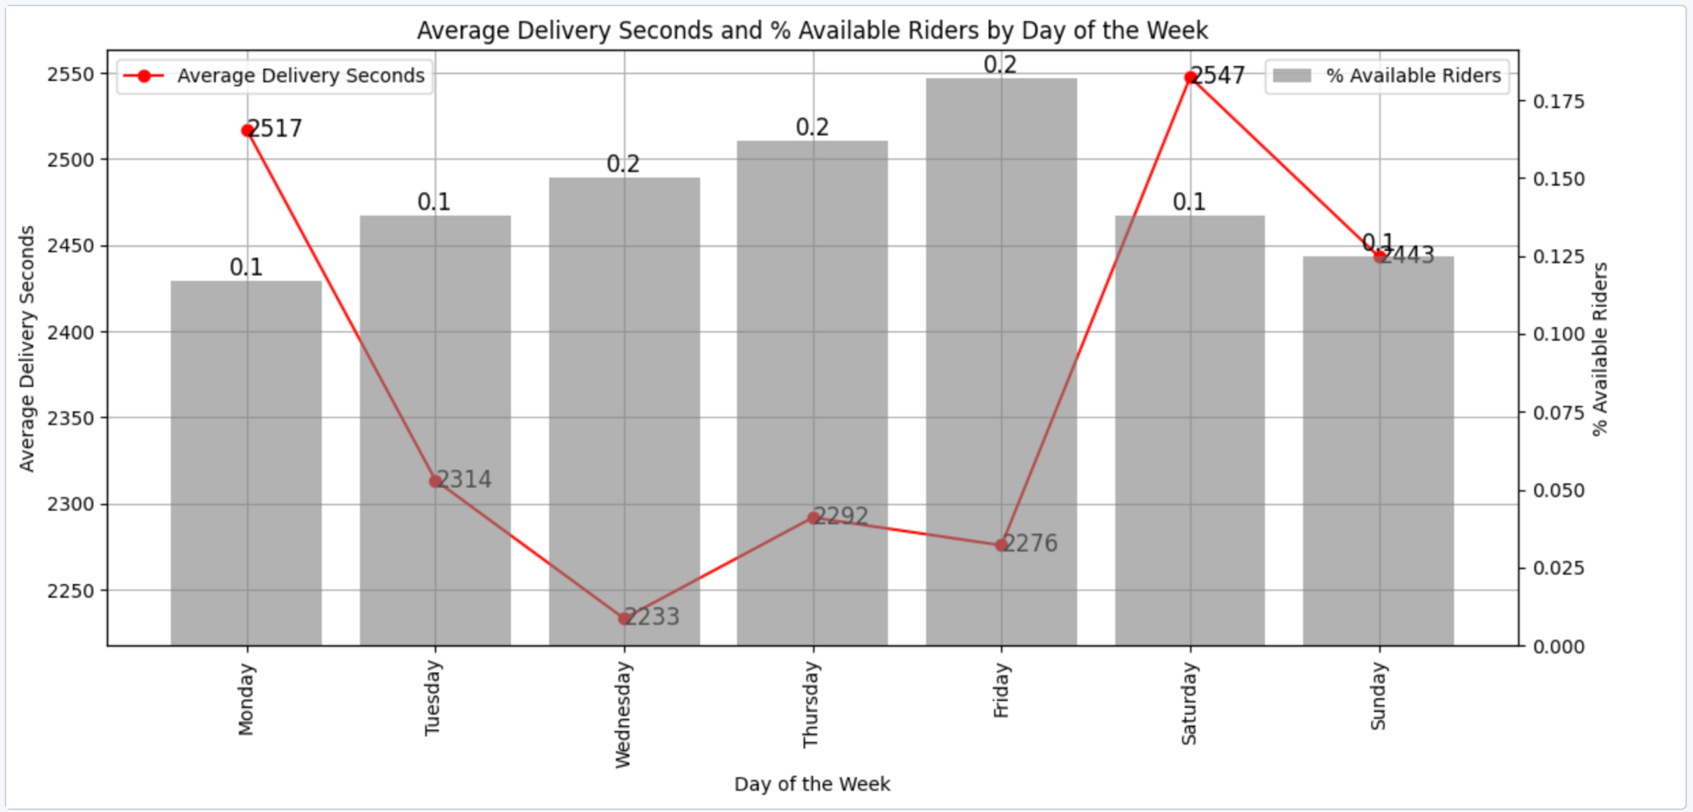
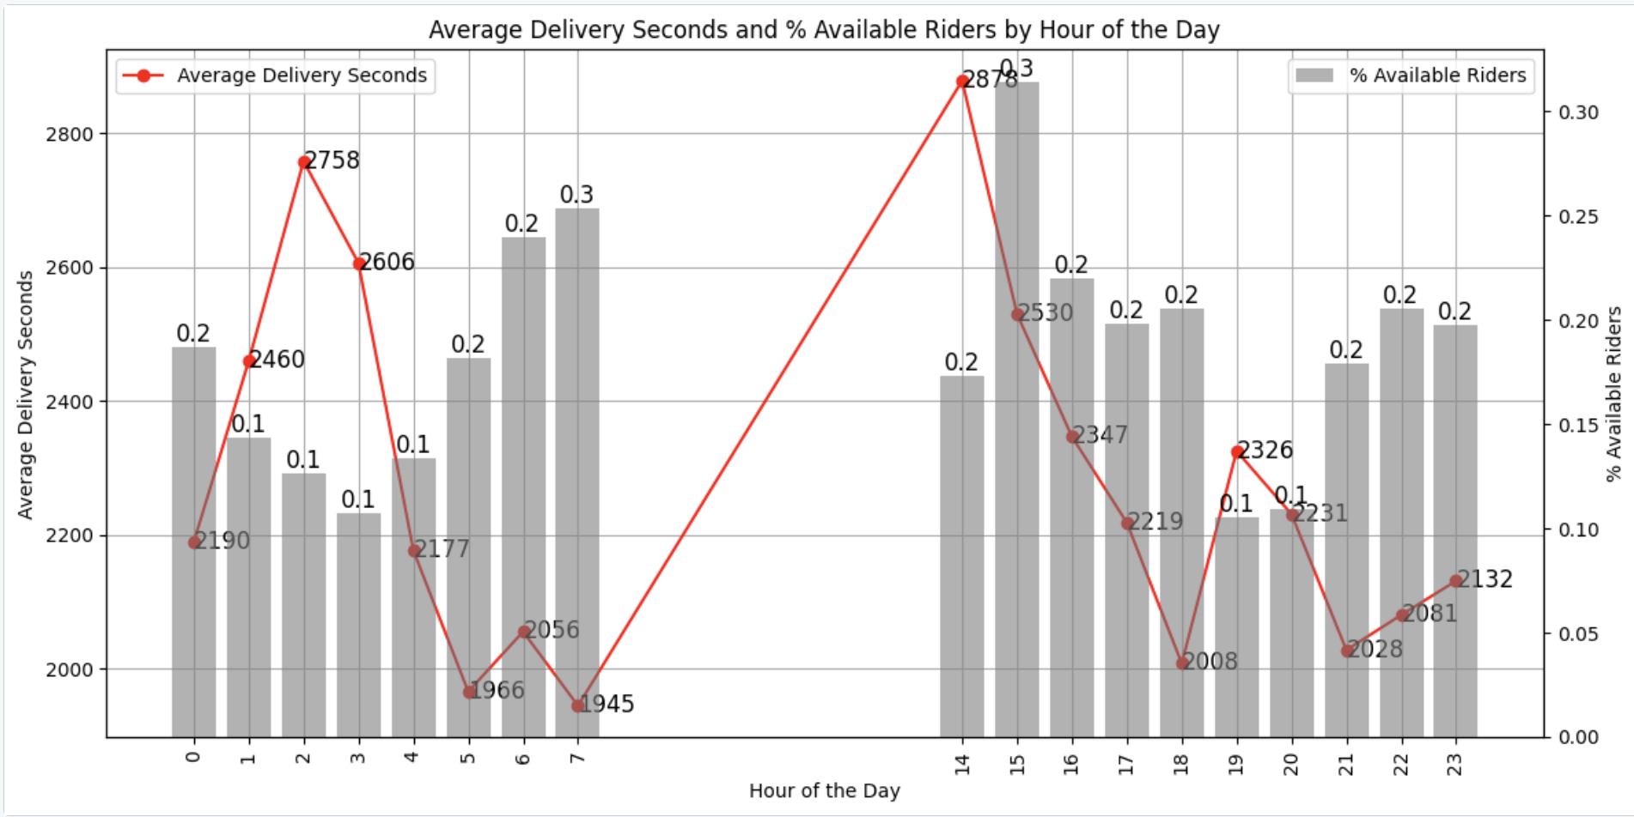
Peak Times and Delivery Challenges: A Weekday
and Hourly Analysis
Data Availability Issues
The lowest average delivery times occur on Wednesdays (2233 seconds), while the highest are on Saturdays (2547 seconds). The significant increase in orders and possible traffic congestion on Saturdays leads to longer delivery times, despite more riders being available
Average delivery times spike significantly at hour 14 (2758 seconds) and decrease sharply by hour 19 (2056 seconds), with available rider percentages fluctuating, suggesting peak demand or rider scarcity during certain hours

Slide 12
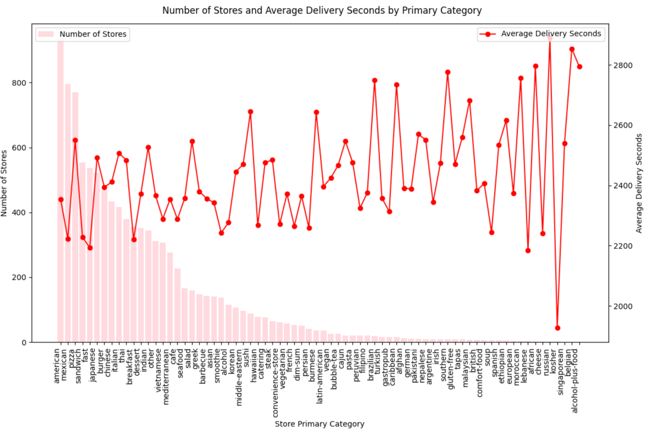
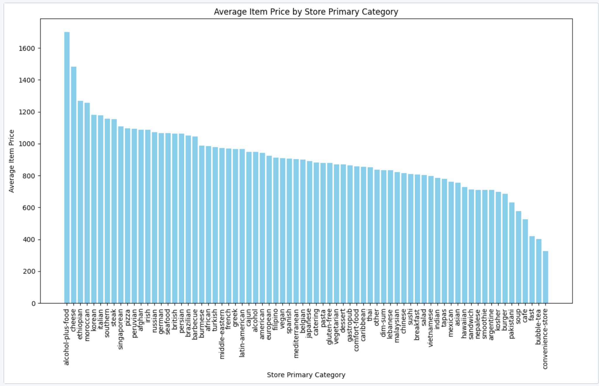
Distribution of Stores by Category and Service Attributes
Number of Stores
American, Mexican, Japanese, and Sandwiches have 500+ stores
German, Singaporean, Austrian, and Polish have <100 stores
Average Delivery Seconds
Range: Delivery times generally fall between 33 to 50 minutes
Higher Times: Southern, Mediterranean, and Thai
Lower Times: Alcohol-plus-food, Brazilian, and Indian
Alcohol-plus-food, Ethiopian, and Moroccan have the highest average item prices, all over 1400, with Alcohol-plus-food exceeding 1800
Korean, French, Lebanese, and Japanese fall within the 800 to 1200 price range, indicating a moderate pricing strategy
Bubble Tea, Fast Food, and Convenience Store have the lowest average item prices, all under 400, focusing on affordability

Slide 13
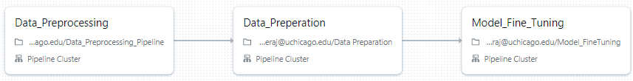

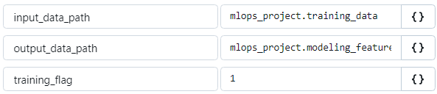
Pipeline 1: Training Pipeline
training_data version 0 is the input for “Data_Procproessing” and it writes back the processed data to training_data as a new version
Saved standard scaler and one hot encoder fitted during training as pickle files to use them during inference. This is identified by the ‘training_flag’ parameter

Slide 14

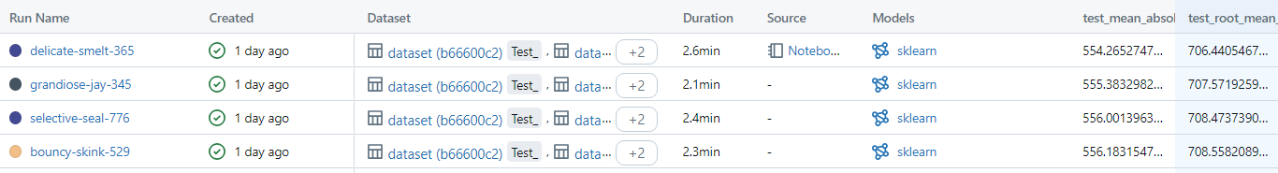
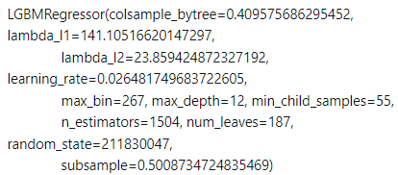
AutoML & Metric Used
Chosen RMSE as the evaluation metric, as it quantifies the average error in delivery time predictions. This directly reflects how closely the model’s ETA aligns with actual delivery times, providing a clear measure of potential delays if implemented in production
AutoML implemented approximately 250 different models from LightGBM, XGBoost, RandomForest, SGD and Decision Trees. However, LightGBM outperformed other models, with a test RMSE of 12 minutes (approx)

Slide 15
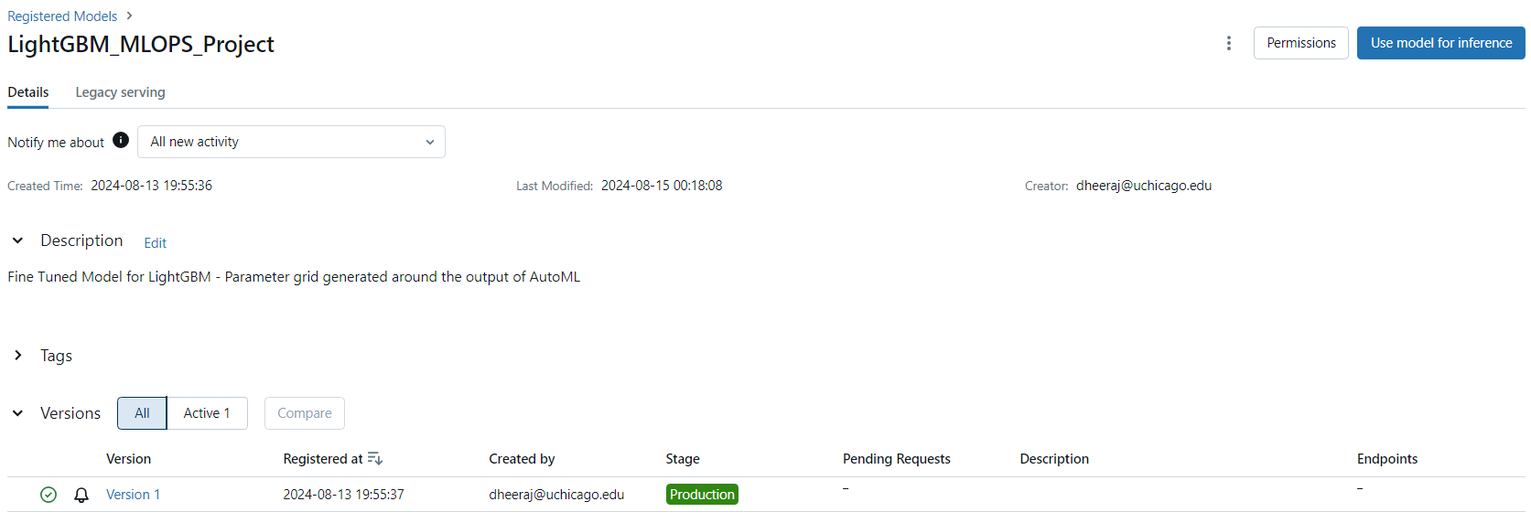
Model Fine Tuning & Deployment
Created a hyperparameter grid around the hyperparameters given by AutoML for LightGBM
Performed Random search reducing RMSE from 12 minutes to 11 minutes
Logged this model on MLFlow and registered it as part of deployment

Slide 16
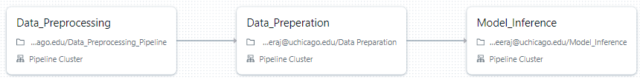

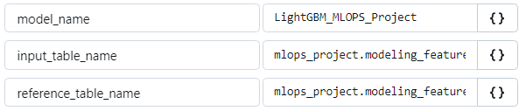
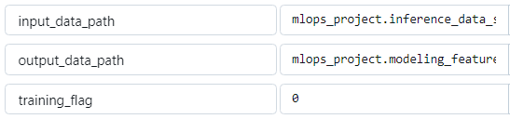
Pipeline 2: Inference Pipeline
Loading the pickle files for standard scaler and one hot encoder fitted during training to transform data during inference
Loads the deployed model and perform batch inference, logs the performance metrics on MLFlow and Data Drift on Evidently

Slide 17

Demo

Slide 18
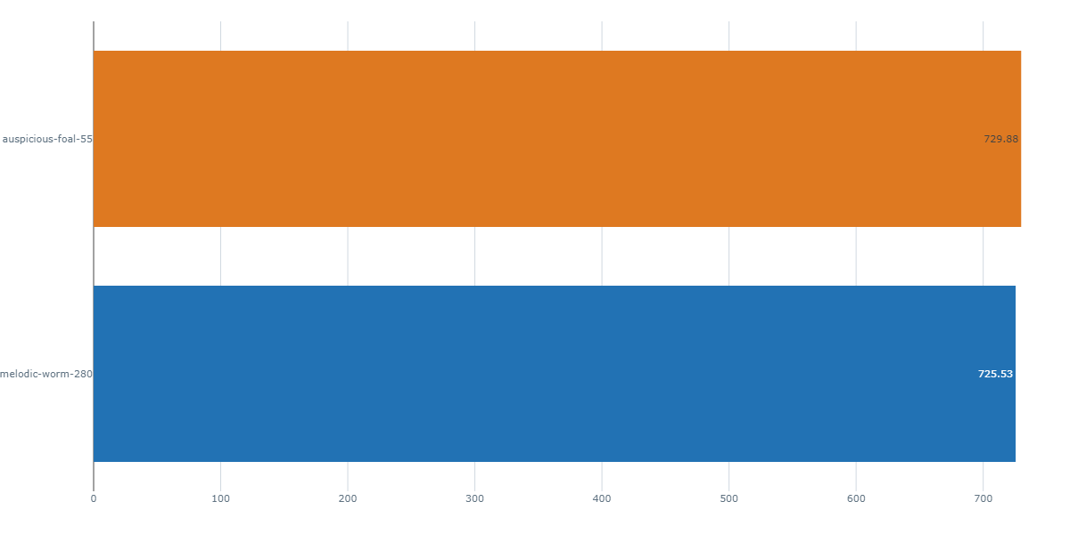
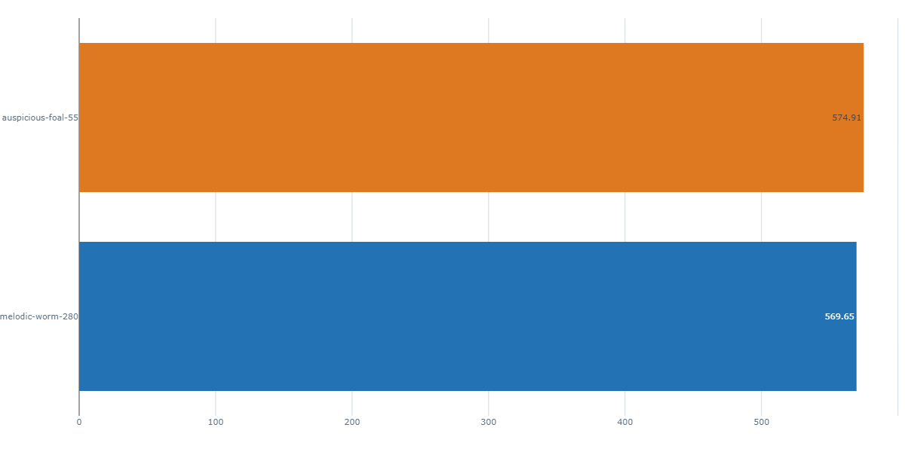
Model Performance Monitoring
RMSE
729.88
MAE
574.91
725.53
569.65
We observe an increase in RMSE/ MAE by 4 seconds during inference with the same model and data, but with columns swapped
Inference Set 1
Inference Set 2 (swapped)

Slide 19
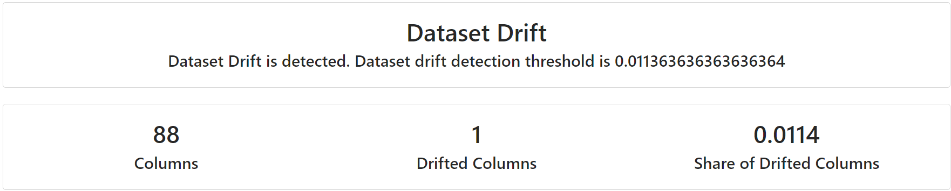
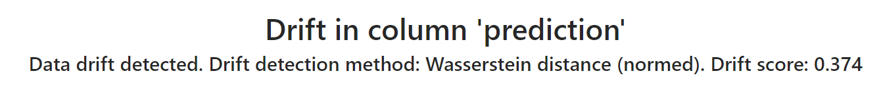
Data Drift: Inference Set 1
Covariate shift identified in ‘max_item_price’
Prior probability drift identified with a drift score of 0.374

Slide 20
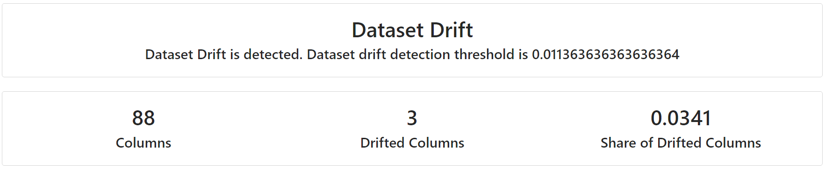
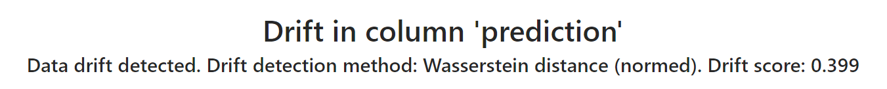
Data Drift: Inference Set 2
Covariate shift identified in 3 columns: columns that were swapped (‘total_items’, ‘subtotal’) and ‘max_item_price’
Prior probability drift identified with a drift score of 0.399 (greater than the score observed with inference set 1)

Slide 21
Conclusion
1
4
Project Achievements:
Successfully deployed a machine learning pipeline to predict DoorDash delivery times accurately
Improved ETA accuracy, enhancing customer satisfaction and operational efficiency
Implemented robust data preprocessing, reducing the dataset by 34% while maintaining quality
Monitoring and Drift Detection:
Implemented continuous monitoring of model performance and data drift
Detected covariate shift in 'max_item_price' and prior probability drift in both inference sets
Observed slight performance degradation when feature values were swapped
2
5
Model Performance:
Utilized AutoML to test ~250 models, with LightGBM emerging as the best performer
Fine-tuned the model, reducing RMSE from 12 minutes to 11 minutes
Achieved RMSE of 569.65 seconds (~9.5 minutes) on the first inference set
Infrastructure and Pipeline:
Successfully set up Databricks environment with Unity Catalog and Delta Tables
Developed separate training and inference pipelines for maintainability and scalability
3
Data Insights:
Identified key factors influencing delivery times: driving duration and outstanding orders
Discovered patterns in delivery times across weekdays and hours, informing resource allocation
Analyzed store categories and service attributes, revealing trends in delivery times and pricing
6
Future Directions:
Further optimize the model based on drift insights
Expand the feature set to capture more nuanced factors affecting delivery times
Implement real-time monitoring and retraining strategies to maintain model accuracy

Slide 22
Contributions
Achintya: Auto ML, Inference Pipeline
Dheeraj: Training Pipeline, Model Deployment and Monitoring
Yujata: EDA, Inference Pipeline

