Slide 1


Doctor Channeling
Database System
This Photo by Unknown Author is licensed under CC BY-SA

Slide 2
Description
Facilitates finding a doctor according to a patients needs
Booking an appointment with the preferred doctor.
Contains details of doctors and the hospitals.
It will allow the patients to book appointments
Thus, three users that will access the database can be established

Slide 3
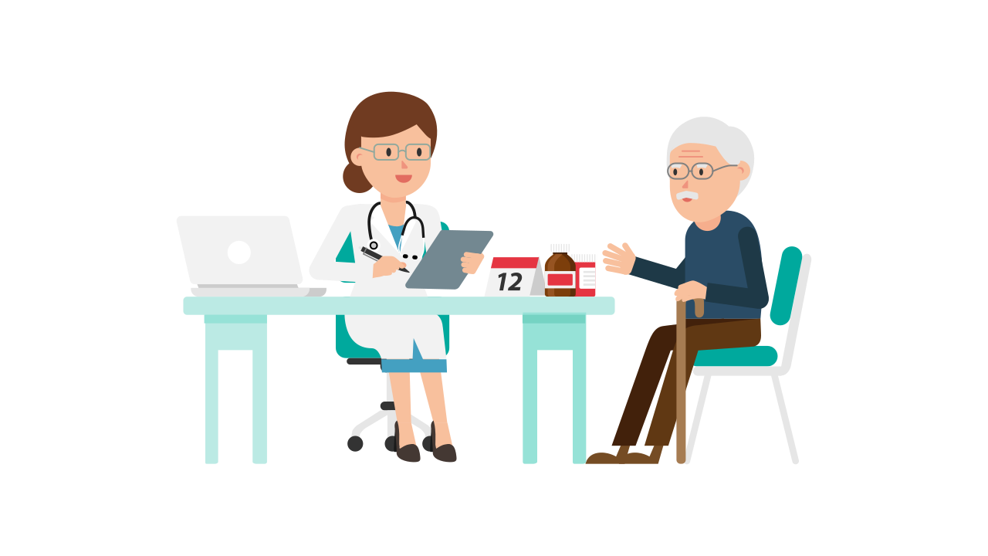
Users
Patients
Doctors
Channel Centers

Slide 4
Roles of users
1.Patients
Search for doctors based on their needs
Make an appointment with a chosen doctor
2. Hospitals
View appointments made at the hospital
Adding external appointments to the list of appointments
3. Doctors
View appointments

Slide 5
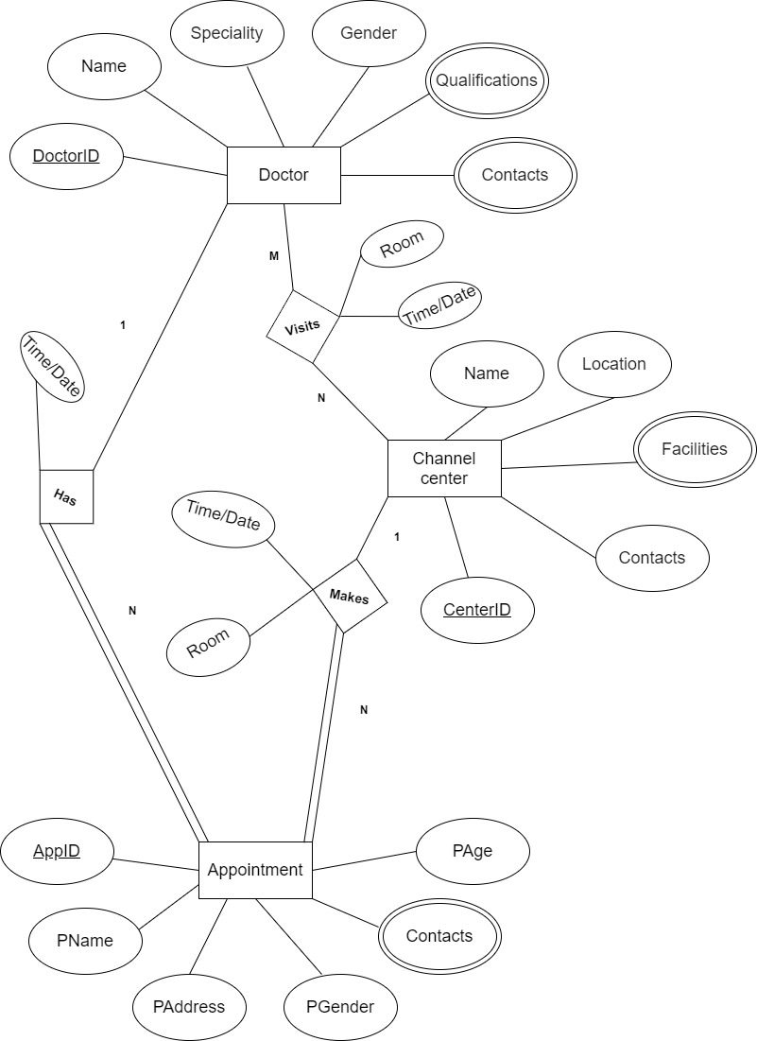
Conceptual Model

Slide 6
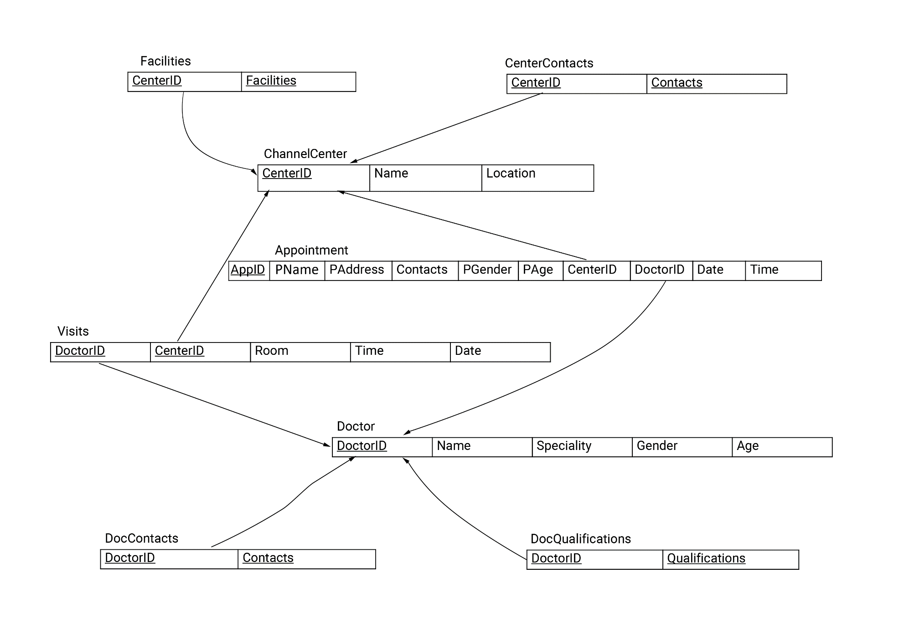
Logical Model

Slide 7
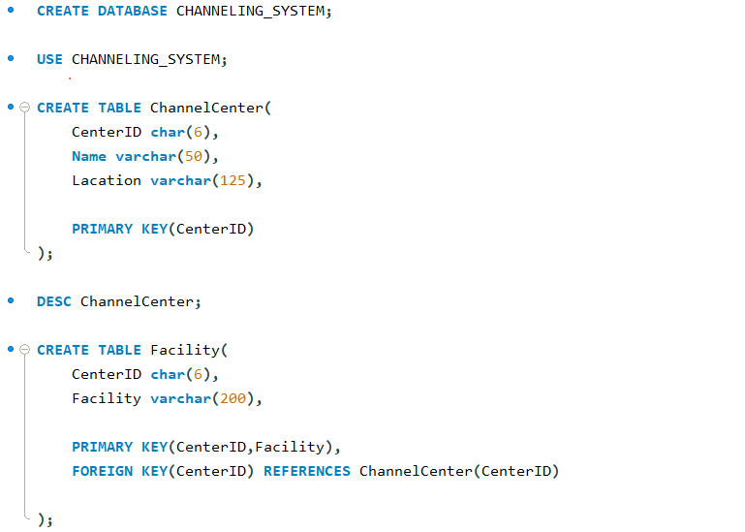
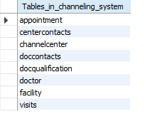
Physical Model
Tables

Slide 8
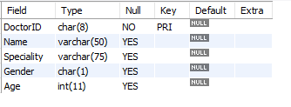
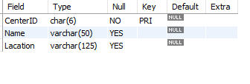
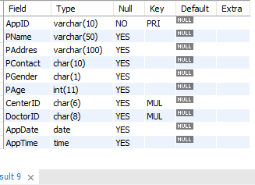
Doctors
Channel center
Appointments

Slide 9
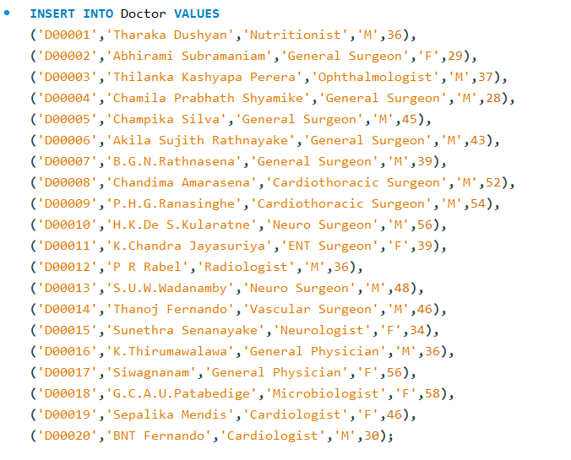
Populated Database

Slide 10
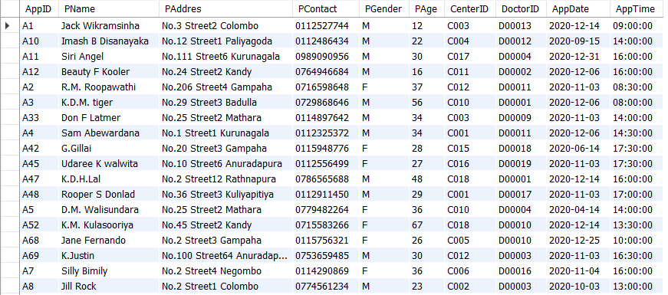
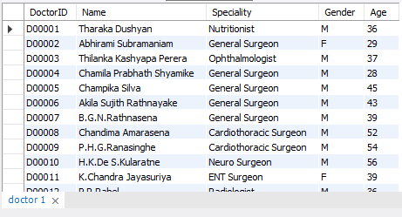
Appointments
Doctors

Slide 11
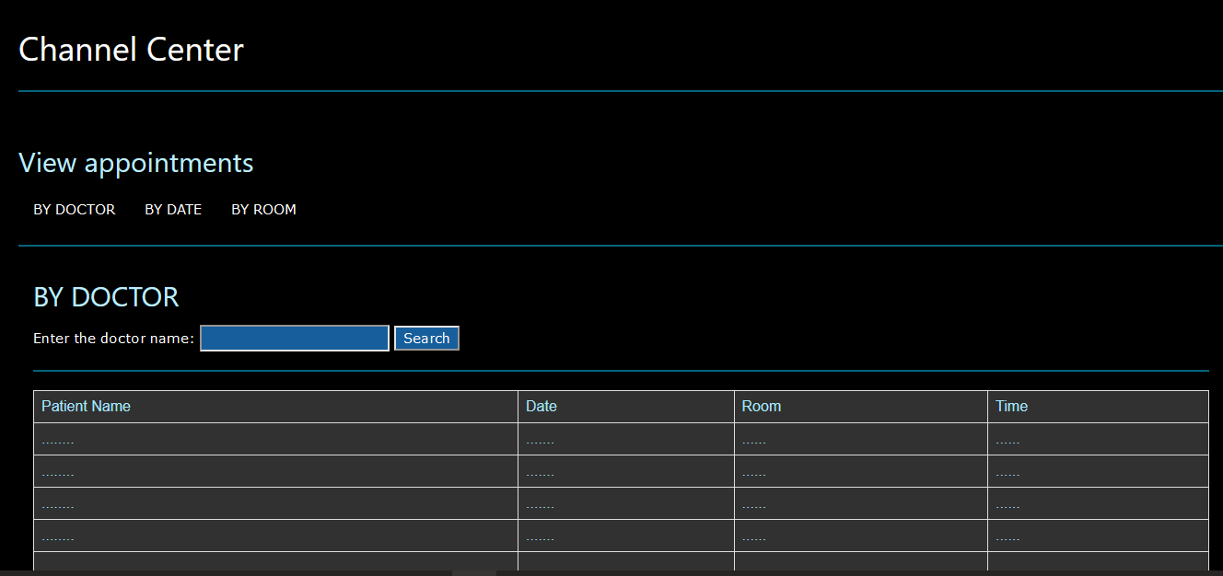
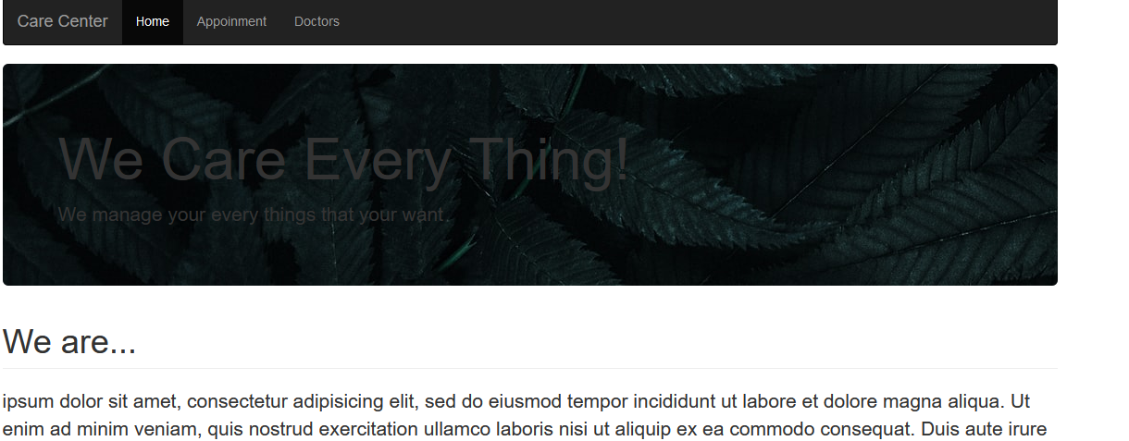
Interface

Slide 12
Implementation
Database model is relational
MySQL is better for implementing Relational database.
Multiple users , Different locations - web based interface
PHP integrates well with MySQL

Slide 13


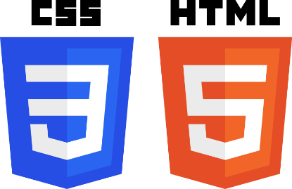
Tools
MySQL Server
MySQL Workbench
PHP
HTML
CSS

Slide 14
Views
Channel center appointment view
DocID | DocName | AppID | PName | AppDate | AppTime | Room
Doctor patient view
DocID | CenterName | Room | NumberOfApps | Date | Time
.
.
.

Slide 15
Stored Procedures
To calculate number of appointments per doctor
To generate patient appointment time based on doctor visit time
To add appointments

Slide 16


Summary
Web-based e-Channeling System
Fast, efficient Channeling of Doctors
Three Primary Users
Channel Centre
Patient
Doctor
This Photo by Unknown Author is licensed under CC BY-NC

