Slide 1
The A* Algorithm
@Sudharshan Welihinda - 2019

Slide 2
The Search Problem
Starting from a node n find the shortest path to a goal node g
20
15
10
5
15
?
18
20
25
33
@Sudharshan Welihinda - 2019

Slide 3
Shortest Path
Consider the following weighted undirected graph:
20
10
22
20
7
9
16
2
18
6
8
24
5
4
6
66
10
20
We want:
A path 5 → v1 → v2 → … → 20
Such that g(20) = cost(5→v1) + cost(v1→ v2) + … + cost ( →20) is minimum
@Sudharshan Welihinda - 2019

Slide 4
Djikstra Algorithm
Greedy algorithm: from the candidate nodes select the one that has a path with minimum cost from the starting node
20
15
10
5
15
?
18
20
25
33
@Sudharshan Welihinda - 2019

Slide 5

Dijktra’s Algorithm
Shortest path from A to F is;
Visited :{A,C,B,E,D,F}
11
F
2
3
4
5
9
B
D
11
10
6
3
12
4
C
2
G
3
8
7
5
0
7
A
E
Node | A | B | C | D | E | F | G
predecessor | A | A | A | B | A | D | E
@Sudharshan Welihinda - 2018

Slide 6
Djikstra Algorithm
Given a Graph G = (V,E) and T a subset of V, the fringe of T, is defined as:
Fringe(T) = { (w,x) in E : w ∈ T and x ∈V − T}
T
Djikstra’s algorithm pick the edge v in Fringe(T) that has minimum distance to the starting node
g(v) is minimum
@Sudharshan Welihinda - 2017

Slide 7
Example
20
10
22
20
7
9
16
2
18
6
8
24
5
4
6
66
10
20
@Sudharshan Welihinda - 2017

Slide 8
Properties
Dijkstra’s is a greedy algorithm
Why Dijkstra’s Algorithm works?
The path from u to every node in T is the minimum path
T
V  T
7
s
x
20
u
w
6
v
20
15
r
@Sudharshan Welihinda - 2017

Slide 9

Example
What does Djikstra’s algorithm will do? (minimizing g(n))
Problem: Visit too many nodes, some clearly out of the question
@Sudharshan Welihinda - 2019

Slide 10
Dijktra’s Algorithm
Shortest path from A to F is;
Visited :{A,C,B,E,D,F}
11
F
2
3
4
5
9
B
D
11
10
6
3
12
4
C
2
G
3
8
7
5
0
7
A
E
Node | A | B | C | D | E | F | G
predecessor | A | A | A | B | A | D | E
@Sudharshan Welihinda - 2018

Slide 11
Complexity
Actual complexity is O(|E|log₂ |E|)
Is this good?
Actually it is bad for very large graphs!
Branching factor: b
….
# nodes = b^{(# levels)}
….
Another Example: think of the search space in chess
@Sudharshan Welihinda - 2019

Slide 12
Better Solution: Make a ‘hunch”!
Use heuristics to guide the search
  Heuristic: estimation or “hunch” of how to search for a solution
We define a heuristic function:
  h(n) = “estimate of the cost of the cheapest path from the starting node(current node) to the goal node”
@Sudharshan Welihinda - 2019

Slide 13
Lets Try A Heuristic
Heuristic: minimize h(n) = “Euclidean distance to destination”
Problem: not optimal (through Rimmici Viicea and Pitesti is shorter)
@Sudharshan Welihinda - 2017

Slide 14
The A* Search
Difficulty: we want to still be able to generate the path with minimum cost
A* is an algorithm that:
  Uses heuristic to guide search
  While ensuring that it will compute a path with minimum cost
“estimated cost”
A* computes the function f(n) = g(n) + h(n)
@Sudharshan Welihinda - 2019
“actual cost”

Slide 15
A*
f(n) = g(n) + h(n)
  g(n) = “cost from the starting node to reach n”
  h(n) = “estimate of the cost of the cheapest path from n to the goal node”
h(n)
20
g(n)
15
n
10
5
15
18
20
25
33
@Sudharshan Welihinda - 2019

Slide 16
Example
A*: minimize f(n) = g(n) + h(n)
@Sudharshan Welihinda - 2019

Slide 17

A* search example
@Sudharshan Welihinda - 2019

Slide 18

A* search example
@Sudharshan Welihinda - 2019

Slide 19

A* search example
@Sudharshan Welihinda - 2019

Slide 20

A* search example
@Sudharshan Welihinda - 2019

Slide 21

A* search example
@Sudharshan Welihinda - 2019

Slide 22

A* search example
@Sudharshan Welihinda - 2019

Slide 23
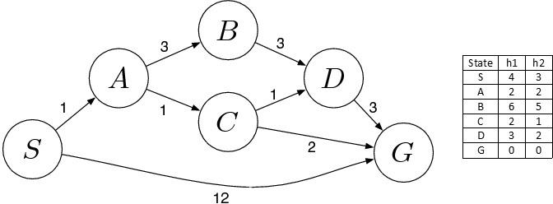
@Sudharshan Welihinda - 2019

Slide 24
Exam Paper - 2017
Given the graph depicted by the figure above, we apply an A* algorithm in order to figure out the shortest path from S to G. The labels on the edges denote the costs associated with the edge, whereas he table next to the graph depicts the associated costs for two heuristics, h1 and h2, respectively. Based on this input, answer the following questions:
What will be the elaborated shortest path from S to G and at which cost based on heuristic h1?
[5 Marks]
Explain in terms of the f(x) = g(x) + h(x) function underpinning our A* algorithm what will be
  the nodes being visited;
  the calculated cost;
  the decisions made and at which point to take an alternative path.
[13 Marks]
Will it be any change if we apply the heuristic h2 instead of h1?
[5 Marks]
@Sudharshan Welihinda - 2019

Slide 25
a) S->A->C->G (Total Cost: 4)
b)
Initialization: { [ S , 4 ] }
Iteration1: { [ S->A , 3 ] , [ S->G , 12 ] }
Iteration2: { [ S->A->C , 4 ] , [ S->A->B , 10 ] , [ S->G , 12 ] }
Iteration3: { [ S->A->C->G , 4 ] , [ S->A->C->D , 6 ] , [ S->A->B , 10 ] , [ S->G , 12] }
c) No, there will be no change of the algorithmic output as the added costs based on h2 are minimally different from those of h1 [5 Marks]
@Sudharshan Welihinda - 2019

Slide 26
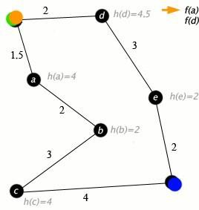
Given the road network depicted by the figure above, we apply an A* algorithm, where nodes are cities connected with roads at a cost measured in miles. The figure also includes the heuristic h(x) cost being used, which is the straight-line distance to the target point (dot on the right bottom corner). The starting point is the dot at the top-left corner. Based on this picture, answer the following questions:
What will be the elaborated shortest path from top-left to bottom-right corner cities?
@Sudharshan Welihinda - 2017

Slide 27
Properties of A*
A* generates an optimal solution if h(n) is an admissible heuristic and the search space is a tree:
  h(n) is admissible if it never overestimates the cost to reach the destination node
A* generates an optimal solution if h(n) is a consistent heuristic and the search space is a graph:
  h(n) is consistent if for every node n and for every successor node n’ of n:
  h(n) ≤ c(n,n’) + h(n’)
h(n)
n
d
c(n,n’)
h(n’)
n’
If h(n) is consistent then h(n) is admissible
Frequently when h(n) is admissible, it is also consistent
@Sudharshan Welihinda - 2017

Slide 28
Admissible Heuristics
A heuristic is admissible if it is too optimistic, estimating the cost to be smaller than it actually is.
Example:
In the road map domain,
h(n) = “Euclidean distance to destination”
is admissible as normally cities are not connected by roads that make straight lines
@Sudharshan Welihinda - 2017

Slide 29
How to Create Admissible Heuristics
Relax the conditions of the problem
  This will result in admissible heuristics!
Lets look at an 8-puzzle game:
http://www.permadi.com/java/puzzle8/
Possible heuristics?
@Sudharshan Welihinda - 2017

Slide 30
Example: Admissible Heuristics in 8-Puzzle Game
Heuristic: a tile A can be moved to any tile B
  H1(n) = “number of misplaced tiles in board n”
Heuristic: a tile A can be moved to a tile B if B is adjacent to A
  H2(n) = “sum of distances of misplaced tiles to goal positions in board n”
Some experimental results reported in Russell & Norvig (2002):
  A* with h2 performs up to 10 times better than A* with h1
  A* with h2 performs up to 36,000 times better than a classical uninformed search algorithm (iterative deepening)
@Sudharshan Welihinda - 2017

Slide 31
Using A* in Planning
A
C
C
B
B
A
C
B
A
B
A
C
B
C
B
A
C
A
B
C
B
A
B
A
C
A
C
A
A
B
C
B
C
C
B
A
A
B
C
h(n) = “# of goals remaining to be satisfied” g(n) = “# of steps so far”
@Sudharshan Welihinda - 2017

Slide 32
A* in Games
Path finding (duh!)
  We will have several presentations on the topic
  We will see that sometimes even A* speed improvements are not sufficient
  Additional improvements are required
A* can be used for planning moves computer-controlled player (e.g., chess)
F.E.A.R. uses A* to plan its search
@Sudharshan Welihinda - 2017

Slide 33
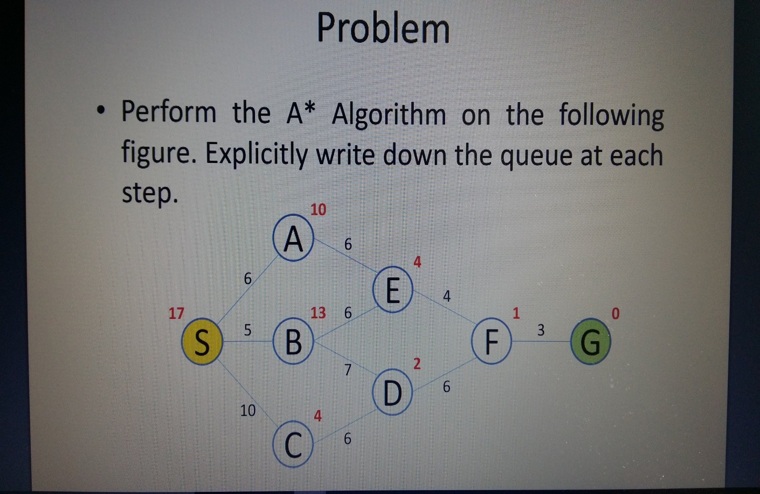
@Sudharshan Welihinda - 2017

