Slide 1
5SENG001W - Algorithms, Week 10
Dr. Klaus Draeger

Slide 2
Recap: Searching in graphs
► A common operation on graphs is search
► Searching for some particular vertex
► Searching for any vertex satisfying a given condition
► Searching for a path between two vertices
► Searching for a shortest path between two vertices
► Search in graphs is more complex than in trees or lists
► Graphs can have cycles
► Naive search could get stuck in a loop
► Need to keep track of visited vertices to prevent this

Slide 3
Recap: iterative depth-first search
► We can also perform depth-first search in the iterative style that we saw in breadth-first search
► The key change is organising the open list as a stack
rather than a queue
► In each iteration, the open list contains a path from the starting vertex to the most recently explored one
► When the target vertex is reached, the open list contains a path to it
► This will usually not be a shortest path

Slide 4
Recap: breadth-first search for shortest paths
► Open list is organised as a queue rather than a stack
► BFS advances in "layers" (see next slide)
► Vertices along the path are not preserved in the open list
► Need to reconstruct the path once the target has been found:
► Either based on the distances from the start stored in the closed list
► Or using an extra map that remembers from which other vertex each vertex was reached

Slide 5
Why breadth-first search works
► BFS advances in "layers":
► For each vertex v , define f (v ) to be the distance from the start to v .
► BFS first visits first all vertices v with f (v ) = 0, then
f (v ) = 1 etc
► Why is this the case?
► At first, the open list only contains the start vertex, which is the only vertex s with f (s) = 0
► All vertices with f (v ) = k + 1 are reached in one step from vertices with f (v ) = k
► So they are all enqueued while the vertices with f (v ) = k
are getting visited

Slide 6
Why breadth-first search breaks for weighted graphs
► In a weighted graph, vertices in the open list are no longer ordered by distance
► For example, vertices with f (v ) = 5 may have edges to vertices with f (v ) = k for any k > 5.
► Idea: could use a sorted data structure like a binary search tree for the open list to fix this
► Then insertion and extraction in the open list both are in
O(log n)
► We can do better, since we only ever want to extract the minimal-distance vertex
► The idea is to use a priority queue based on a min-heap.
► This gives us Dijkstra’s Algorithm.
► Finds shortest paths from the start to all other targets
► Easy to turn into a single-target version

Slide 7






Dijkstra’s algorithm: example
► Consider this example:
v₂
1
v₃
1
1
v₁
v₄
3
3
1
1
3
3
v₀
v₅
v₆
5
5
► Open list:
v₀
► Closed list:
{v₀ 1→ 0}
►
►
Step 5: Vertex v₂ inserted in front of v₅
Done; found shortest distances to all vertices

Slide 8

Dijkstra’s algorithm: example
► Consider this example:
v₂
1
v₃
1
1
v₁
v₄
3
3
1
1
3
3
v₀
v₅
v₆
5
5
► Open list:
v₀ v₁
► Closed list:
{v₀ 1→ 0, v₁ 1→ 1}
►
►
Step 5: Vertex v₂ inserted in front of v₅
Done; found shortest distances to all vertices

Slide 9

Dijkstra’s algorithm: example
► Consider this example:
v₂
1
v₃
1
1
v₁
v₄
3
3
1
1
3
3
v₀
v₅
v₆
5
5
► Open list:
v₀ v₁ v₅
► Closed list:
{v₀ 1→ 0, v₁ 1→ 1, v₅ 1→ 5}
► Step 5: Vertex v₂ inserted in front of v₅
► Done; found shortest distances to all vertices

Slide 10
Dijkstra’s algorithm: example
► Consider this example:
v₂
1
v₃
1
1
v₁
v₄
3
3
1
1
3
3
v₀
v₅
v₆
5 5
► Open list:
v₁ v₅
► Closed list:
{v₀ 1→ 0, v₁ 1→ 1, v₅ 1→ 5}
►
►
Step 5: Vertex v₂ inserted in front of v₅
Done; found shortest distances to all vertices

Slide 11

Dijkstra’s algorithm: example
► Consider this example:
v₂
1
v₃
1
1
v₁
v₄
3
3
1
1
3
3
v₀
v₅
v₆
5 5
► Open list:
v₁ v₂ v₅
► Closed list:
{v₀ 1→ 0, v₁ 1→ 1, v₂ 1→ 2, v₅ 1→ 5}
►
►
Step 5: Vertex v₂ inserted in front of v₅
Done; found shortest distances to all vertices

Slide 12
Dijkstra’s algorithm: example
► Consider this example:
v₂
1
v₃
1
1
v₁
v₄
3
3
1
1
3
3
v₀
v₅
v₆
5
5
► Open list:
v₁ v₂ v₅
► Closed list:
{v₀ 1→ 0, v₁ 1→ 1, v₂ 1→ 2, v₅ 1→ 4}
► Step 5: Vertex v₂ inserted in front of v₅
► Done; found shortest distances to all vertices

Slide 13
Dijkstra’s algorithm: example
► Consider this example:
v₂
1
v₃
1
1
v₁
v₄
3
3
1
1
3
3
v₀
v₅
v₆
5 5
► Open list:
v₂ v₅
► Closed list:
{v₀ 1→ 0, v₁ 1→ 1, v₂ 1→ 2, v₅ 1→ 4}
►
►
Step 5: Vertex v₂ inserted in front of v₅
Done; found shortest distances to all vertices

Slide 14

Dijkstra’s algorithm: example
► Consider this example:
v₂
1
v₃
1
1
v₁
v₄
3
3
1
1
3
3
v₀
v₅
v₆
5 5
► Open list:
v₂ v₃ v₅
► Closed list:
{v₀ 1→ 0, v₁ 1→ 1, v₂ 1→ 2, v₃ 1→ 3, v₅ 1→ 4}
►
►
Step 5: Vertex v₂ inserted in front of v₅
Done; found shortest distances to all vertices

Slide 15
Dijkstra’s algorithm: example
► Consider this example:
v₂
1
v₃
1
1
v₁
v₄
3
3
1
1
3
3
v₀
v₅
v₆
5 5
► Open list:
v₃ v₅
► Closed list:
{v₀ 1→ 0, v₁ 1→ 1, v₂ 1→ 2, v₃ 1→ 3, v₅ 1→ 4}
►
►
Step 5: Vertex v₂ inserted in front of v₅
Done; found shortest distances to all vertices

Slide 16
Dijkstra’s algorithm: example
► Consider this example:
v₂
1
v₃
1
1
v₁
v₄
3
3
1
1
3
3
v₀
v₅
v₆
5 5
► Open list:
v₃ v₅ v₄
► Closed list:
{v₀ 1→ 0, v₁ 1→ 1, v₂ 1→ 2, v₃ 1→ 3, v₄ 1→ 4, v₅ 1→ 4}
►
►
Step 5: Vertex v₂ inserted in front of v₅
Done; found shortest distances to all vertices

Slide 17
Dijkstra’s algorithm: example
► Consider this example:
v₂
1
v₃
1
1
v₁
v₄
3
3
1
1
3
3
v₀
v₅
v₆
5 5
► Open list:
v₅ v₄
► Closed list:
{v₀ 1→ 0, v₁ 1→ 1, v₂ 1→ 2, v₃ 1→ 3, v₄ 1→ 4, v₅ 1→ 4}
►
►
Step 5: Vertex v₂ inserted in front of v₅
Done; found shortest distances to all vertices

Slide 18
Dijkstra’s algorithm: example
► Consider this example:
v₂
1
v₃
1
1
v₁
v₄
3
3
1
1
3
3
v₀
v₅
v₆
5 5
► Open list:
v₅ v₄ v₆
► Closed list:
{v₀ 1→ 0, v₁ 1→ 1, v₂ 1→ 2, v₃ 1→ 3, v₄ 1→ 4, v₅ 1→ 4, v₆ 1→ 9}
►
►
Step 5: Vertex v₂ inserted in front of v₅
Done; found shortest distances to all vertices

Slide 19
Dijkstra’s algorithm: example
► Consider this example:
v₂
1
v₃
1
1
v₁
v₄
3
3
1
1
3
3
v₀
v₅
v₆
5
5
► Open list:
v₄ v₆
► Closed list:
{v₀ 1→ 0, v₁ 1→ 1, v₂ 1→ 2, v₃ 1→ 3, v₄ 1→ 4, v₅ 1→ 4, v₆ 1→ 9}
► Step 5: Vertex v₂ inserted in front of v₅
► Done; found shortest distances to all vertices

Slide 20
Dijkstra’s algorithm: example
► Consider this example:
v₂
1
v₃
1
1
v₁
v₄
3
3
1
1
3
3
v₀
v₅
v₆
5
5
► Open list:
v₄ v₆
► Closed list:
{v₀ 1→ 0, v₁ 1→ 1, v₂ 1→ 2, v₃ 1→ 3, v₄ 1→ 4, v₅ 1→ 4, v₆ 1→ 5}
► Step 5: Vertex v₂ inserted in front of v₅
► Done; found shortest distances to all vertices

Slide 21
Dijkstra’s algorithm: example
► Consider this example:
v₂
1
v₃
1
1
v₁
v₄
3
3
1
1
3
3
v₀
v₅
v₆
5
5
► Open list:
v₆
► Closed list:
{v₀ 1→ 0, v₁ 1→ 1, v₂ 1→ 2, v₃ 1→ 3, v₄ 1→ 4, v₅ 1→ 4, v₆ 1→ 5}
► Step 5: Vertex v₂ inserted in front of v₅
► Done; found shortest distances to all vertices

Slide 22
Dijkstra’s algorithm: example
► Consider this example:
v₂
1
v₃
1
1
v₁
v₄
3
3
1
1
3
3
v₀
v₅
v₆
5
5
► Open list:
► Closed list:
{v₀ 1→ 0, v₁ 1→ 1, v₂ 1→ 2, v₃ 1→ 3, v₄ 1→ 4, v₅ 1→ 4, v₆ 1→ 5}
► Step 5: Vertex v₂ inserted in front of v₅
► Done; found shortest distances to all vertices

Slide 23
Dijkstra’s algorithm in a nutshell
► In a nutshell, Dijkstra’s algorithm does the following:
► For each vertex v , keep track of the shortest known distance d (s, v ) from s to v
► Many versions of the algorithm initially set all distances to ∞
except s, where it is 0
► Our closed list represents those vertices where we have found a non-∞ distance
►
In each iteration, expand a vertex v
► This means exploring its outgoing edges (v , x )
► v must be a previously unexpanded vertex with minimal
d (s, v )
► Our open list contains the candidates for this
► During the expansion, update d (s, x ) if d (s, v ) + w (v , x ) is smaller

Slide 24
Dijkstra’s algorithm: details
► We want to be able to output actual paths
► So we keep track of the predecessor of each vertex (i.e. from which other vertex we reached it, getting the shortest distance)
► Final output in the example:
Vertex | Distance | Shortest path
v₀ | 0 | v₀
v₁ | 1 | v₀, v₁
v₂ | 2 | v₀, v₁, v₂
v₃ | 3 | v₀, v₁, v₂, v₃
v₄ | 4 | v₀, v₁, v₂, v₃, v₄
v₅ | 4 | v₀, v₁, v₅
v₆ | 5 | v₀, v₁, v₂, v₃, v₄, v₆

Slide 25
Dijkstra’s algorithm: implementation
► We make a few changes to our existing code:
► We use a dedicated Vertex class
► This allows us to store additional information in them, which will be helpful soon
► We use maps (java.util.HashMap or std::map)
► In adjacency lists to keep track of weights
public class Vertex{ public int id;
public HashMap<Vertex, Integer> adjacencyList;
/* ... */
}
► In the closed list to keep track of shortest path lengths

Slide 26
Dijkstra’s algorithm: implementation
► We make a few changes to our existing code:
► We use a wrapper class containing
► A vertex
► The length of the shortest known path from s to v
public class WrappedVertex{ public Vertex vertex;
// shortest currently known distance from the start public int distance;
public WrappedVertex(Vertex v, int d){ vertex = v;
distance = d;
}
}
in order to store vertices in a heap

Slide 27
Dijkstra’s algorithm: implementation
► We adapt the MinHeap class
► It now stores wrapped vertices
► It uses the current distance to figure out how far to sift up a new entry
public class MinHeap { ArrayList<WrappedVertex> items;
public MinHeap(){
items = new ArrayList<WrappedVertex>();
}
public void insert(Vertex v, int d){
WrappedVertex newItem = new WrappedVertex(v, d); int index = items.size();
items.add(newItem);
// Determine position for insertion while(index > 0){
int parent = (index-1)/2; // parent index
if(items.get(parent).distance > newItem.distance){ // sift up items.set(index, items.get(parent));
index = parent;
}
else
break;
}
items.set(index, newItem);
}
/* ... */
}

Slide 28
Dijkstra’s algorithm: implementation
► Finally, we adapt the search method we have seen before to use a heap as its open list
► Note that if we find a new, shorter path to a vertex v , we
► Create a new WrappedVertex with the new distance
► Insert it in the open list
► We may have several wrapped versions of the same vertex
► They will have different distances
► The one with the smallest distance will be handled first
► The others will just be discarded eventually

Slide 29
Dijkstra’s algorithm: implementation
► The structure of the main loop looks like this:
public void Dijkstra(Vertex source){
// Set up open, closed, and predecessor lists MinHeap o = new MinHeap();
HashMap<Vertex, Integer> c = new HashMap<>();
HashMap<Vertex, Vertex> p = new HashMap<>(); o.insert(source, 0);
c.put(source, 0);
p.put(source, null); while(!o.empty()){
WrappedVertex w = o.extractMinimum();
if(w.distance == c.get(w.vertex)){ // w is up to date
/* TO DO: complete this
Output the distance and shortest path (follow the chain of predecessors)
For every edge e out of w.vertex,
check if e gives a new shortest path to its target
update lists if yes
*/
}
}
}

Slide 30
Dijkstra’s algorithm: analysis
► Dijkstra’s algorithm is an example of a greedy algorithm
► It always picks the option that currently looks best
► It expands each vertex (i.e. examines its outgoing edges)
once
► Its complexity depends on details such as graph representation, sparsity, etc.
A general lower bound is Θ(|E | + |V |²).

Slide 31
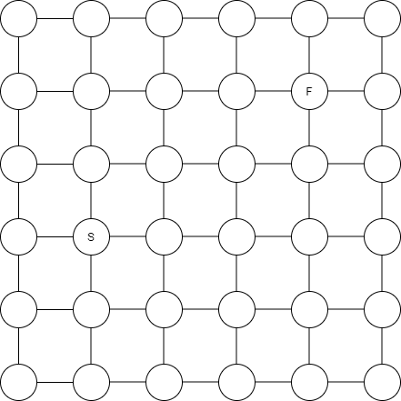
Towards A*
► Suppose we want to get from S to F in this graph:
►
Why do we bother exploring to the south and west?

Slide 32
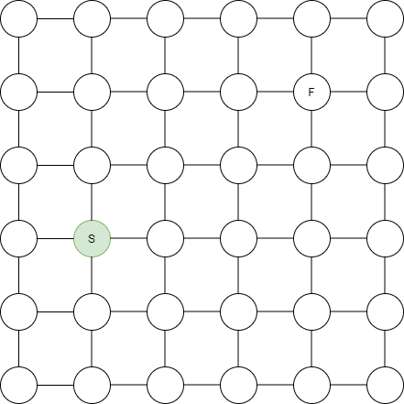
Towards A*
► Suppose we want to get from S to F in this graph:
►
Why do we bother exploring to the south and west?

Slide 33
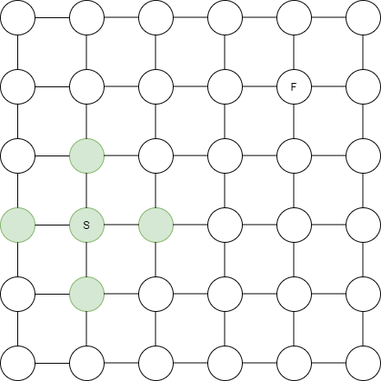
Towards A*
► Suppose we want to get from S to F in this graph:
►
Why do we bother exploring to the south and west?

Slide 34
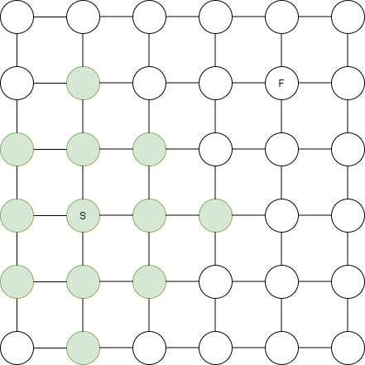
Towards A*
► Suppose we want to get from S to F in this graph:
►
Why do we bother exploring to the south and west?

Slide 35
Towards A*
► In the grid example, we know exactly where to go
► We have a notion of directions, and know in which direction the target is
► We know how far any given vertex is from the target
► So pathfinding becomes trivial
► In general, we don’t have this exact information
► We would need to already have solved the path-finding problem
► But we may have a suitable estimate of distances to the target

Slide 36
Towards A*
► For example, if the edges in the grid
have unknown weights on them
► The edges on the direct paths may have higher weights
► So it may make sense to take a detour
► But the distance in the unweighted version (“as the crow flies”) can still be used to steer the search
► We use it to bias the exploration to vertices that are “in the
right direction”

Slide 37
The A* algorithm
► Like Dijkstra’s algorithm, A*organises its open list as a priority queue
► The value associated with a vertex v is f (v ) + h(v ), where
► f (v ) is the distance from the start to v
(discovered during the exploration)
► h(v ) is an estimate for the distance from v to the target (must be provided)

Slide 38
Estimate functions
► A* relies on an estimate function h to work.
► This function should have some properties in order to work well:
► It needs to be cheap to compute for each vertex
► It needs to be an underapproximation, i.e. h(v ) cannot be greater than the actual distance to the target
(otherwise a suboptimal path can be found first)
► How to find such an estimate?

Slide 39
State graphs and relaxations
► Common case: the graph represents some system
► Vertices are states of the system
► Edges are transitions
► We want to go from some initial to some final state
► This graph is potentially huge
► We do not want to create the whole graph before looking for a path
► Instead, we want to create vertices only when needed ("on the fly")

Slide 40
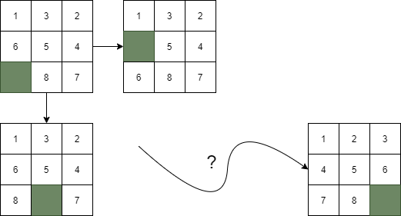
State graphs: example
► The 9-puzzle consists of a 3*3 square (bigger versions also exist)
► Eight tiles numbered 1,. . . ,8
► One hole which adjacent tiles can be moved into
► Goal is to have all the tiles in order

Slide 41
State graphs: example
► The state graph for the 9-puzzle has
► One vertex for each permutation of the tiles and hole
► Edges corresponding to moves in the puzzle
► A total of 9! = 362880 vertices
(and 16! = 20, 922, 789, 888, 000 for the 4*4 version) so we really don’t want to construct the whole graph
► On-the-fly search using A* helps avoid this

Slide 42
State graphs and relaxations
► Estimate functions for state graphs can be found based on
relaxations
► Idea: relax the interaction between parts, so that
► They can move independently
(so it is easier to compute the distance in the relaxation)
► All moves in the original system are still in the relaxation (so the distance in the relaxation is an underapproximation)
► Let’s have a look at how this works in the 9-puzzle

Slide 43
State graphs: example
► In the 9-puzzle, the parts are the numbered tiles
► Their moves are not independent (because they cannot share a position)
► We can relax the system by removing this constraint
► In the relaxation, we can move each tile to its place independently
► The distance in the relaxation is the sum of each tile’s distance to its target position

Slide 44
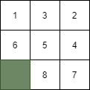
State graphs: example
► For example, this state in the 9-puzzle:
gets the value 8, because
► Tiles 1, 5, 8 are in their target position
► Tiles 2,3 are 1 step away from their target location
► Tiles 4,6,7 are 2 steps away from their target location
► 0 + 1 + 1 + 2 + 0 + 2 + 2 + 0 = 8

