Slide 1




GLOBAL INSTITUTE OF TECHNOLOGY,JAIPUR
Department of Computer Science and Engineering
Company: Learn And Build
Domain: Java Core Programming
Submitted To :-
Dr. Pardeep Jha
HOD of CSE Dept.
Presented By:
Student Name : Achintya Agrawal
Roll No.: 24EGJCS009
Semester : 3ʳᵈ
Year : 2ⁿᵈ

Slide 2


CONTENTS :
Company Introduction
Objective of Internship
Training Outcomes
Technologies Learned
Challenges Faced
Conclusion

Slide 3


COMPANY INTRODUCTION
About the Company– Learn and Build (LnB)
Jaipur-based EdTech company
Practical training in AI, Data Science, Cloud & Robotics
Internships + Certifications for industry readiness
Focus on hands-on projects & career
Focus areas:-
Foundational skill development
Career Growth
Ehancing technical skills
Productivity

Slide 4

Objectives of Internship
To gain practical knowledge of java core programming beyond classroom theory
To learn how to apply core concept of java in software development
To improve problem-solving and logical thinking skills through practicing coding exercises .
To understand the best practices of industry in a professional environment
To prepare for job interviews and build confidence for technical rounds

Slide 5
Training Outcomes
✓
Strong Understanding of Java Basics.
✓
Learned to build basic Java applications independently.
✓
Improved skills in Object-Oriented Programming (OOP) Concepts , File I/O Operations, JDBC Basics
✓
Practiced version control using Git basics for source code management
✓
Hands-on Experience on Real-time Projects.

Slide 6
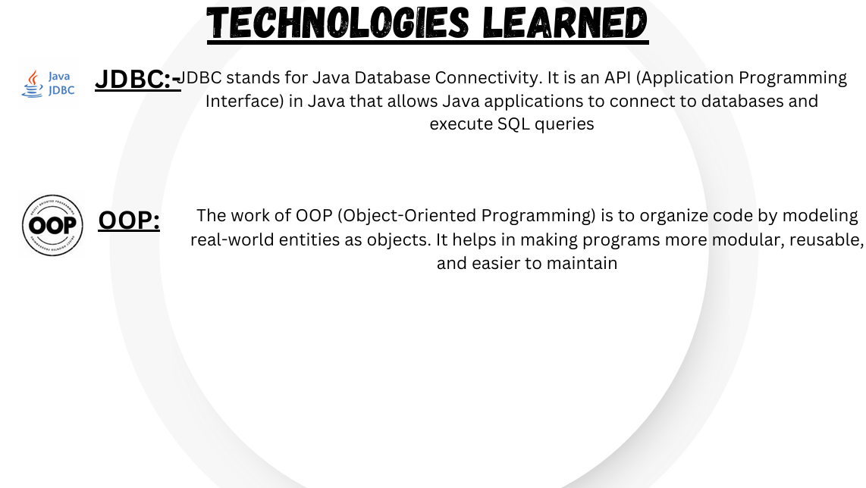

Slide 7


Challenges Faced
Understanding OOP Concepts (Object-Oriented Programming)
Problem-Solving and Logical Thinking.
Managing time effectively to balance learning new concepts.
Understanding Real-World Application Structure
Difficulty in reading and understanding stack traces to fix problems.

Slide 8

Conclusion
This internship provided me with exposure to real-world programming challenges, helping me develop problem-solving skills. 2. I gained hands-on skills in OOP , Java Data Types, Control Structures, File I/O.
3. Improved my practical skills in writing efficient and well-structured Java programs. 4. Boosted my confidence for a career in software development, giving me a solid foundation in Java Core concepts.

Slide 9
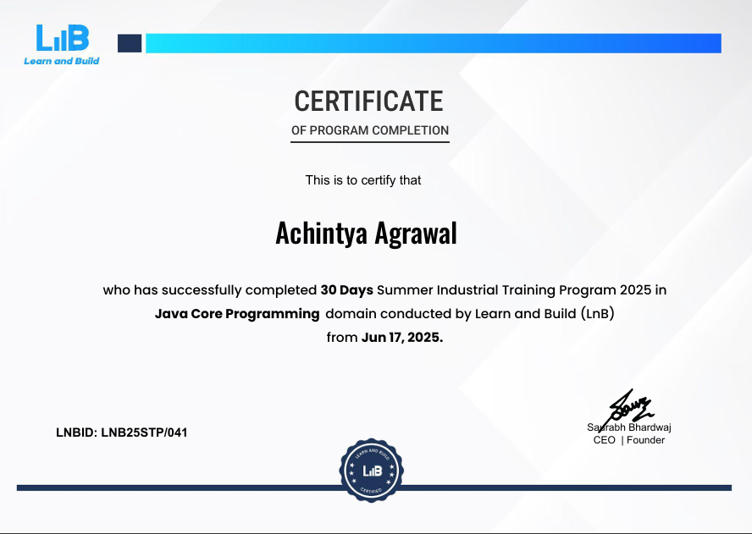

Slide 10

Name:- Achintya Agrawal
Email ID:-
achintyaagrawal9@gamil.com

