Slide 1
Modelling Crowder-Salt Interactions in a FUS-PEG-KCl System Using an Extended Flory-Huggins Framework
Project Presentation by
Achintya Mathur
3rd Year BS in Chemistry
S.R. No.: 23593

Slide 2
Objective
To develop a minimal extended Flory-Huggins framework to test whether:
Effects of salt concentration and molecular crowder are simply additive
Non-trivial coupling effects emerge
To model various phase separation-related phenomena:
Reentrant behaviour at high salt
Crowder-driven phase separation

Slide 3
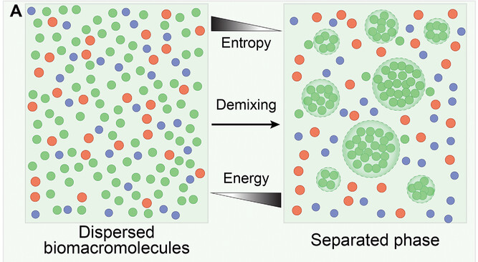
Liquid-Liquid Phase Separation
Homogeneous solution splits into immiscible dense and dilute phases
Demonstrated by intrinsically disordered proteins (IDPs)
Can function as membrane-less organelles
Plays a role in neurodegenerative diseases
J.Ren, Z.Zhang, Z.Zong, L.Zhang, F.Zhou, Adv. Sci.2022, 9, 2202855. https://doi.org/10.1002/advs.202202855

Slide 4
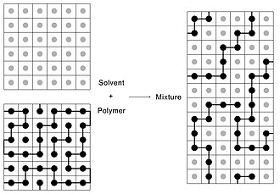
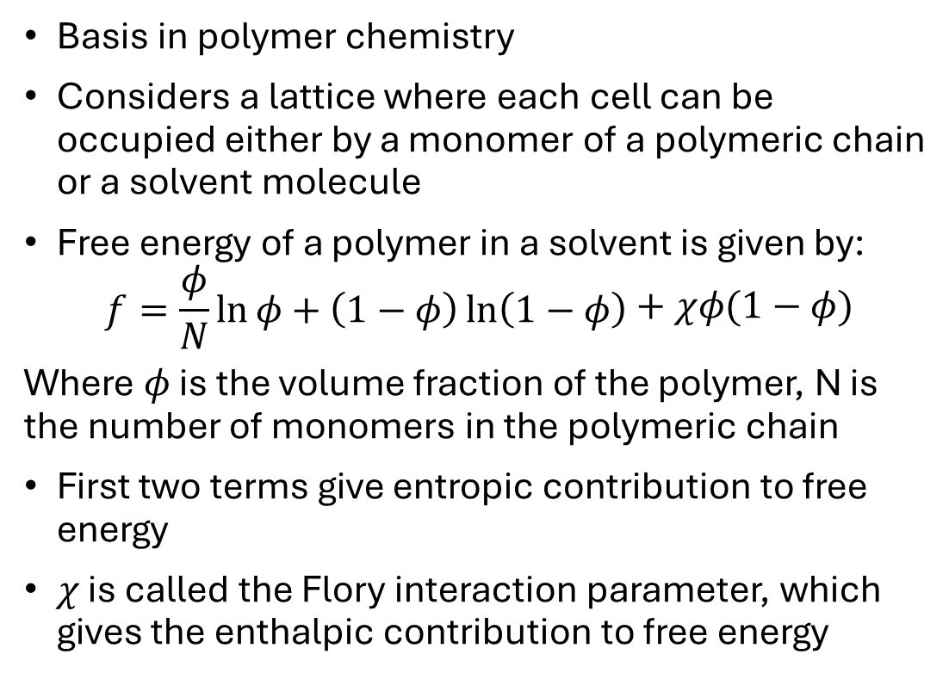
Flory-Huggins Theory
Basis in polymer chemistry
Considers a lattice where each cell can be occupied either by a monomer of a polymeric chain or a solvent molecule
Free energy of a polymer in a solvent is given by:
$$\begin{aligned}f=\frac{φ}{N}\ln{φ}+\left(1−φ\right)\ln\left(1−φ\right)\end{aligned}+χφ(1−φ)$$
Where $φ$ is the volume fraction of the polymer, N is the number of monomers in the polymeric chain
First two terms give entropic contribution to free energy
$χ$ is called the Flory interaction parameter, which gives the enthalpic contribution to free energy
https://en.wikipedia.org/wiki/Flory–Huggins_solution_theory

Slide 5
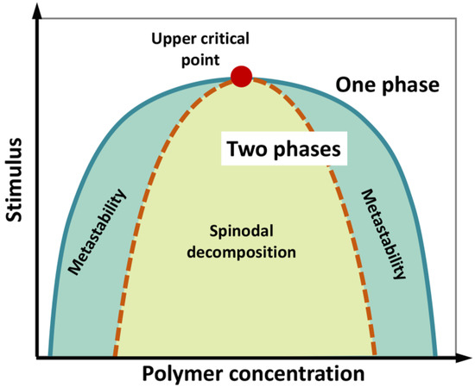
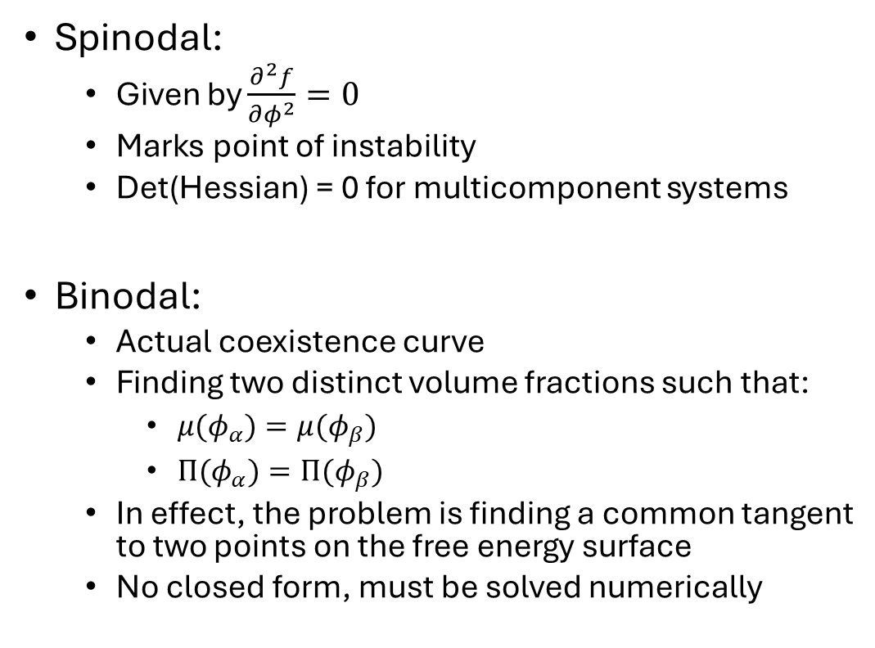
Phase Diagrams
Spinodal:
Given by $\frac{∂^{2}f}{∂φ^{2}}=0$
Marks point of instability
Det(Hessian) = 0 for multicomponent systems
Binodal:
Actual coexistence curve
Finding two distinct volume fractions such that:
$μ(φ_{α})=μ(φ_{β})$
$Π(φ_{α})=Π(φ_{β})$
In effect, the problem is finding a common tangent to two points on the free energy surface
No closed form, must be solved numerically
Brocca, S., Grandori, R., Longhi, S., & Uversky, V. (2020). International Journal of Molecular Sciences, 21(23), 9045. https://doi.org/10.3390/ijms21239045

Slide 6
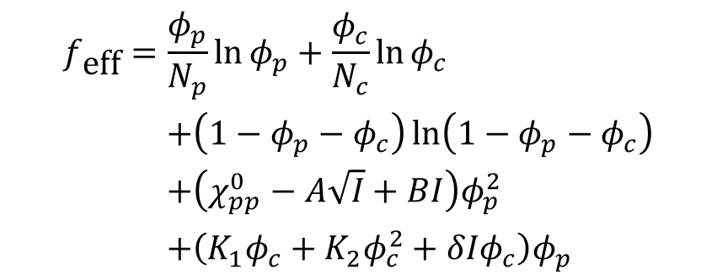
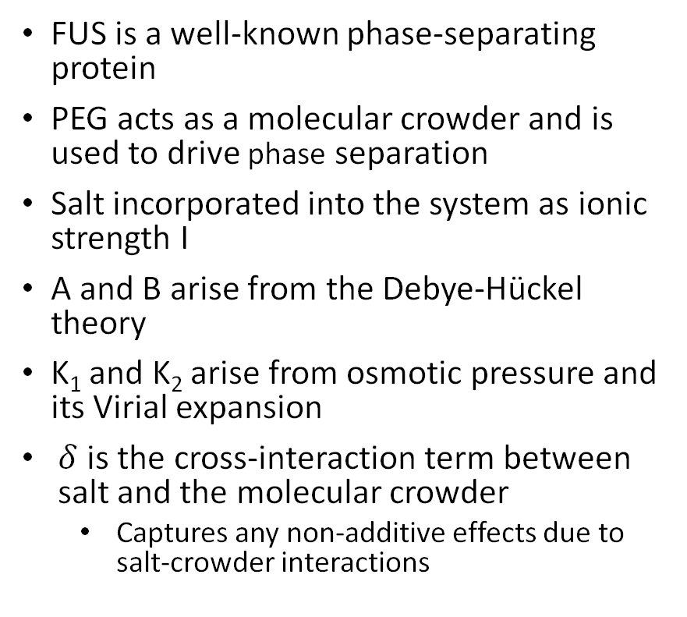
Extended Flory-Huggins Framework
FUS is a well-known phase-separating protein
PEG acts as a molecular crowder and is used to drive phase separation
Salt incorporated into the system as ionic strength I
A and B arise from the Debye-Hückel theory
K₁ and K₂ arise from osmotic pressure and its Virial expansion
$δ$ is the cross-interaction term between salt and the molecular crowder
Captures any non-additive effects due to salt-crowder interactions
$$\begin{aligned}f_{\text{eff}}&=\frac{φ_{p}}{N_{p}}\ln{φ_{p}}+\frac{φ_{c}}{N_{c}}\ln{φ_{c}} \\ & +\left(1−φ_{p}−φ_{c}\right)\ln\left(1−φ_{p}−φ_{c}\right) \\ & +\left(χ_{pp}^{0}−A\sqrt{I}+BI\right)φ_{p}^{2} \\ & +\left(K_{1}φ_{c}+K_{2}φ_{c}^{2}+δIφ_{c}\right)φ_{p}\end{aligned}$$

Slide 7
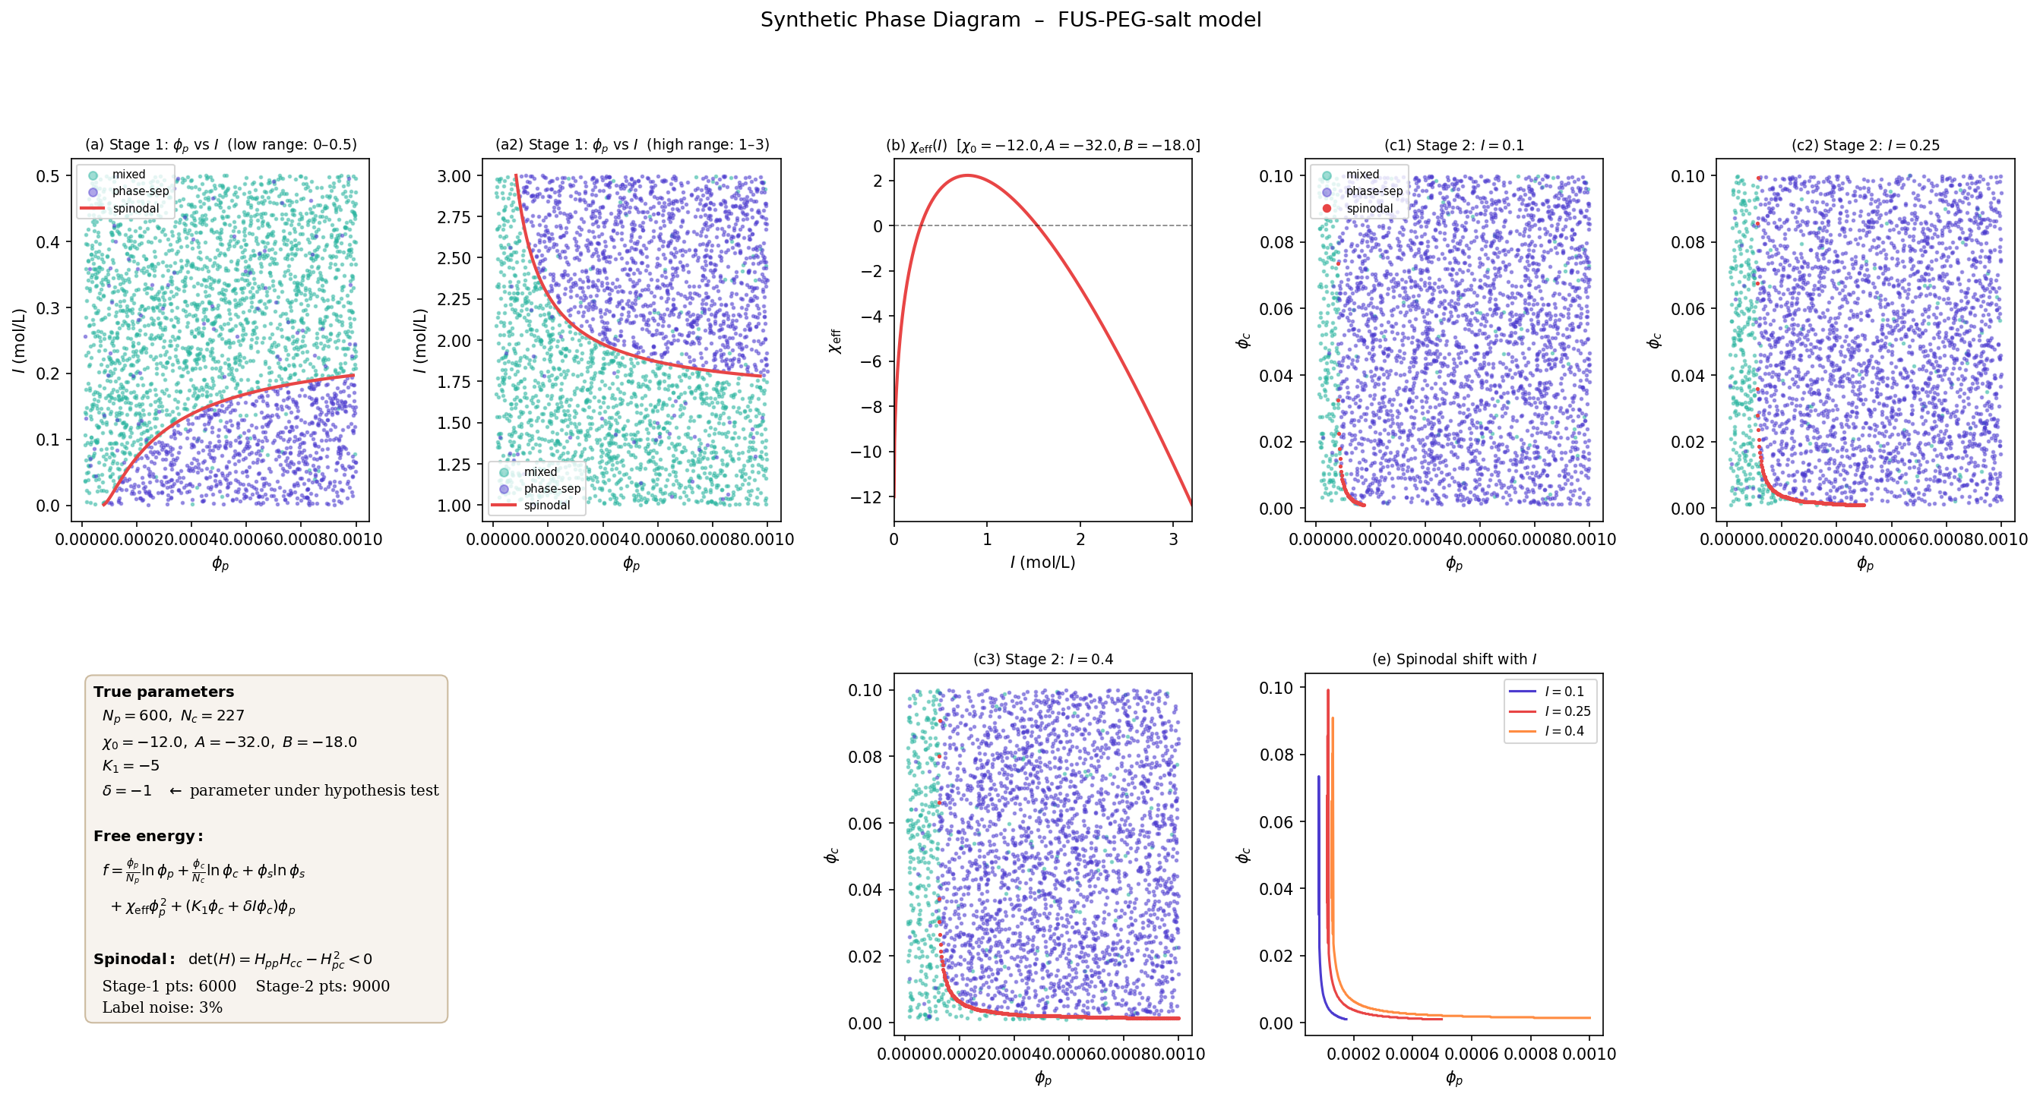
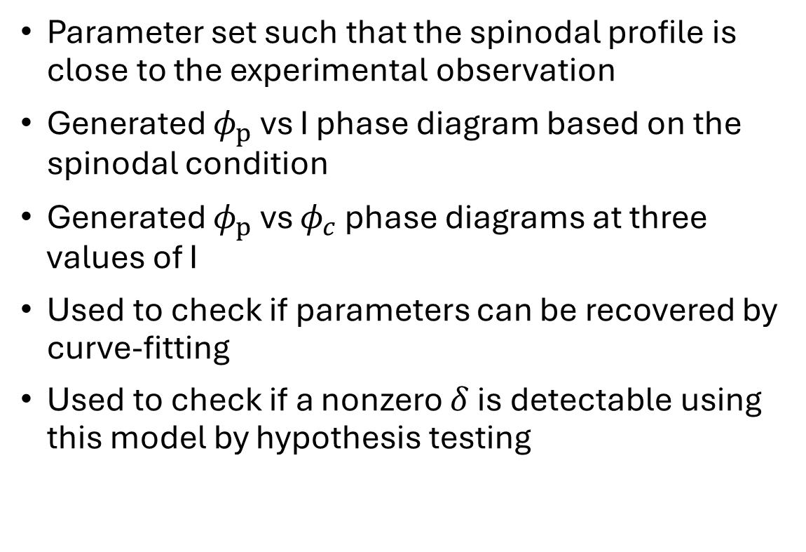
Synthetic Data Generation: Method
Parameter set such that the spinodal profile is close to the experimental observation
Generated $φ_{p}$ vs I phase diagram based on the spinodal condition
Generated $φ_{p}$ vs $φ_{c}$ phase diagrams at three values of I
Used to check if parameters can be recovered by curve-fitting
Used to check if a nonzero $δ$ is detectable using this model by hypothesis testing

Slide 8

Synthetic Data Generation: Results
Model shows reentrant behaviour
2D spinodal shifts with increasing I

Slide 9
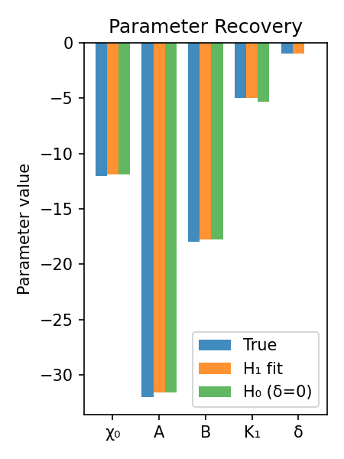
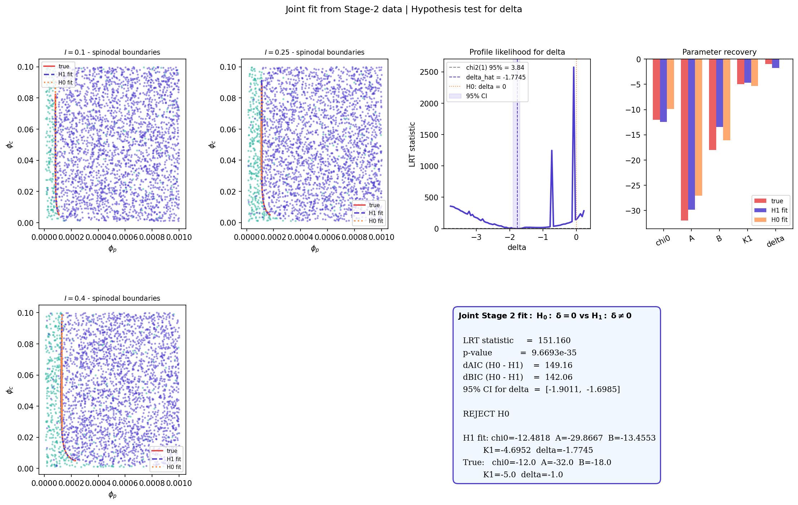
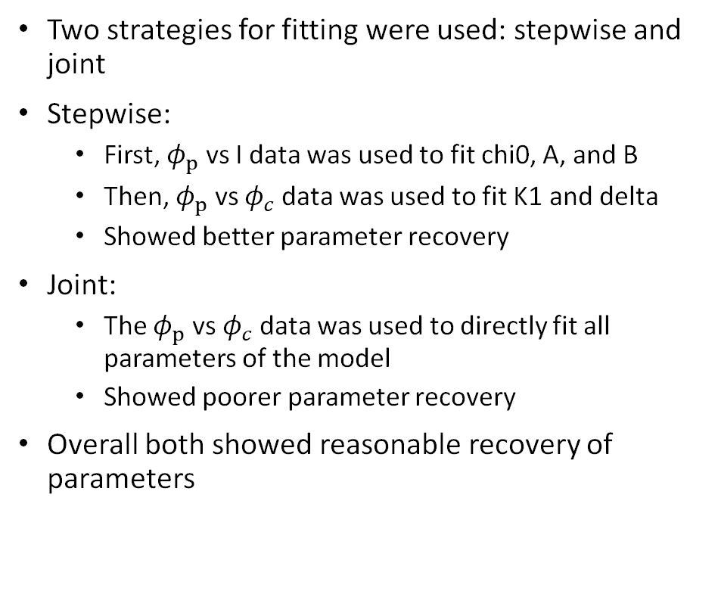
Fitting: Parameter Recovery
Two strategies for fitting were used: stepwise and joint
Stepwise:
First, $φ_{p}$ vs I data was used to fit chi0, A, and B
Then, $φ_{p}$ vs $φ_{c}$ data was used to fit K1 and delta
Showed better parameter recovery
Joint:
The $φ_{p}$ vs $φ_{c}$ data was used to directly fit all parameters of the model
Showed poorer parameter recovery
Overall both showed reasonable recovery of parameters

Slide 10
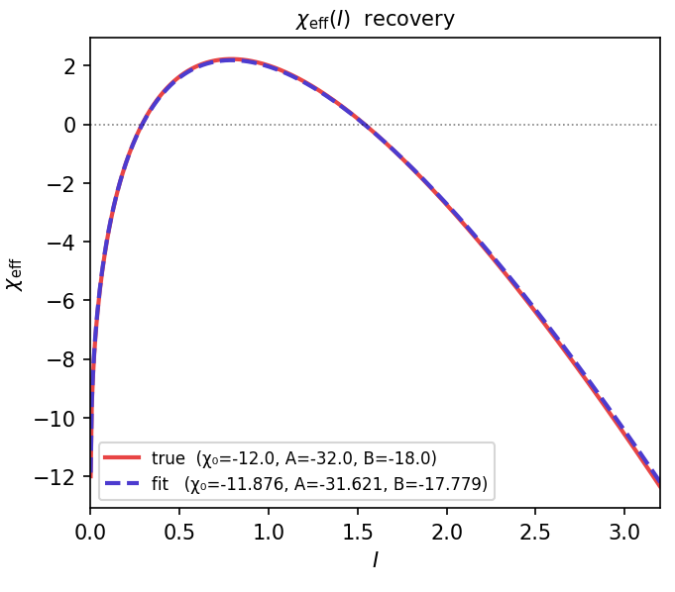
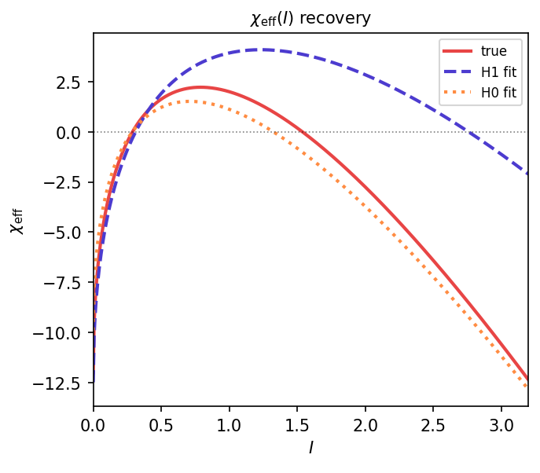
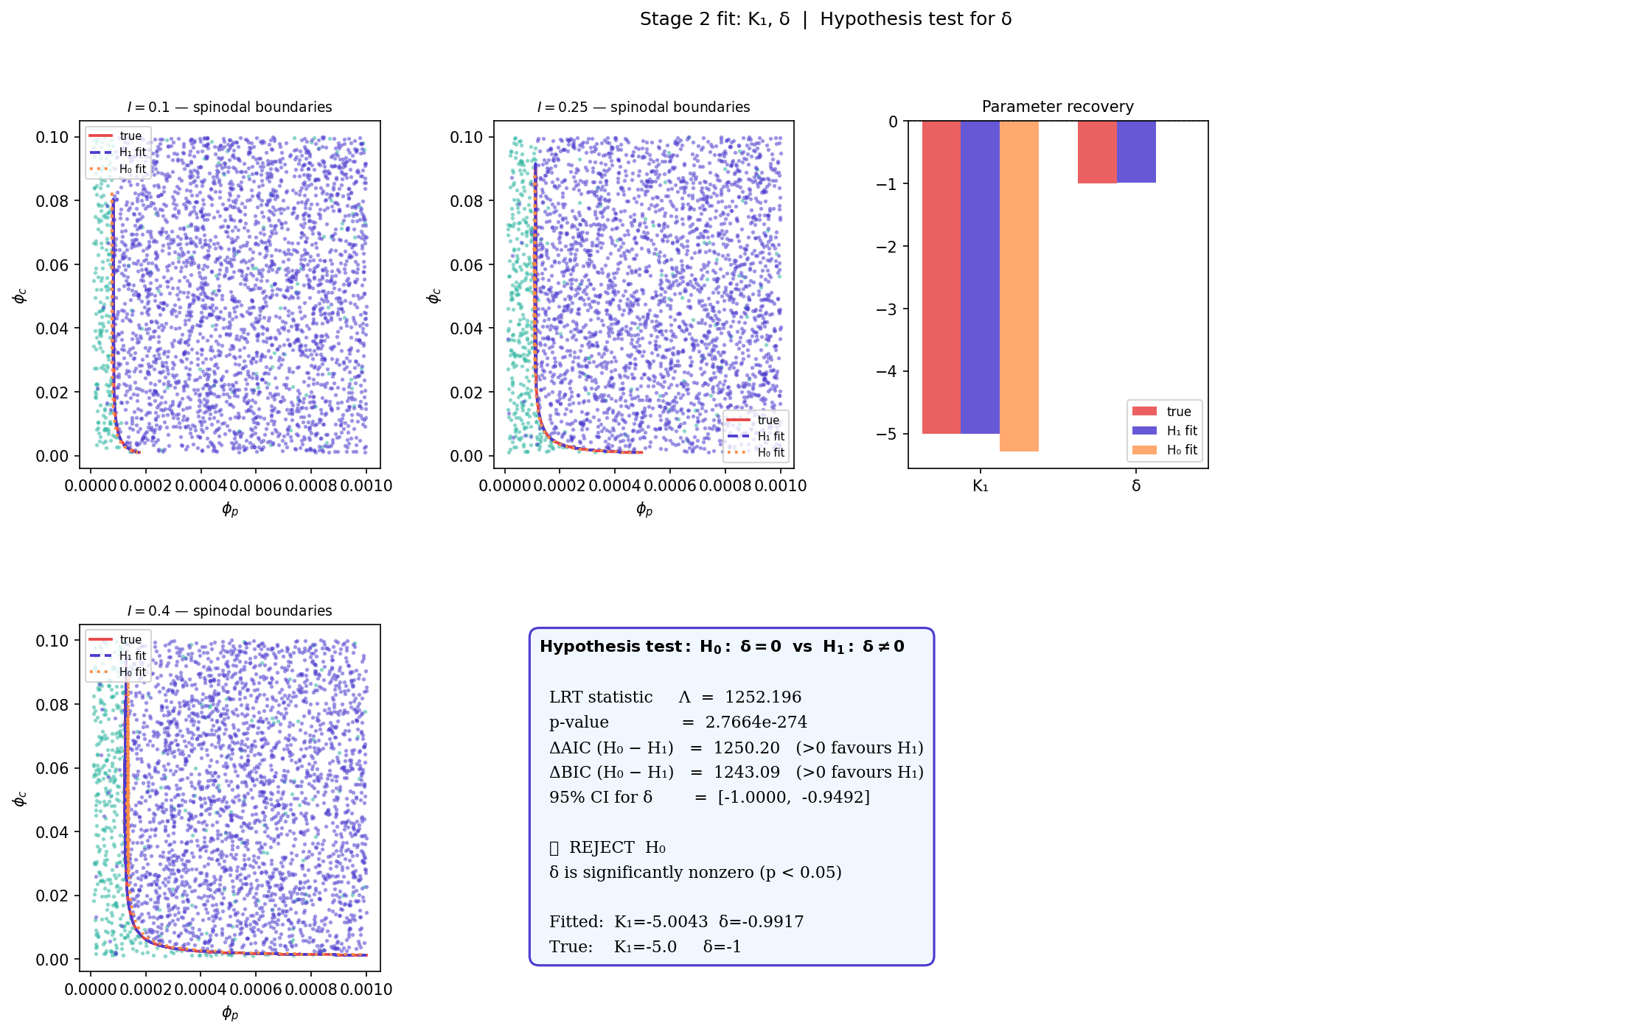
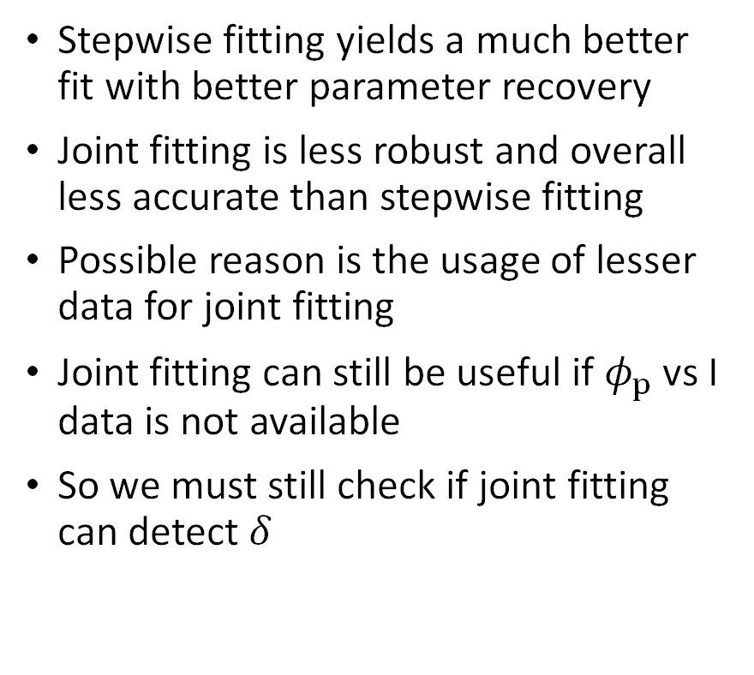
Fitting: Comparing Fitting Approach
Stepwise fitting yields a much better fit with better parameter recovery
Joint fitting is less robust and overall less accurate than stepwise fitting
Possible reason is the usage of lesser data for joint fitting
Joint fitting can still be useful if $φ_{p}$ vs I data is not available
So we must still check if joint fitting can detect $δ$

Slide 11
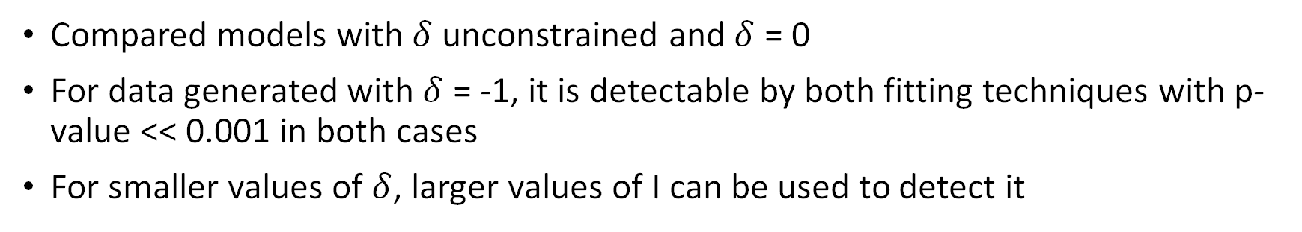
Fitting: Detectability of Delta
Compared models with $δ$ unconstrained and $δ$ = 0
For data generated with $δ$ = -1, it is detectable by both fitting techniques with p-value << 0.001 in both cases
For smaller values of $δ$, larger values of I can be used to detect it

Slide 12
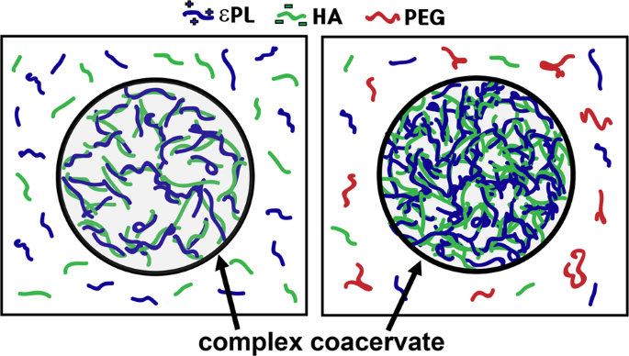
Conclusion
This model can be reliably used to detect salt-crowder interactions from experimental data
It captures many known phenomena of phase-separating systems:
Reentrant behaviour with increasing salt
Crowders driving phase separation
Uses a minimal model that is easily interpretable

Slide 13
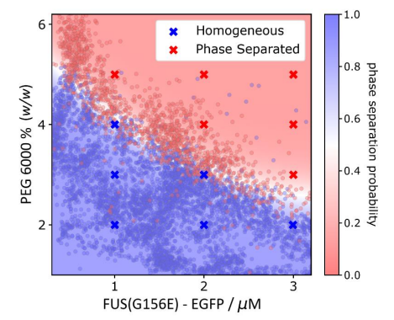
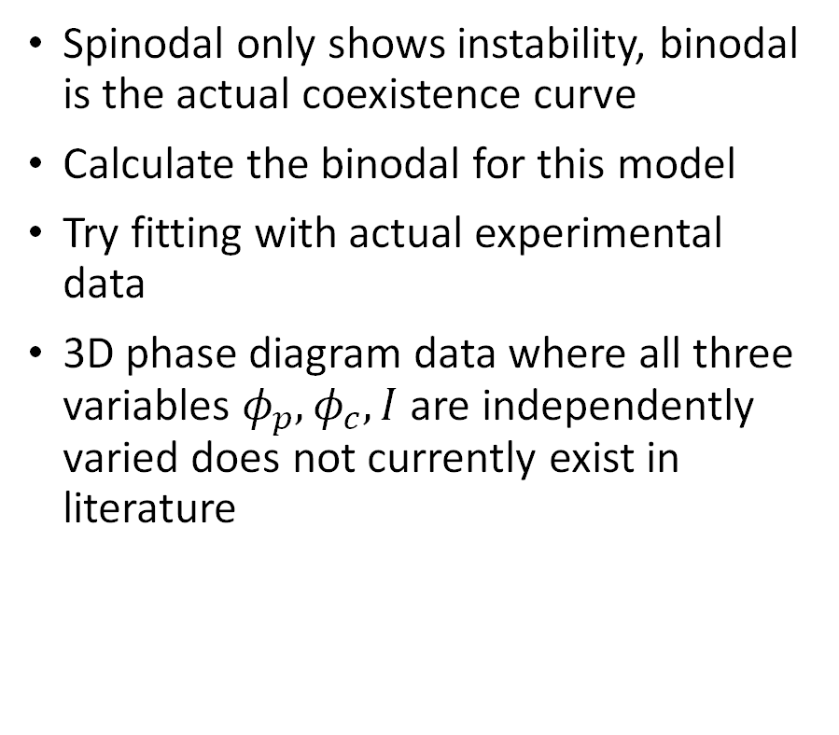
Limitations and Future Work
Spinodal only shows instability, binodal is the actual coexistence curve
Calculate the binodal for this model
Try fitting with actual experimental data
3D phase diagram data where all three variables $φ_{p},φ_{c}, I$ are independently varied does not currently exist in literature

Slide 14
References
Qian, D., Michaels, T. C., & Knowles, T. P. (2022). Analytical solution to the Flory–Huggins model. The journal of physical chemistry letters, 13(33), 7853-7860.
Krainer, G., Welsh, T.J., Joseph, J.A. et al. Reentrant liquid condensate phase of proteins is stabilized by hydrophobic and non-ionic interactions. Nat Commun 12, 1085 (2021). https://doi.org/10.1038/s41467-021-21181-9
Arter, W.E., Qi, R., Erkamp, N.A. et al. Biomolecular condensate phase diagrams with a combinatorial microdroplet platform. Nat Commun 13, 7845 (2022). https://doi.org/10.1038/s41467-022-35265-7
Ausserwöger, H., de Csilléry, E., Qian, D. et al. Quantifying collective interactions in biomolecular phase separation. Nat Commun 16, 7724 (2025). https://doi.org/10.1038/s41467-025-62437-y
Dr. Max C.M. Martens, Mr. Zexiang Han, Prof. Tuomas P.J. Knowles, et al. Protein self-assembly in crowded environments. ChemRxiv. 23 August 2025. https://doi.org/10.26434/chemrxiv-2025-zhb2l

Slide 15
Thank You

