Slide 1
Customers Like You
Product suggestions and customer groups for GiftLane
Achintya Shah, Data Engineer | Tanay Mihani, ML Engineer
Notes:
Achintya (15 s): Introduce the two of us and our roles. Sarah asked for two things: a 'customers who bought this also bought' box that runs nightly and beats best sellers, and one picture of our customer groups for marketing.

Slide 2
All four targets from Sarah's email were met
22x
~1 s
41%
6
smaller
nightly job
hit rate at 10
customer groups
7.3 MB of factors instead of a 161 MB table
Fit, product page boxes and top 10 for every customer
vs 27% for best sellers, on 1,919 test customers
Each named from the products it buys most
Target: under 16 MB
Target: under 60 s
Target: beat best sellers
Target: 3 to 6 nameable groups
Achintya
Notes:
Achintya (30 s): On Day 1 we turned Sarah's email into four measurable targets, written at the top of our README. All four were met; the rest of the talk shows how. Hit rate at 10 means: for what share of customers was at least one of our 10 suggestions something they actually bought next.

Slide 3
Cleaning kept 773,216 of 1.07 million invoice lines
72%
of the raw file kept
Lines without a customer can't tell us anyone's taste, so they go first.
Postage, fees and other non-product codes aren't purchases.
Cancellations and items returned in full are removed inside each period, so the test months never affect training.
Achintya
Notes:
Achintya (40 s): The raw file has 1,067,371 lines. Each rule is logged with how many rows it removed. The big one is missing customer IDs, 23% of lines. Cancellations and full returns are handled separately for the training and test periods so nothing from the test months leaks into training. 773,216 lines remain.

Slide 4
Split by time, then a matrix that is 98% empty
Training: Dec 2009 to 9 Oct 2011
Test: 2 months
The model only ever sees training. The test months are the 'future' we check against: 1,919 returning customers and 49,214 products they bought for the first time.
5,456 x 3,680
411,136
97.95%
4.96 MB
customers x products (products bought by 10+ customers)
cells set to 1 (customer ever bought it)
of cells are 0
stored sparse (160.6 MB if stored dense)
Achintya
Notes:
Achintya (40 s): The last two months are held out by date. For each test customer we keep only products they had never bought before, because the box is about suggesting something new. The matrix is built from training only: one row per customer, one column per product bought by at least 10 customers, a 1 if they ever bought it. It is almost all zeros, which is why stored sparse it is only about 5 MB.

Slide 5
SVD finds buying patterns; validation picked k = 100
Why SVD
Works on the sparse matrix as it is, and gives product and customer factors in one fit.
How k was chosen
Learn from orders before 9 Aug 2011, check first-time buys up to 9 Oct. The test months stay untouched. Smallest k within 1 point of the best.
A surprise
The starter code's cosine scoring never beat best sellers. Scoring with plain dot products (the rank-k rebuild) did: 41.9% at k = 100.
Tanay
Notes:
Tanay (45 s): SVD compresses the matrix into k patterns. I chose it before fitting anything because it works on the sparse matrix directly. To pick k without touching the test set, I moved the same two-month setup back two months inside training. The dot-product scoring wins at every k and peaks at k = 100. The cosine version from the starter code throws away how strongly a product follows the main patterns, which is mostly popularity, so it suggests niche look-alikes and loses to best sellers.

Slide 6
On unseen purchases, suggestions beat best sellers 1.5 to 1
On the White Hanging Heart T-Light Holder page
Red Hanging Heart T-Light Holder
Candleholder Pink Hanging Heart
Hanging Metal Heart Lantern
Cream Heart Card Holder
White Metal Lantern
Correct products per top 10: 0.66 vs 0.36 for best sellers.
Validation said 41.9%, test gave 40.9%: the validation split was a fair guide.
Tanay
Notes:
Tanay (40 s): With k and the scoring fixed, the test set was used once. 40.9% of test customers had one of their next new purchases in their top 10, against 26.5% for best sellers. The product page box uses cosine similarity of the product factors, and the example shows it groups hanging-heart decorations together. The whole nightly job takes about a second.

Slide 7
PCA and SVD came out almost the same on this matrix
Measure | PCA | Truncated SVD
Fit time | 0.30 s | 0.21 s
Peak memory during fit | 16.6 MB | 17.8 MB
Stored factors | 7.34 MB | 7.31 MB
Variance kept | 36.2% | 36.0%
Hit rate at 10 (test) | 40.2% | 40.9%
Component 1 | basket size (corr 0.98) | basket size (corr 0.98)
Why so close
Product averages are tiny: the median product was bought by 1.2% of shops. Subtracting them barely moves the matrix.
What we kept
SVD: same accuracy, a bit faster, and it works on the matrix exactly as built.
Tanay
Notes:
Tanay (35 s): I ran PCA on the same matrix with the same k. scikit-learn's arpack solver centres implicitly, so it never builds the 160 MB dense matrix; its peak memory was even slightly lower. Both first components measure how much a customer buys. The differences I expected from centring didn't show up, because the averages being subtracted are so small. SVD stays the main method.

Slide 8
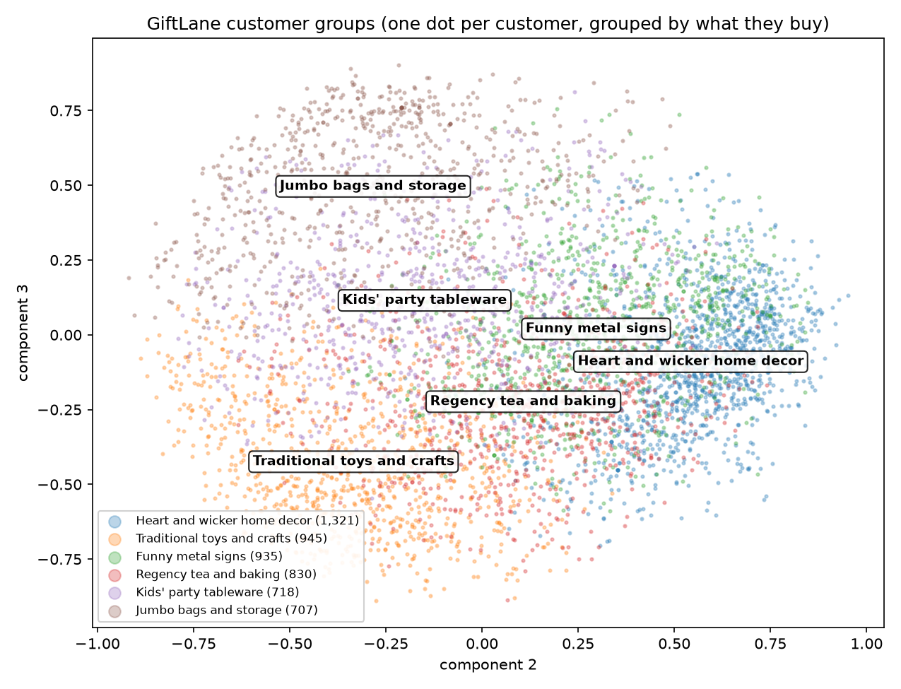
Six customer groups, named from what they buy
Heart and wicker home decor 1,321 shops
Hanging and wicker hearts; 98% UK
Traditional toys and crafts 945 shops
Paint sets, modelling clay, dominoes
Funny metal signs 935 shops
Novelty metal signs; narrowest range
Regency tea and baking 830 shops
Regency teacups, teapots, cake tins
Kids' party tableware 718 shops
Party paperware; most international
Jumbo bags and storage 707 shops
Jumbo bags; widest range
Tanay
Notes:
Tanay (40 s): For the map I drop component 1, which is just basket size, so customers are grouped by what they buy rather than how much. k-means with 3 to 6 groups, six had the best silhouette. Names come from each group's signature products, the ones most over-represented compared with all customers. The groups overlap, so they are tendencies for steering campaigns, not hard labels. No customer IDs anywhere.

Slide 9
What could go wrong, and what's next
Risks
New products (under 10 buyers) are never suggested: about 1 in 10 of the new purchases we tested
New customers have no history, so they only get best sellers
Tested on one season, the run-up to Christmas 2011
Suggestions lean towards popular products
Tested on past orders only
Next steps
Four-week A/B test of the box on part of the product pages
Fallbacks: category best sellers for new products and new customers
Marketing pilots one campaign per group
One-command rebuild (build_matrix.py) for the nightly run
Both
Notes:
Both (30 s): Achintya takes the data risks (new products, missing customer IDs, one season); Tanay takes the model risks and next steps. Close by offering questions.

