Slide 1
1
MATLAB can be thought of as a super-powerful graphing calculator
Notes:
11

Slide 2
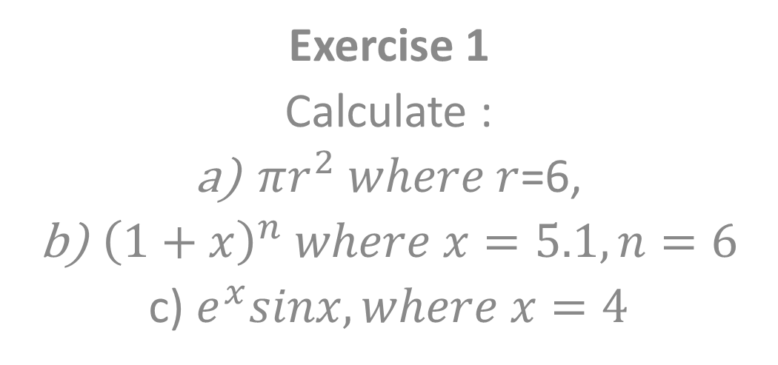
2
Exercise 1
Calculate :
$πr^{2} where r$=6,
${\left(1+x\right)}^{n} where x=5.1,n=6$
c) $e^{x}sinx, where x=4$
Notes:
11

Slide 3
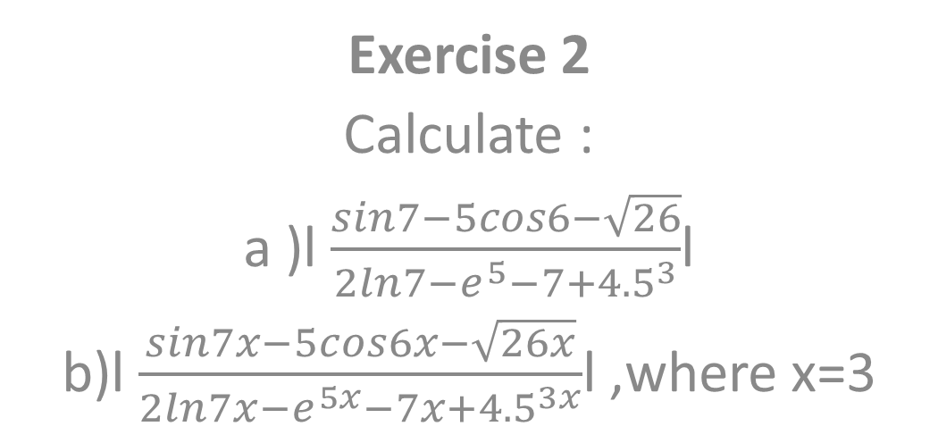
3
Exercise 2
Calculate :
a )l $\frac{sin7−5cos6−\sqrt{26}}{2ln7−e^{5}−7+{4.5}^{3}}$l
b)l $\frac{sin7x−5cos6x−\sqrt{26x}}{2ln7x−e^{5x}−7x+{4.5}^{3x}}$l ,where x=3
Notes:
11

