Slide 1
1
Scripts
Pseudocode
Notes:
11

Slide 2
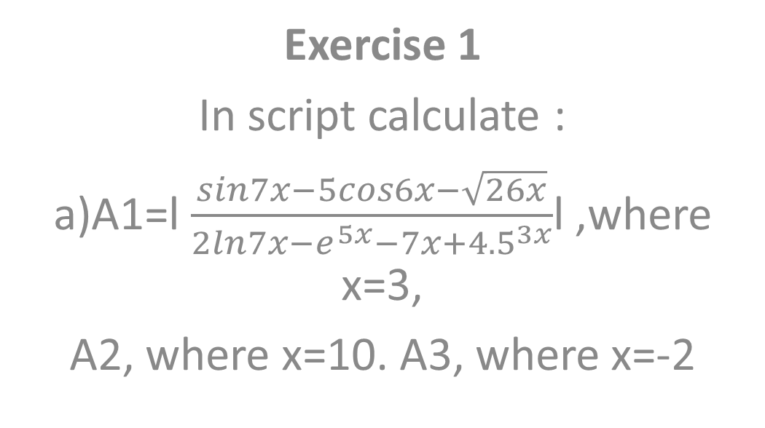
2
Exercise 1
In script calculate :
a)A1=l $\frac{sin7x−5cos6x−\sqrt{26x}}{2ln7x−e^{5x}−7x+{4.5}^{3x}}$l ,where x=3,
A2, where x=10. A3, where x=-2
Notes:
11

Slide 3
3
Exercise 2
In another script :
Create row vector b=(1 2 ….n),
Column vector c=(1 2 ….n), where n=30
b) Calculate d=b*c, e=c*d
Notes:
11

Slide 4
4
Exercise 3
In another script :
Create matrixes K and H size 5*5 with any numbers
Calculate sum, difference, product those matrixes(name those Z1,Z2,…)
Notes:
11

Slide 5
5
Exercise 4
In another script :
Clear all memory ,
Using previous scripts calculate
A1* Z1, A2*d, e*A3, Z3*d
Notes:
11

Slide 6
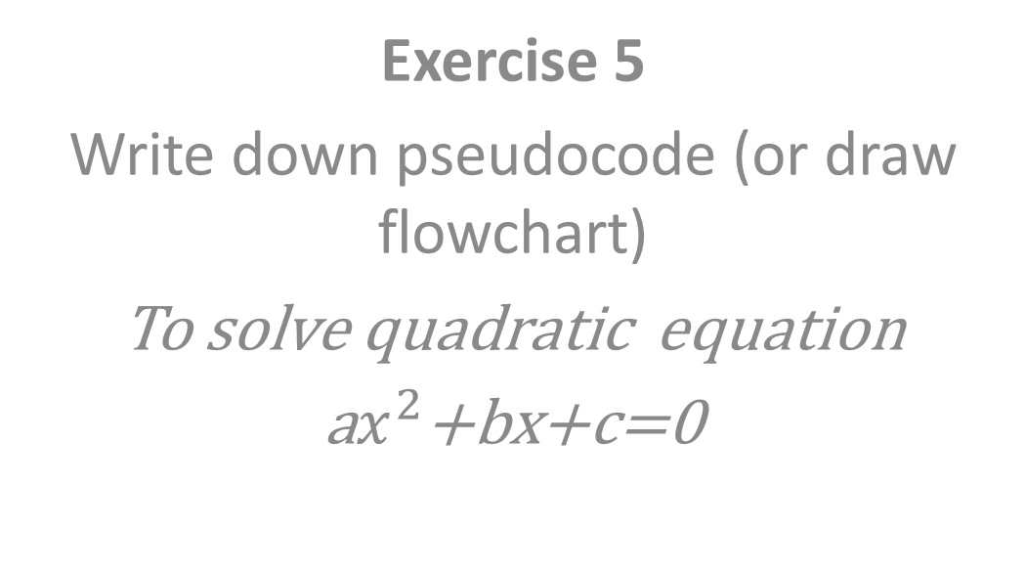
6
Exercise 5
Write down pseudocode (or draw flowchart)
To solve quadratic equation
a$x^{2}$+bx+c=0
Notes:
11

