Slide 1

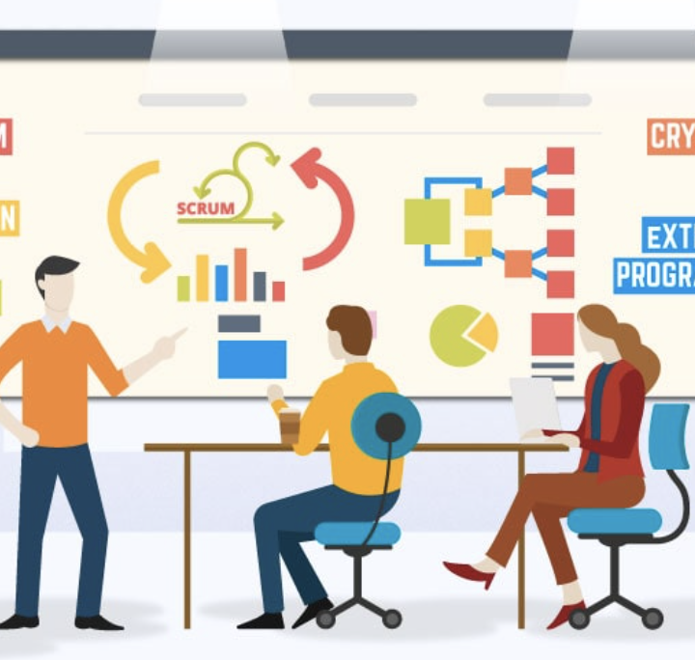
Agile -Presentation
Achna Hettiarachchi

Slide 2

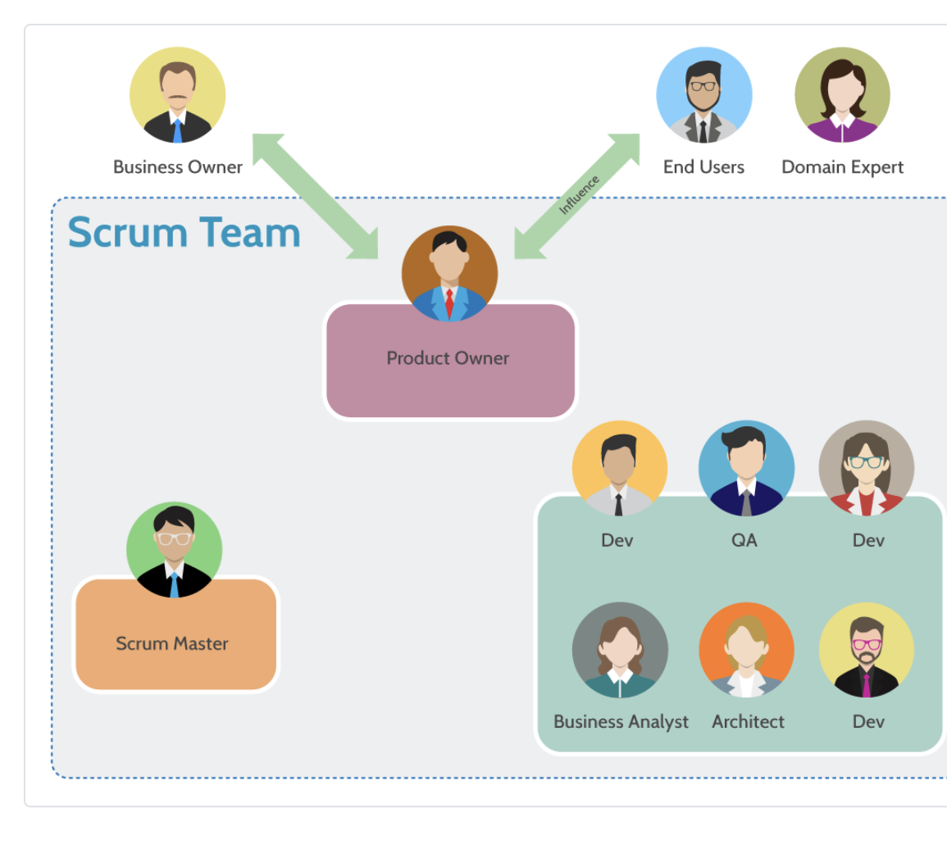
Agile Roles

Slide 3
Scrum is an agile framework that involves a team-based approach to deliver products incrementally. The following are the roles in a Scrum-agile team (Dhirendra, 2022):
Product Owner: responsible for defining and prioritizing the product backlog (which is a list of features and requirements for the product), acts as a bridge between the development team and stakeholders and ensures that the team is working on the right things at the right time.
Scrum Master: facilitates the scrum process, ensures that the team is following the scrum framework and practices and that any impediments are removed to ensure the team can deliver a high-quality product.
Development Team: responsible for building the product collaboratively, includes testers who create and deliver feedback on test status, test progress, and product quality, and includes developers who analyze the user stories and test cases to do the coding.

Slide 4
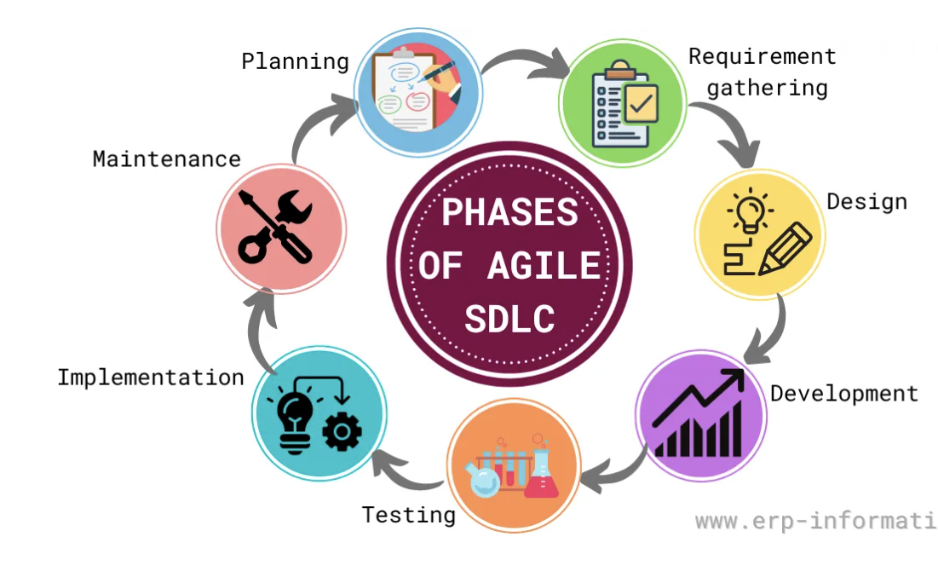
Agile phases

Slide 5
The phases of the SDLC in an agile approach are (erp-information, 2023):
Planning: creates a roadmap for the project that outlines the goals, objectives, and timeline.
Requirement gathering: gather customer requirements and determine the software’s features
Design: Create a software prototype that tests the design’s feasibility and gathers customer feedback.
Development or coding: The developers review and break down requirements into smaller tasks that can be completed efficiently and quickly and writes the code for the software.
Testing: The software is tested to ensure that it meets the requirements, finds bugs, and fixes them.
Implementation: The customer installs and uses the software.
Maintenance: Provide maintenance and support after the software is up and running and ensure that the software is updated as needed.

Slide 6
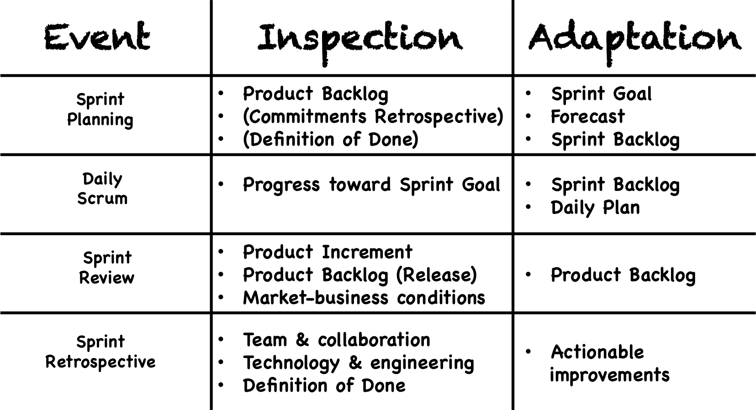
In the agile method, software development happens iteratively through sprints. Each sprint contains 4 cyclical events (Gunther, 2015).

Slide 7
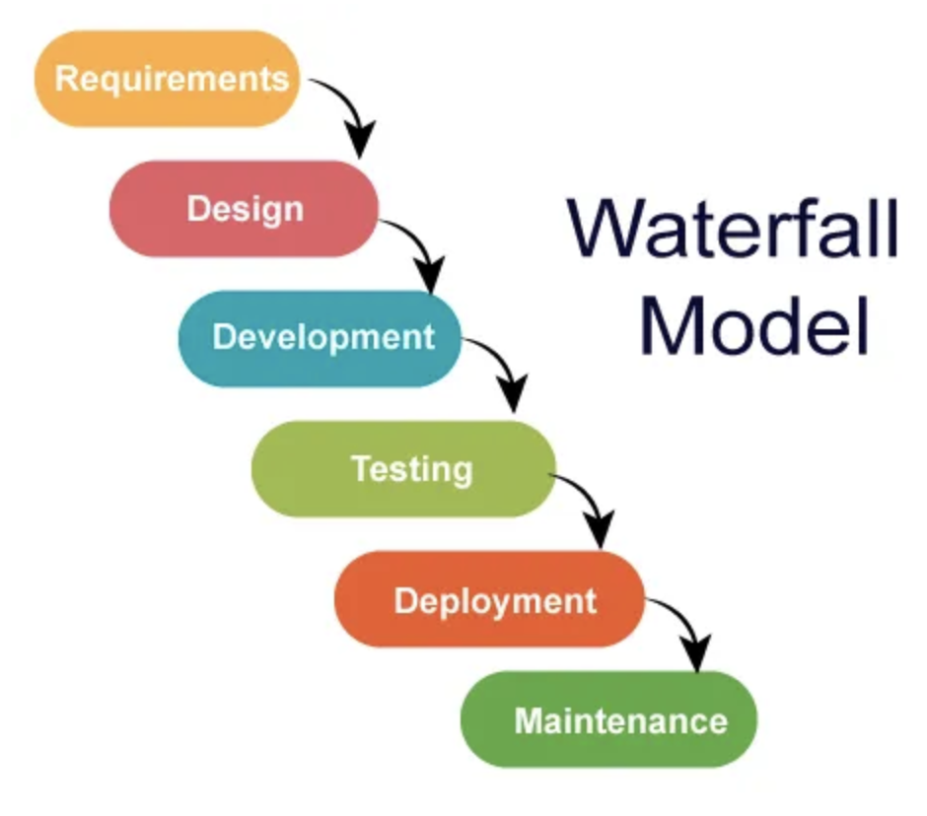
Waterfall model

Slide 8
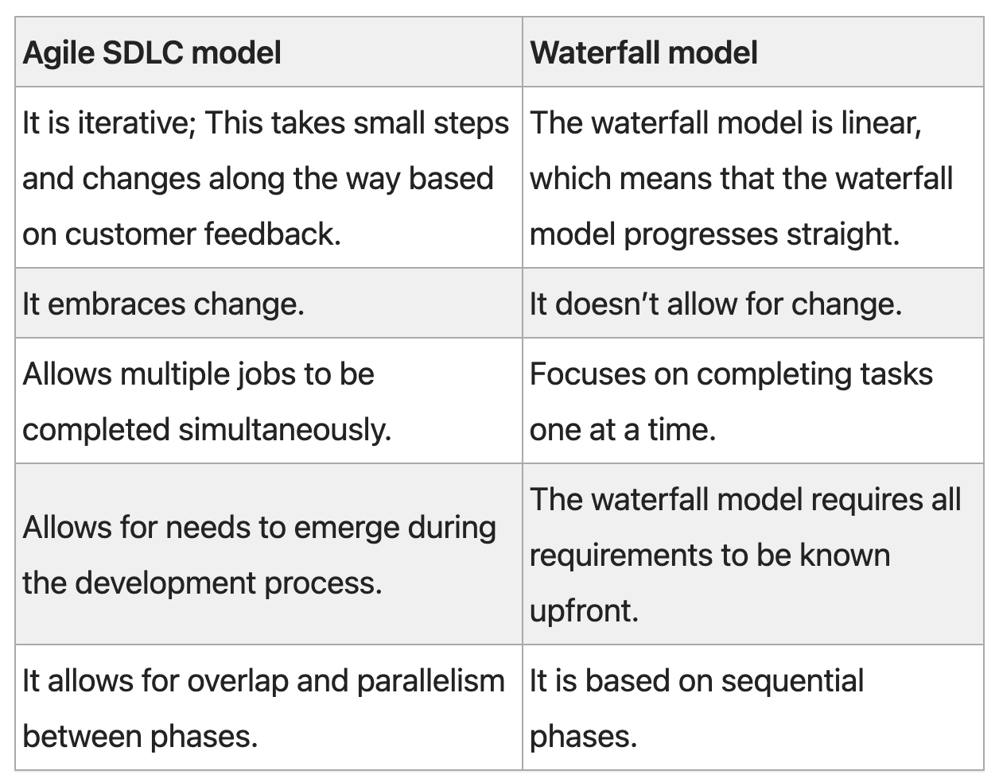
Let’s compare the agile and waterfall methods in SDLC (erp-information, 2023).

Slide 9
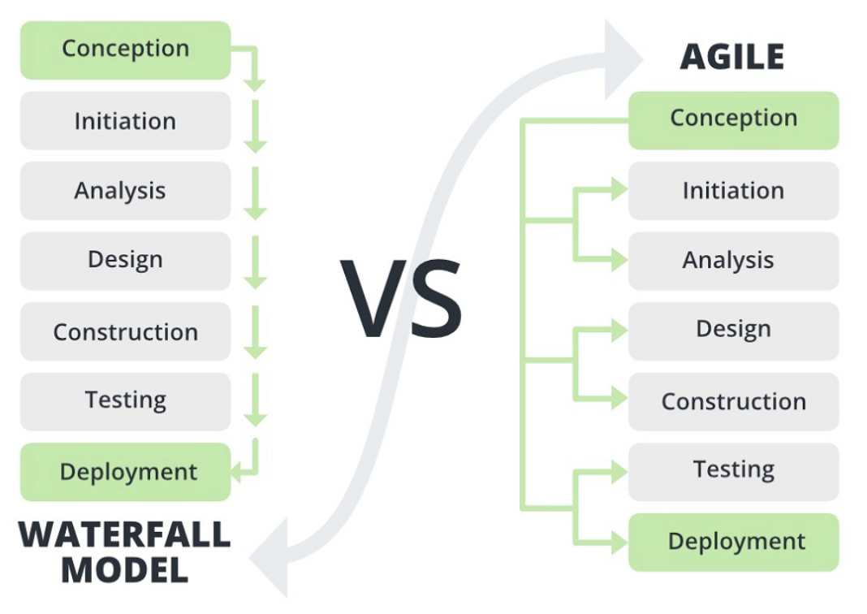
Waterfall or agile

Slide 10
The waterfall method is appropriate when the requirements are very well-known, clear, and fixed, the product definition is stable, and there are no ambiguous requirements.
Yet the SNHU travel project is subject to changes depending on travel trends and customer requirements. For example, we already changed our focus on the destinations to detox/wellness travel in between the project.
So, we need a method that involves the client throughout and is flexible to changes, which confirms that the agile method fits well for the project.

Slide 11
References
Dhirendra, Y. (2022, June 3). What Is Agile Methodology? Stellar digital. https://www.stellardigital.in/blog/what-is-agile-methodology/
Gunther, V. (2015, March 11). Meetings in Scrum, actually. Ullizee-Inc. https://guntherverheyen.com/2015/03/11/meetings-in-scrum-actually/
What is Agile SDLC? (Phases, Methodologies, and Disadvantages). (2023, March 24). Erp-information. https://www.erp-information.com/agile-sdlc

