Slide 1
Graphs

Slide 2
Outline
Graph Definitions and Notations
Graph Representation
  Adjacency Matrix
  Adjacency Lists
Operations on Graphs
Templates (Revisited)
Graphs as ADTs
Graph traversals
  Depth First Traversal
  Breadth First Traversal
Shortest Path Algorithm
Minimal Spanning Tree
Topological Order

Slide 3
1. Graph Definitions and Notations
A graph G is a pair, G = (V, E)
  V: is a finite nonempty set of vertices of G.
  E ⊆ V×V is a set of edges.
  If the elements of E are ordered pairs, G is called a directed graph.
  If the elements of E are not ordered pairs, G is called an undirected graph.
  In an undirected graph (u, v) = (v, u).
  A graph H is called a subgraph of a graph G if:
    V(H) ⊆ V(G) and,
    E(H) ⊆ E(G).

Slide 4
1. Graph Definitions and Notations: Undirected graphs
1
2
1
2
3
5
3
4
5
6
4
Sitra
Muharraq
Manamah
Rifa’
Issa

Slide 5
1. Graph Definitions and Notations: Undirected graphs
Let G = (V, E) an undirected graph:
  u ∈ V and v ∈ V are called adjacent vertices if the edge (u, v) ∈ E or the edge (v, u) ∈ E.
  An edge e = (u, v) ∈ E is called incident to u and v.
  An edge incident on a single vertex is called a loop.
  If two edges e₁ and e₂ are associated with the same pair of vertices then e₁ and e₂ are called parallel edges.

Slide 6
1. Graph Definitions and Notations: Undirected graphs
Let G = (V, E) an undirected graph:
  A graph is called a simple graph if it has no loops and no parallel edges.
  There is a path from u to v if there is a sequence of vertices u₁, u₂, …, u_{n} such that u₁ = u and u_{n} = v and (u_{i}, u_{i+1}) is an edge for all i=1, 2, …, n-1.
  Vertices u and v are called connected if there is a path from u to v.
  A simple path is a path in which all the vertices (except possibly the first and the last) are distinct.

Slide 7
1. Graph Definitions and Notations: Undirected graphs
Let G = (V, E) an undirected graph:
  A cycle in G is a simple path in which the first and last vertices are the same.
  G is called connected if there is a path from any vertex u to any other vertex v.
  A maximal subset of connected vertices is called a component of G.

Slide 8
1. Graph Definitions and Notations: Directed graphs
2
1
5
3
4
0
1
2
3
4

Slide 9
1. Graph Definitions and Notations: Directed graphs
Let G = (V, E) a directed graph:
  If (u, v) ∈ E then u is adjacent to v and v is adjacent from u.
  G is called strongly connected if any two vertices in G are connected.

Slide 10
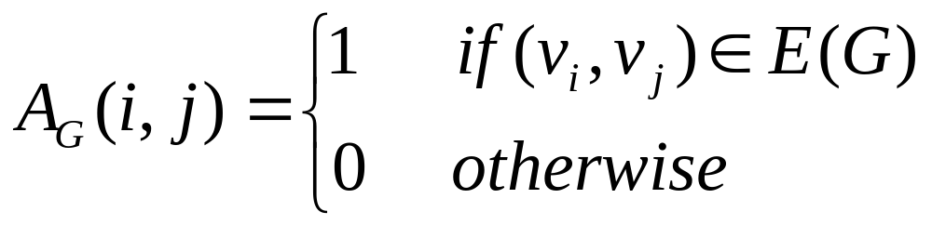
2. Graph Representation: Adjacency Matrix
Let G = (V, E) a graph with n vertices, n > 0. Let V(G) = {v₁, v₂, …, v_{n}}.
  The adjacency matrix A_{G} is a two-dimensional n × n matrix such that:

Slide 11
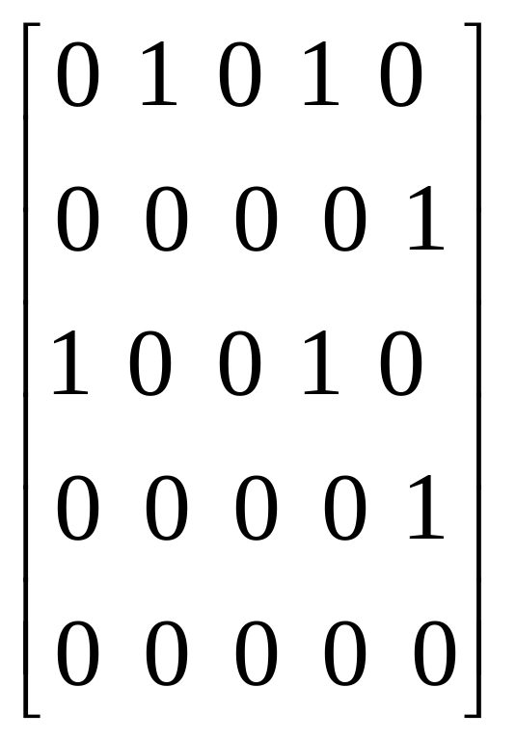
2. Graph Representation: Adjacency Matrix
2
1
5
3
4

Slide 12
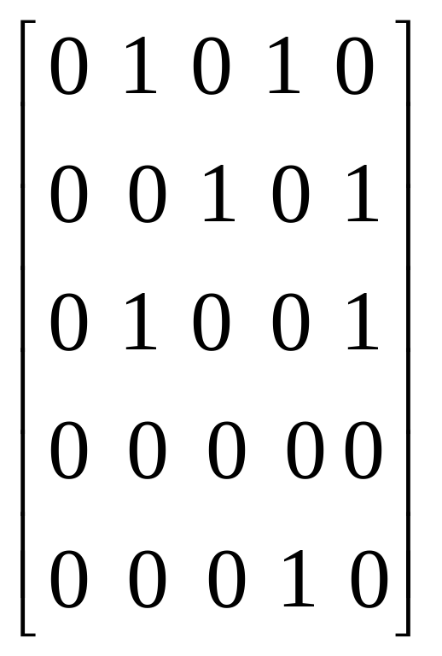
2. Graph Representation: Adjacency Matrix
0
1
2
3
4

Slide 13
2. Graph Representation: Adjacency Lists
Let G = (V, E) a graph with n vertices, n > 0. Let V(G) = {v₁, v₂, …, v_{n}}.
  In the adjacency list, for each vertex u corresponds a linked list with the vertices adjacent from u.
  Because we have n vertices, we use an array of n pointers.
  Each node in the linked list has two components: vertex and link.

Slide 14
2. Graph Representation: Adjacency Lists
[1]
2
4
2
1
[2]
5
5
[3]
1
4
3
[4]
5
4
[5]

Slide 15
2. Graph Representation: Adjacency Lists
[0]
1
3
[1]
2
4
0
1
2
[2]
1
4
[3]
4
3
4
[4]

Slide 16
6. Graph Traversals
Traversing a graph is similar to traversing a binary tree, except:
  A graph might have cycles.
  We might not be able to traverse the entire graph from a single vertex (if the graph is not connected).
The two most common graph traversals are: the depth first traversal and the breadth first traversal.

Slide 17
6. Graph Traversals: Depth First Traversal
The depth first traversal is similar to the preorder traversal of a binary tree. The general algorithm is:
  For each vertex v in the graph
    If v is not visited
      Start the depth first traversal at v
The general algorithm to do a depth first traversal at a given node v is:
  Mark node v as visited
  Visit the node (display its value)
  For each vertex u adjacent to v
    If u is not visited
      Start the depth first traversal at u

Slide 18
6. Graph Traversals: Depth First Traversal
0
1
2
4
3
5
7
9
6
8
10
0 1 2 4 3 5 6 8 10 7 9

Slide 19
6. Graph Traversals: Breadth First Traversal: Algorithm
  for each vertex u in the graph
    if u is not visited
      Add u to the queue
      Mark u as visited
      while the queue is not empty
        Display the front of the queue (u)
        Remove vertex u from the queue
        for each vertex v that is adjacent to u
        If v is not visited
        Add v to the queue
        Mark v as visited

Slide 20
6. Graph Traversals: Breadth First Traversal
The breadth first traversal of a graph is similar to traversing a binary tree level by level.
All the nodes at any level i are visited before visiting the nodes at a level i+1.
0
1
2
4
3
0 1 5 2 3 6 4 8 10 7 9
5
7
9
6
8
10

Slide 21
Example
Obtain the sequence of vertices of the graph, if the graph is traversed using depth first traversal (DFT) starting from vertex 0: 0 1 2 3 4 5
•Obtain the sequence of vertices of the graph, if the graph is traversed using breadth first traversal (BFT) starting from vertex 0: 0 1 4 2 3 5
2
1
3
0
5
4

