Slide 1
Trees
Chapter 6

Slide 2
Chapter Objectives
To learn how to use a tree to represent a hierarchical organization of information
To learn how to use recursion to process trees
To understand the different ways of traversing a tree
To understand the differences between binary trees, binary search trees, and heaps
To learn how to implement binary trees, binary search trees, and heaps using linked data structures and arrays

Slide 3
Chapter Objectives (cont.)
To learn how to use a binary search tree to store information so that it can be retrieved in an efficient manner
To learn how to use a Huffman tree to encode characters using fewer bytes than ASCII or Unicode, resulting in smaller files and reduced storage requirements

Slide 4
Trees - Introduction
All previous data organizations we've studied are linear—each element can have only one predecessor and successor
Accessing all elements in a linear sequence is O(n)
Trees are nonlinear and hierarchical
Tree nodes can have multiple successors (but only one predecessor)

Slide 5
Trees - Introduction (cont.)
Trees can represent hierarchical organizations of information:
class hierarchy
disk directory and subdirectories
family tree
Trees are recursive data structures because they can be defined recursively
Many methods to process trees are written recursively

Slide 6
Trees - Introduction (cont.)
This chapter focuses on the binary tree
In a binary tree each element has two successors
Binary trees can be represented by arrays and by linked data structures
Searching a binary search tree, an ordered tree, is generally more efficient than searching an ordered list—O(log n) versus O(n)

Slide 7
Tree Terminology and Applications
Section 6.1

Slide 8
Tree Terminology
A tree consists of a collection of elements or nodes, with each node linked to its successors
dog
cat
wolf
canine

Slide 9
Tree Terminology (cont.)
A tree consists of a collection of elements or nodes, with each node linked to its successors
The node at the top of a tree is called its root
dog
cat
wolf
canine

Slide 10
Tree Terminology (cont.)
A tree consists of a collection of elements or nodes, with each node linked to its successors
The links from a node to its successors are called branches
dog
cat
wolf
canine

Slide 11
Tree Terminology (cont.)
A tree consists of a collection of elements or nodes, with each node linked to its successors
The successors of a node are called its children
dog
cat
wolf
canine

Slide 12
Tree Terminology (cont.)
A tree consists of a collection of elements or nodes, with each node linked to its successors
dog
The predecessor of a node is called its parent
cat
wolf
canine

Slide 13
Tree Terminology (cont.)
A tree consists of a collection of elements or nodes, with each node linked to its successors
Each node in a tree has exactly one parent except for the root node, which has no parent
dog
cat
wolf
canine

Slide 14
Tree Terminology (cont.)
A tree consists of a collection of elements or nodes, with each node linked to its successors
Nodes that have the same parent are siblings
dog
cat
wolf
canine

Slide 15
Tree Terminology (cont.)
A tree consists of a collection of elements or nodes, with each node linked to its successors
A node that has no children is called a leaf node
dog
cat
wolf
canine

Slide 16
Tree Terminology (cont.)
A tree consists of a collection of elements or nodes, with each node linked to its successors
Leaf nodes also are known as external nodes, and nonleaf nodes are known as internal nodes
A node that has no children is called a leaf node
dog
cat
wolf
canine

Slide 17
Tree Terminology (cont.)
A tree consists of a collection of elements or nodes, with each node linked to its successors
dog
cat
wolf
canine
A generalization of the parent-child relationship is the ancestor-descendant relationship

Slide 18
Tree Terminology (cont.)
A tree consists of a collection of elements or nodes, with each node linked to its successors
dog is the parent of cat in this tree
dog
cat
wolf
canine
A generalization of the parent-child relationship is the ancestor-descendant relationship

Slide 19
Tree Terminology (cont.)
A tree consists of a collection of elements or nodes, with each node linked to its successors
cat is the parent of canine in this tree
dog
cat
wolf
canine
A generalization of the parent-child relationship is the ancestor-descendant relationship

Slide 20
Tree Terminology (cont.)
A tree consists of a collection of elements or nodes, with each node linked to its successors
dog
canine is a descendant of cat in this tree
cat
wolf
canine
A generalization of the parent-child relationship is the ancestor-descendant relationship

Slide 21
Tree Terminology (cont.)
A tree consists of a collection of elements or nodes, with each node linked to its successors
dog is an ancestor of canine in this tree
dog
cat
wolf
canine
A generalization of the parent-child relationship is the ancestor-descendant relationship

Slide 22
Tree Terminology (cont.)
A tree consists of a collection of elements or nodes, with each node linked to its successors
dog
cat
wolf
canine
A subtree of a node is a tree whose root is a child of that node

Slide 23
Tree Terminology (cont.)
A tree consists of a collection of elements or nodes, with each node linked to its successors
dog
cat
wolf
canine
A subtree of a node is a tree whose root is a child of that node

Slide 24
Tree Terminology (cont.)
A tree consists of a collection of elements or nodes, with each node linked to its successors
dog
cat
wolf
canine
A subtree of a node is a tree whose root is a child of that node

Slide 25
Tree Terminology (cont.)
A tree consists of a collection of elements or nodes, with each node linked to its successors
The level of a node is determined by its distance from the root
dog
cat
wolf
canine

Slide 26
Tree Terminology (cont.)
A tree consists of a collection of elements or nodes, with each node linked to its successors
The level of a node is its distance from the root plus 1
Level 1
dog
Level 2
cat
wolf
Level 3
canine

Slide 27
Tree Terminology (cont.)
A tree consists of a collection of elements or nodes, with each node linked to its successors
Level 1
dog
The level of a node is defined recursively
Level 2
cat
wolf
Level 3
canine

Slide 28
Tree Terminology (cont.)
A tree consists of a collection of elements or nodes, with each node linked to its successors
Level 1
dog
The level of a node is defined recursively
Level 2
cat
wolf
Level 3
canine
If node n is the root of tree T, its level is 1
If node n is not the root of tree T, its level is 1 + the level of its parent

Slide 29
Tree Terminology (cont.)
A tree consists of a collection of elements or nodes, with each node linked to its successors
The height of a tree is the number of nodes in the longest path from the root node to a leaf node
dog
cat
wolf
canine

Slide 30
Tree Terminology (cont.)
A tree consists of a collection of elements or nodes, with each node linked to its successors
The height of a tree is the number of nodes in the longest path from the root node to a leaf node
dog
The height of this tree is 3
cat
wolf
canine

Slide 31
Binary Trees
In a binary tree, each node has two subtrees
A set of nodes T is a binary tree if either of the following is true
T is empty
Its root node has two subtrees, T_{L} and T_{R}, such that T_{L} and T_{R} are binary trees
(T_{L} = left subtree; T_{R} = right subtree)

Slide 32
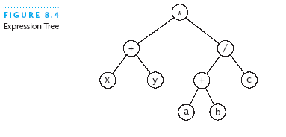
Expression Tree
Each node contains an operator or an operand
Operands are stored in leaf nodes
Parentheses are not stored in the tree because the tree structure dictates the order of operand evaluation
Operators in nodes at higher tree levels are evaluated after operators in nodes at lower tree levels
(x + y) * ((a + b) / c)

Slide 33
Huffman Tree
A Huffman tree represents Huffman codes for characters that might appear in a text file
As opposed to ASCII or Unicode, Huffman code uses different numbers of bits to encode letters; more common characters use fewer bits
Many programs that compress files use Huffman codes

Slide 34
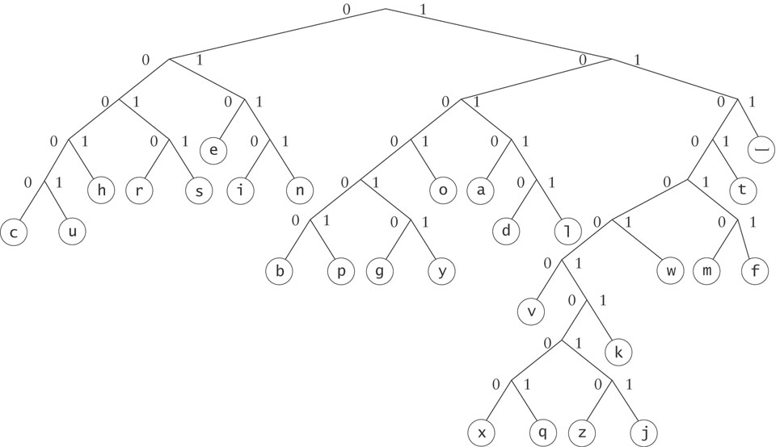
Huffman Tree (cont.)
To form a code, traverse the tree from the root to the chosen character, appending 0 if you branch left, and 1 if you branch right.

Slide 35
Huffman Tree (cont.)
Examples:
d : 10110
e : 010

Slide 36
Binary Search Tree
dog
Binary search trees
All elements in the left subtree precede those in the right subtree
A formal definition:
A set of nodes T is a binary search tree if either of the following is true:
T is empty
If T is not empty, its root node has two subtrees, T_{L} and T_{R}, such that T_{L} and T_{R} are binary search trees and the value in the root node of T is greater than all values in T_{L} and is less than all values in T_{R}
cat
wolf
canine

Slide 37
Binary Search Tree (cont.)
A binary search tree never has to be sorted because its elements always satisfy the required order relationships
When new elements are inserted (or removed) properly, the binary search tree maintains its order
In contrast, a sorted array must be expanded whenever new elements are added, and compacted whenever elements are removed—expanding and contracting are both O(n)

Slide 38
Binary Search Tree (cont.)
When searching a BST, each probe has the potential to eliminate half the elements in the tree, so searching can be O(log n)
In the worst case, searching is O(n)

Slide 39
Recursive Algorithm for Searching a Binary Tree
if the tree is empty
return null (target is not found) else if the target matches the root node's data
return the data stored at the root node else if the target is less than the root node's data
return the result of searching the left subtree of the root else
return the result of searching the right subtree of the root

Slide 40
Full, Perfect, and Complete Binary Trees
A full binary tree is a binary tree where all nodes have either 2 children or 0 children (the leaf nodes)
7
1
10
0
3
9
12
2
5
11
13
4
6

Slide 41
Full, Perfect, and Complete Binary Trees (cont.)
A perfect binary tree is a full binary tree of height n with exactly 2^{n} – 1 nodes
In this case, n = 3 and 2^{n} – 1 = 7
3
1
5
0
2
4
6

Slide 42
Full, Perfect, and Complete Binary Trees (cont.)
A complete binary tree is a perfect binary tree through level n - 1 with some extra leaf nodes at level n (the tree height), all toward the left
3
1
5
0
2
4

Slide 43
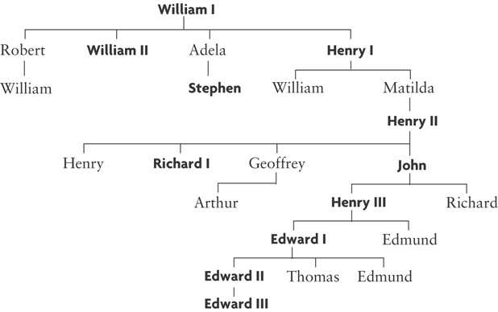
General Trees
We do not discuss general trees in this chapter, but nodes of a general tree can have any number of subtrees

Slide 44
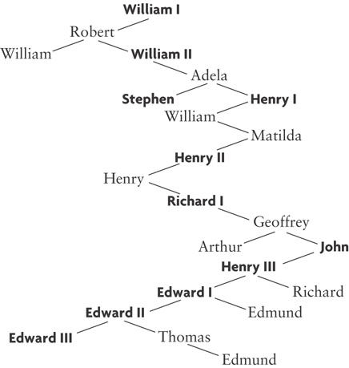
General Trees (cont.)
A general tree can be represented using a binary tree
The left branch of a node is the oldest child, and each right branch is connected to the next younger sibling (if any)

Slide 45
Tree Traversals
Section 6.2

Slide 46
Tree Traversals
Often we want to determine the nodes of a tree and their relationship
We can do this by walking through the tree in a prescribed order and visiting the nodes as they are encountered
This process is called tree traversal
Three common kinds of tree traversal
Inorder
Preorder
Postorder

Slide 47
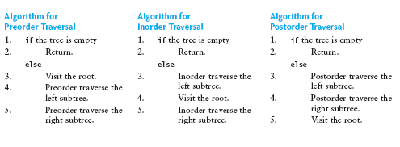
Tree Traversals (cont.)
Preorder: visit root node, traverse T_{L}, traverse T_{R}
Inorder: traverse T_{L}, visit root node, traverse T_{R}
Postorder: traverse T_{L}, traverse T_{R}, visit root node

Slide 48
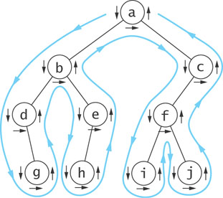
Visualizing Tree Traversals
You can visualize a tree traversal by imagining a mouse that walks along the edge of the tree
If the mouse always keeps the tree to the left, it will trace a route known as the Euler tour
The Euler tour is the path traced in blue in the figure on the right

Slide 49
Visualizing Tree Traversals (cont.)
A Euler tour (blue path) is a preorder traversal
The sequence in this example is a b d g e h c f i j
The mouse visits each node before traversing its subtrees (shown by the downward pointing arrows)

Slide 50
Visualizing Tree Traversals (cont.)
If we record a node as the mouse returns from traversing its left subtree (shown by horizontal black arrows in the figure) we get an inorder traversal
The sequence is d g b h e a i f j c

Slide 51
Visualizing Tree Traversals (cont.)
If we record each node as the mouse last encounters it, we get a postorder traversal (shown by the upward pointing arrows)
The sequence is g d h e b i j f c a

Slide 52
Traversals of Binary Search Trees and Expression Trees
An inorder traversal of a binary search tree results in the nodes being visited in sequence by increasing data value
canine, cat, dog, wolf
dog
cat
wolf
canine

Slide 53
Traversals of Binary Search Trees and Expression Trees (cont.)
An inorder traversal of an expression tree results in the sequence x + y * a + b / c
If we insert parentheses where they belong, we get the infix form:
(x + y) * ((a + b) / c)
*
+
/
x
y
+
c
a
b

Slide 54
Traversals of Binary Search Trees and Expression Trees (cont.)
A postorder traversal of an expression tree results in the sequence x y + a b + c / *
This is the postfix or reverse polish form of the expression
Operators follow operands
*
+
/
x
y
+
c
a
b

Slide 55
Traversals of Binary Search Trees and Expression Trees (cont.)
A preorder traversal of an expression tree results in the sequence * + x y / + a b c
This is the prefix or forward polish form of the expression
Operators precede operands
*
+
/
x
y
+
c
a
b

Slide 56
Implementing a BinaryTree Class
Section 6.3

Slide 57
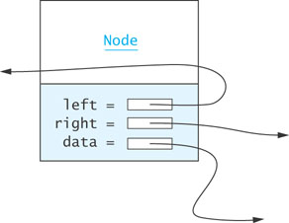
Node<E> Class
Just as for a linked list, a node consists of a data part and links to successor nodes
The data part is a reference to type E
A binary tree node must have links to both its left and right subtrees

Slide 58
Node<E> Class (cont.)
protected static class Node<E> implements Serializable {
protected E data;
protected Node<E> left;
protected Node<E> right;
public Node(E data) {
this.data = data;
left = null;
right = null;
}
public String toString() {
return data.toString();
}
}
Node<E> is declared as an inner class within BinaryTree<E>

Slide 59
Node<E> Class (cont.)
protected static class Node<E> implements Serializable {
protected E data;
protected Node<E> left;
protected Node<E> right;
public Node(E data) {
this.data = data;
left = null;
right = null;
}
public String toString() {
return data.toString();
}
}
Node<E> is declared protected. This way we can use it as a superclass.

Slide 60
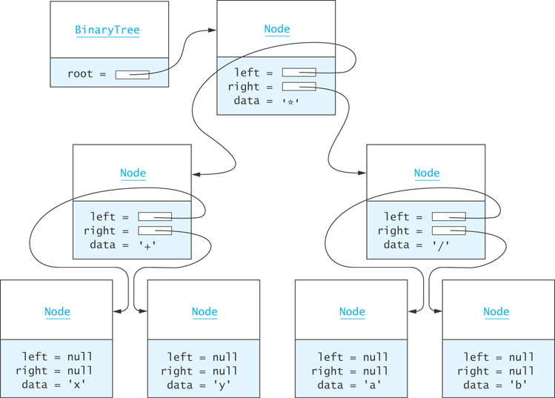
BinaryTree<E> Class (cont.)

Slide 61
BinaryTree<E> Class (cont.)
Assuming the tree is referenced by variable bT (type BinaryTree) then . . .

Slide 62
BinaryTree<E> Class (cont.)
bT.root.data references the Character object storing '*'

Slide 63
BinaryTree<E> Class (cont.)
bT.root.left references the left subtree of the root

Slide 64
BinaryTree<E> Class (cont.)
bT.root.right references the right subtree of the root

Slide 65
BinaryTree<E> Class (cont.)
bT.root.right.data references the Character object storing '/'

Slide 66
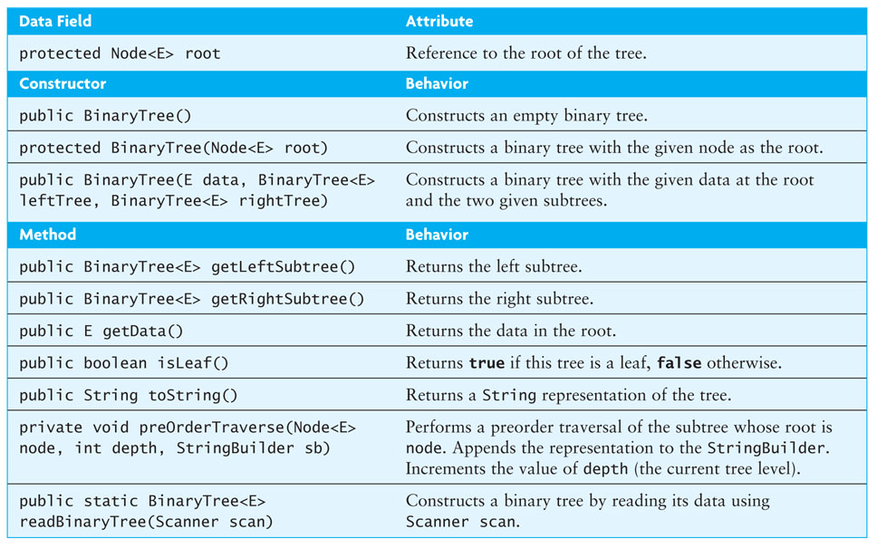
BinaryTree<E> Class (cont.)

Slide 67
BinaryTree<E> Class (cont.)
Class heading and data field declarations:
import java.io.*;
public class BinaryTree<E> implements Serializable {
// Insert inner class Node<E> here
protected Node<E> root;
. . .
}

Slide 68
BinaryTree<E> Class (cont.)
The Serializable interface defines no methods
It provides a marker for classes that can be written to a binary file using the ObjectOutputStream and read using the ObjectInputStream

Slide 69
Constructors
The no-parameter constructor:
public BinaryTree() {
root = null;
}
The constructor that creates a tree with a given node at the root:
protected BinaryTree(Node<E> root) {
this.root = root;
}

Slide 70
Constructors (cont.)
The constructor that builds a tree from a data value and two trees:
public BinaryTree(E data, BinaryTree<E> leftTree,
BinaryTree<E> rightTree) {
root = new Node<E>(data);
if (leftTree != null) {
root.left = leftTree.root;
} else {
root.left = null;
}
if (rightTree != null) {
root.right = rightTree.root;
} else {
root.right = null;
}
}

Slide 71
getLeftSubtree and getRightSubtree Methods
public BinaryTree<E> getLeftSubtree() {
if (root != null && root.left != null) {
return new BinaryTree<E>(root.left);
} else {
return null;
}
}
getRightSubtree method is symmetric

Slide 72
isLeaf Method
public boolean isLeaf() {
return (root.left == null && root.right == null);
}

Slide 73
toString Method
The toString method generates a string representing a preorder traversal in which each local root is indented a distance proportional to its depth
public String toString() {
StringBuilder sb = new StringBuilder();
preOrderTraverse(root, 1, sb);
return sb.toString();
}

Slide 74
preOrderTraverse Method
private void preOrderTraverse(Node<E> node, int depth, StringBuilder sb) {
for (int i = 1; i < depth; i++) {
sb.append(" "); // indentation
}
if (node == null) {
sb.append("null\n");
} else {
sb.append(node.toString());
sb.append("\n");
preOrderTraverse(node.left, depth + 1, sb);
preOrderTraverse(node.right, depth + 1, sb);
}
}

Slide 75
preOrderTraverse Method (cont.)
*
+
x
null
null
y
null
null
/
a
null
null
b
null
null
*
+
/
x
y
a
b
(x + y) * (a / b)

Slide 76
Reading a Binary Tree
If we use a Scanner to read the individual lines created by the toString and preOrderTraverse methods, we can reconstruct the tree
Read a line that represents information at the root
Remove the leading and trailing spaces using String.trim
if it is "null"
return null
else
recursively read the left child
recursively read the right child
return a tree consisting of the root and the two children

Slide 77
Reading a Binary Tree (cont.)
public static BinaryTree<String> readBinaryTree(Scanner scan) {
String data = scan.next();
if (data.equals("null")) {
return null;
} else {
BinaryTree<String> leftTree = readBinaryTree(scan);
BinaryTree<String> rightTree = readBinaryTree(scan);
return new BinaryTree<String>(data, leftTree, rightTree);
}
}

Slide 78
Using ObjectOutputStream and ObjectInputStream
The Java API includes the class ObjectOutputStream that will write to an external file any object that is declared to be Serializable
To declare an object Serializable, add
implements Serializable
to the class declaration
The Serializable interface contains no methods, but it serves to mark the class and gives you control over whether or not you want your object written to an external file

Slide 79
Using ObjectOutputStream and ObjectInputStream (cont.)
To write a Serializable object to a file:
try {
ObjectOutputStream out =
new ObjectOutputStream(new FileOutputStream(filename));
out.writeObject(nameOfObject);
} catch (Exception ex) {
ex.printStackTrace();
System.exit(1);
}
A deep copy of all the nodes of the binary tree will be written to the file

Slide 80
Using ObjectOutputStream and ObjectInputStream (cont.)
To read a Serializable object from a file:
try {
ObjectInputStream in =
new ObjectInputStream(new FileInputStream(filename));
objectName = (objectClass)in.readObject();
} catch (Exception ex) {
ex.printStackTrace();
System.exit(1);
}

Slide 81
Using ObjectOutputStream and ObjectInputStream (cont.)
Do not recompile the Java source file for a class after an object of that class has been serialized
Even if you didn't make any changes to the class, the resulting .class file associated with the serialized object will have a different class signature
When you attempt to read the object, the class signatures will not match, and you will get an exception

Slide 82
Binary Search Trees
Section 6.4

Slide 83
Overview of a Binary Search Tree
Recall the definition of a binary search tree:
A set of nodes T is a binary search tree if either of the following is true
T is empty
If T is not empty, its root node has two subtrees, T_{L} and T_{R}, such that T_{L} and T_{R} are binary search trees and the value in the root node of T is greater than all values in T_{L} and less than all values in T_{R}

Slide 84
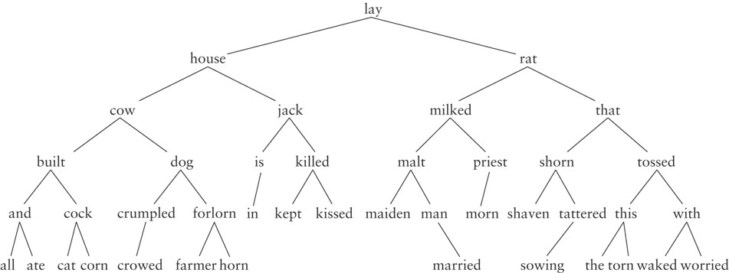
Overview of a Binary Search Tree (cont.)

Slide 85
Recursive Algorithm for Searching a Binary Search Tree
if the root is null
the item is not in the tree; return null
Compare the value of target with root.data
if they are equal
the target has been found; return the data at the root
else if the target is less than root.data
return the result of searching the left subtree
else
return the result of searching the right subtree

Slide 86
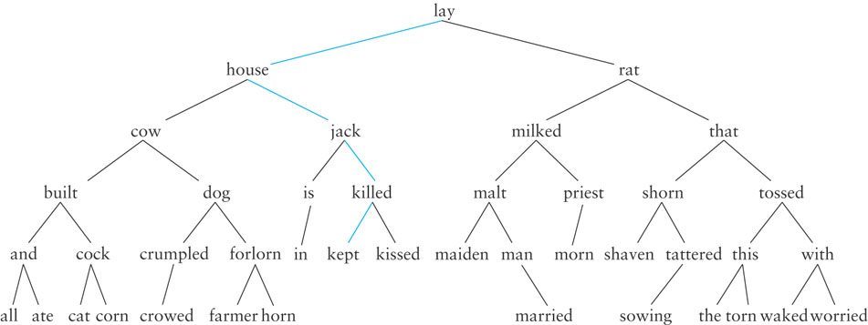
Searching a Binary Tree
Searching for "kept"

Slide 87
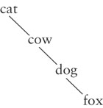
Performance
Search a tree is generally O(log n)
If a tree is not very full, performance will be worse
Searching a tree with only right subtrees, for example, is O(n)

Slide 88
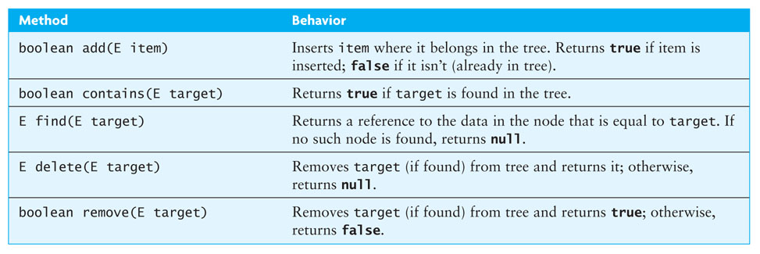
Interface SearchTree<E>

Slide 89
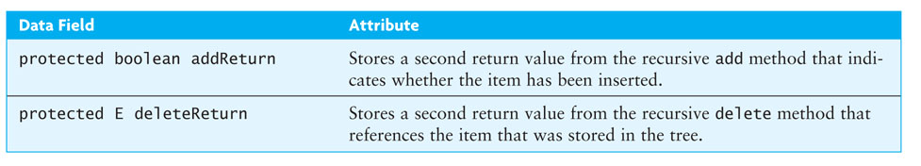
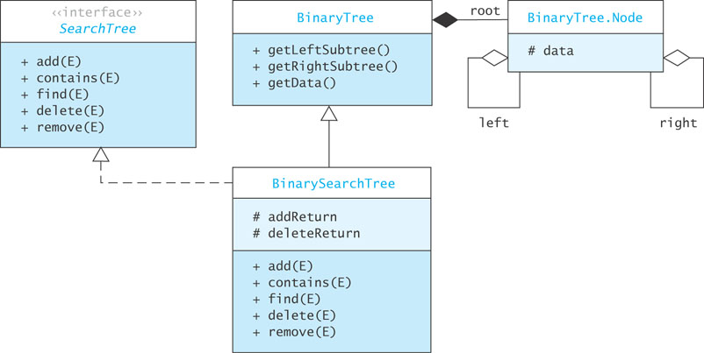
BinarySearchTree<E> Class

Slide 90
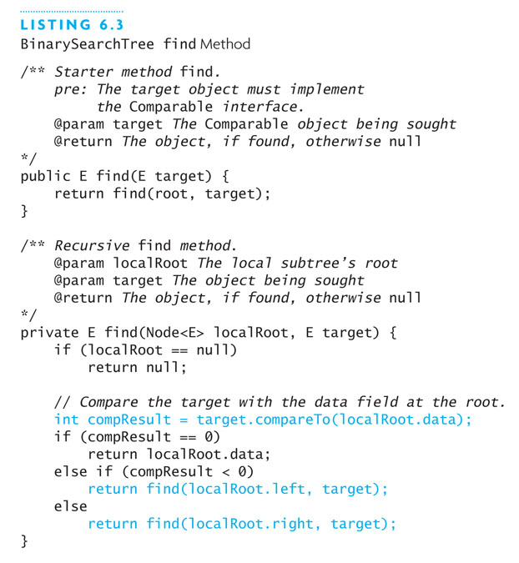
Implementing find Methods

Slide 91
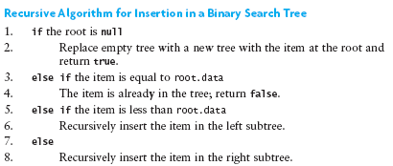
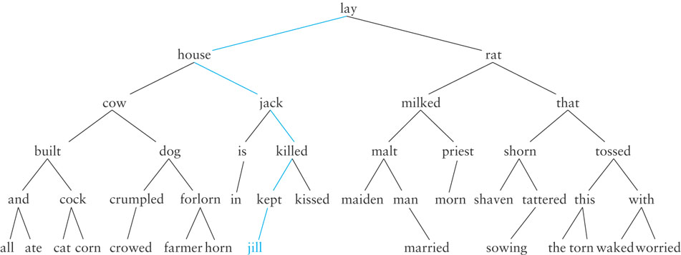
Insertion into a Binary Search Tree

Slide 92
Implementing the add Methods
/** Starter method add.
pre: The object to insert must implement the
Comparable interface.
@param item The object being inserted
@return true if the object is inserted, false
if the object already exists in the tree
*/
public boolean add(E item) {
root = add(root, item);
return addReturn;
}

Slide 93
Implementing the add Methods (cont.)
/** Recursive add method.
post: The data field addReturn is set true if the item is added to
the tree, false if the item is already in the tree.
@param localRoot The local root of the subtree
@param item The object to be inserted
@return The new local root that now contains the
inserted item
*/
private Node<E> add(Node<E> localRoot, E item) {
if (localRoot == null) {
// item is not in the tree — insert it.
addReturn = true;
return new Node<E>(item);
} else if (item.compareTo(localRoot.data) == 0) {
// item is equal to localRoot.data
addReturn = false;
return localRoot;
} else if (item.compareTo(localRoot.data) < 0) {
// item is less than localRoot.data
localRoot.left = add(localRoot.left, item);
return localRoot;
} else {
// item is greater than localRoot.data
localRoot.right = add(localRoot.right, item);
return localRoot;
}
}

Slide 94
Removal from a Binary Search Tree
If the item to be removed has no children, simply delete the reference to the item
If the item to be removed has only one child, change the reference to the item so that it references the item’s only child

Slide 95
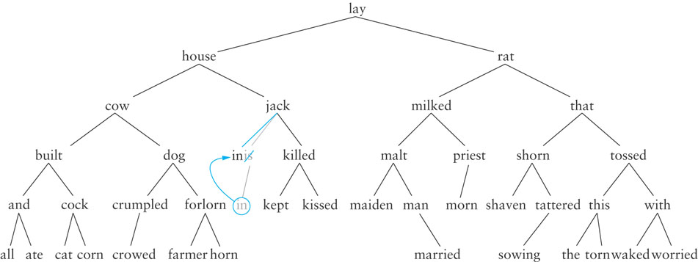
Removal from a Binary Search Tree (cont.)

Slide 96
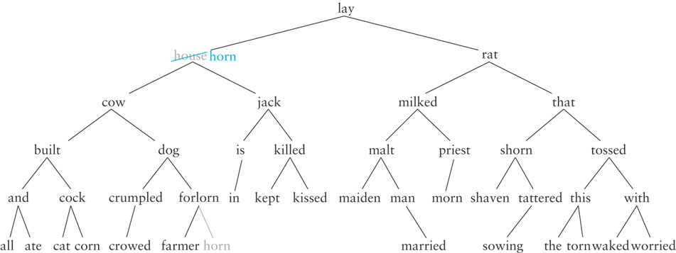
Removing from a Binary Search Tree (cont.)
If the item to be removed has two children, replace it with the largest item in its left subtree – the inorder predecessor

Slide 97
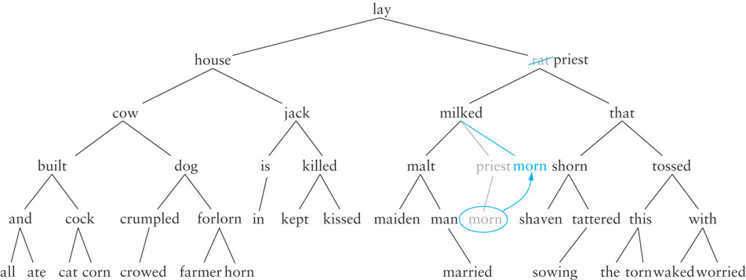
Removing from a Binary Search Tree (cont.)

Slide 98
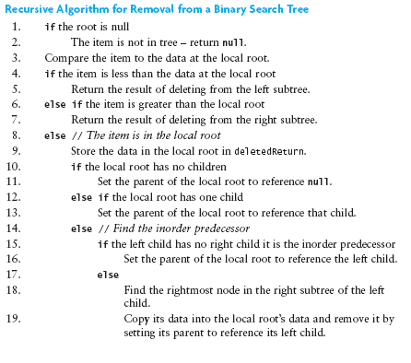
Algorithm for Removing from a Binary Search Tree

Slide 99
Implementing the delete Method
Listing 6.5 (BinarySearchTree delete Methods; pages 325-326)

Slide 100
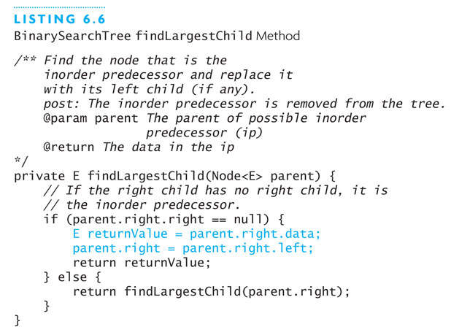
Method findLargestChild

Slide 101
Testing a Binary Search Tree
To test a binary search tree, verify that an inorder traversal will display the tree contents in ascending order after a series of insertions and deletions are performed

Slide 102
Writing an Index for a Term Paper
Problem: write an index for a term paper
The index should show each word in the paper followed by the line number on which it occurred
The words should be displayed in alphabetical order
If a word occurs on multiple lines, the line numbers should be listed in ascending order: a, 003 a, 013 are, 003

Slide 103
Writing an Index for a Term Paper (cont.)
Analysis
Store each word and its line number as a string in a tree node
For example, two occurences of "java": "java, 005" and "java, 010"
Display the words in ascending order by performing an inorder traversal

Slide 104
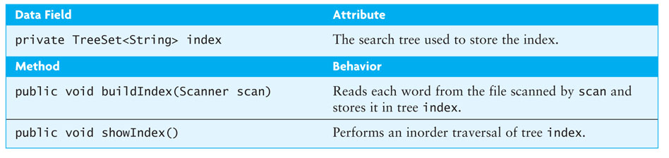
Writing an Index for a Term Paper (cont.)
Design
Use TreeSet<E>, a class based on a binary search tree, provided in the Java API
Write a class IndexGenerator with a TreeSet<String> data fields

Slide 105
Writing an Index for a Term Paper (cont.)
Listing 6.7 (Class IndexGenerator.java; pages 330-331)

Slide 106
Heaps and Priority Queues
Section 6.5

Slide 107
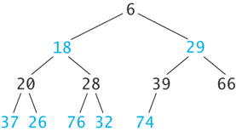
Heaps and Priority Queues
A heap is a complete binary tree with the following properties
The value in the root is a smallest item in the tree
Every nonempty subtree is
a heap

Slide 108

Inserting an Item into a Heap
6
18
29
20
28
39
66
37
26
76
32
74
89

Slide 109
Inserting an Item into a Heap (cont.)
6
18
29
20
28
39
66
37
26
76
32
74
89
8

Slide 110
Inserting an Item into a Heap (cont.)
6
18
29
20
28
39
8
37
26
76
32
74
89
66

Slide 111
Inserting an Item into a Heap (cont.)
6
18
8
20
28
39
29
37
26
76
32
74
89
66

Slide 112
Inserting an Item into a Heap (cont.)
6
18
8
20
28
39
29
37
26
76
32
74
89
66

Slide 113
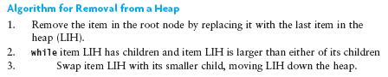
Removing an Item from a Heap
6
18
8
20
28
39
29
37
26
76
32
74
89
66

Slide 114
Removing an Item from a Heap (cont.)
6
18
8
20
28
39
29
37
26
76
32
74
89
66

Slide 115
Removing an Item from a Heap (cont.)
66
18
8
20
28
39
29
37
26
76
32
74
89

Slide 116
Removing an Item from a Heap (cont.)
8
18
66
20
28
39
29
37
26
76
32
74
89

Slide 117
Removing an Item from a Heap (cont.)
8
18
29
20
28
39
66
37
26
76
32
74
89

Slide 118
Removing an Item from a Heap (cont.)
8
18
29
20
28
39
66
37
26
76
32
74
89

Slide 119
Implementing a Heap
Because a heap is a complete binary tree, it can be implemented efficiently using an array rather than a linked data structure

Slide 120
Implementing a Heap (cont.)
8
8
29
18
29
18
39
66
20
66
20
28
28
39
37
37
26
26
76
76
32
32
74
74
89
89
0
1
2
3
4
5
6
7
8
9
10
11
12
8
18
29
20
28
39
66
37
26
76
32
74
89

Slide 121
Implementing a Heap (cont.)
For a node at position p, L. child position: 2p + 1
R. child position: 2p + 2
8
18
29
20
28
39
66
37
26
76
32
74
89
0
1
2
3
4
5
6
7
8
9
10
11
12
8
18
29
20
28
39
66
37
26
76
32
74
89
Parent
L. Child
R. Child

Slide 122
Implementing a Heap (cont.)
For a node at position p, L. child position: 2p + 1
R. child position: 2p + 2
8
18
29
20
28
39
66
37
26
76
32
74
89
0
1
2
3
4
5
6
7
8
9
10
11
12
8
18
29
20
28
39
66
37
26
76
32
74
89
Parent
L. Child
R. Child

Slide 123
Implementing a Heap (cont.)
For a node at position p, L. child position: 2p + 1
R. child position: 2p + 2
8
18
29
20
28
39
66
37
26
76
32
74
89
0
1
2
3
4
5
6
7
8
9
10
11
12
8
18
29
20
28
39
66
37
26
76
32
74
89
Parent
L. Child
R. Child

Slide 124
Implementing a Heap (cont.)
For a node at position p, L. child position: 2p + 1
R. child position: 2p + 2
8
18
29
20
28
39
66
37
26
76
32
74
89
0
1
2
3
4
5
6
7
8
9
10
11
12
8
18
29
20
28
39
66
37
26
76
32
74
89
Parent
L. Child
R. Child

Slide 125
Implementing a Heap (cont.)
For a node at position p, L. child position: 2p + 1
R. child position: 2p + 2
8
18
29
20
28
39
66
37
26
76
32
74
89
0
1
2
3
4
5
6
7
8
9
10
11
12
8
18
29
20
28
39
66
37
26
76
32
74
89
Parent
L. Child
R. Child

Slide 126
Implementing a Heap (cont.)
8
18
29
A node at position c can find its parent at (c – 1)/2
20
28
39
66
37
26
76
32
74
89
0
1
2
3
4
5
6
7
8
9
10
11
12
8
18
29
20
28
39
66
37
26
76
32
74
89
Parent
Child

Slide 127
Inserting into a Heap Implemented as an ArrayList
1. Insert the new element at the end of the ArrayList and set child to table.size() - 1
8
18
29
20
28
39
66
37
26
76
32
74
89
0
1
2
3
4
5
6
7
8
9
10
11
12
13
8
18
29
20
28
39
66
37
26
76
32
74
89

Slide 128
Inserting into a Heap Implemented as an ArrayList (cont.)
1. Insert the new element at the end of the ArrayList and set child to table.size() - 1
6
18
29
20
28
39
66
37
26
76
32
74
89
8
0
1
2
3
4
5
6
7
8
9
10
11
12
13
6
18
29
20
28
39
66
37
26
76
32
74
89
8
Child

Slide 129
Inserting into a Heap Implemented as an ArrayList (cont.)
2. Set parent to (child – 1)/ 2
6
18
29
20
28
39
66
37
26
76
32
74
89
8
0
1
2
3
4
5
6
7
8
9
10
11
12
13
6
18
29
20
28
39
66
37
26
76
32
74
89
8
Parent
Child

Slide 130
Inserting into a Heap Implemented as an ArrayList (cont.)
3. while (parent >= 0 and table[parent] > table[child])
Swap table[parent] and table[child]
Set child equal to parent
Set parent equal to (child-1)/2
6
18
29
20
28
39
66
37
26
76
32
74
89
8
0
1
2
3
4
5
6
7
8
9
10
11
12
13
6
18
29
20
28
39
66
37
26
76
32
74
89
8
Parent
Child

Slide 131
Inserting into a Heap Implemented as an ArrayList (cont.)
3. while (parent >= 0 and table[parent] > table[child])
Swap table[parent] and table[child]
Set child equal to parent
Set parent equal to (child-1)/2
6
18
29
20
28
39
8
37
26
76
32
74
89
66
0
1
2
3
4
5
6
7
8
9
10
11
12
13
6
18
29
20
28
39
8
37
26
76
32
74
89
66
Parent
Child

Slide 132
Inserting into a Heap Implemented as an ArrayList (cont.)
3. while (parent >= 0 and table[parent] > table[child])
Swap table[parent] and table[child]
Set child equal to parent
Set parent equal to (child-1)/2
6
18
29
20
28
39
8
37
26
76
32
74
89
66
0
1
2
3
4
5
6
7
8
9
10
11
12
13
6
18
29
20
28
39
8
37
26
76
32
74
89
66
Parent
Child

Slide 133
Inserting into a Heap Implemented as an ArrayList (cont.)
3. while (parent >= 0 and table[parent] > table[child])
Swap table[parent] and table[child]
Set child equal to parent
Set parent equal to (child-1)/2
6
18
29
20
28
39
8
37
26
76
32
74
89
66
0
1
2
3
4
5
6
7
8
9
10
11
12
13
6
18
29
20
28
39
8
37
26
76
32
74
89
66
Parent
Child

Slide 134
Inserting into a Heap Implemented as an ArrayList (cont.)
3. while (parent >= 0 and table[parent] > table[child])
Swap table[parent] and table[child]
Set child equal to parent
Set parent equal to (child-1)/2
6
18
29
20
28
39
8
37
26
76
32
74
89
66
0
1
2
3
4
5
6
7
8
9
10
11
12
13
6
18
29
20
28
39
8
37
26
76
32
74
89
66
Parent
Child

Slide 135
Inserting into a Heap Implemented as an ArrayList (cont.)
3. while (parent >= 0 and table[parent] > table[child])
Swap table[parent] and table[child]
Set child equal to parent
Set parent equal to (child-1)/2
6
18
8
20
28
39
29
37
26
76
32
74
89
66
0
1
2
3
4
5
6
7
8
9
10
11
12
13
6
18
8
20
28
39
29
37
26
76
32
74
89
66
Parent
Child

Slide 136
Inserting into a Heap Implemented as an ArrayList (cont.)
3. while (parent >= 0 and table[parent] > table[child])
Swap table[parent] and table[child]
Set child equal to parent
Set parent equal to (child-1)/2
6
18
8
20
28
39
29
37
26
76
32
74
89
66
0
1
2
3
4
5
6
7
8
9
10
11
12
13
6
18
8
20
28
39
29
37
26
76
32
74
89
66
Parent
Child

Slide 137
Inserting into a Heap Implemented as an ArrayList (cont.)
3. while (parent >= 0 and table[parent] > table[child])
Swap table[parent] and table[child]
Set child equal to parent
Set parent equal to (child-1)/2
6
18
8
20
28
39
29
37
26
76
32
74
89
66
0
1
2
3
4
5
6
7
8
9
10
11
12
13
6
18
8
20
28
39
29
37
26
76
32
74
89
66
Parent
Child

Slide 138
Inserting into a Heap Implemented as an ArrayList (cont.)
3. while (parent >= 0 and table[parent] > table[child])
Swap table[parent] and table[child]
Set child equal to parent
Set parent equal to (child-1)/2
6
18
8
20
28
39
29
37
26
76
32
74
89
66
0
1
2
3
4
5
6
7
8
9
10
11
12
13
6
18
8
20
28
39
29
37
26
76
32
74
89
66

Slide 139
Removal from a Heap Implemented as an ArrayList
Removing an Element from a Heap Implemented as an ArrayList
1. Remove the last element (i.e., the one at size() – 1) and set the item at 0 to this value.
2. Set parent to 0.
3. while (true)
4. Set leftChild to (2 * parent) + 1 and rightChild to leftChild + 1.
5. if leftChild >= table.size()
6. Break out of loop.
7. Assume minChild (the smaller child) is leftChild.
8. if rightChild < table.size() and
table[rightChild] < table[leftChild]
9. Set minChild to rightChild.
10. if table[parent] > table[minChild]
11. Swap table[parent] and table[minChild].
12. Set parent to minChild.
else
13. Break out of loop.

Slide 140
Performance of the Heap
remove traces a path from the root to a leaf
insert traces a path from a leaf to the root
This requires at most h steps where h is the height of the tree
The largest full tree of height h has 2^{h}-1 nodes
The smallest complete tree of height h has 2^{(h-1)} nodes
Both insert and remove are O(log n)

Slide 141
Priority Queues
The heap is used to implement a special kind of queue called a priority queue
The heap is not very useful as an ADT on its own
We will not create a Heap interface or code a class that implements it
Instead, we will incorporate its algorithms when we implement a priority queue class and heapsort
Sometimes a FIFO queue may not be the best way to implement a waiting line
A priority queue is a data structure in which only the highest-priority item is accessible

Slide 142
Priority Queues (cont.)
In a print queue, sometimes it is more appropriate to print a short document that arrived after a very long document
A priority queue is a data structure in which only the highest-priority item is accessible (as opposed to the first item entered)

Slide 143
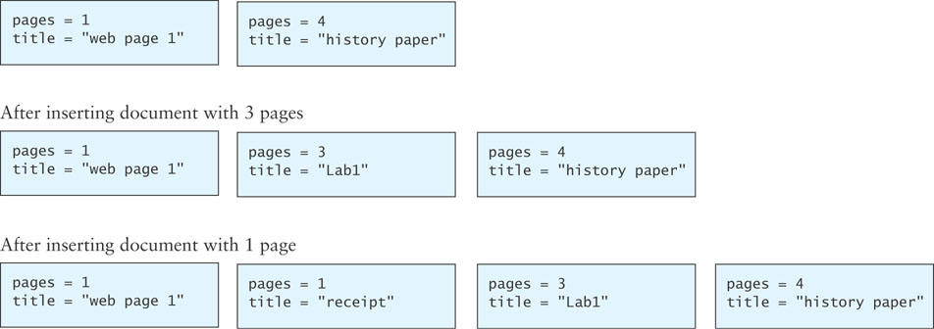
Insertion into a Priority Queue

Slide 144
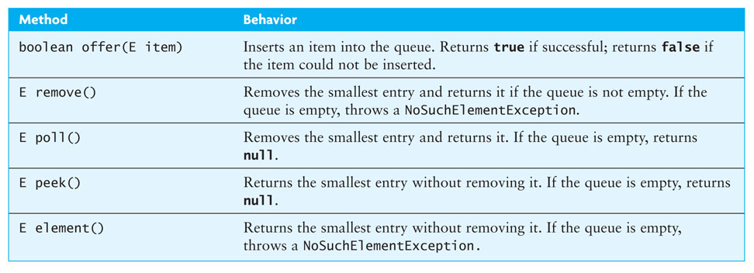
PriorityQueue Class
Java provides a PriorityQueue<E> class that implements the Queue<E> interface given in Chapter 4.

Slide 145
Using a Heap as the Basis of a Priority Queue
In a priority queue, just like a heap, the smallest item always is removed first
Because heap insertion and removal is O(log n), a heap can be the basis of a very efficient implementation of a priority queue
While the java.util.PriorityQueue uses an Object[] array, we will use an ArrayList for our custom priority queue, KWPriorityQueue

Slide 146
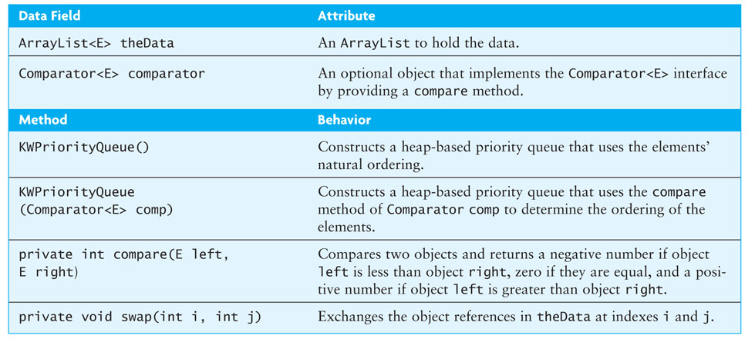
Design of a KWPriorityQueue Class

Slide 147
Design of a KWPriorityQueue Class (cont.)
import java.util.*;
/** The KWPriorityQueue implements the Queue interface
by building a heap in an ArrayList. The heap is structured
so that the "smallest" item is at the top.
*/
public class KWPriorityQueue<E> extends AbstractQueue<E>
implements Queue<E> {
// Data Fields
/** The ArrayList to hold the data. */
private ArrayList<E> theData;
/** An optional reference to a Comparator object. */
Comparator<E> comparator = null;
// Methods
// Constructor
public KWPriorityQueue() {
theData = new ArrayList<E>();
}
. . .

Slide 148
offer Method
/** Insert an item into the priority queue.
pre: The ArrayList theData is in heap order.
post: The item is in the priority queue and
theData is in heap order.
@param item The item to be inserted
@throws NullPointerException if the item to be inserted is null.
*/
@Override
public boolean offer(E item) {
// Add the item to the heap.
theData.add(item);
// child is newly inserted item.
int child = theData.size() - 1;
int parent = (child - 1) / 2; // Find child’s parent.
// Reheap
while (parent >= 0 && compare(theData.get(parent),
theData.get(child)) > 0) {
swap(parent, child);
child = parent;
parent = (child - 1) / 2;
}
return true;
}

Slide 149
poll Method
/** Remove an item from the priority queue
pre: The ArrayList theData is in heap order.
post: Removed smallest item, theData is in heap order.
@return The item with the smallest priority value or null if empty.
*/
@Override
public E poll() {
if (isEmpty()) {
return null;
}
// Save the top of the heap.
E result = theData.get(0);
// If only one item then remove it.
if (theData.size() == 1) {
theData.remove(0);
return result;
}

Slide 150
poll Method (cont.)
/* Remove the last item from the ArrayList and place it into
the first position. */
theData.set(0, theData.remove(theData.size() - 1));
// The parent starts at the top.
int parent = 0;
while (true) {
int leftChild = 2 * parent + 1;
if (leftChild >= theData.size()) {
break; // Out of heap.
}
int rightChild = leftChild + 1;
int minChild = leftChild; // Assume leftChild is smaller.
// See whether rightChild is smaller.
if (rightChild < theData.size()
&& compare(theData.get(leftChild),
theData.get(rightChild)) > 0) {
minChild = rightChild;
}
// assert: minChild is the index of the smaller child.
// Move smaller child up heap if necessary.
if (compare(theData.get(parent),
theData.get(minChild)) > 0) {
swap(parent, minChild);
parent = minChild;
} else { // Heap property is restored.
break;
}
}
return result;
}

Slide 151
Other Methods
The iterator and size methods are implemented via delegation to the corresponding ArrayList methods
Method isEmpty tests whether the result of calling method size is 0 and is inherited from class AbstractCollection
The implementations of methods peek and remove are left as exercises

Slide 152
Using a Comparator
To use an ordering that is different from the natural ordering, provide a constructor that has a Comparator<E> parameter
/** Creates a heap-based priority queue with the specified initial
capacity that orders its elements according to the specified
comparator.
@param cap The initial capacity for this priority queue
@param comp The comparator used to order this priority queue
@throws IllegalArgumentException if cap is less than 1
*/
public KWPriorityQueue(Comparator<E> comp) {
if (cap < 1)
throw new IllegalArgumentException();
theData = new ArrayList<E>();
comparator = comp;
}

Slide 153
compare Method
If data field comparator references a Comparator<E> object, method compare delegates the task to the object’s compare method
If comparator is null, it will delegate to method compareTo

Slide 154
compare Method (cont.)
/** Compare two items using either a Comparator object’s compare method
or their natural ordering using method compareTo.
pre: If comparator is null, left and right implement Comparable<E>.
@param left One item
@param right The other item
@return Negative int if left less than right,
0 if left equals right,
positive int if left > right
@throws ClassCastException if items are not Comparable
*/
private int compare(E left, E right) {
if (comparator != null) { // A Comparator is defined.
return comparator.compare(left, right);
} else { // Use left’s compareTo method.
return ((Comparable<E>) left).compareTo(right);
}
}

Slide 155
PrintDocuments Example
The class PrintDocument is used to define documents to be printed on a printer
We want to order documents by a value that is a function of both size and time submitted
In the client program, use
Queue printQueue =
new PriorityQueue(new ComparePrintDocuments());

Slide 156
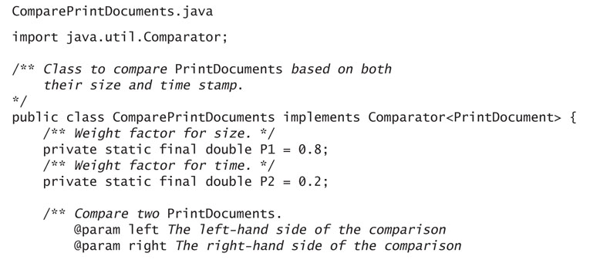
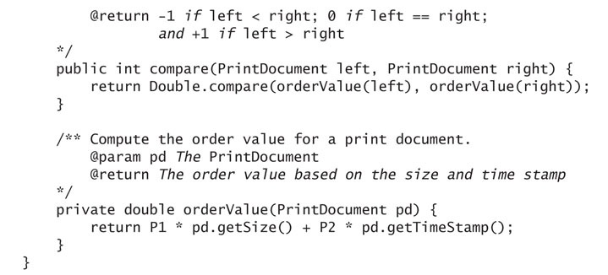
PrintDocuments Example (cont.)

Slide 157
Huffman Trees
Section 6.6

Slide 158
Huffman Trees
A Huffman tree can be implemented using a binary tree and a PriorityQueue
A straight binary encoding of an alphabet assigns a unique binary number to each symbol in the alphabet
Unicode is an example of such a coding
The message “go eagles” requires 144 bits in Unicode but only 38 bits using Huffman coding

Slide 159
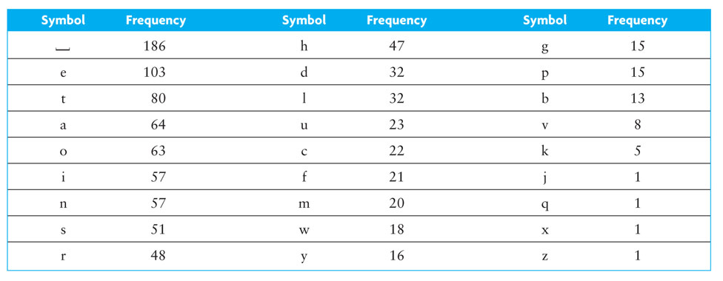
Huffman Trees (cont.)

Slide 160
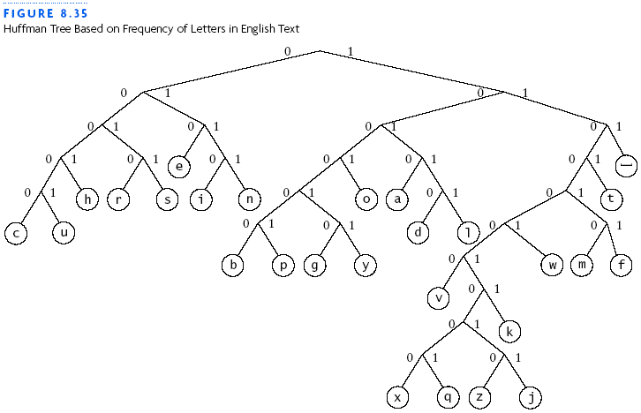
Huffman Trees (cont.)

Slide 161
Building a Custom Huffman Tree
Suppose we want to build a custom Huffman tree for a file
Input: an array of objects such that each object contains a reference to a symbol occurring in that file and the frequency of occurrence (weight) for the symbol in that file

Slide 162
Building a Custom Huffman Tree (cont.)
Analysis:
Each node will have storage for two data items:
the weight of the node and
the symbol associated with the node
All symbols will be stored in leaf nodes
For nodes that are not leaf nodes, the symbol part has no meaning
The weight of a leaf node will be the frequency of the symbol stored at that node
The weight of an interior node will be the sum of frequencies of all leaf nodes in the subtree rooted at the interior node

Slide 163
Building a Custom Huffman Tree (cont.)
Analysis:
A priority queue will be the key data structure in our Huffman tree
We will store individual symbols and subtrees of multiple symbols in order by their priority (frequency of occurrence)

Slide 164

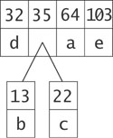
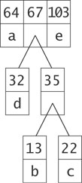
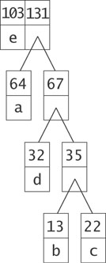
Building a Custom Huffman Tree (cont.)

Slide 165
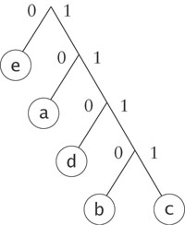
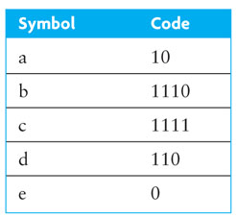
Building a Custom Huffman Tree (cont.)

Slide 166
Design
Algorithm for Building a Huffman Tree
1. Construct a set of trees with root nodes that contain each of the individual
symbols and their weights.
2. Place the set of trees into a priority queue.
3. while the priority queue has more than one item
4. Remove the two trees with the smallest weights.
5. Combine them into a new binary tree in which the weight of the tree
root is the sum of the weights of its children.
6. Insert the newly created tree back into the priority queue.

Slide 167
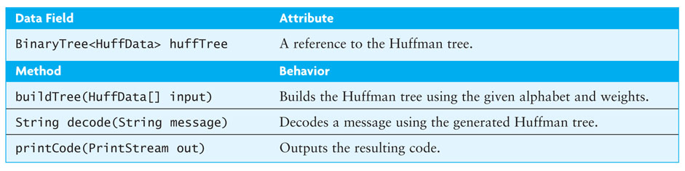
Design (cont.)

Slide 168
Implementation
Listing 6.9 (Class HuffmanTree; page 349)
Listing 6.10 (The buildTree Method (HuffmanTree.java); pages 350-351)
Listing 6.11 (The decode Method (HuffmanTree.java); page 352)

