Slide 1
PIXELS
Measurements are pixels (int)
figure_width
plot_pad_top
plot_offset_x
plot_offset_y
plot_height
figure_height
axis_y_label
plot_width
axis_x_label
plot_pad_bot
plot_pad_left
plot_pad_right

Slide 2
AXIS
Measurements are units (double)
axis_width
axis_right
axis_top
view_left
view_top
axis_height
View_height
view_width
view_right
view_bot
axis_left
axis_bot
view_px_per_unit_x
view_px_per_unit_y
view_units_per_px_x
view_units_per_px_y

Slide 3
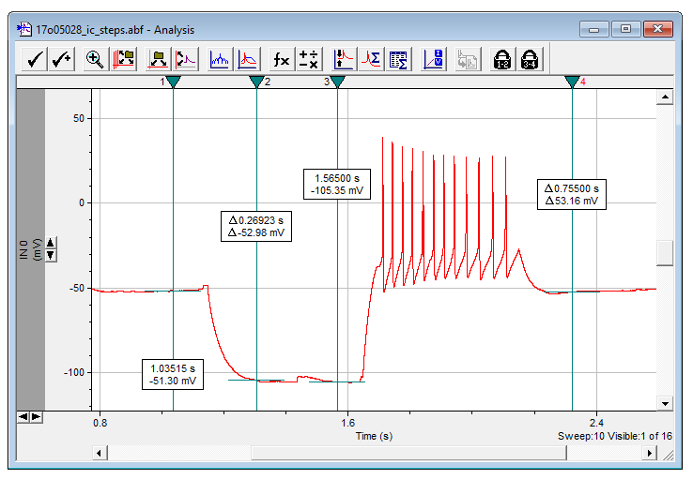

Slide 5
custom click&drag
ScottPlot graph
form buttons
form labels
form scrollbars

Slide 6
Master panel
panel_data_viewer
contains everything and has
a sunken 3d appearance
Marker window
pb_markers
will contain draggable elements
Graph area
pb_graph
data and axis ticks
Y axis label
lbl_axis_y
PICTUREBOX
PICTUREBOX
Zoom buttons
btn_zoom_y_in
btn_zoom_y_out
btn_zoom_x_in
btn_zoom_x_out
LABEL
<
SCROLLBAR
>
FLOW LAYOUT
LABEL
LABEL
<
>
SCROLLBAR
Sweep info
lbl_sweep
Every color represents another layer of nested layout panels.
Attempts are made to align cells of unrelated tables at vertical dashed black lines.
Red-filled squares are controls, white-filled squares are empty table cells.
Every object is fill-docked, except zoom buttons which are anchored.
X axis label
lbl_axis_x

