Slide 1
Lightweight IDE
Talen en automaten
by Achraf Yandouzi, Flor Ronsmans De Vry, Jonas Caluwé and Michel Dierckx

Slide 2
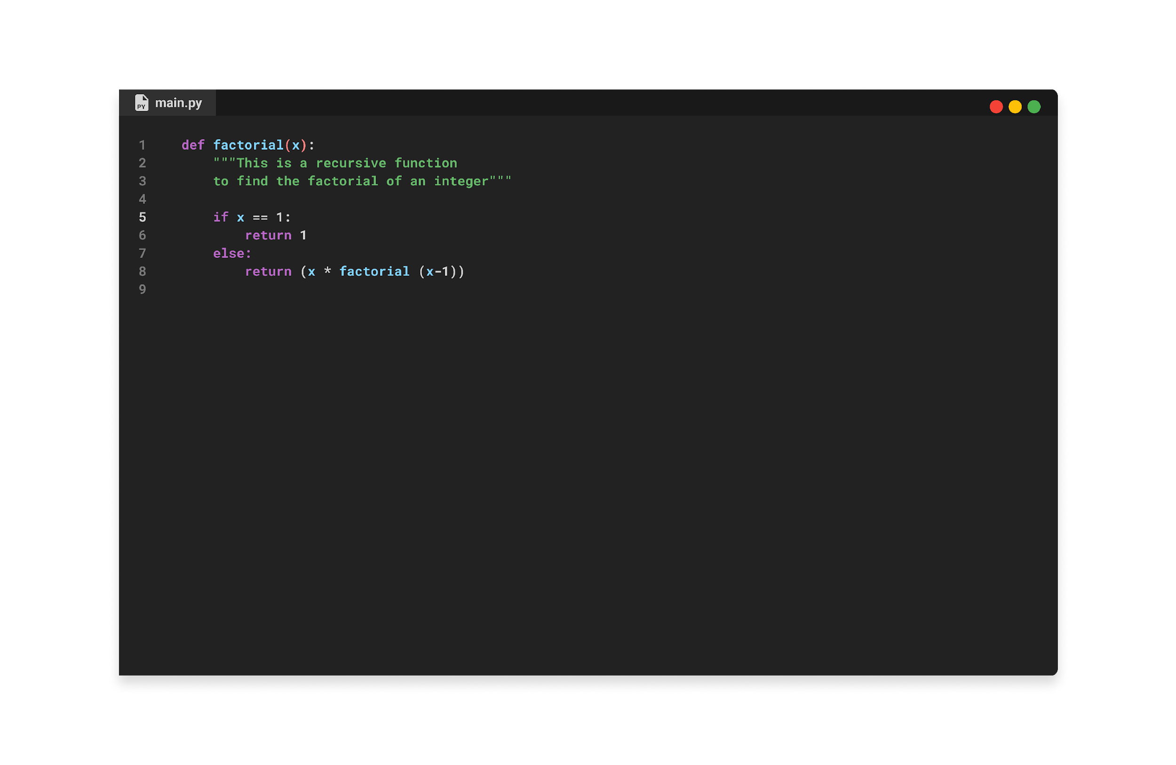


Lightweight IDE

Slide 3
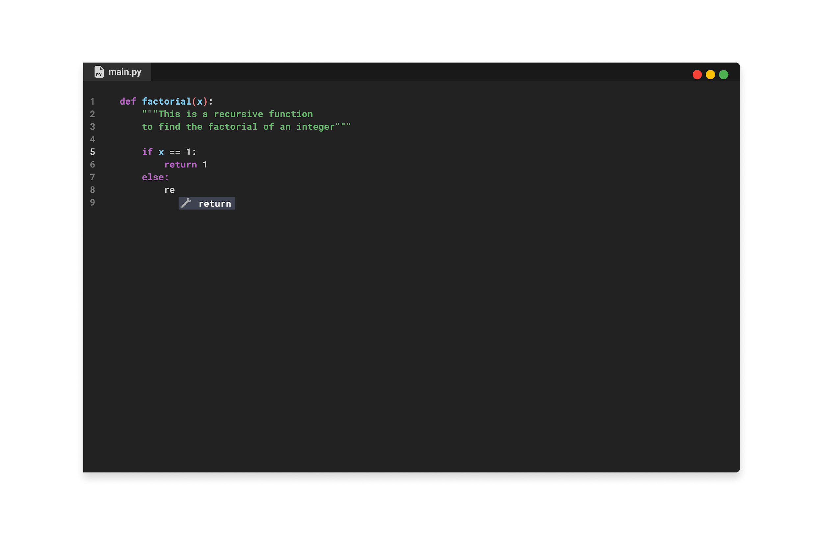


Features
In-browser
syntax highlighting
auto complete

Slide 4
Syntax highlighting

Slide 5
Options
Two ways of doing it
Defining the entire language as one automata
Defining patterns using regular expressions

Slide 6
Regex
Strings
Comments
("""Σ*""")+(#Σ*\n)
"(Σ \ {“, \} + (\”) + (\\))*"
Python keywords
Λ = {a, b, …, z, A, B, …, Z}
((Σ \ Λ) + ε)(while)((Σ \ Λ) + ε)

Slide 7

Regex to ϵ-NFA (for every keyword)
Σ
🪩
(For double quotes)
"(Σ \ {“, \} + (\”) + (\\))*"

Slide 8

Other algorithms
Modified subset construction
Product automaton (union)
Table filling algorithm

Slide 9
Autocomplete

Slide 10


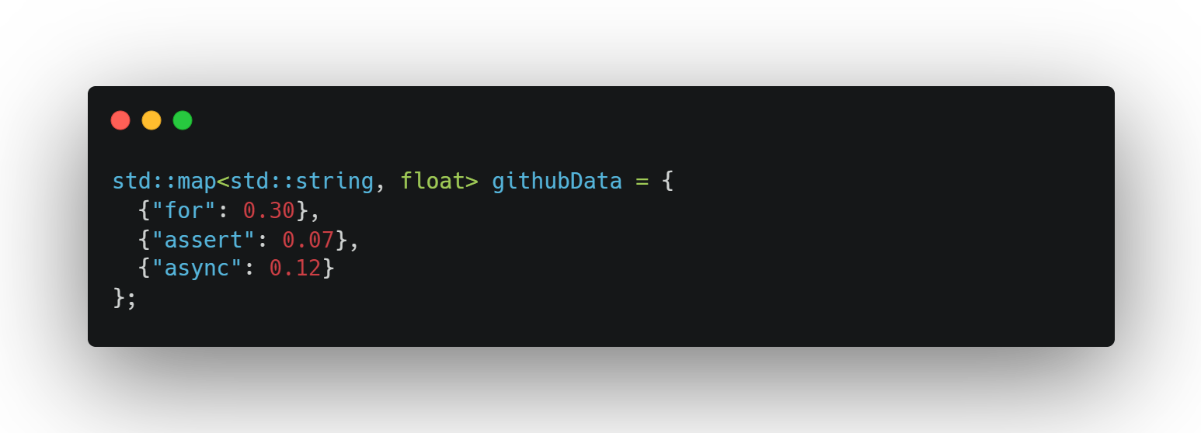
Probabilistic deterministic finite automata
Σ
Statistical analysis of open source code
Dynamically generated
Probabilistic transitions

Slide 11

Dataset to PDFA
JSON to PDFA

Slide 12
Minimization of PDFA
Delete all branches with a probability less than a predetermined threshold.
ε, 1
ε, 1
ε, 1

