Slide 1
CS433 Parallel and Distributed Computing
Lecture 4 OpenMP, Cont’d
Prof. Xiaoyao Liang
2020/9/28

Slide 2
Data Distribution
Data distribution describes how global data is partitioned across processors.
This data partitioning is implicit in OpenMP and may not match loop iteration scheduling.
Compiler will try to do the right thing with static scheduling specifications.

Slide 3
Data Locality
Consider a 1-Dimensional array to solve the global sum problem, 16 elements, 4 threads
CYCLIC (chunk = 1):
BLOCK (chunk = 4):
3
6
7
5
3
5
6
2
9
1
2
7
0
9
3
6
3
6
7
5
3
5
6
2
9
1
2
7
0
9
3
6

Slide 4
Data Locality
Consider how data is accessed
Temporal locality
Same or nearby data used multiple times
Intrinsic in computation
Spacial locality
Data nearby to be used and is present in “fast memory”
Same data transfer (same cache line, same DRAM transaction)
What can we do to get locality
Appropriate data placement and layout
Code reordering transformations

Slide 5
Message Passing
Suppose we have several “producer” threads and several “consumer” threads.
Producer threads might “produce” requests for data.
Consumer threads might “consume” the request by finding or generating the requested data.
Each thread could have a shared message queue, and when one thread wants to “send a message” to another thread, it could enqueue the message in the destination thread’s queue.
A thread could receive a message by dequeuing the message at the head of its message queue.

Slide 6

Barrier
One or more threads may finish allocating their queues before some other threads.
We need an explicit barrier so that when a thread encounters the barrier, it blocks until all the threads in the team have reached the barrier.
After all the threads have reached the barrier all the threads in the team can proceed.

Slide 7
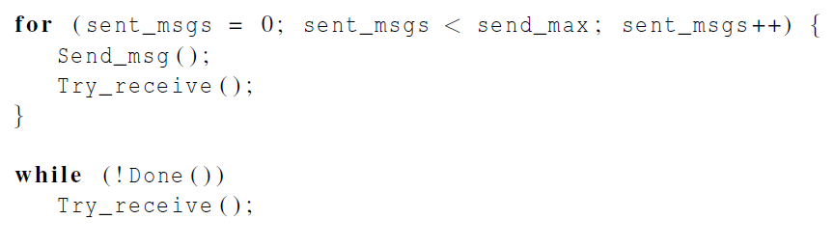
Synchronization

Slide 8
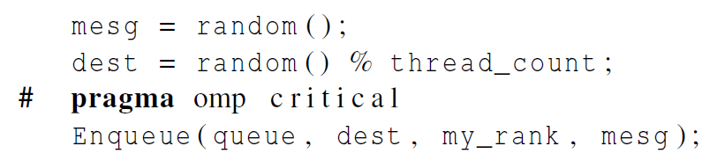
Synchronization
Use synchronization mechanisms to update FIFO
What is the implementation of Enqueue?

Slide 9
Synchronization
if (queue_size==0) return;
else
# pragma omp critical
Dequeue (queue, &src, &mesg);
Print_message (src, mesg);
This thread is the only one to dequeue its messages. Other threads may only add more messages. Messages added to end and removed from front. Depending on the data structure implementation, synchronization may be needed.

Slide 10
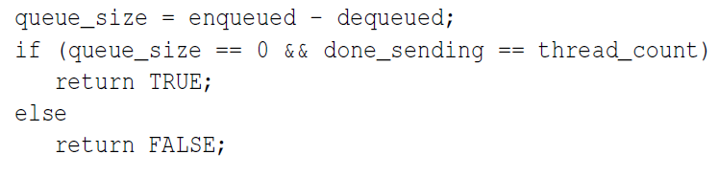
Synchronization
each thread increments this after completing its for loop
More synchronization needed on “done_sending”

Slide 11

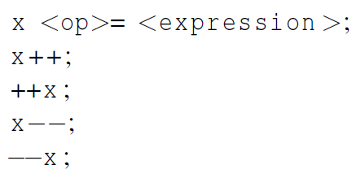
Atomic
“done_sending”is critical
Unlike the critical directive, it can only protect critical sections that consist of a single C assignment statement.
Further, the statement must have one of the following forms:
What is the difference with reduction?

Slide 12
Atomic
Here <op> can be one of the binary operators
Many processors provide a special load-modify-store instruction.
A critical section that only does a load-modify-store can be protected much more efficiently by using this special instruction rather than the constructs that are used to protect more general critical sections.

Slide 13

Named Critical Sections
Three critical sections:
done_sending
Enqueue
Dequeue
Need to differential critical sections
Using atomic and critical sections
Using Named critical sections

Slide 14

Locks
How to differential in one critical section? (enqueue1, enqueue2… )
A lock consists of a data structure and functions that allow the programmer to explicitly enforce mutual exclusion in a critical section.

Slide 15
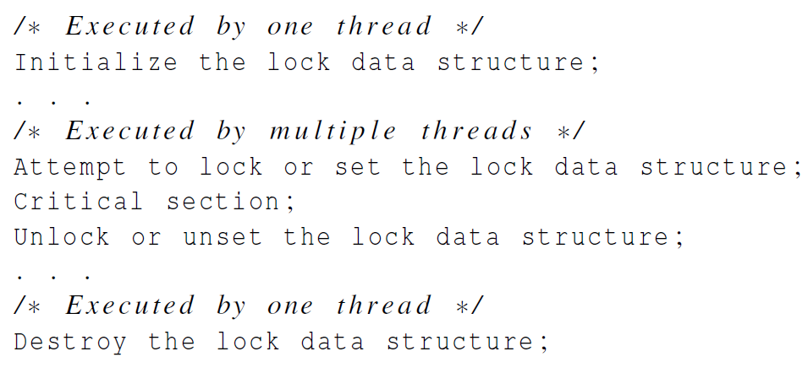
Locks

Slide 16
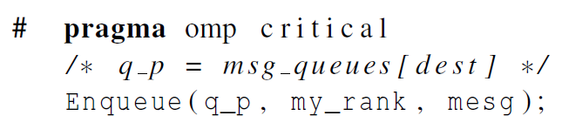
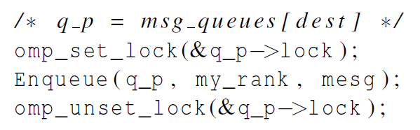
Locks

Slide 17
Summary of Mutual Exclusion
“critical”
Blocks of code
Easy to use
Limited named critical section (naming at compiler time)
“atomic”
Single expression
Faster speed
Variable name differentiate different critical sections
“lock”
Locks for data structures
Flexible to use
Dynamically updated

Slide 18
Caveat
You shouldn’t mix the different types of mutual exclusion for a single critical section.
There is no guarantee of fairness in mutual exclusion constructs.

Slide 19
Caveat
It can be dangerous to “nest” mutual exclusion constructs.
#pragma omp critical
y=f(x)
…
double f(double x) {
pragma omp critical
z=g(x); /* z is shared */
}
Dead Lock!

Slide 20
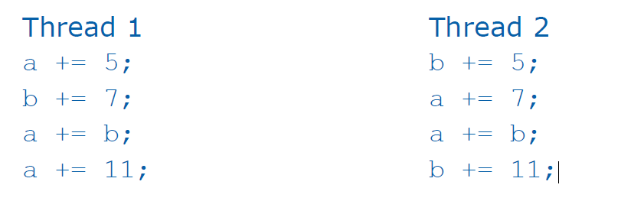
Deadlock

Slide 21
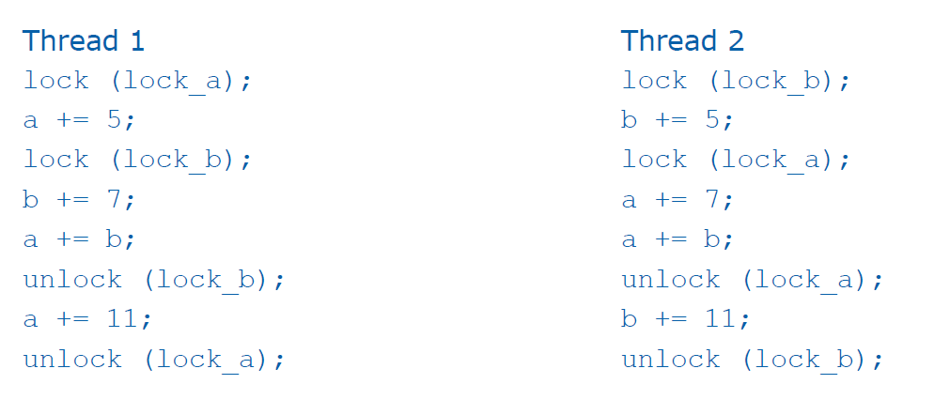
Deadlock
An implementation that can cause deadlock
Deadlock!

Slide 22
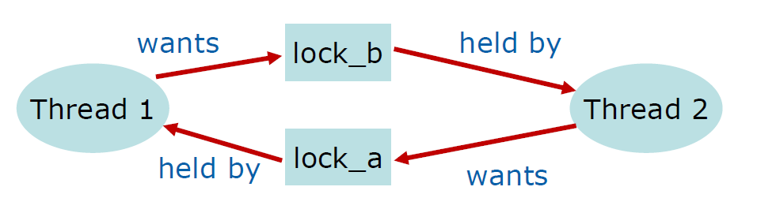
Deadlock
A graph of deadlock contains a cycle

Slide 23
Deadlock
A program exhibits a global deadlock if every thread is blocked
A program exhibits local deadlock if only some of the threads in the program are blocked
A deadlock is another example of a nondeterministic behavior exhibited by a parallel program
Change timing can change deadlock occurring

Slide 24
Deadlock
Mutually exclusive access to a resource
Threads hold onto resources they have while they wait for additional resources
Resources cannot be taken away from threads
Cycle in resource allocation graph

Slide 25
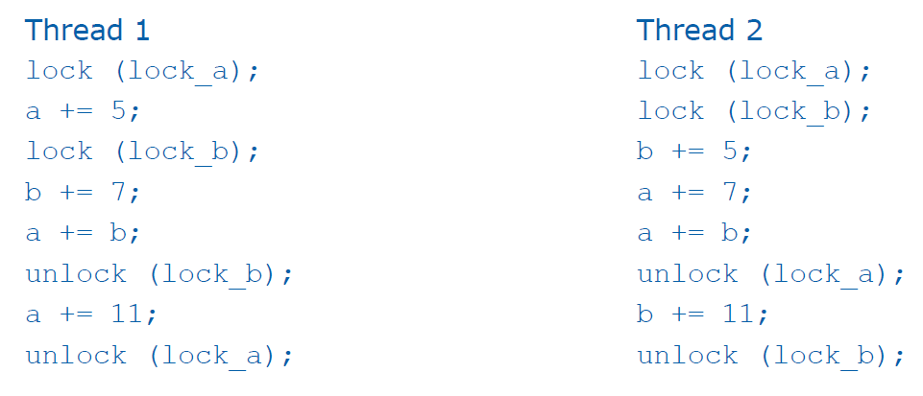
Deadlock
Enforce order for locks to eliminate deadlock

Slide 26
Deadlock
Every call to function lock should be matched with a call to unlock, representing the start and the end of the critical section
A program may be syntactically correct (i.e., may compile) without having matching calls
A thread that never releases a shared resource creates a deadlock

Slide 27
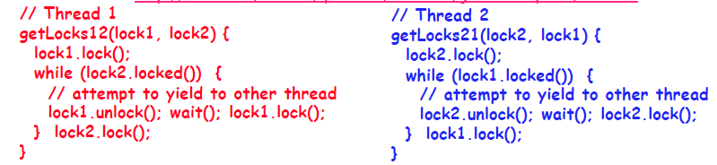
Livelock
Introduce randomness in wait() can eliminate livelock

Slide 28
Recovery From Deadlock
So, the deadlock has occurred. Now, how do we get the resources back and gain forward progress?
PROCESS TERMINATION:
Could delete all the processes in the deadlock -- this is expensive.
Delete one at a time until deadlock is broken ( time consuming ).
Select who to terminate based on priority, time executed, time to completion, needs for completion, or depth of rollback
In general, it's easier to preempt the resource, than to terminate the process.
RESOURCE PREEMPTION:
Select a victim - which process and which resource to preempt.
Rollback to previously defined "safe" state.
Prevent one process from always being the one preempted ( starvation ).

Slide 29
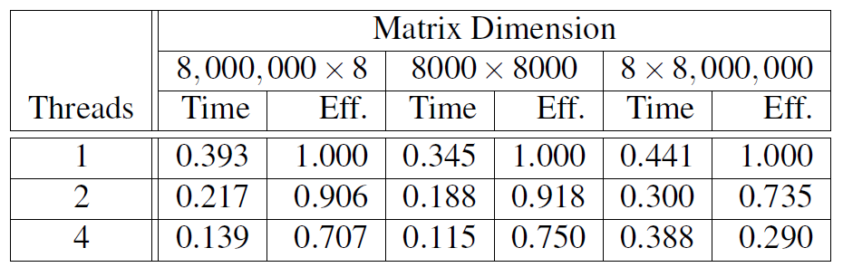
False Sharing
#pragma omp parallel for shared(Nthreads,a) schedule(static,1)
for(i=0;i<Nthreads;i++)
a[i]+=i;
Each thread updates 1 element of the same cache line, causing false sharing
Use private data whenever possible
Reorganize data layout to eliminate false sharing

