Slide 1
CS433 Parallel and Distributed Computing
Lecture 6 CUDA
Prof. Xiaoyao Liang
2020/10/10

Slide 2
CUDA
“Compute Unified Device Architecture”
General purpose programming model
User kicks off batches of threads on the GPU
Targeted software stack
Compute oriented drivers, language, and tools
Driver for loading computation programs into GPU
Standalone Driver -Optimized for computation
Interface designed for compute –graphics-free API
Data sharing with OpenGL buffer objects
Guaranteed maximum download & readback speeds
Explicit GPU memory management

Slide 3
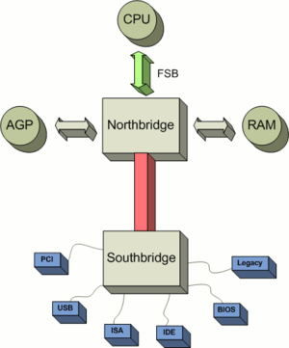
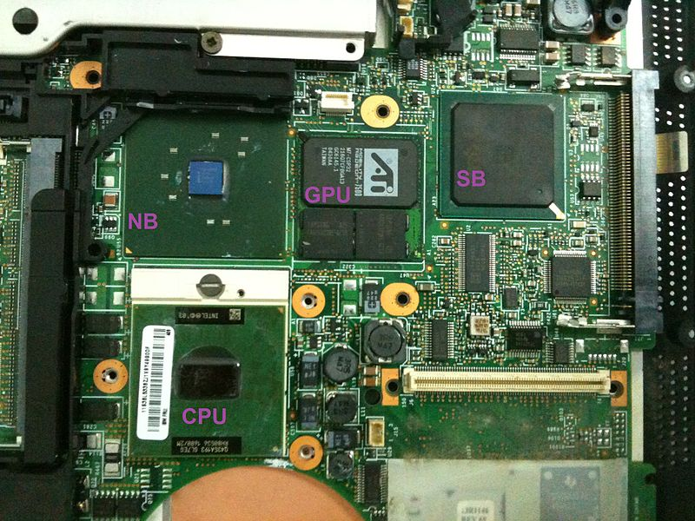
GPU Location

Slide 4
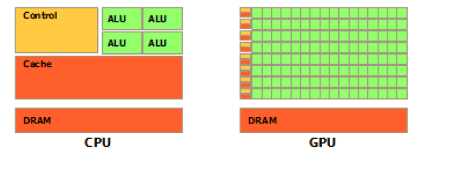
GPU Vs. CPU

Slide 5
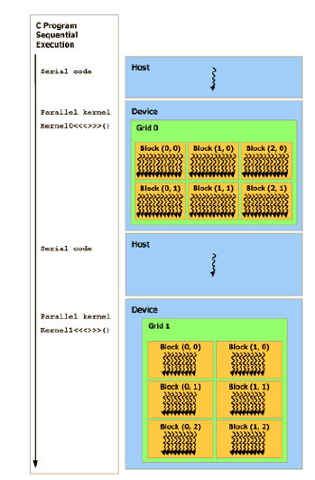
CUDA Execution Model

Slide 6
CUDA Device and Threads
A compute device
Is a coprocessor to the CPU or host
Has its own DRAM (device memory)
Runs many threads in parallel
Is typically a GPU but can also be another type of parallel processing device
Data-parallel portions of an application are expressed as device kernels which run on many threads
Differences between GPU and CPU threads
GPU threads are extremely light weight
Very little creation overhead
GPU needs 1000s of threads for full efficiency
Multi-core CPU needs only a few

Slide 7
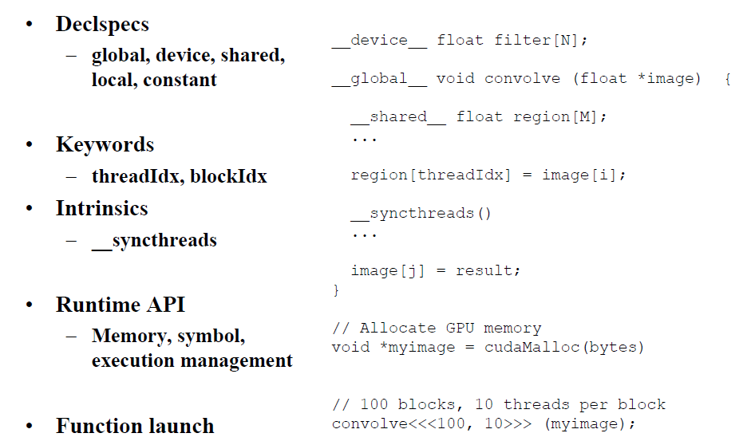
C Extension

Slide 8
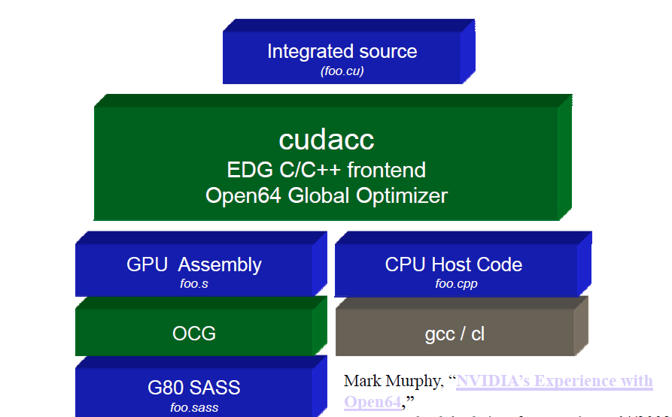
Compilation Flow

Slide 9
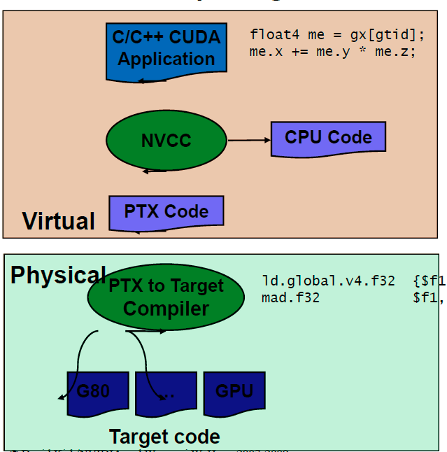
Compilation Flow

Slide 10
Loop Transformation
We will study a few loop transformations that reorder memory accesses to improve locality.
Two key questions:
Safety: Does the transformation preserve dependences?
Profitability: Is the transformation likely to be profitable? Will the gain be greater than the overheads (if any) associated with the transformation?

Slide 11
Permutation
Permute the order of the loops to modify the traversal order
for (i= 0; i<3; i++)
for (j=0; j<6; j++)
A[i][j]=A[i][j]+B[j];
for (j=0; j<6; j++)
for (i= 0; i<3; i++)
A[i][j]=A[i][j]+B[j];
i
i
new traversal order!
j
j
NOTE: C multi-dimensional arrays are stored in row-major order, Fortran in column major

Slide 12
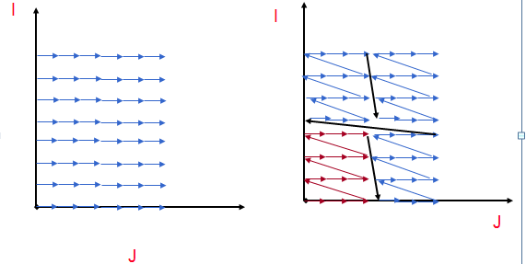
Tiling
Tiling reorders loop iterations to bring iterations that reuse data closer in time
Goal is to retain in cache/register/scratchpad (or other constrained memory structure) between reuse

Slide 13
Tiling
Tiling is very commonly used to manage limited storage
Registers
Caches
Software-managed buffers
Small main memory
Can be applied hierarchically
Also used in context of managing granularity of parallelism

Slide 14
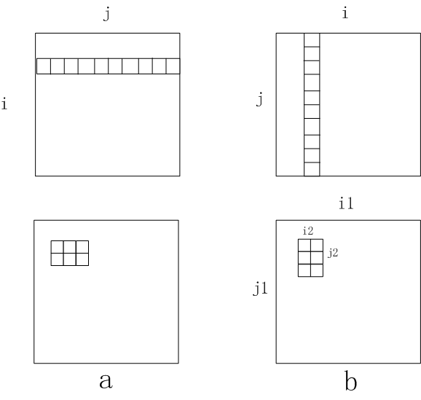
Tiling

Slide 15
Tiling
for (j=1; j<M; j++)
for (i=1; i<N; i++)
D[i] = D[i] +B[j,i]
Strip
mine
for (j=1; j<M; j++)
for (ii=1; ii<N; ii+=s)
for (i=ii; i<min(ii+s-1,N); i++)
D[i] = D[i] +B[j,i]
for (ii=1; ii<N; ii+=s)
for (j=1; j<M; j++)
for (i=ii; i<min(ii+s-1,N); i++)
D[i] = D[i] +B[j,i]
Permute

Slide 16
Blocking
for (i=0; j<n; j++)
for (j=0; i<m; j++)
b[i][j] = a[j,i]
for (j1=0; j1<n; j1+=nbj)
for (i1=0; i1<n; i1+=nbi)
for (j2=0; j2<min(n-j1,nbj); j2++)
for (i2=0; i2<min(n-i1,nbi); i2++)
b[i1+i2][j1+j2] = a[j1+j2][i1+i2]
Increased cache hit rate and TLB hit rate

Slide 17
Unroll and Jam
Unroll simply replicates the statements in a loop, with the number of copies called the unroll factor
As long as the copies don’t go past the iterations in the original loop, it is always safe
Unroll-and-jam involves unrolling an outer loop and fusing together the copies of the inner loop (not always safe)
One of the most effective optimizations there is, but there is a danger in unrolling too much
Original:
for (i=0; i<4; i++)
for (j=0; j<8; j++)
A[i][j] = B[j+1][i];
Unroll j
for (i=0; i<4; i++)
for (j=0; j<8; j+=2)
A[i][j] = B[j+1][i];
A[i][j+1] = B[j+2][i];
Unroll-and-jam i
for (i= 0; i<4; i+=2)
for (j=0; j<8; j++)
A[i][j] = B[j+1][i];
A[i+1][j] = B[j+1][i+1];

Slide 18
Unroll and Jam
Original:
for (i=0; i<4; i++)
for (j=0; j<8; j++)
A[i][j] = B[j+1][i] + B[j+1][i+1];
Unroll-and-jam i and j loops
for (i=0; i<4; i+=2)
for (j=0; j<8; j+=2) {
A[i][j] = B[j+1][i] + B[j+1][i+1];
A[i+1][j] = B[j+1][i+1] + B[j+1][i+2];
A[i][j+1] = B[j+2][i] + B[j+2][i+1];
A[i+1][j+1] B[j+2][i+1] + B[j+2][i+2];
}
Temporal reuse of B in registers
Less loop control

Slide 19
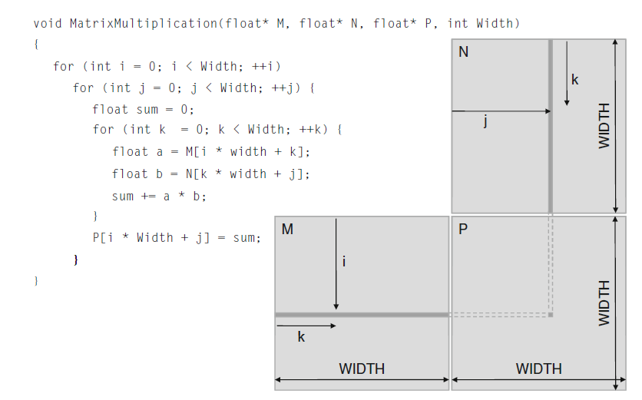
Matrix Multiplication
1000X1000=1,000,000 independent dot product
1000 multiply+1000 accumulate per dot

Slide 20
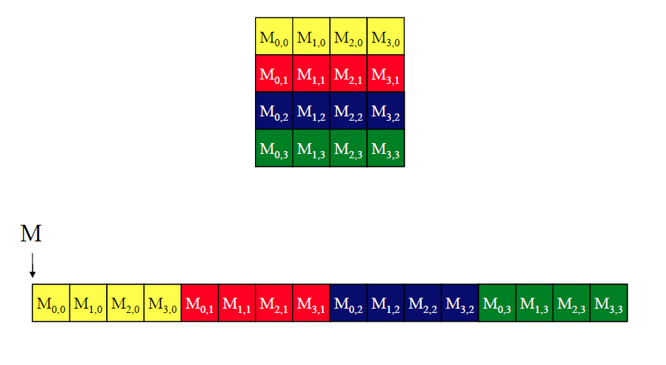
Matrix Layout

Slide 21
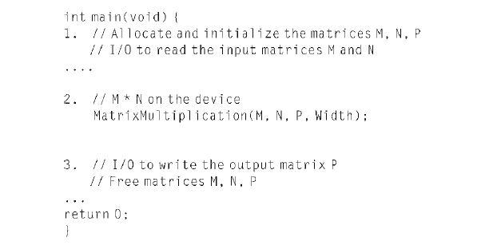
Matrix Main Program

Slide 22
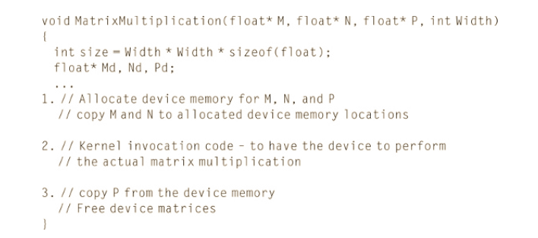
Kernel Program

Slide 23
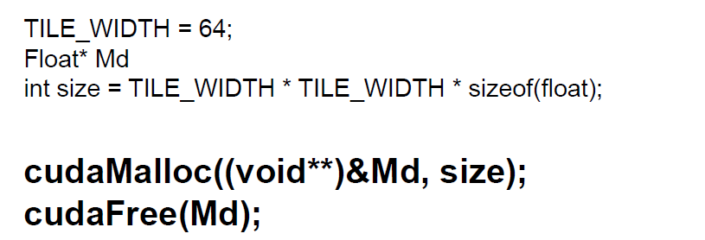
Creating CUDA Memory Space

Slide 24
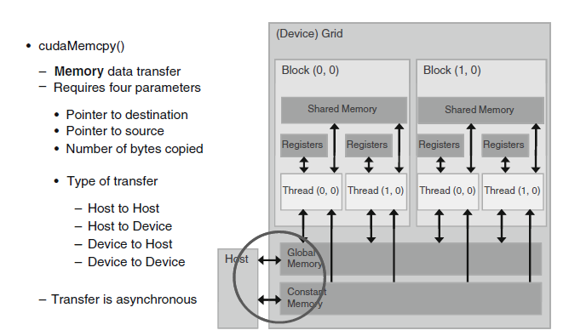
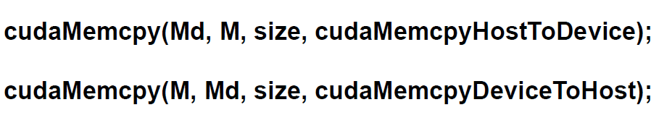
Memory Copy

Slide 25
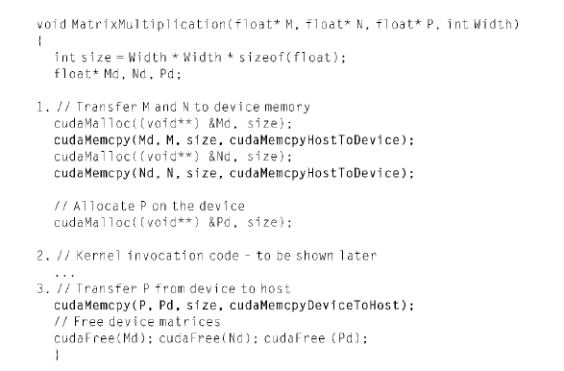
Kernel Program

Slide 26
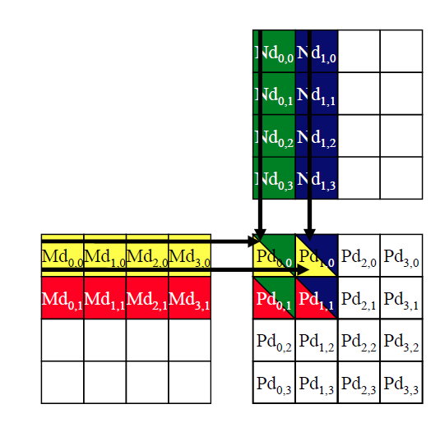
Calculating a Dot

Slide 27
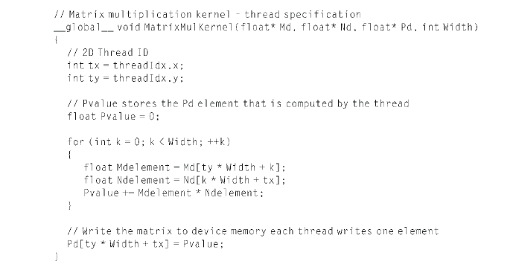
Kernel Program

Slide 28
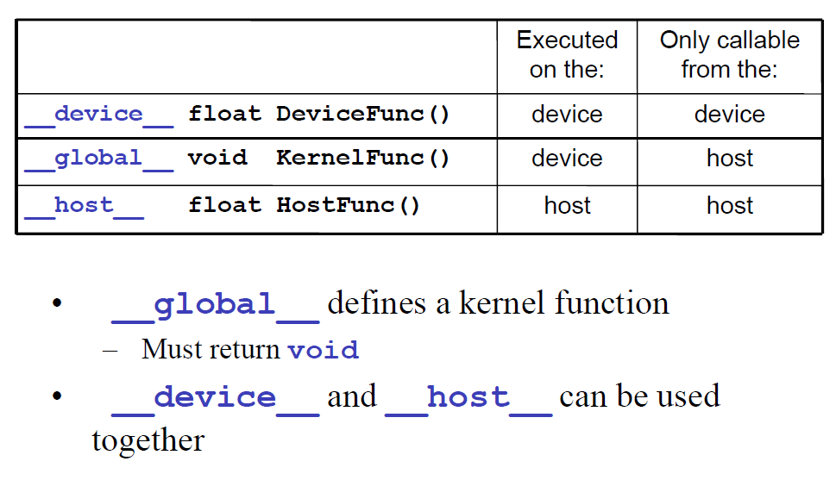
Function Declarations

Slide 29
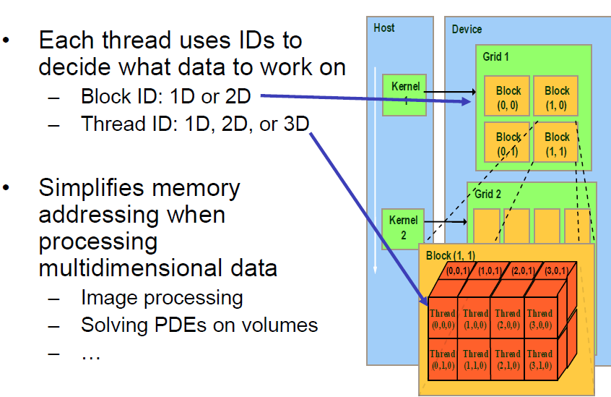
Thread Blocks

Slide 30
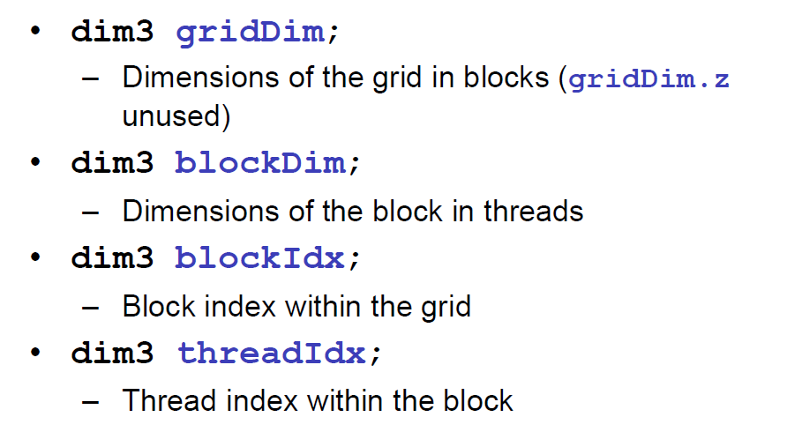
Building Variables

Slide 31
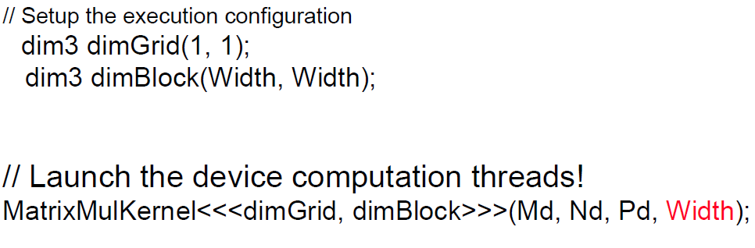
Kernel Invocation

Slide 32
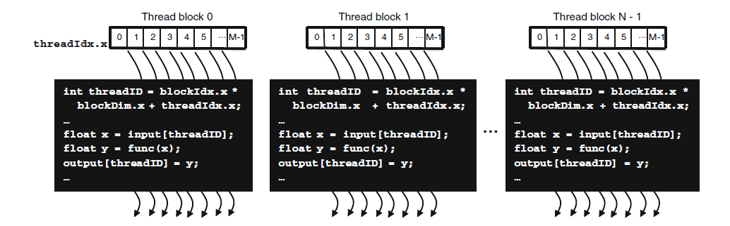

Thread Blocks

Slide 33
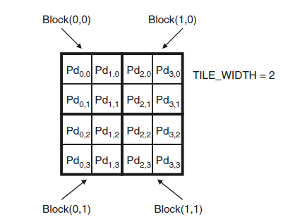
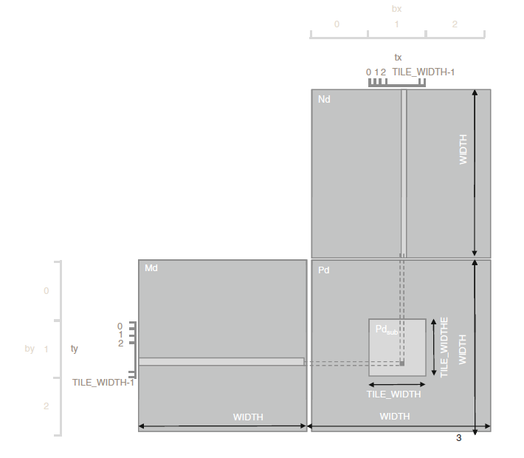
Matrix Program

Slide 34
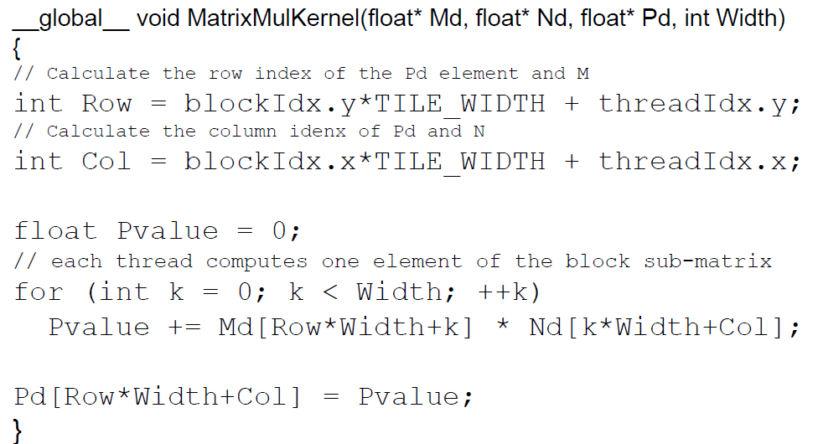
Kernel Program

Slide 35
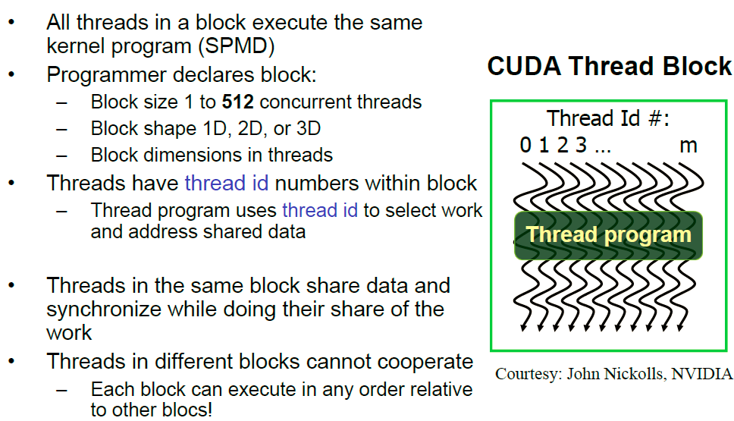
Characteristics of Thread Blocks

Slide 36
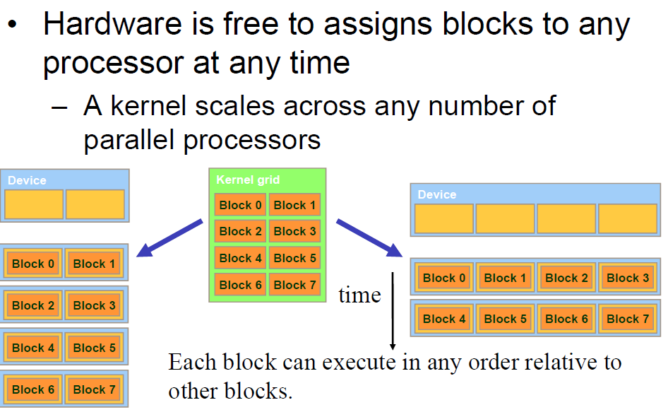
Transparency

Slide 37
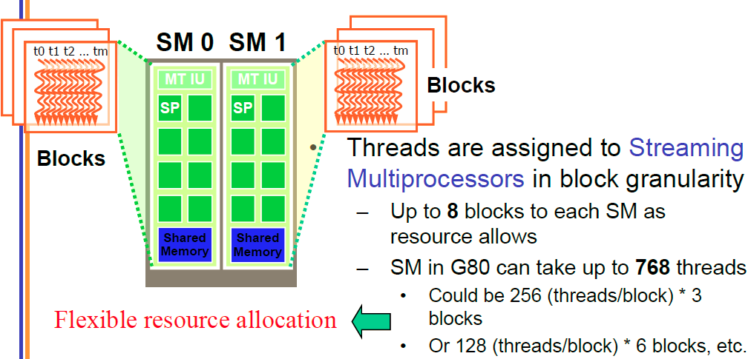
Threads Assignment

Slide 38
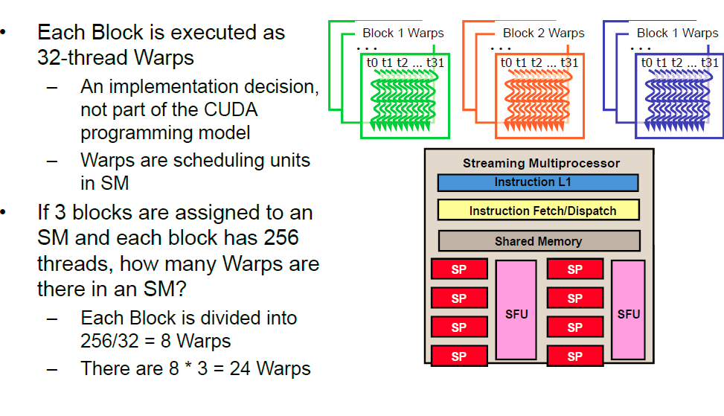
Threads Scheduling

Slide 39
Threads Allocation
For Matrix Multiplication using multiple blocks, should I use 8X8, 16X16 or 32X32 blocks?
For 8X8, we have 64 threads per Block. Since each SM can take up to 768 threads, there are 12 Blocks. However, each SM can only take up to 8 Blocks, only 512 threads will go into each SM!
For 16X16, we have 256 threads per Block. Since each SM can take up to 768 threads, it can take up to 3 Blocks and achieve full capacity unless other resource considerations overrule.
For 32X32, we have 1024 threads per Block. Not even one can fit into an SM!

Slide 40
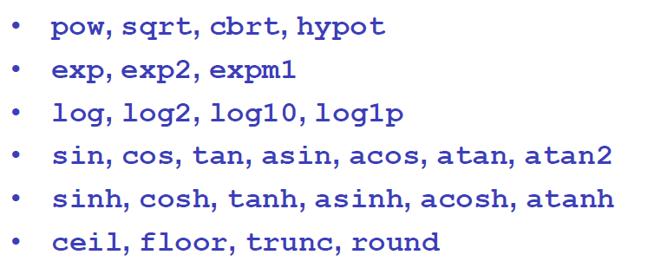
Special Functions

Slide 41
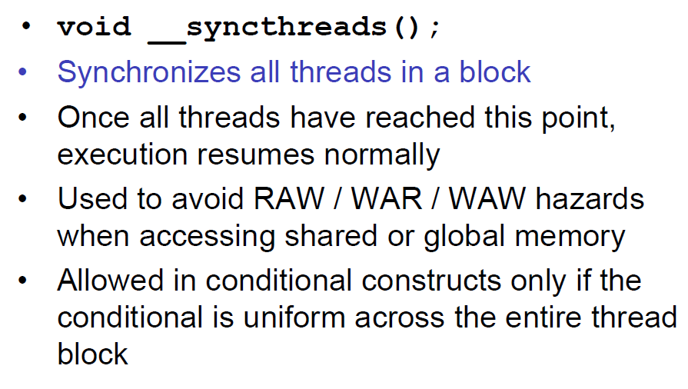
Synchronization

Slide 42
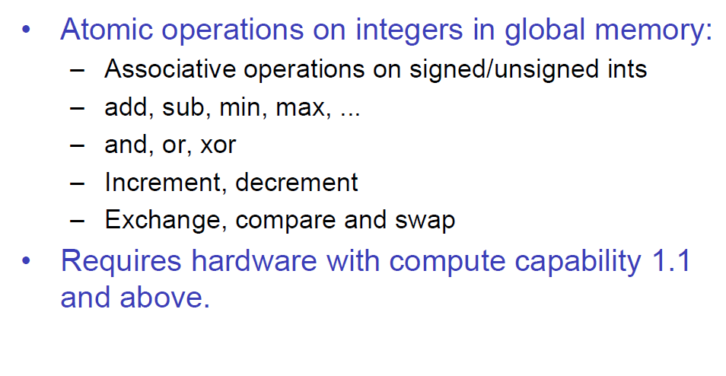
Synchronization

Slide 43
Memory Constraints
Compute to Global Memory Access Ratio (CGMA)
Two global memory access required for one multiplication
and one addition
CGMA=1
G80 Memory Bandwidth
86.4 GB/s memory bandwidth
4B per float type
86.4/4=21.6Gflops/s compute operations
G80 Compute Capability
367Gflops/s
21.6/367=5.8% potential is used

Slide 44
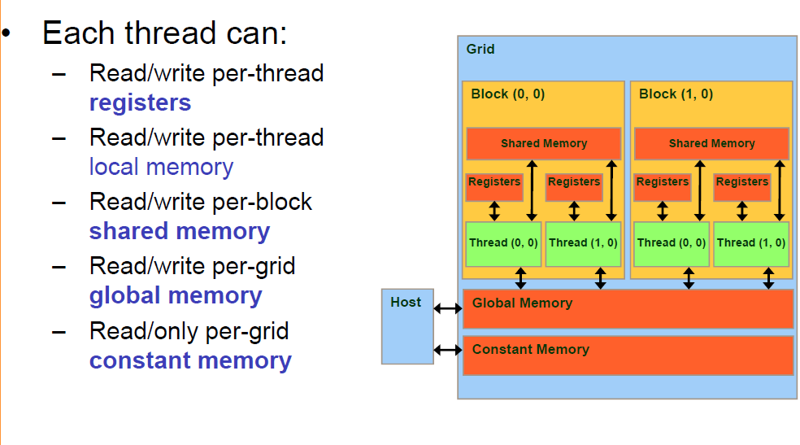
Memory Types

Slide 45
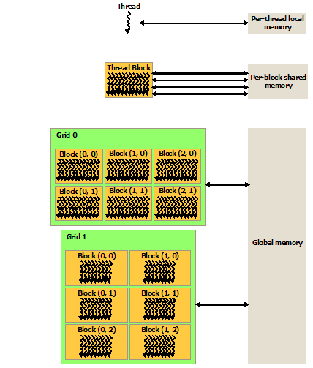
Memory Types

Slide 46
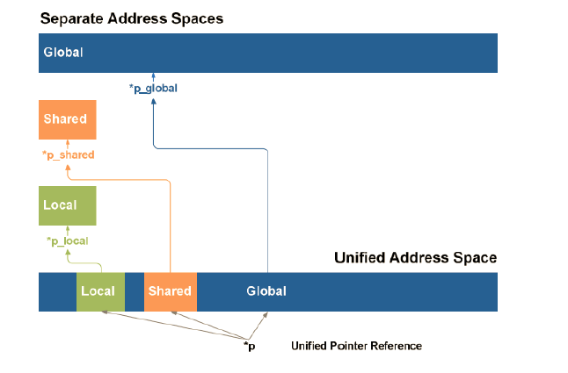
Unified Memory Space

Slide 47
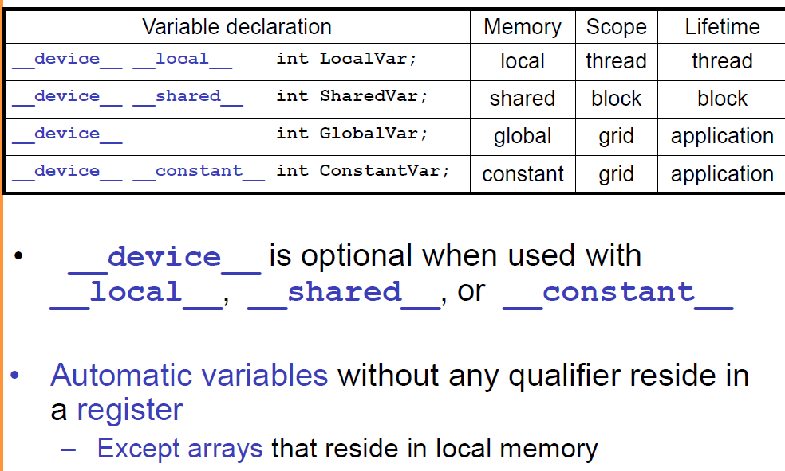
Memory Declaration

Slide 48
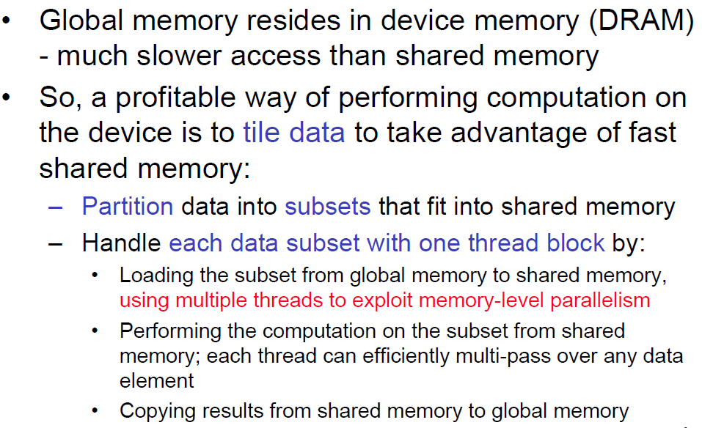
Memory Strategy

Slide 49
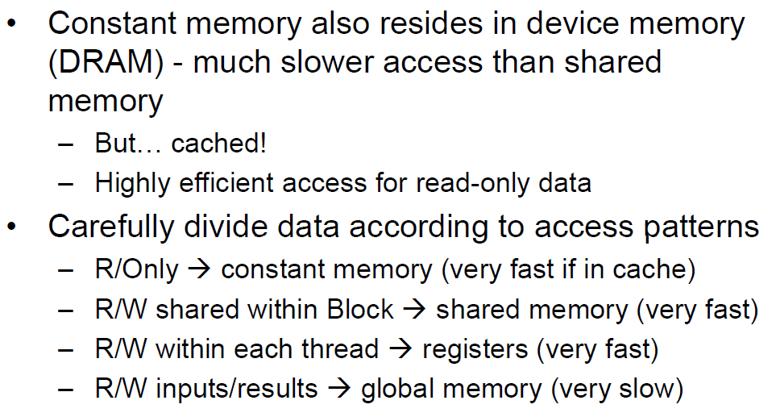
Memory Strategy

Slide 50

Shared Data in Matrix

Slide 51
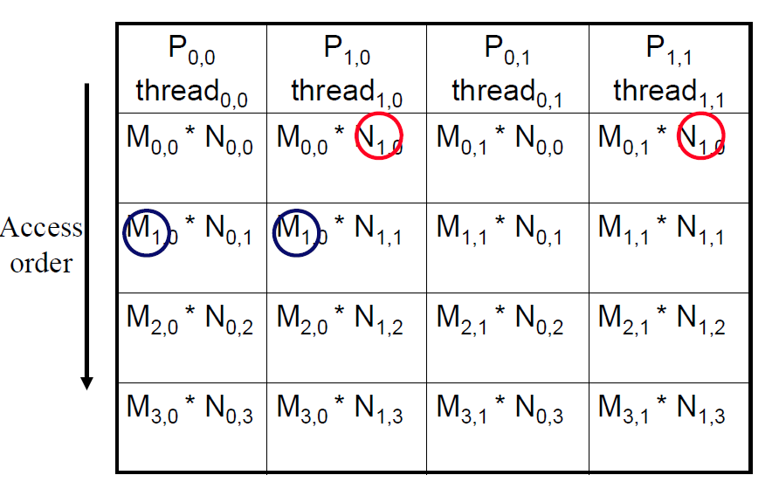
Shared Data in Matrix
Every Md and Nd Element is used twice in a 2x2 tile
Load the data into shared memory and saved for the later use
Save 15 global memory access in a 16x16 tile

Slide 52
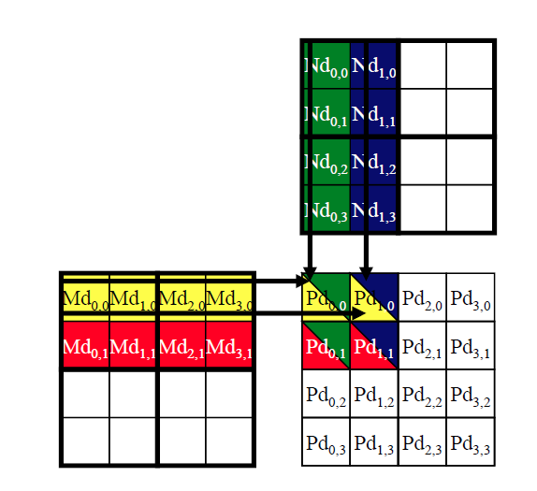
Matrix Tiling

Slide 53
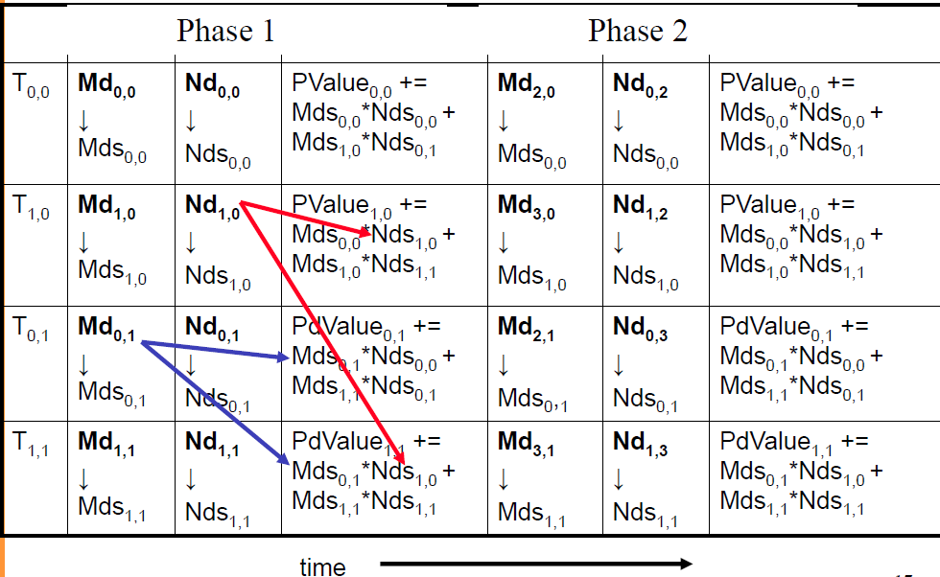
Matrix Tiling

Slide 54
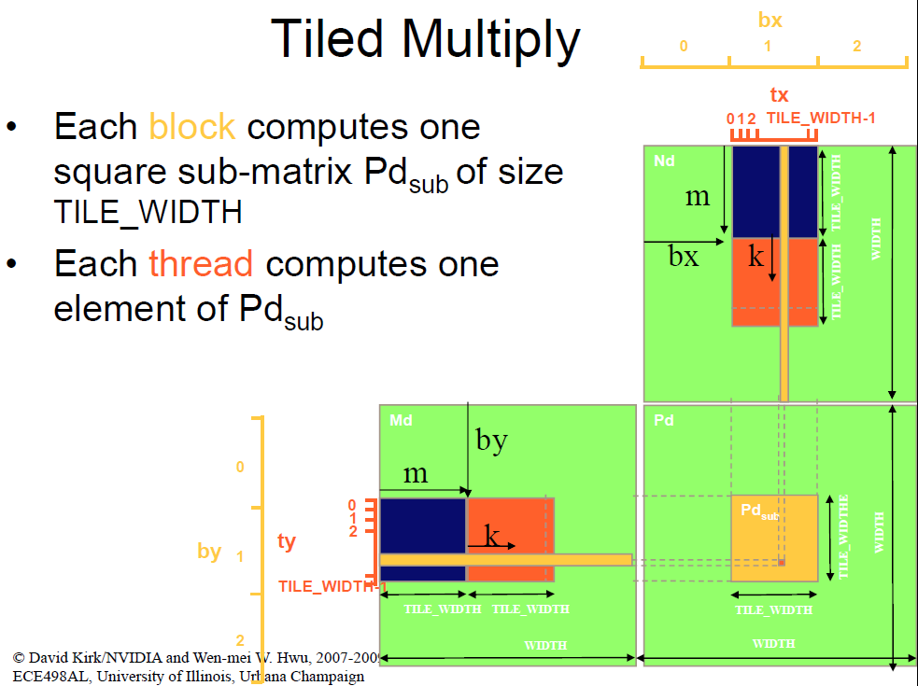
Tiled Multiply

Slide 55
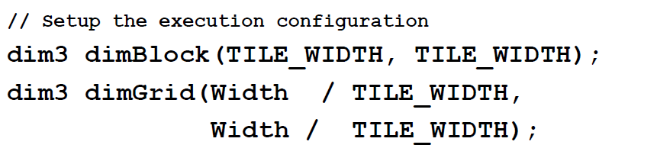
Tiling Code

Slide 56
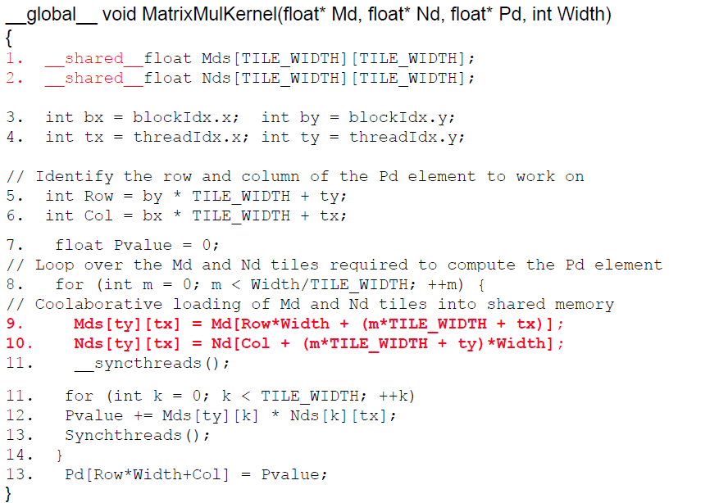
Tiling Code

Slide 57
Tiling Impact
G80 without tiling
367Gflops/s
21.6/367=5.8% potential is used
G80 with 16x16 tiling
G80 has 16KB shard memory
16*16*2*4=2KB shared memory for each block, can accommodate 8 blocks
21.6*15=324Gflops/s
324/367=88% potential is used
However G80 only support 768 threads per SM
16*16=256 threads, 768/256=3 blocks
Only 6KB shared memory is used
Fermi can support 1536 threads per SM

Slide 58
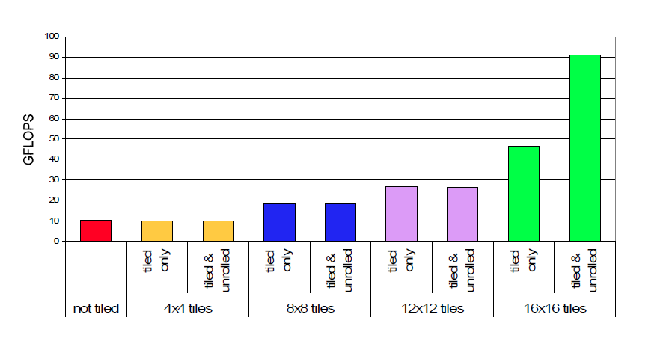
Performance

