Slide 1
CS433 Parallel and Distributed Computing
Lecture 2 Basic Architecture
Prof. Xiaoyao Liang
2020/9/14

Slide 2



Basic Computer Model
programs
input
Computer runs one
program at a time.
output

Slide 3
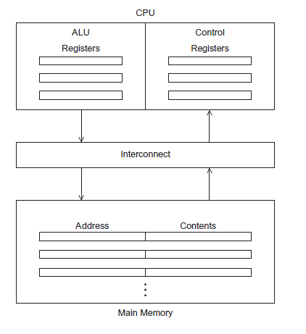
The Von Neumann Machine

Slide 4
Main Components
Main memory
  This is a collection of locations, each of which is capable of storing both instructions and data.
  Every location consists of an address, which is used to access the location, and the contents of the location.
CPU
  Control unit - responsible for deciding which instruction in a program should be executed.
  ALU - responsible for executing the actual instructions.
  Register – very fast storage, part of the CPU.
  Program counter – stores address of the next instruction to be executed.
Bus
  Wires and hardware that connects the CPU and memory.
Cache
  Fill the gap between CPU and main memory

Slide 5
Pipeline
Dave Patterson’s Laundry example: 4 people doing laundry
wash (30 min) + dry (40 min) + fold (20 min) = 90 min Latency
6 PM
7
8
9
In this example:
  Sequential execution takes 4 * 90min = 6 hours
  Pipelined execution takes 30+4*40+20 = 3.5 hours
Bandwidth = loads/hour
BW = 4/6 l/h w/o pipelining
BW = 4/3.5 l/h w pipelining
BW <= 1.5 l/h w pipelining, more total loads
Pipelining helps bandwidth but not latency (90 min)
Potential speedup = Number pipe stages
Time
T
a
s
k
O
r
d
e
r
30
40
40
40
40
20
A
B
C
D

Slide 6
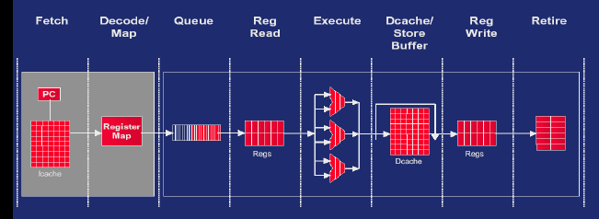
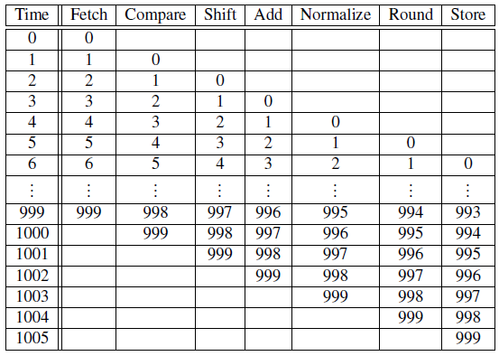

Pipeline

Slide 7
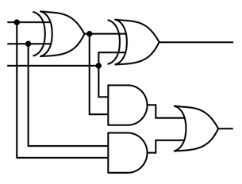
Multiple Issue
Multiple issue processors replicate functional units and try to simultaneously execute different instructions in a program.
for (i = 0; i < 1000; i++)
z[i] = x[i] + y[i];
z[3]
z[4]
z[1]
z[2]
adder #1
adder #2

Slide 8
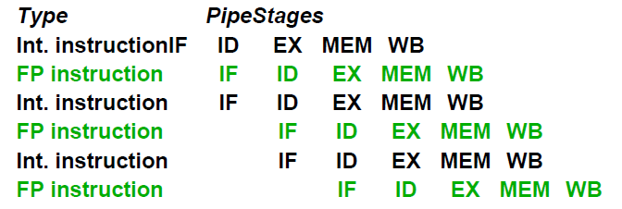

Multiple Issue
Static multiple issue
  functional units are scheduled at compile time.
Dynamic multiple issue
  functional units are scheduled at run-time.
  Allow instruction behind stalls to proceed
  Enable out-of-order execution and out-of-order completion
  Tomasulo algorithm
.

Slide 9



Register Renaming
Multiple issue challenge
  WAR, WAW harzard
  Limited register resource
  Register renaming

Slide 10
Loop Unrolling
for (i = 1 to bignumber)
A(i)
B(i)
C(i)
end
After Unrolling:
for (i = 1 to bignumber/3)
A(i)
A(i+1)
A(i+2)
B(i)
B(i+1)
B(i+2)
C(i)
C(i+1)
C(i+2)
end
  Without Unrolling: A(1) X X B(1) X X C(1) X X ...
  With Unrolling: A(1) A(2) A(3) B(1) B(2) B(3) C(1) C(2) C(3) ...

Slide 11
Software Pipelining
for (i = 1 to bignumber)
A(i) ; 3
B(i) ; 3
C(i) ; 12(perhaps a floating point operation)
D(i) ; 3
E(i) ; 3
F(i) ; 3
End
Software Pipelining:
for i = (1 to bignumber - 6)
A(i+6)
B(i+5)
C(i+4)
D(i+2)
E(i+1)
F(i)
end
Iteration 1: A(7) B(6) C(5) D(3) E(2) F(1)
Iteration 2: A(8) B(7) C(6) D(4) E(3) F(2)
Iteration 3: A(9) B(8) C(7) D(5) E(4) F(3)
Iteration 4: A(10) B(9) C(8) D(6) E(5) F(4)
Iteration 5: A(11) B(10) C(9) D(7) E(6) F(5)
Iteration 6: A(12) B(11) C(10) D(8) E(7) F(6)
Iteration 7: A(13) B(12) C(11) D(9) E(8) F(7)

Slide 12
Speculation
for (i = 0; i < 1000; i++)
z[i] = x[i] + y[i];
In speculation, the compiler or the processor makes a guess about an instruction, and then executes the instruction on the basis of the guess
Always speculate the branch is taken, 1/1000 error rate!

Slide 13
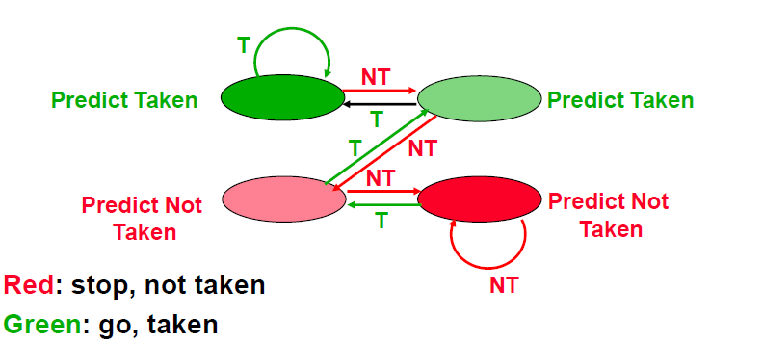
Speculation
for (i = 0; i < 1000; i++)
z[i] = x[i] + y[i];

Slide 14
Vector Processing
Scalar processing
  traditional mode
  one operation produces
  one result
SIMD processing
  with SSE / SSE2
  one operation produces
  multiple results
X
X
x3
x2
x1
x0
+
+
Y
Y
y3
y2
y1
y0
X + Y
X + Y
x3+y3
x2+y2
x1+y1
x0+y0
Slide Source: Alex Klimovitski & Dean Macri, Intel Corporation

Slide 15
Vector Processing
Intel SSE2 data types: anything that fits into 16 bytes
Instructions perform add, multiply etc. on all the data in this 16-byte register in parallel
Challenges:
  Need to be contiguous in memory and aligned
  Some instructions to move data around from one part of register to another
4x floats
2x doubles
16x bytes
Year

Slide 16
Vector Processing
Vector Register
  Fixed length bank holding a single vector has at least 2 read and 1 write ports typically 8-32 vector registers, each holding 64-128 64-bit elements
Vector Functional Units (FUs)
  Fully pipelined, start new operation every clock typically 4 to 8 FUs: FP add, FP mult, FP reciprocal (1/X), integer add, logical, shift; may have multiple of same unit
Vector Load-Store Units (LSUs)
  fully pipelined unit to load or store a vector; may have multiple LSUs
Scalar registers
  Single element for FP scalar or address
Cross-bar to connect FUs , LSUs, registers

Slide 17
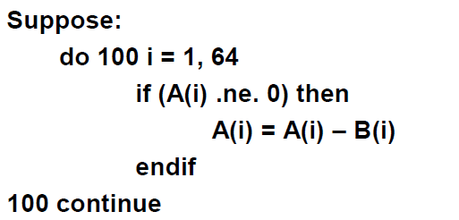
Vector Processing
Vector-mask control takes a Boolean vector
  when vector-mask registeris loaded from vector test, vector instructions operate only on vector elements whose corresponding entries in the vector-mask register are 1.
  Still requires clock even if result not stored
Year

Slide 18
Vector Processing
Easy to get high performance
  N operations:
  are independent
  use same functional unit
  access disjoint registers
  access registers in same order as previous instructions
  access contiguous memory words or known pattern
  can exploit large memory bandwidth
  hide memory latency (and any other latency)
Scalable
  get higher performance as more HW resources available
Compact
  Describe N operations with 1 short instruction (v. VLIW)
Predictable
  (real-time) performance vs. statistical performance (cache)
Multimedia ready
  choose N * 64b, 2N * 32b, 4N * 16b, 8N * 8b

Slide 19
Multithreading
Hardware multithreading provides a means for systems to continue doing useful work when the task being currently executed has stalled.
  Ex., the current task has to wait for data to be loaded from memory.
Coarse-grained - only switches threads that are stalled waiting for a time-consuming operation to complete.
  Pros: switching threads doesn’t need to be nearly instantaneous.
  Cons: the processor can be idled on shorter stalls, and thread switching will also cause delays.
Fine-grained - the processor switches between threads after each instruction, skipping threads that are stalled.
  Pros: potential to avoid wasted machine time due to stalls.
  Cons: a thread that’s ready to execute a long sequence of instructions may have to wait to execute every instruction.

Slide 20
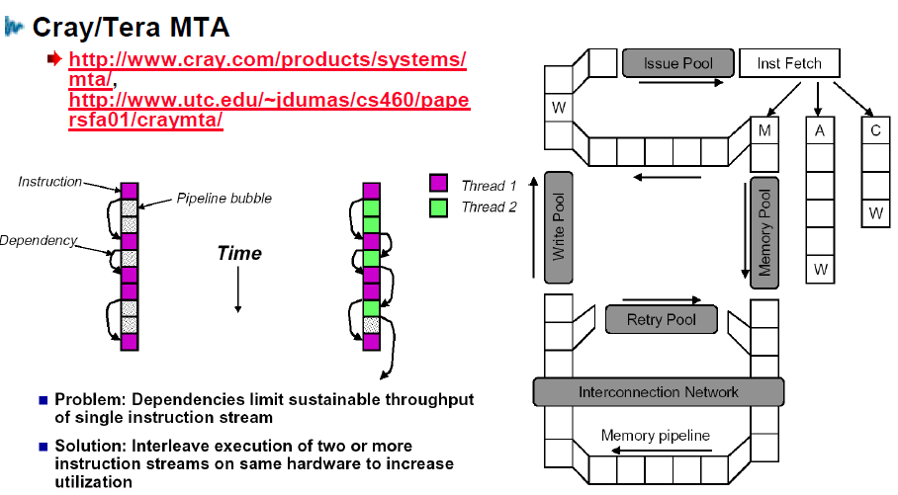
Multithreading
Simultaneous Multithreading (SMT)

Slide 21
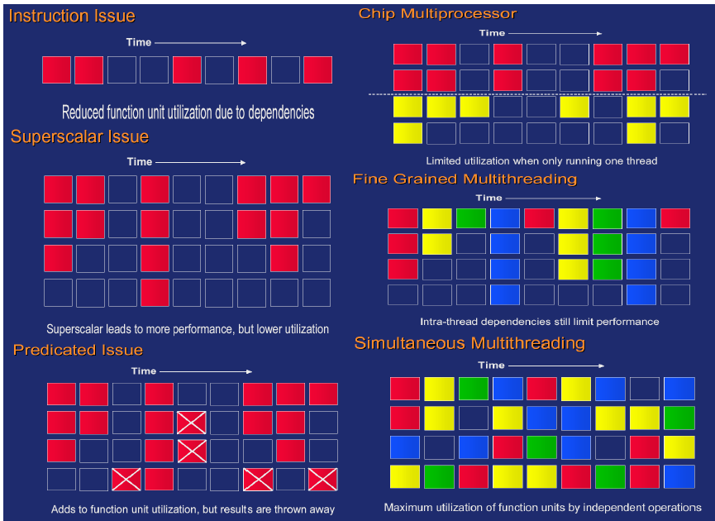
Parallel Processors

Slide 22
Memory Hierarchy
Most programs have a high degree of locality in their accesses
  spatial locality: accessing things nearby previous accesses
  temporal locality: reusing an item that was previously accessed
Memory hierarchy tries to exploit locality
processor
control
Second level cache (SRAM)
Main memory
(DRAM)
Secondary storage (Disk)
Tertiary storage
(Disk/Tape)
datapath
registers
on-chip cache
Speed | 1ns | 10ns | 100ns | 10ms | 10sec
Size | B | KB | MB | GB | TB

Slide 23
Processor-DRAM Gap
Memory hierarchies are getting deeper
  Processors get faster more quickly than memory
1000
µProc
60%/yr.
CPU
“Moore’s Law”
100
Processor-Memory
Performance Gap:
(grows 50% / year)
Performance
10
DRAM
7%/yr.
DRAM
1
1980
1981
1982
1983
1984
1985
1986
1987
1988
1989
1990
1991
1992
1993
1994
1995
1996
1997
1998
1999
2000
Time

Slide 24
Cache Mappings
Full associative
  a new line can be placed at any location in the cache.
Direct mapped
  each cache line has a unique location in the cache to which it will be assigned.
n-way set associative
  each cache line can be place in one of n different locations in the cache.

Slide 25
Cache Mappings
Full associative
  a new line can be placed at any location in the cache.
Direct mapped
  each cache line has a unique location in the cache to which it will be assigned.
n-way set associative
  each cache line can be place in one of n different locations in the cache.

Slide 26
Cache Write
Cache write
  the value in cache may be inconsistent with the value in main memory.
Write-through caches
  handle this by updating the data in main memory at the time it is written to cache.
Write-back caches
  mark data in the cache as dirty. When the cache line is replaced by a new cache line from memory, the dirty line is written to memory.

Slide 27
Reduce Misses
Classifying Misses: 3 Cs
Compulsory
  The first access to a block is not in the cache, so the block must be brought into the cache. Also called cold start missesor first reference misses.(Misses in even an Infinite Cache)
Capacity
  If the cache cannot contain all the blocks needed during execution of a program, capacity misses will occur due to blocks being discarded and later retrieved.(Misses in Fully Associative Size X Cache)
Conflict
  If block-placement strategy is set associative or direct mapped, conflict misses (in addition to compulsory & capacity misses) will occur because a block can be discarded and later retrieved if too many blocks map to its set. Also called collision missesor interference misses.(Misses in N-way Associative, Size X Cache)
Maybe four: 4th “C”
  Coherence-Misses caused by cache coherence: data may have been invalidated by another processor or I/O device

Slide 28
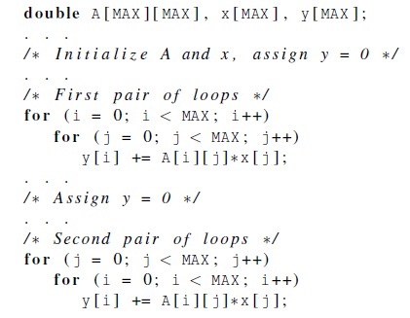
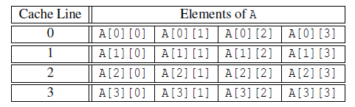
Cache and Program
Assuming only two cache lines

Slide 29
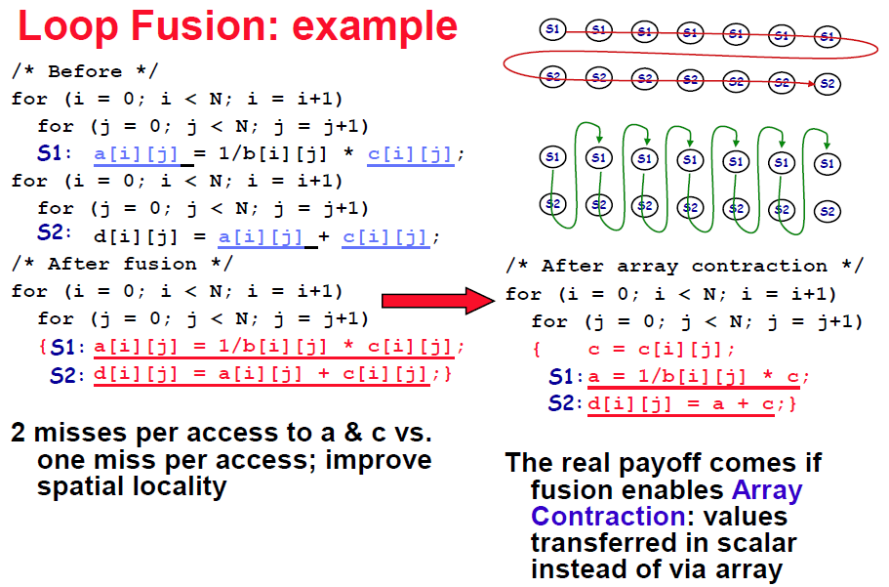
Cache and Program

Slide 30
Common Techniques
Merging Arrays
  improve spatial locality by single array of compound elements vs. 2 arrays
Permuting a multidimensional array
  improve spatial locality by matching array layout to traversal order
Loop Interchange
  change nesting of loops to access data in order stored in memory
Loop Fusion
  Combine 2 independent loops that have same looping and some variables overlap
Blocking
  Improve temporal locality by accessing “blocks” of data repeatedly vs. going down whole columns or rows

Slide 31
Main Memory
Performance of Main Memory
  Latency: Cache Miss Penalty
  Access Time: time between request and word arrives
  Cycle Time: time between requests
  Turn around time (write-read)
  Burst read/write mode
  Bandwidth: I/O & Large Block Miss Penalty (L2)
Main Memory is DRAM: Dynamic Random Access Memory
  Dynamic since needs to be refreshed periodically (8 ms, 1% time)
  Addresses divided into 2 halves (Memory as a 2D matrix):RAS or Row Access Strobe
  CAS or Column Access Strobe
Cache uses SRAM: Static Random Access Memory
  No refresh (6 transistors/bit vs. 1 transistor)
  Size: DRAM/SRAM 4-8,
  Cost/Cycle time: SRAM/DRAM 8-16

Slide 32
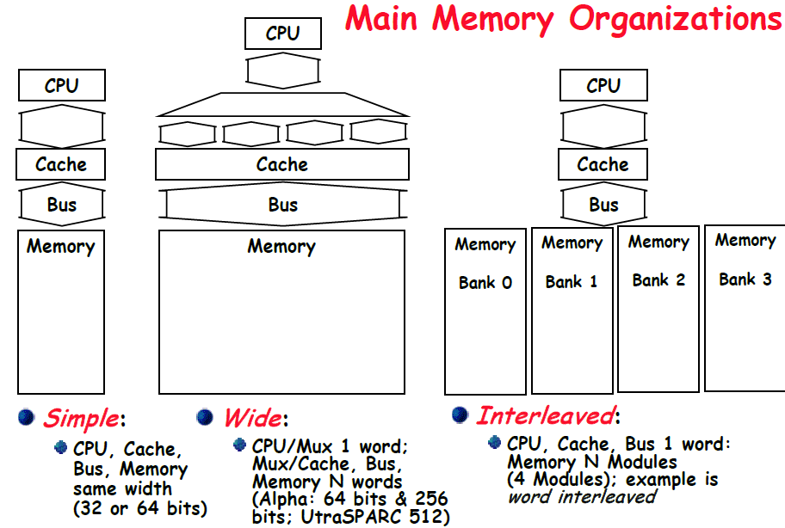
Memory Organization

Slide 33
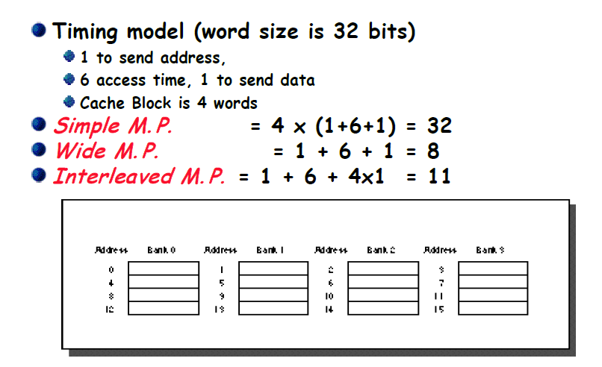
Main Memory Performance

Slide 34
Avoid Bank Conflict
Even a lot of banks, still bank conflict in certain regular accesses
e.g. Storing 256x512 array in 512 banks and column processing (512 is an even multiple of 128)
int x[256][512];
for (j = 0; j < 512; j = j+1)
for (i = 0; i < 256; i = i+1)
x[i][j] = 2 * x[i][j];
Inner Loop is a column processing which causes bank conflicts
Column processing
Bank0 Bank1 Bank127 ,…, Bank511
0,0 0,1 ,..., 0,127 ,..., 0,511
1,0 1,1 ,..., 1,127 ,..., 1,511
...
127,0 127,1 ,..., 127,127 ,..., 127,511
...
128,0 128,1 ,..., 128,127 ,..., 128,511
...
255,0 255,1 ,..., 255,127 ,..., 255,511
Column elements are in the same bank

Slide 35

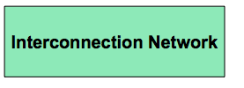

An Abstraction of Multicore System
How is parallelism managed?
Where is the memory physically located?
How the processors work?
What is the connectivity of the network?

Slide 36
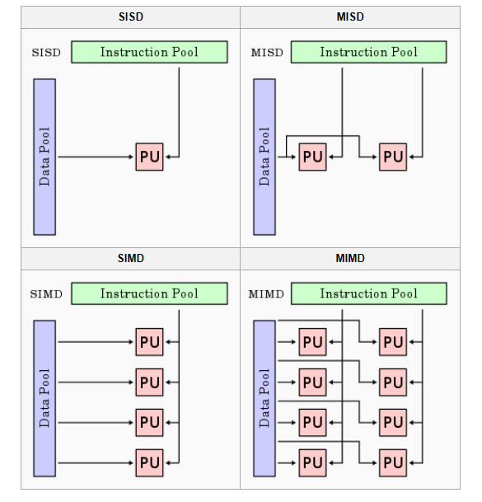
Flynn’s Taxonomy
classic von Neumann
not covered

Slide 37
Two Major Classes
Shared memory multiprocessor architectures
  A collection of autonomous processors connected to a memory system.
  Supports a global address space where each processor can access each memory location.
Distributed memory architectures
  A collection of autonomous systems connected by an interconnect.
  Each system has its own distinct address space, and processors must explicitly communicate to share data.
  Clusters of PCs connected by commodity interconnect is the most common example.

Slide 38
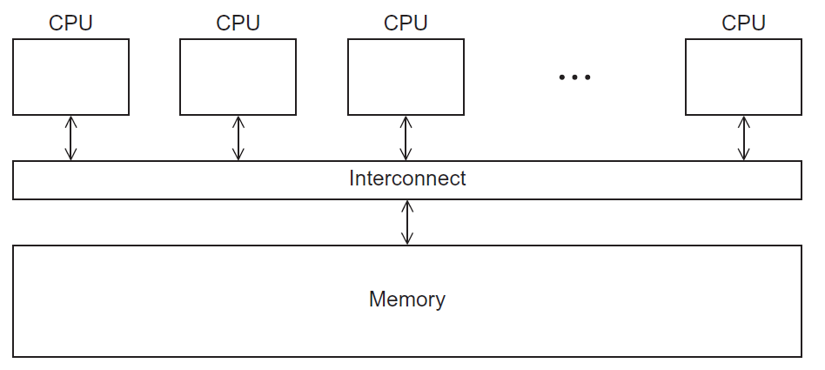
Shared Memory System

Slide 39
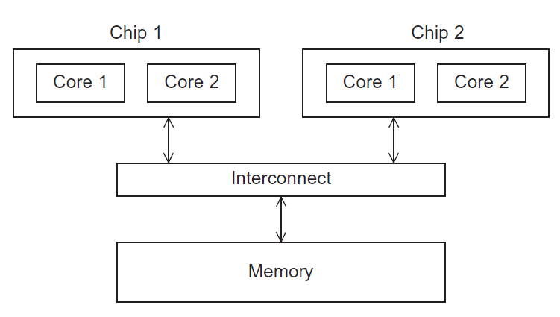
UMA Multicore System
Uniform Memory Access: Time to access all the memory locations will be the same for all the cores.

Slide 40
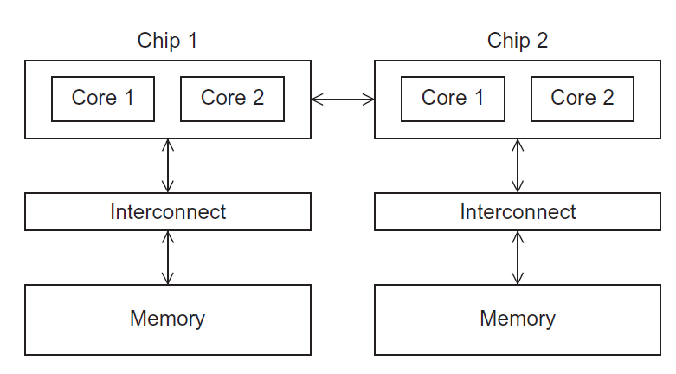
NUMA Multicore System
Non-Uniform Memory Access: A memory location a core is directly connected to can be accessed faster than a memory location that must be accessed through another chip.

Slide 41
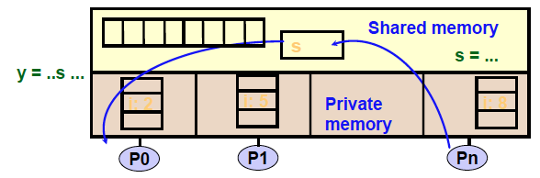
Programming Abstraction
A shared-memory program is a collection of threads of control.
Each thread has private variables, e.g., local stack variables
Also a set of shared variables, e.g., static variables, shared
common blocks, or global heap.
Threads communicate implicitly by writing and reading shared variables.
Threads coordinate through locks and barriers implemented using shared variables.

Slide 42
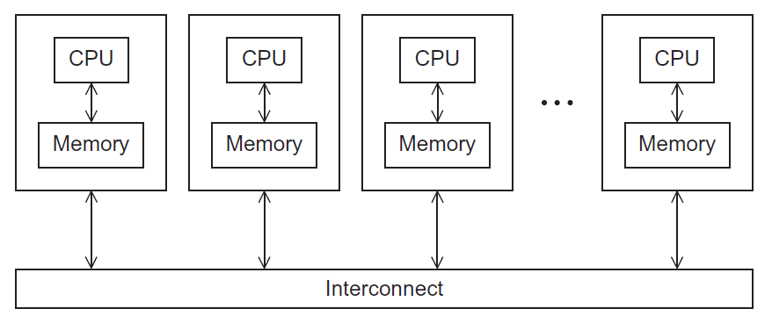
Distributed Memory System

Slide 43
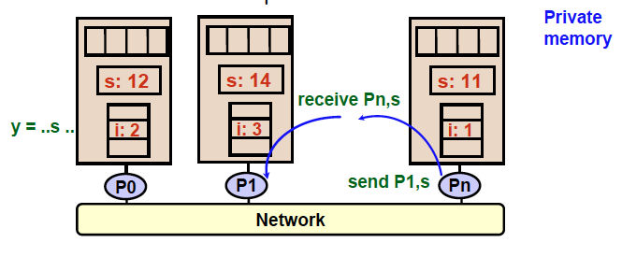
Programming Abstraction
Distributed-memory program consists of named processes.
• Process is a thread of control plus local address space -- NO shared data.
• Logically shared data is partitioned over local processes.
• Processes communicate by explicit send/receive pairs
• Coordination is implicit in every communication event.

Slide 44
Interconnects
Affects performance of both distributed and shared memory systems.
Two categories
  Shared memory interconnects
  Distributed memory interconnects

Slide 45
Shared Memory Interconnects
Bus interconnect
  A collection of parallel communication wires together with some hardware that controls access to the bus.
  Communication wires are shared by the devices that are connected to it.
  As the number of devices connected to the bus increases, contention for use of the bus increases, and performance decreases.
Switched interconnect
  Uses switches to control the routing of data among the connected devices.

Slide 46
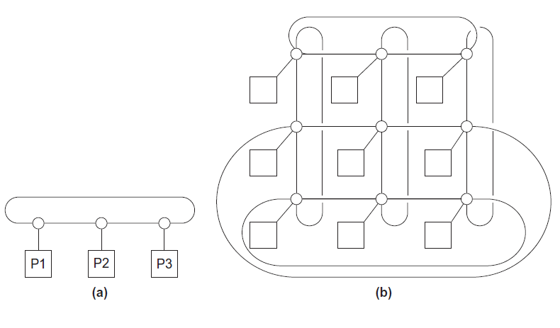
Distributed Memory Interconnects
ring
toroidal mesh

Slide 47
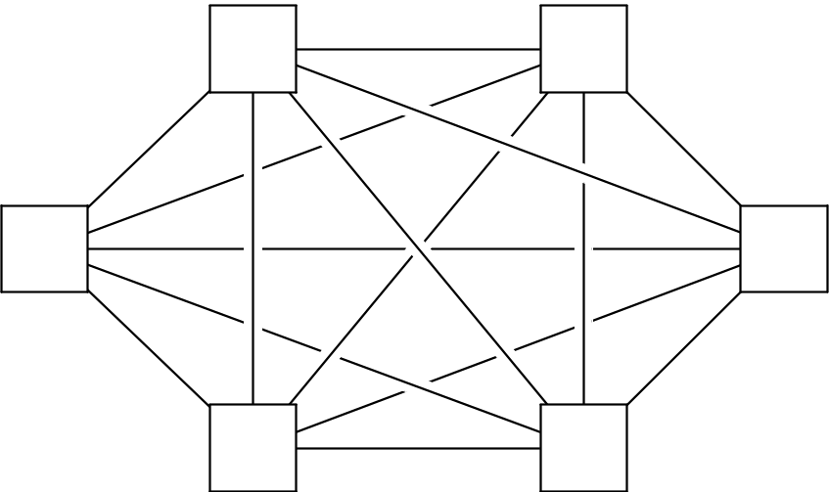
Fully Connected Interconnects
Each switch is directly connected to every other switch.
impractical

Slide 48
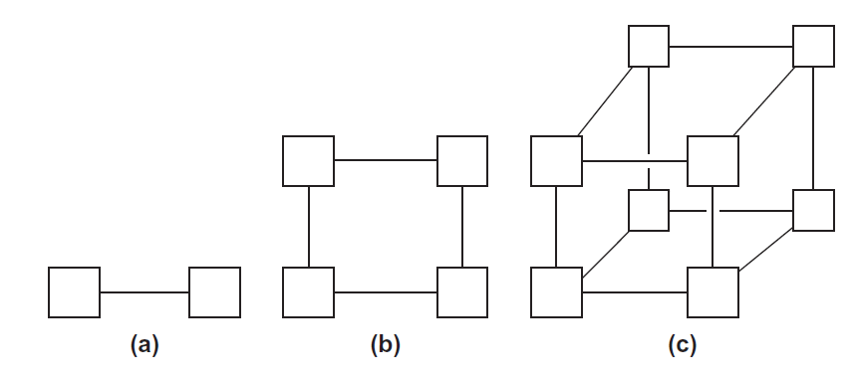
Hypercubes
one-
two-
three-dimensional

Slide 49
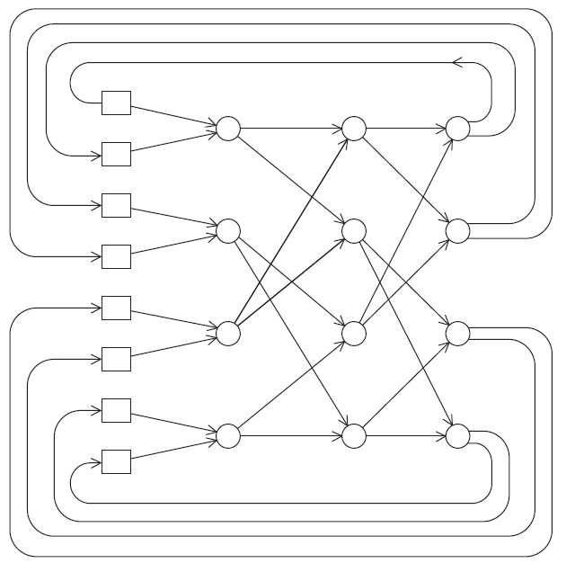
Omega Network

Slide 50
Network Parameters
Any time data is transmitted, we’re interested in how long it will take for the data to finish transmission.
Latency
  The time that elapses between the source’s beginning to transmit the data and the destination’s starting to receive the first byte.
Bandwidth
  The rate at which the destination receives data after it has started to receive the first byte.

Slide 51
Data Transmission Time
Message transmission time = l + n / b
latency (seconds)
length of message (bytes)
bandwidth (bytes per second)

