Slide 1

2020
Distributed Smart-Contract-based board Game
Monopoly
517030910386 杨晨宇
517030910376 蓝宇霆

Slide 2
01 Background
02 Framework
03 UML
04 Demo

Slide 3
Background

Slide 4
Game Introduction
Smart contract is a new technology implemented through blockchain. It is digital, stored in the blockchain, and uses encrypted code to enforce the protocol. It is precisely because of its mandatory and security, the use of smart contracts to develop some simple small games, can effectively prevent players from tampering with game data, without additional supervision, while effectively maintaining the fairness of the game.
In our project, we will use smart contracts to develop a distributed monopoly game. It supports multiple players and multiple matches at the same time, transforms the entire game logic, and the decision mechanism is embedded inside the contract. Players can promote the game by calling the contract's function , The player's identity will also be verified within the function, thus ensuring security. , We quantify and simplify the code logic, reduce the extra expenses and save the game while ensuring the completeness of the game

Slide 5
Comparison
Most blockchain-based games have simple game architectures, less front-end and back-end interaction, and low real-time requirements. Mostly developed, or gambling games, such as cryptozombies, cryptokitty
Existing Game Project
Our distributed smart-contract-based board Game Monopoly has the characteristics of high distribution, exquisite back-end architecture, many front-end and back-end interactions, innovative, interactive, and interesting game types.
Our Monopoly Game

Slide 6
Difficulties
Random number generation
2. Information synchronization between players
3. Save system overhead

Slide 7
Framework

Slide 8
Front-End
Build
HTML + CSS + JS
characteristic
Use web3.js to interact with smart contracts Use the private chain built by truffle or Ganache to link

Slide 9
Back-End
Compile
This smart contract uses Ethereum solidity ^0.5.1
Test
Use Remix Online as IDE, and use the provided graphical buttons for testing

Slide 10
Deployment
Truffle
Truffle is a development environment, testing framework and asset pipeline for Ethereum, aiming to make life as an Ethereum developer easier.
Advantage
Built-in smart contract compilation, linking, deployment and binary management.
(b) Network management for deploying to many public & private networks.
(c) Automated contract testing.

Slide 11
UML

Slide 12
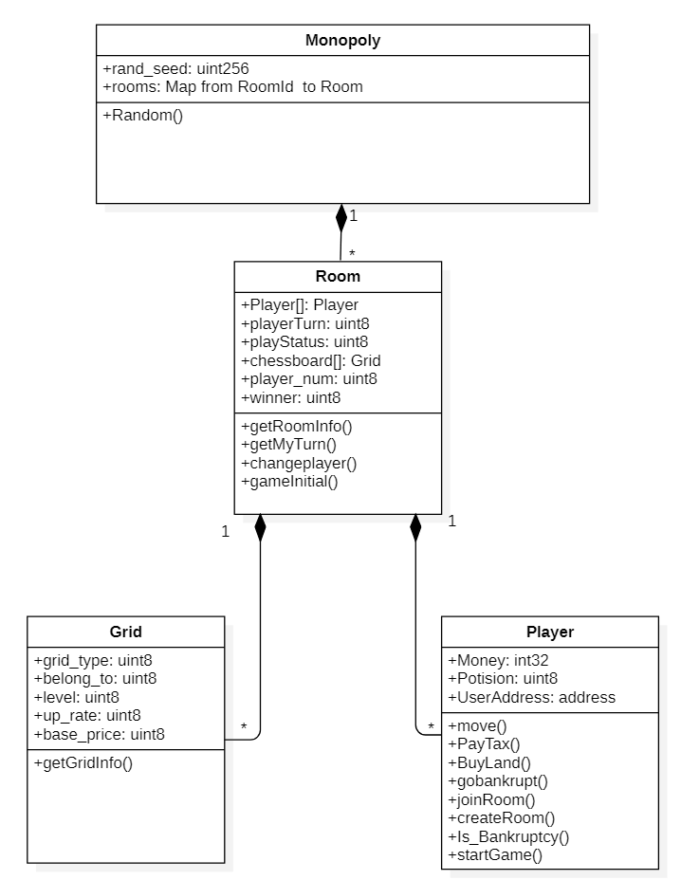
Class Diagram
Monopoly
Grid
Room
Player

Slide 13
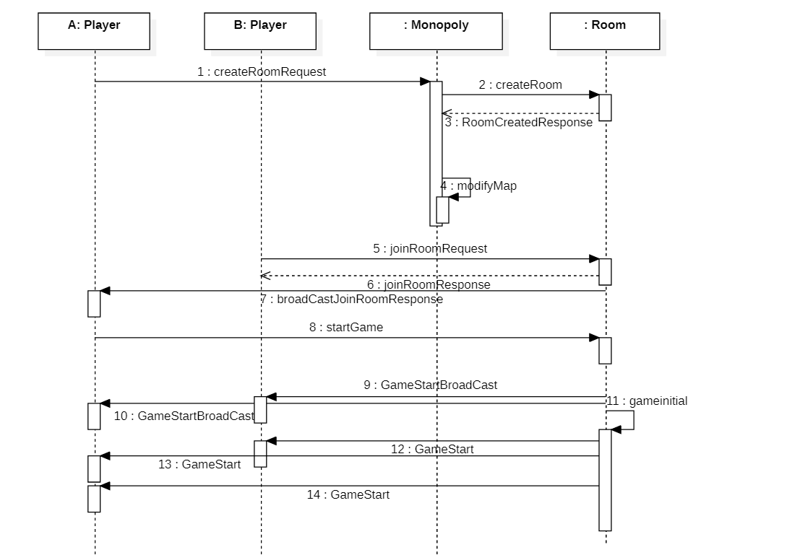
Sequence Diagram
Sequence diagram of CreateRoom, JoinRoom, and StartGame

Slide 14
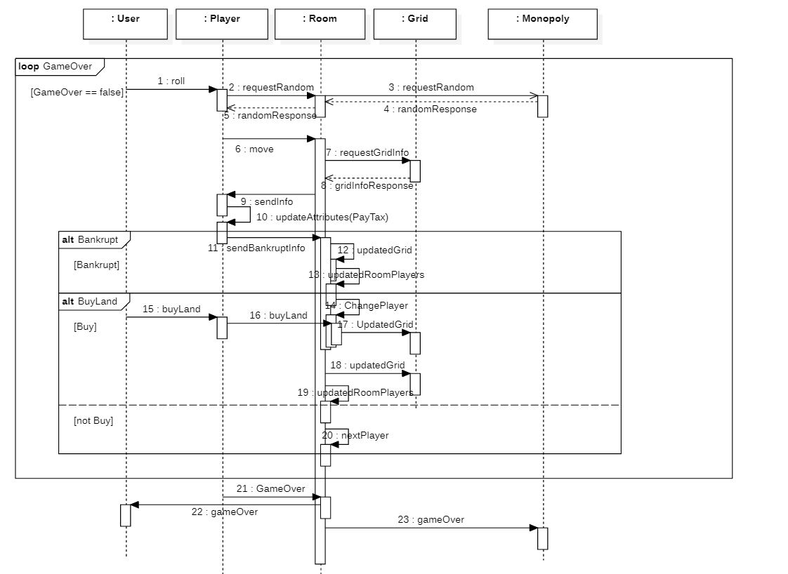
Sequence Diagram
Sequence diagram of GameRunning
and GameOver

Slide 15
Demo

Slide 16
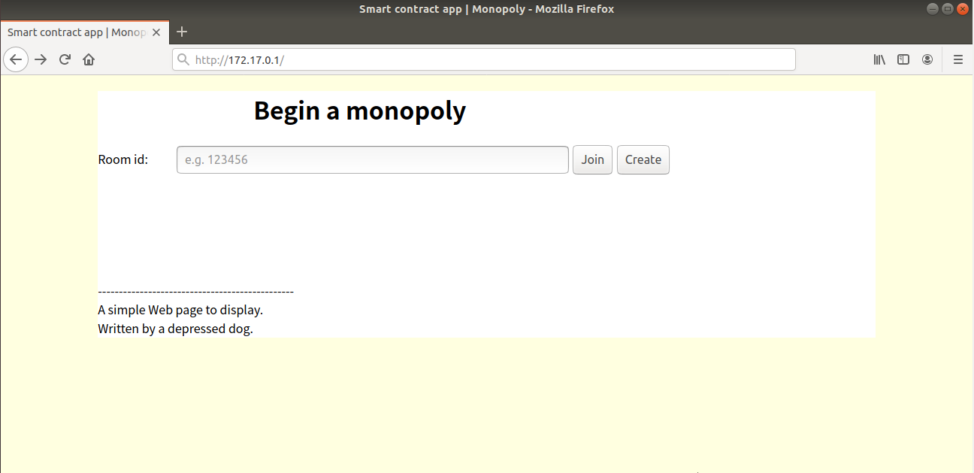
Start

Slide 17
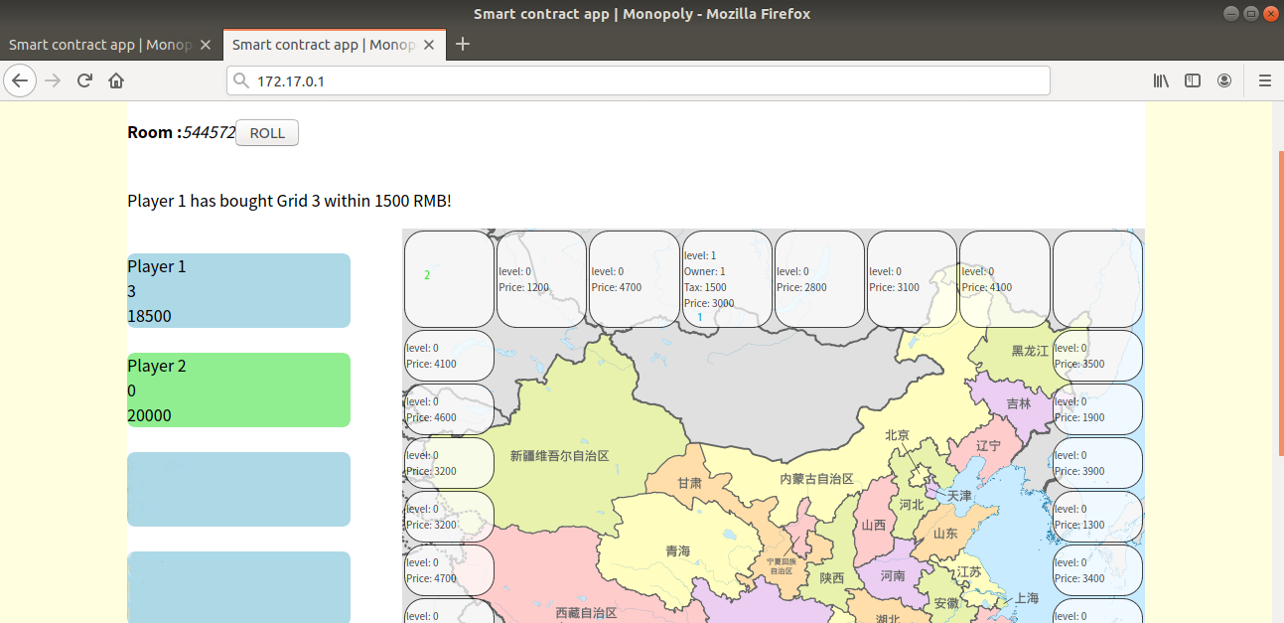
Roll

Slide 18
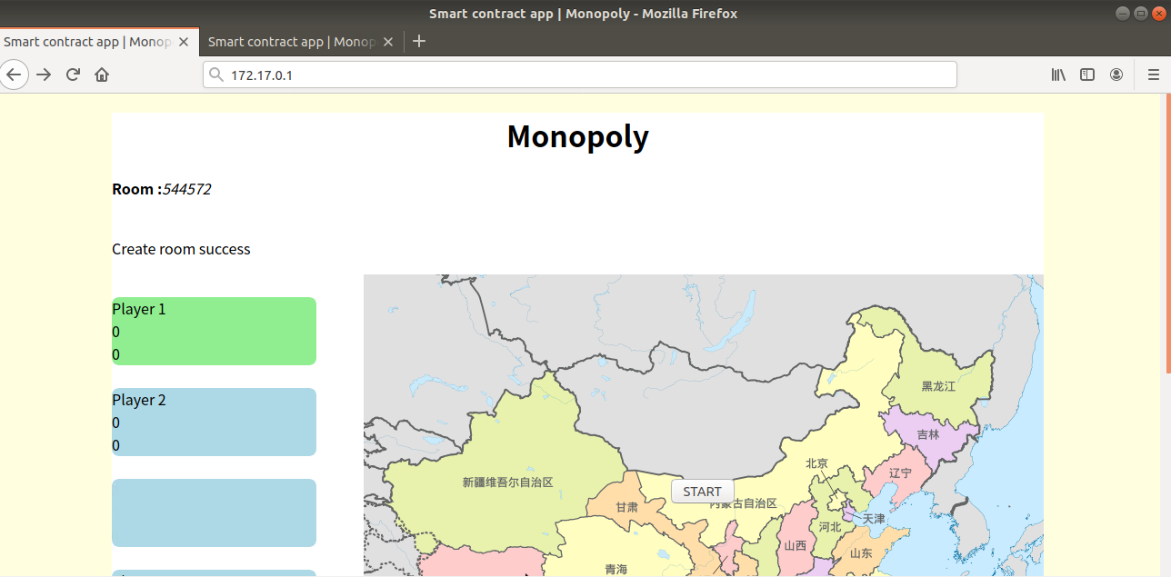
Room

Slide 19
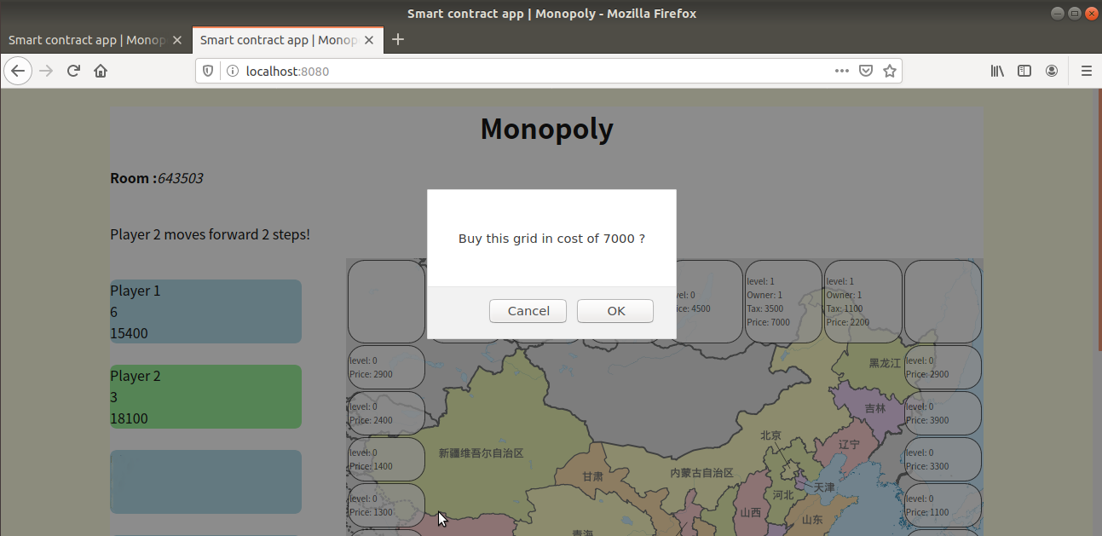
Buy

Slide 20
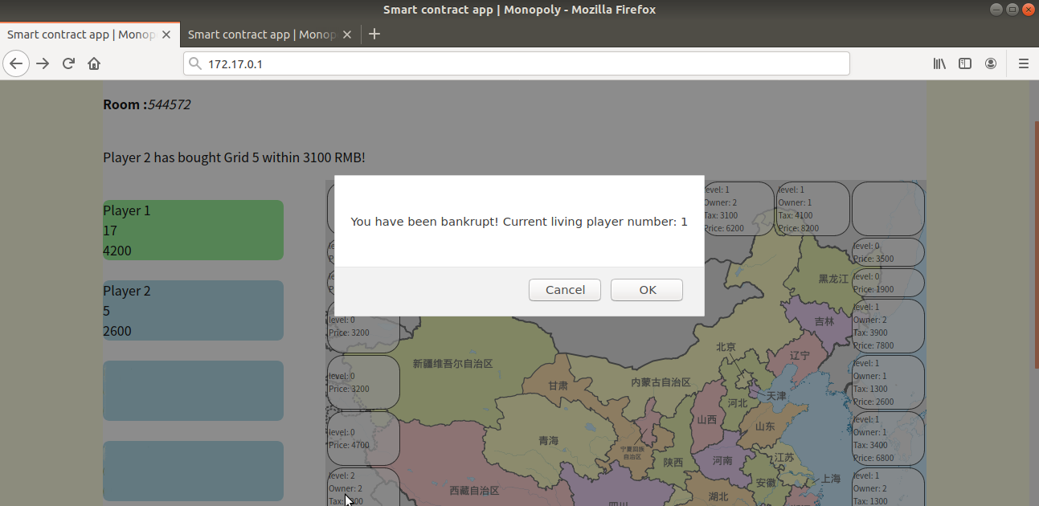
lose

Slide 21
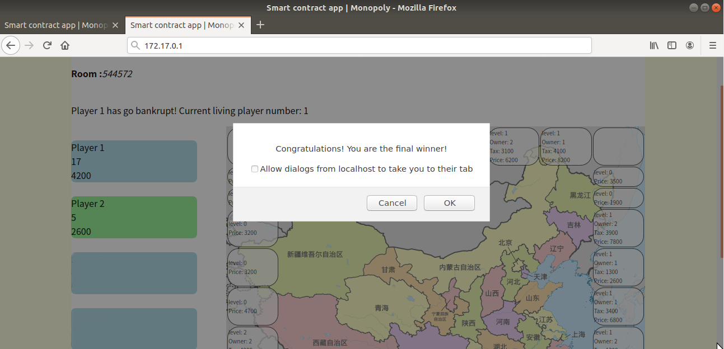
Win

Slide 22
Division of Work
杨晨宇主要负责游戏前端开发，框架部署，游戏逻辑及合约API的设计
蓝宇霆主要负责游戏后端智能合约的设计，solidity编写测试

Slide 23
Reference
Truffle official website https://www.trufflesuite.com/docs
Web3.js official website https://web3js.readthedocs.io/en/v1.2.9/
Official sample pet shop https://github.com/truffle-box/pet-shop-box
Zombie Factory https://cryptozombies.io/en/course
Use smart contracts to achieve backgammon games https://github.com/Alexygui/Gobang
WebPack https://github.com/truffle-box/webpack-box

