Slide 1

2020
Distributed Smart-Contract-based board Game
Monopoly
517030910386 杨晨宇
517030910376 蓝宇霆

Slide 2
01 Background
02 Framework
03 UML
04 Demo

Slide 3
Background

Slide 4
Game Introduction
Our blockchain-based Monopoly game originate from the famous board game Monopoly. In our game, players roll two six-sided dice to move around the game board, buying and trading properties, and upgrade them. Players collect rent from their opponents, with the goal being to drive them into bankruptcy

Slide 5
Difficulties

Slide 6
Comparison
Most blockchain-based games have simple game architectures, less front-end and back-end interaction, and low real-time requirements. Mostly developed, or gambling games, such as cryptozombies, cryptokitty
Existing Game Project
Our distributed smart-contract-based board Game Monopoly has the characteristics of high distribution, exquisite back-end architecture, many front-end and back-end interactions, innovative, interactive, and interesting game types.
Our Monopoly Game

Slide 7
Division of Work

Slide 8
Framework

Slide 9
Front-End
Build
HTML + CSS + JS
characteristic
Use web3.js to interact with smart contracts Use the private chain built by truffle or Ganache to link

Slide 10
Back-End
Compile
This smart contract uses Ethereum solidity ^0.5.1
Test
Use Remix Online as IDE, and use the provided graphical buttons for testing

Slide 11
Deployment
Truffle
Truffle is a development environment, testing framework and asset pipeline for Ethereum, aiming to make life as an Ethereum developer easier.
Advantage
Built-in smart contract compilation, linking, deployment and binary management.
(b) Network management for deploying to many public & private networks.
(c) Automated contract testing.

Slide 12
UML

Slide 13
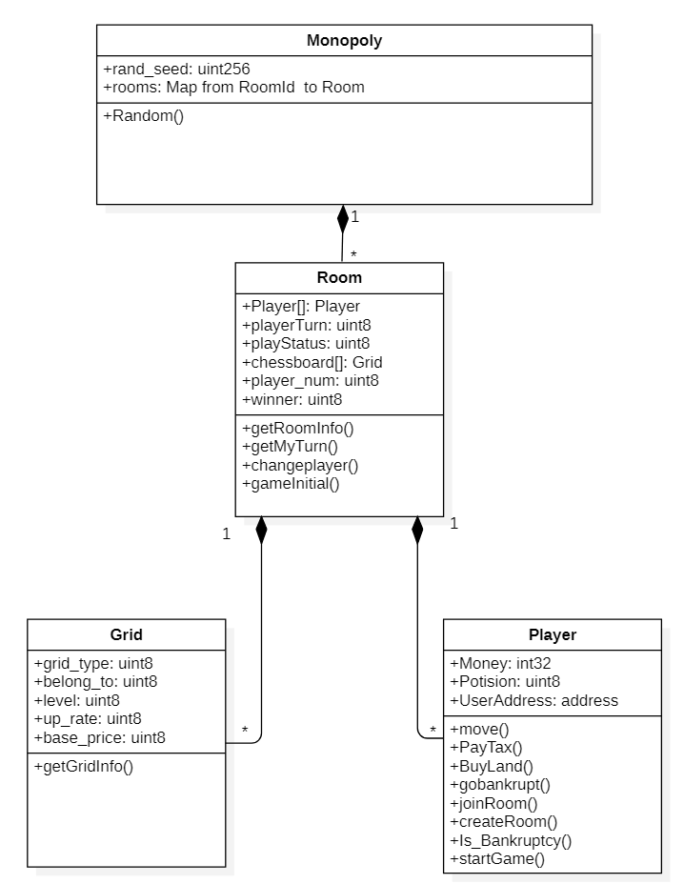
Class Diagram
Monopoly
Grid
Room
Player

Slide 14
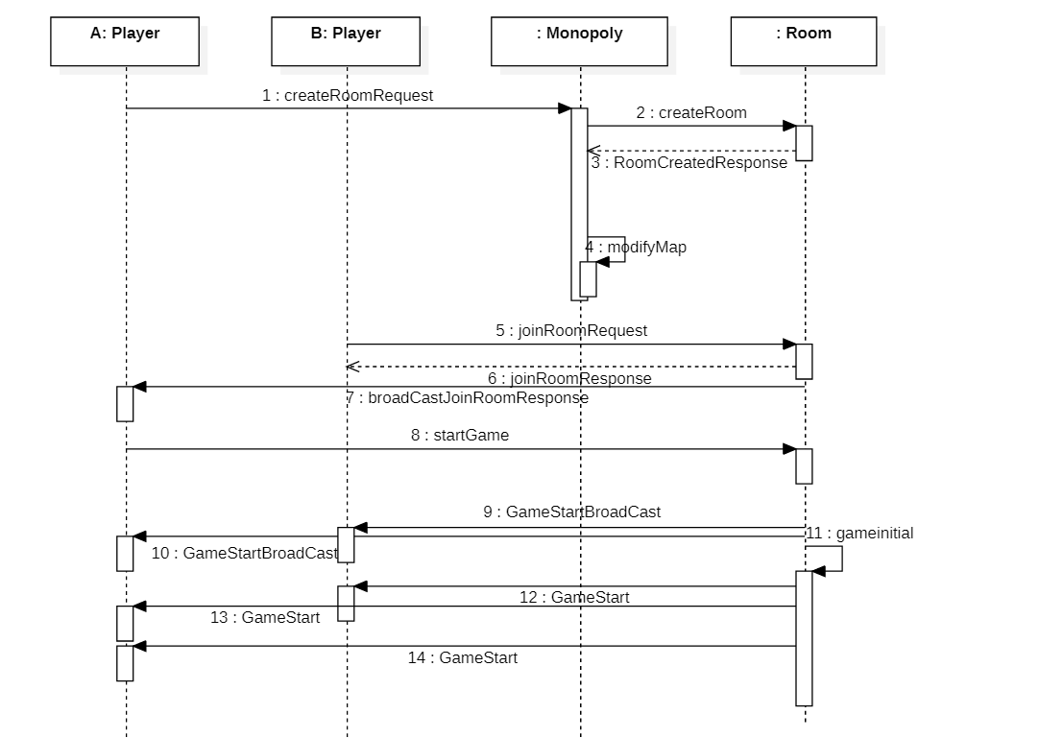
Sequence Diagram
Sequence diagram of CreateRoom, JoinRoom, and StartGame

Slide 15
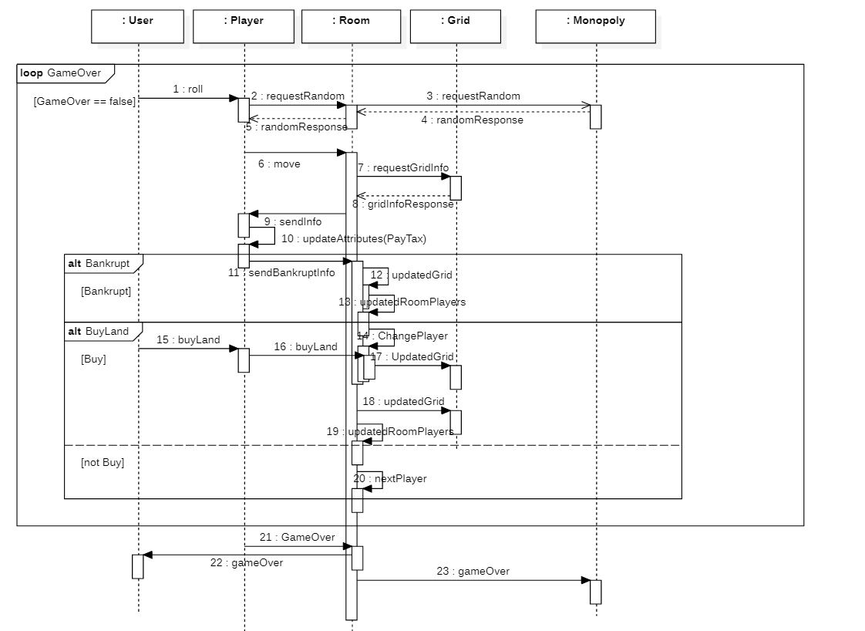
Sequence Diagram
Sequence diagram of GameRunning
and GameOver

Slide 16
Demo

Slide 17
Future Work

Slide 18
Reference
Truffle official website https://www.trufflesuite.com/docs
Web3.js official website https://web3js.readthedocs.io/en/v1.2.9/
Official sample pet shop https://github.com/truffle-box/pet-shop-box
Zombie Factory https://cryptozombies.io/en/course
Use smart contracts to achieve backgammon games https://github.com/Alexygui/Gobang
WebPack https://github.com/truffle-box/webpack-box

