Slide 1

Need Car Insurance?
USING CLASSIFICATION ALGORITHMS TO PREDICT WHETHER A Health insurance policyowner WILL BE INTERESTED IN BUYING auto insurance

Slide 2

Background
Our Client: Insurance Company which hopes to cross-sell auto insurance to their current health insurance policy owners

Slide 3
Impact
Analyzing Cross-Selling trends will:
Help target interested customers
Bring in additional revenue
Build brand loyalty
Help gauge customer interest in new services

Slide 4
Dataset: Kaggle
10 columns x 381109 rows
Features
Gender
Age
Drivers License
Previously Insured
Vehicle Age
Vehicle Damage
Annual Premium (INR)
Policy Sales Channel
Region Code
Vintage
Response
0 – Not Interested
1- Interested

Slide 5
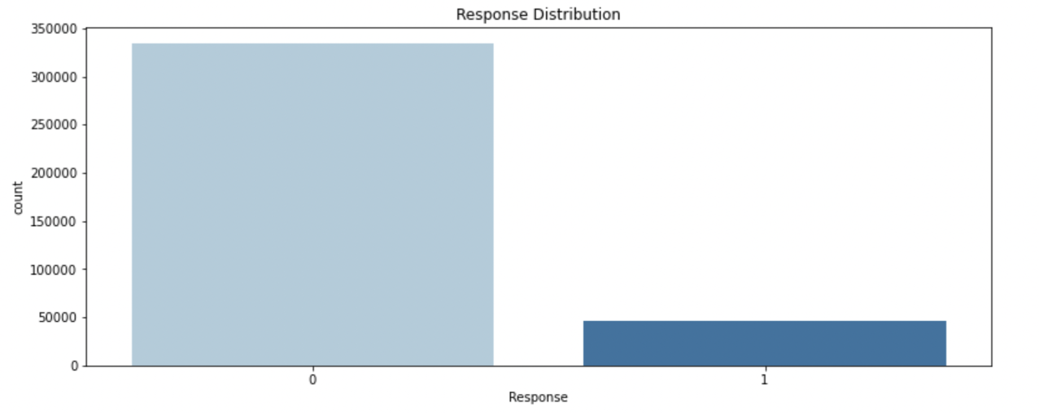
Evaluation Metric
F2: Targeting Recall

Slide 6
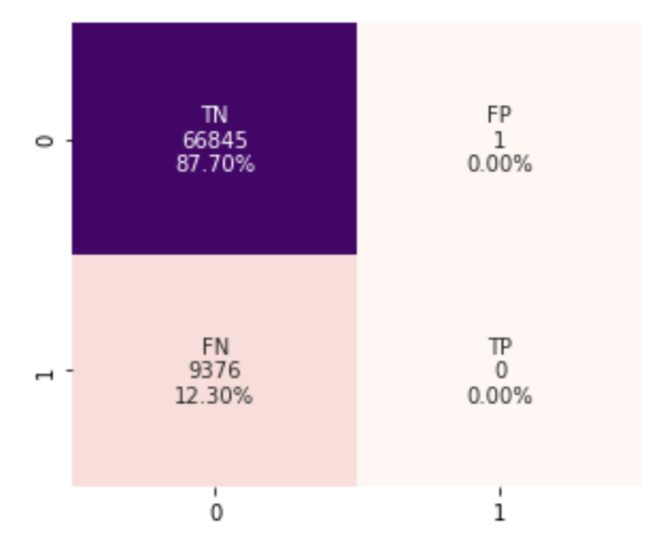
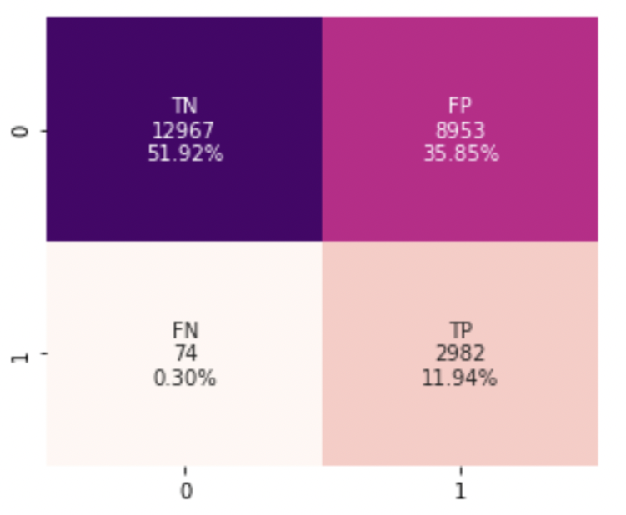
Model Choices: Decision Tree, Random Forest, XGBoost, Logistic Regression
Baseline : Top Choice:
Logistic Regression
Logistic Regression, balanced class weight
F2 Score: 0
F2 Score: 0.617161

Slide 7
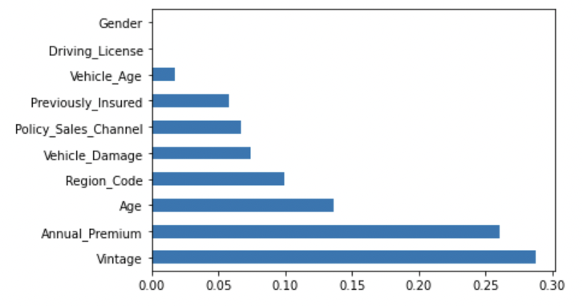
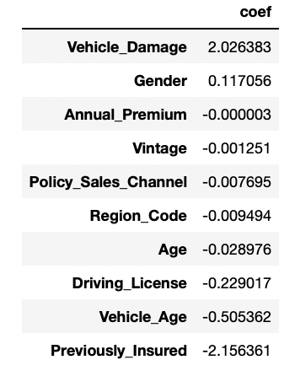
Feature Importance:

Slide 8
Future Work:
Continue to optimize current models
Utilize other models (CatBoost/ LightGBM)

Slide 9
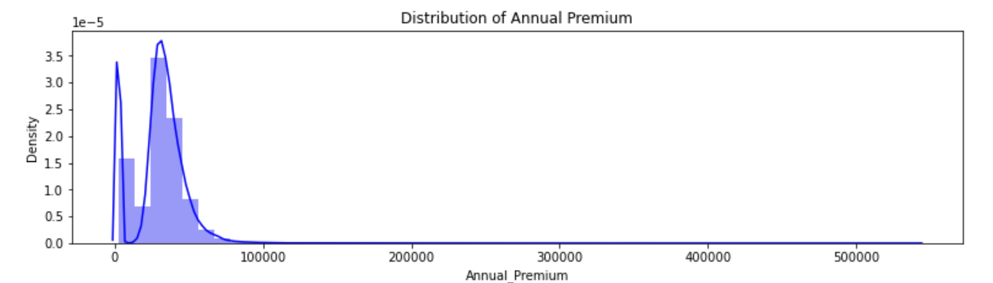
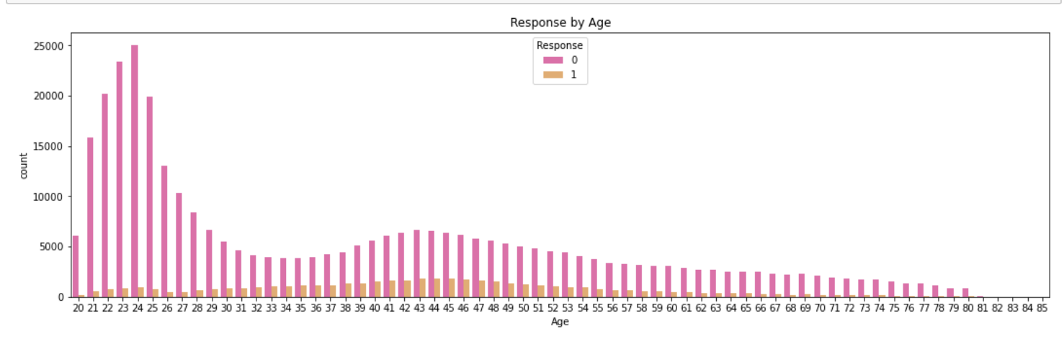
Appendix:

