Slide 1
The Power of Job Boards
Connecting Job Seekers with
Opportunities

Slide 2
What Is a Job Board?
A job board (also known as a job search engine) is a website or platform that allows employers to advertise job openings and job seekers to search for available jobs.
Job boards typically allow employers to create detailed listings for job openings, including information about the job duties, requirements, and location. Job seekers can then search for job listings based on various criteria, such as location, job type, and industry, and can apply for job opportunities directly through the job board.
Job boards are a popular tool for both employers and job seekers.

Slide 3
Problem Statement
In today's fast-paced and digitally driven job market, both job seekers and employers face significant challenges in connecting efficiently and effectively. Job seekers struggle to find relevant job opportunities that match their skills and preferences due to the overwhelming amount of information and limited filtering options on many job platforms. On the other hand, employers encounter difficulties in reaching and attracting qualified candidates, managing job postings, and efficiently handling applications.
Current job board solutions often lack personalized recommendations, intuitive user interfaces, and seamless user experiences, leading to frustration and inefficiencies for both parties. There is a clear need for an advanced job board platform that addresses these issues by providing a user-friendly, secure, and feature-rich environment that enhances the job search and recruitment processes.

Slide 4
Aims and Objectives.
Aim:
To create a user-friendly job board platform that facilitates job search and recruitment processes.
Objectives:
Provide advanced search and filtering options for job seekers.
Enable employers to post and manage job listings efficiently.
Implement secure authentication and data protection mechanisms.
Offer personalized job recommendations to users, based of skill set and preference.

Slide 5
Introduction to Job Boards
Definition: Job boards are online platforms that connect job seekers with employers and facilitate the job application process.
Examples of existing job boards: LinkedIn, Fiverr, Indeed, just to name a few.
Search and Filter Options: Job seekers can easily search for specific job titles, locations, or industries.
Application Tracking: Employers can efficiently manage applications, track candidates, and communicate with them.

Slide 6
Benefits of Job Boards:
Wide Reach: Job boards have a large audience, allowing employers to reach a diverse pool of candidates.
Time and Cost Efficiency: Job boards streamline the hiring process, saving both time and money compared to traditional methods.
Increased Visibility: Employers can showcase their company and job openings to a broader audience.
Provides Access to remote jobs not easily heard or talked about
Gives users the chance and variety access to several jobs from the comfort of their homes.

Slide 7
Types of Job Boards:
General Job Boards: These platforms cater to a wide range of industries and job types, such as Indeed, Monster, and LinkedIn.
Niche Job Boards: These focus on specific industries, professions, or demographics. Examples include Dice for tech jobs and FlexJobs for remote work opportunities.
Company Career Websites: Many companies have their own job boards on their websites to attract talent directly.

Slide 8
Tips for Job Seekers
Create a compelling profile: Craft a well-written resume and optimize your online presence to stand out to potential employers.
Utilize search filters: Use specific keywords, location filters, and other criteria to narrow down your job search. - Set up job alerts: Sign up for email notifications or alerts to stay updated on new job postings.
Tailor your applications: Customize your cover letter and resume for each job application to highlight relevant skills and experiences.
Network and engage: Connect with professionals in your desired field, attend industry events, and engage in online communities.

Slide 9
Tips for Employers
Write clear job descriptions: Clearly define job requirements, responsibilities, and qualifications to attract suitable candidates.
Utilize keywords: Use relevant keywords in your job postings to increase visibility and attract qualified applicants.
Showcase your company culture: Highlight your company's values, mission, and employee benefits to attract top talent.
Engage with candidates: Respond to inquiries, provide updates on application statuses, and maintain clear communication throughout the hiring process.
Utilize analytics: Track the performance of your job postings, such as views and

Slide 10
System Architecture for Job Board
The system architecture of our job board website includes:
Front-End: User Interface built with HTML, CSS.
Back-End: Application logic handled by Java Script framework.
Database: Firebase for data storage.
Deployments done Using GitHub pages, Microsoft Firebase.
External Services: Integration with email and payment gateway services.

Slide 11
System Architecture for Job Board
The system architecture of our job board website includes:
Front-End: User Interface built with HTML, CSS.
Back-End: Application logic handled by Java Script framework.
Database: Firebase for data storage.
Deployments done Using GitHub pages, Microsoft Firebase.
External Services: Integration with email and payment gateway services.

Slide 12
System Specifications and Features
Advanced Job Search: Keyword matching, filtering, and sorting.
Job Recommendations: Personalized job suggestions based on user profile.
Employer Tools: Post jobs, manage applications, and review applicants.
User Authentication: Secure login with OAuth 2.0 integration, using Firebase.
Responsive Design: Accessible on various devices.

Slide 13
Technologies Used
Front-End: User Interface built with HTML, CSS.
Java Script: For creating a dynamic and responsive UI.
Database: Firebase for data storage.
Firebase: For database management.
OAuth 2.0: For secure authentication.
AWS & Firebase: For cloud services and hosting.

Slide 14
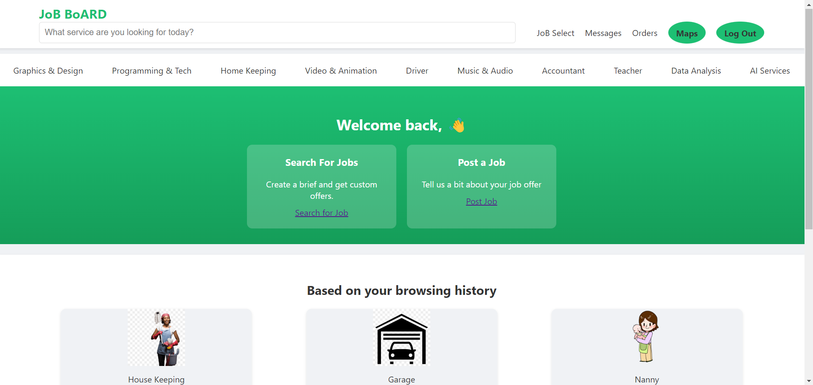
Dashboard Page

Slide 15
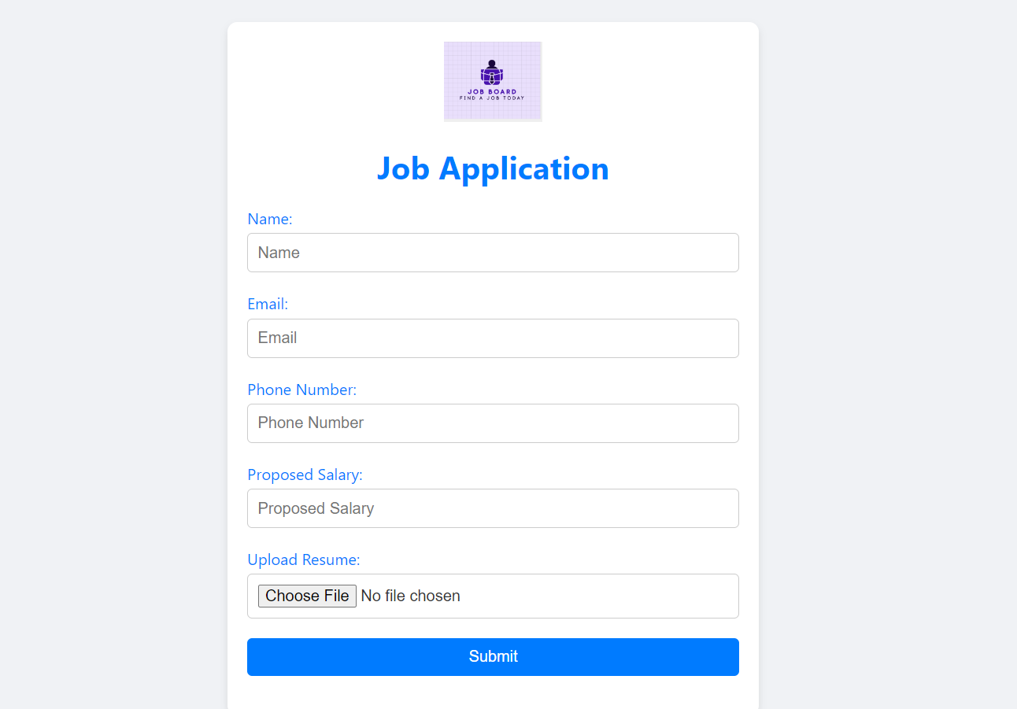
Apply for Jobs Page

Slide 16
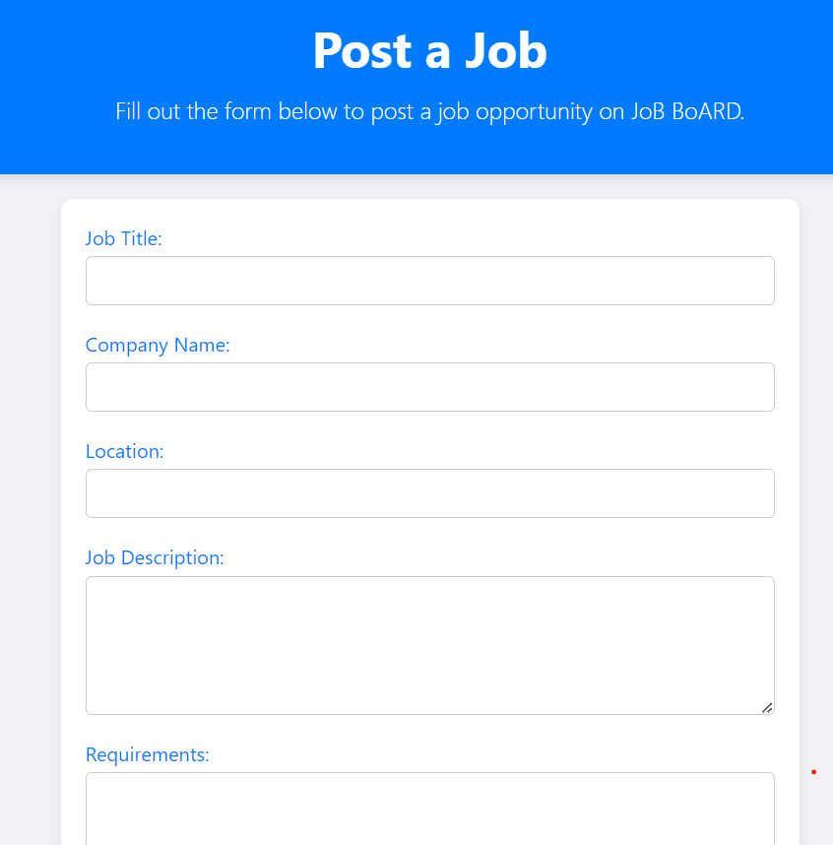
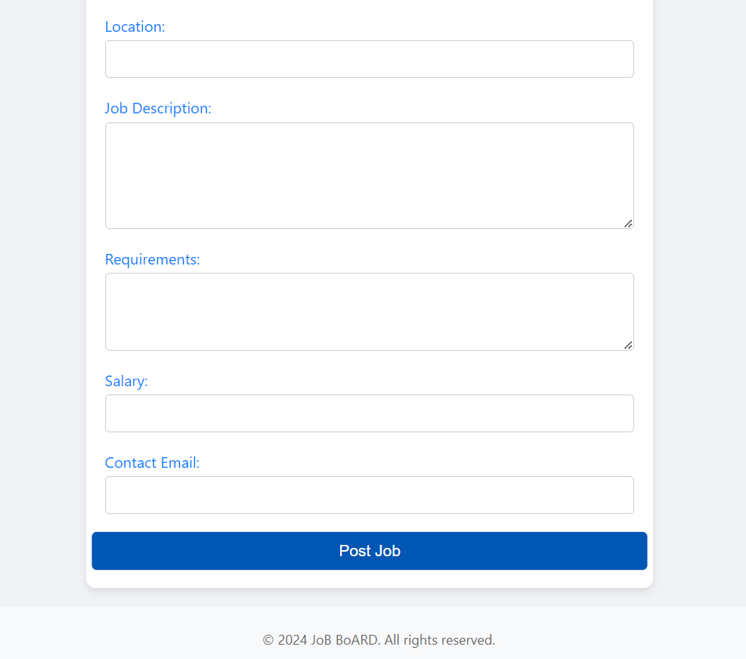
Post a Job Page (Employers)

Slide 17
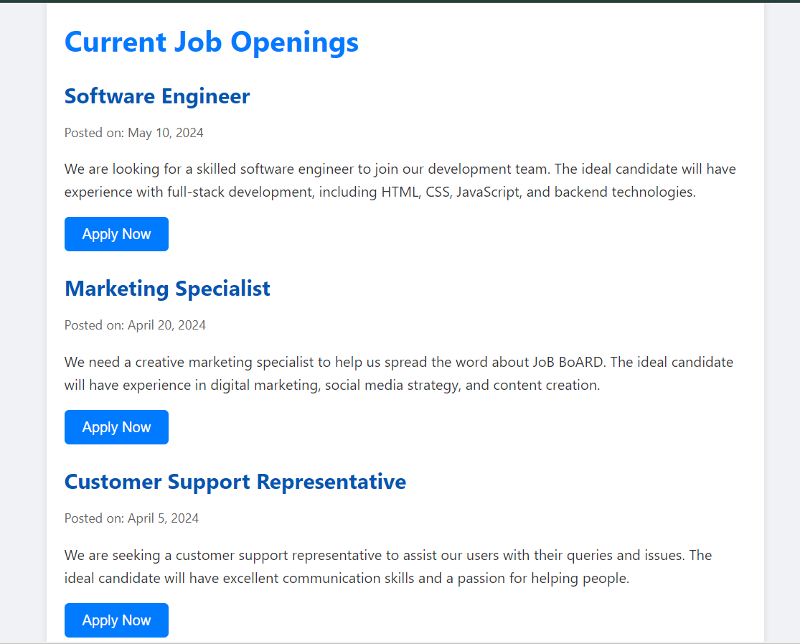
Available Jobs Page

Slide 18
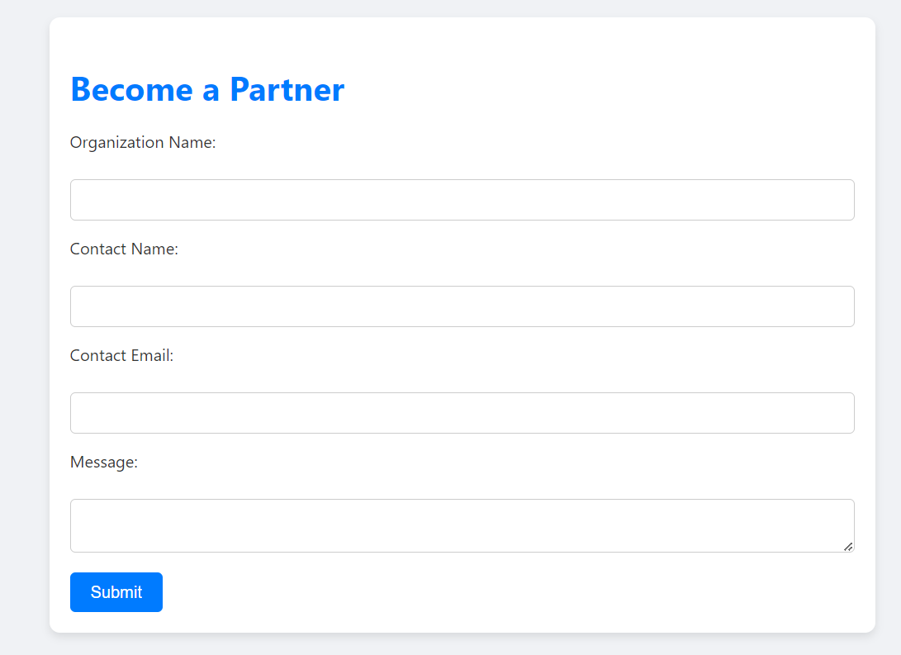
Partnership Registration Page

Slide 19
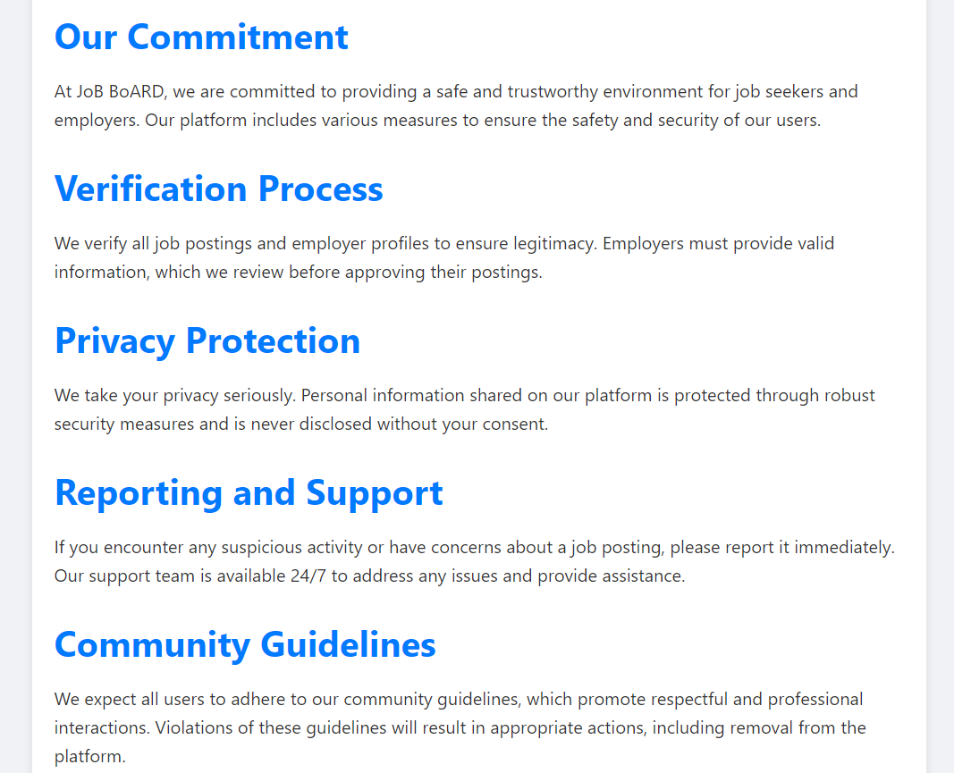
Commitment/ Community Guidelines Page

Slide 20
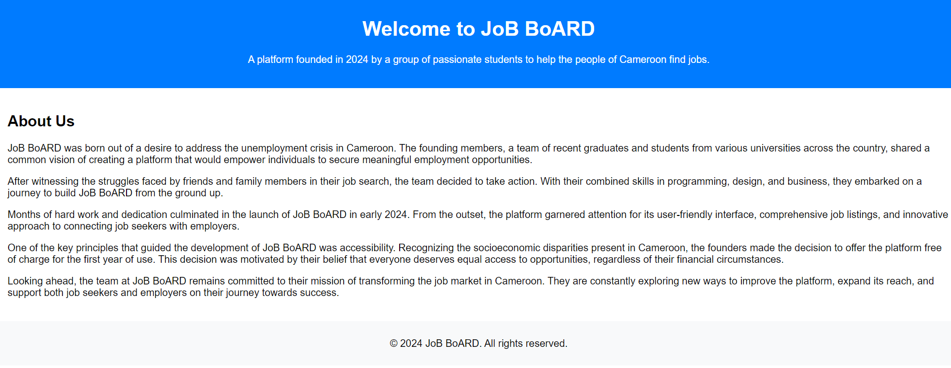
About Job Board Page

Slide 21
How Job Boards Work
Job boards typically offer a range of features and tools to facilitate the job search process for both employers and job seekers.
For employers, job boards typically offer the ability to create detailed job listings that include information about the job duties, requirements, and location. Employers can also include other details about the company, such as its culture and benefits, to help attract potential candidates. Once the job listing is created, it is added to the job board's database, where it can be searched by job seekers.

Slide 22
For job seekers
Job boards typically offer a search function that allows them to search for job listings based on various criteria, such as location, job type, and industry. Job seekers can also use filters and keywords to narrow their search and find job opportunities that are most relevant to them. Once job seekers have found a job listing that interests them, they can apply for the job directly through the job board.

Slide 23
The Benefits of Using Job Boards
There are many benefits to using job boards as part of the job search process. Some of the main advantages of using job boards include:
A wide range of job opportunities in one place: Job boards offer a convenient way for job seekers to search for job opportunities from a variety of employers in different industries. This means that job seekers can find a wider range of job opportunities in one place, rather than having to search for job listings on multiple websites or in different locations.
Email alerts: Job alerts can help job seekers by providing them with notifications when new job opportunities become available that match their search criteria.

Slide 24
How Job Boards Generate Revenue
Job posting fees: Most job boards charge employers a fee to post job listings. These fees can vary depending on the type of job listing, the duration of the listing, and the number of job listings that the employer wants to post. Job boards can generate significant revenue from job postings, particularly if they have a large number of employers using the job board

Slide 25
Who Should Create a Job Board
Publishers, like newspapers and magazines, can create a job board as a way to generate extra income and provide valuable services to their audience.
Professional associations, like trade organizations and industry groups, can create a job board to support their members and provide valuable services to the industry.
Digital communities, like forums and online groups, can create a job board to provide extra value to their members and generate revenue.

Slide 26

Build
Populate your job board with jobs by accepting direct posts, pulling jobs from backfill providers, importing from feeds, and scraping career sites.

Slide 27
END
The End
Thanks for Your keen Attention
Any Questions … ?

