Slide 1


Solutions by
Achutha Rugvedi

Slide 2
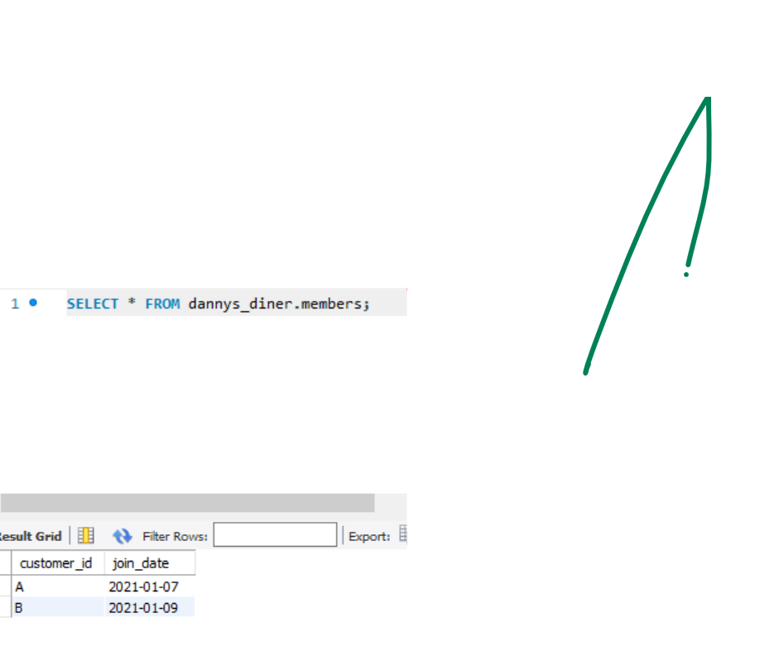
Members Table

Slide 3
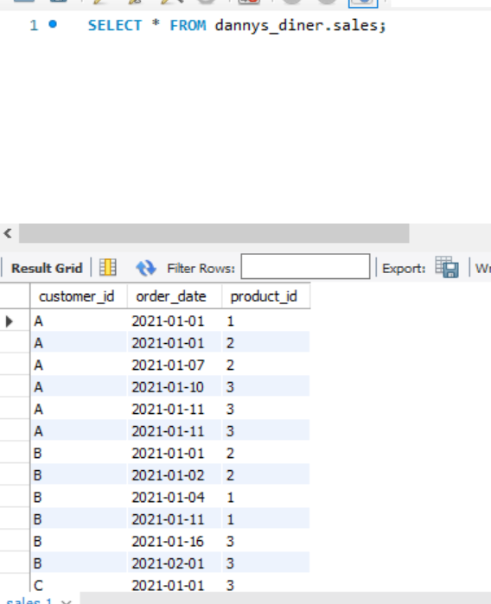
Sales table

Slide 4
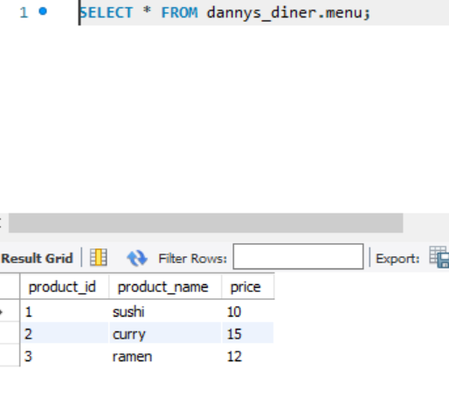
Menu table

Slide 5
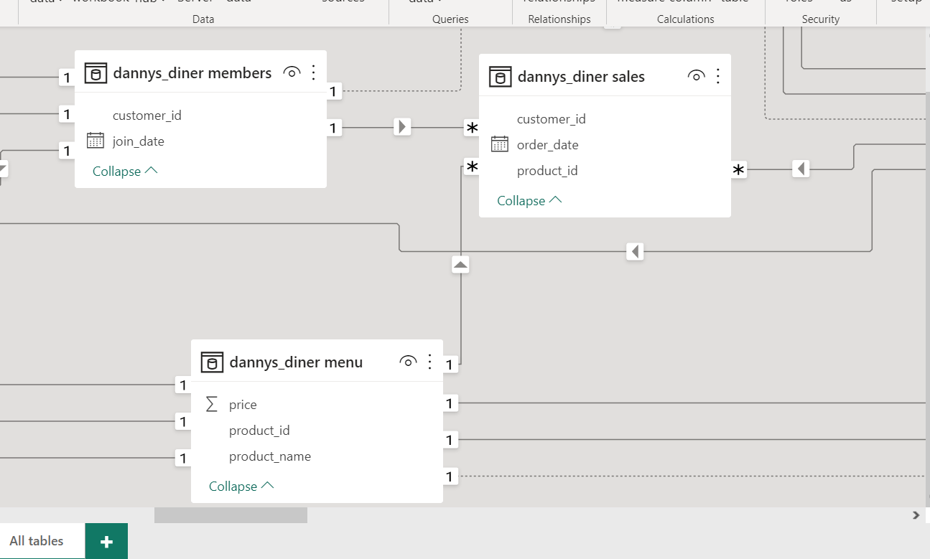
Data Modelling

Slide 6
1st Question
1.What is the total amount each customer spent at the restaurant?

Slide 7
SQL QUERY
SELECT customer_id,sum(price) as total_spent FROM sales s Join menu m on m.product_id=s.product_id
group by customer_id;

Slide 8
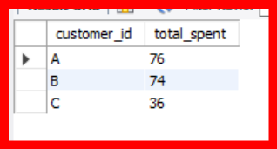
SQL OUTPUT

Slide 9
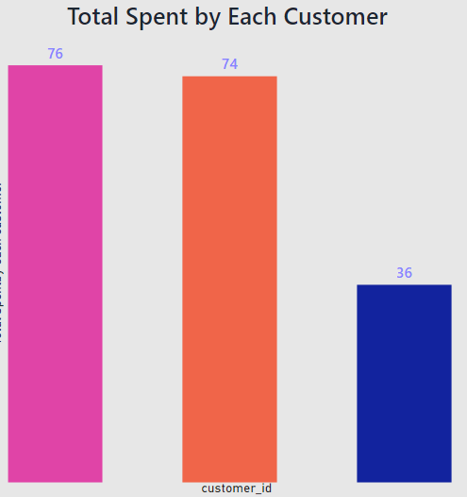

Slide 10
2nd Question
2)How many days has each customer visited the restaurant?

Slide 11
SQL QUERY
Select customer_id,
count(distinct(order_date)) as total_visits from salesgroup by customer_id;

Slide 12
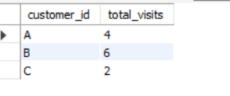
SQL OUTPUT

Slide 13
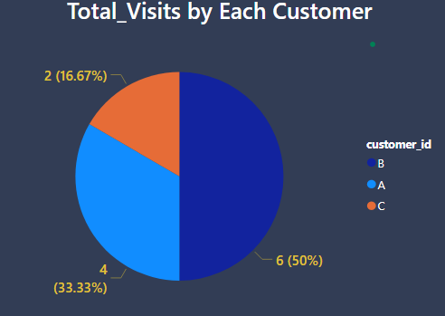

Slide 14
3rd Question
What was the first item from the menu purchased by each customer?

Slide 15
SQL QUERY
with cte1 as
(SELECT
s.*,m.product_name,m.price,
row_number()over
(partition by customer_id) as rn1
FROM dannys_diner.sales s
Join menu m On
s.product_id=m.product_id)
select customer_id,
product_name as first_Item_purchased
from cte1
where rn1=1;

Slide 16
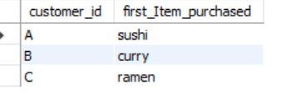
SQL output

Slide 17
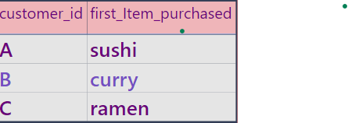

Slide 18
4th Question
What is the most purchased item on the menu and how many times was it purchased by all customers?

Slide 19
SQL QUERY
SELECT product_name,
count(product_id) as max_purchased_item
FROM joined_tablegroup
by product_id
order by max_purchased_item desc limit 1;

Slide 20
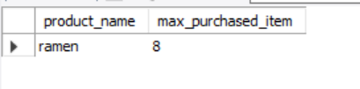
SQL OUTPUT

Slide 21
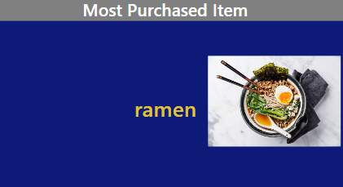

Slide 22
5th Question
Which item was the most popular for each customer?

Slide 23
SQL QUERY
with cte2 as(with cte1 as(SELECT
product_id,product_name,customer_id,count(product_id) as most_popular_itemFROM joined_tablegroup by product_id,customer_idorder by customer_id)select *,dense_rank()over(partition by customer_id order by most_popular_item desc) as drnkfrom cte1)select product_id,product_name,customer_id,most_popular_item from cte2 where drnk=1;

Slide 24
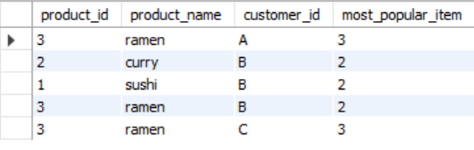
SQL OUTPUT

Slide 25
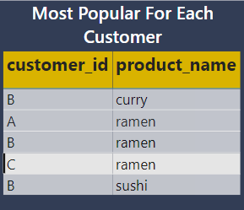

Slide 26
6th Question
Which item was purchased first by the customer after they became a member?

Slide 27
SQL QUERY
with cte1 as
(SELECT *,row_number()
over(partition by customer_id) as rn FROM dannys_diner.fullinfotable
where mem="YES")
select customer_id,product_name as first_item_purchased_aftermember
from cte1 where rn=1;

Slide 28
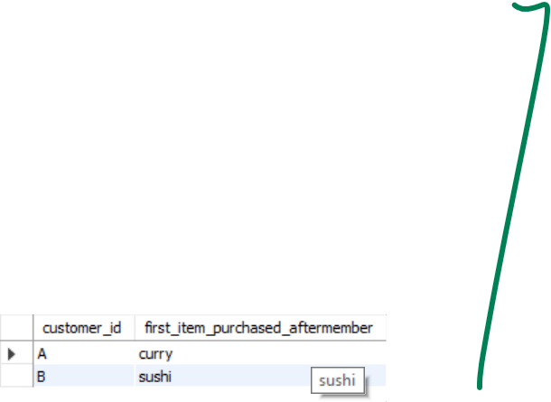
SQL OUTPUT

Slide 29
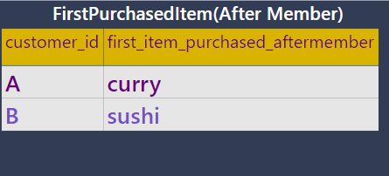

Slide 30
7th Question
Which item was purchased just before the customer became a member?

Slide 31
SQL QUERY
with cte2 as (with cte1 as
(SELECT * FROM dannys_diner.fullinfo_tble where rnk=0 and customer_id in("A","B")) select customer_id,product_name,
order_date,dense_rank() over
(partition by customer_id order by order_date desc) as drnk from cte1)
select customer_id,product_name as last_purchased_beforemember from cte2 where drnk=1;

Slide 32
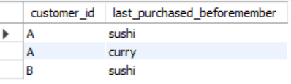
SQL OUTPUT

Slide 33
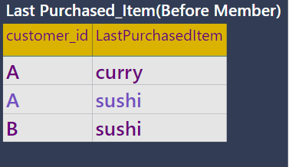

Slide 34
8th Question
What is the total items and amount spent for each member before they became a member?

Slide 35
SQL INPUT
with cte1 as(SELECT s.*,m.product_name,m.price,case when(customer_id="A" and order_date>='2021-01-07') then "YES" when(customer_id="B" and order_date>='2021-01-09') then "YES" else "NO" end as memFROM sales s join menu m on s.product_id=m.product_id) select customer_id,sum(price) as total_spent from cte1 where mem="NO" and customer_id in ("A","B") group by customer_id;

Slide 36

SQL OUTPUT

Slide 37
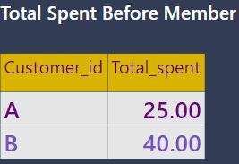

Slide 38
9tH QUESTION
If each $1 spent equates to 10 points and sushi has a 2x points multiplier,how many points would each customer have?

Slide 39
SQL INPUT
SELECT customer_id,
sum(case when product_name="sushi" then (2*10*price)
else (1*10*price) end)as points
FROM sales s join menu m on s.product_id=m.product_id group by customer_id;

Slide 40
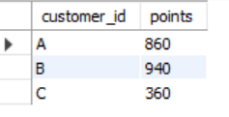
SQL OUTPUT

Slide 41
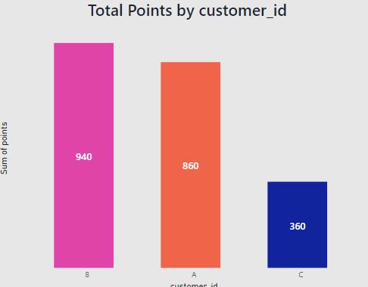

Slide 42
10TH QUESTION
In the first week,after a customer joins the program (including their join date) they earn 2x points on all items,not just sushi - how many points do customer A and B have at the end of January?

Slide 43
SQL INPUT
WITH dates_cte AS ( SELECT *, DATE_ADD(join_date,interval 6 day) AS valid_date, last_day('2021-01-07') AS last_date FROM members AS m)
SELECT d.customer_id,
SUM(CASE WHEN m.product_name = 'sushi' THEN 2 * 10 * m.price WHEN s.order_date BETWEEN d.join_date AND d.valid_date THEN 2 * 10 * m.price ELSE 10 * m.price END) AS points
FROM dates_cte AS d JOIN sales AS s ON d.customer_id = s.customer_idJOIN menu AS m ON s.product_id = m.product_id WHERE s.order_date < d.last_date GROUP BY d.customer_id

Slide 44
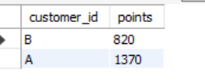
SQL OUTPUT

Slide 45
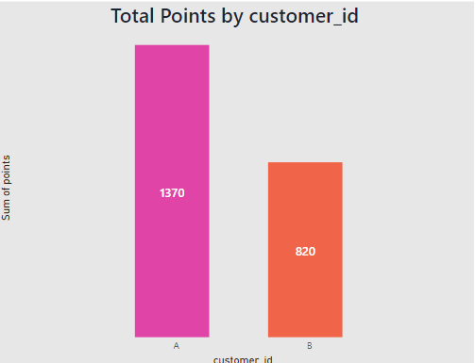

Slide 46
THANK YOU

