Slide 1


San Francisco Airport Data Analysis
Created by H.Achutha Rugvedi

Slide 2
Problem Statement:
Learn to develop Airport and Airline data analysis dashboard development. Prepare a project to identify where the various flights are going and what will be the busiest and most used routes from the airport. Also, create a hidden filter within the dashboard.
Find key metrics and factors and show the meaningful relationships between attributes.
Do your own research and come up with your findings.

Slide 3
APPROACH
Understanding Problem Statement
Collecting and understanding the data
Data Cleaning, Data Transformation, Data Modeling
Data Visualization using Power Bi

Slide 4
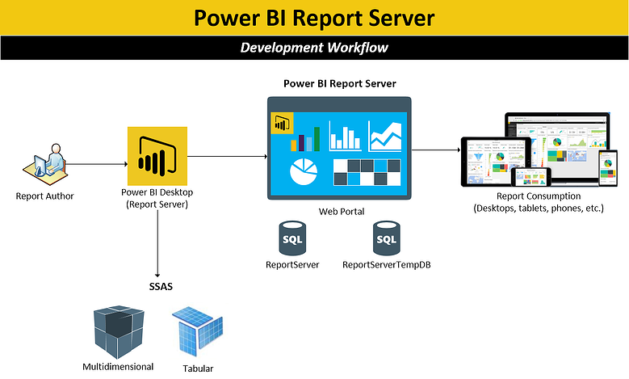

Slide 5
Why we do Airport Data Analysis?
Airport data analytics are considered the enabler to unleash key information and knowledge that will help to address many of the key areas where airports face challenges.
These areas extend to almost every facet of airport processes, from purely operational ones – such as airport resource usage optimization, maintenance, and airport capacity – to non–aeronautical revenue intensification and passenger experience maximization.

Slide 6
Which Data We Used It ?
For this project, we used data from the San Francisco Airport for March 2020. To proceed we have taken the important aspects like Coordinates, Route, Date, Base Airline, Terminal (Gate No.), Actual time, and Estimated time. In order to get data for the Airport and Airlines we have added the dataset for Airport information (City, IATA, Country, Name, Code). Using this information, we have figured most common destinations that were frequent from San Francisco, the busiest route covered along with the distance covered during those flights.

Slide 7
Steps Followed:
CLEANING
Collecting the data from the sources.
Performing the data cleaning with the help of PowerQuery.
Transforming
Removed irrelevant columns such as Properties Edtf Cessation, Properties Edtf Inception, and Properties Flysfo Base Flight Number.
Splitting the route column by delimiter into two columns named to_city and from_city.
Transforming
Performing conditional replacement in Properties Flysfo Base Airline.
Converting Properties Flysfo Estimated Timestamp and Properties Flysfo Actual Timestamp to Estimated date time and Actual Date Time Columns with the help of M language.

Slide 8
Continue..
Transforming
Created diff columns by subtracting actual date time from estimated date time.
Connected
To PowerBi
Connected the clean data to Powerbi
After the connection created the date column using the time intelligence function of DAX
Model created
Prepare a model connection in power bi in model view.
Created different Visuals to anlayse the data.
Created a Conditional Column for terminals and Flight Status

Slide 9
Measures created:
Created measures like average delay,Total flights landed,Total Flights takeoff,Arrival status board and departure status board.
Solving with problem by showing different visuals in powerbi with help of flowmap,tables,slicers,donutcharts,line charts,etc
The route mapshows all the different flying routes from the San Francisco Airport.

Slide 10
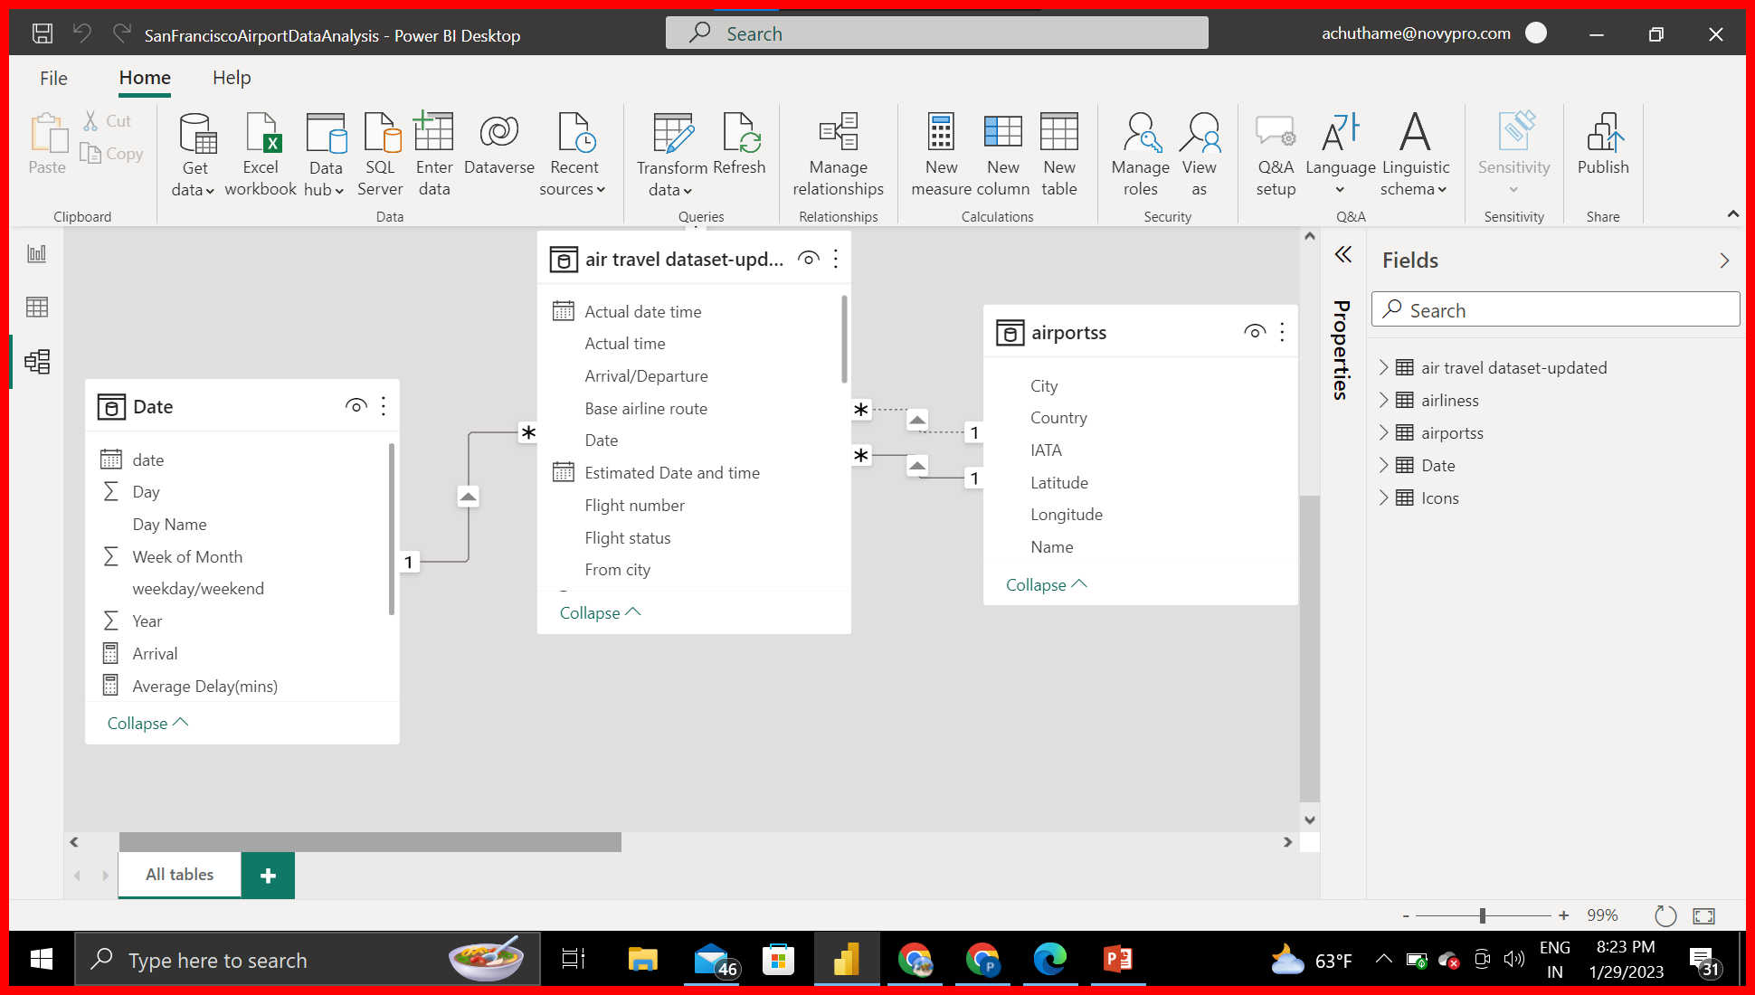
Data Modelling
Linking the Airports data to airtravel dataset using IATA codes and their cities with to and from city in air travel dataset.

Slide 11
Insights:
March 6th 2020 had the highest total Number of flights at 3295 and was 67.34% higher than 26th March 2020 which had the lowest total Number of flights at 1969.
March 6th 2020 accounted for 3.72% of total Number of flights.
Across all 31 Days of march 2020,Total Number of flights ranged from 1969 to 3295.
Maximum number of flights have flown in SFO-LAX route (4036) in March 2020.
Los Angeles was the most frequent destination from San Francisco airport with a Count of 4,036 followed by New York and Seattle.
Los Angeles accounted for 8.63% of the flights Taken off from San Francisco
﻿﻿ Week 4 was the busiest week with 35% of the Month.

Slide 12
Insights:
The Count of Reschedule Flights was 44,116, followed by On-time at 30,129 and Delay at 14,276.
﻿﻿
Reschedule accounted for 49.84% of the Count of Flight Status.﻿﻿
﻿Terminal 3 was the busiest terminal at 35,727, followed by Terminal 2, International Terminal, and Terminal 1.﻿﻿
Terminal 3 was accountable for 46.92% of the Count of Terminal.﻿﻿
﻿ Count of Landed flights was 45,573 which was higher than the take-off flights that are 42,948.
﻿﻿﻿﻿ Landed flights in San Fransisco were accountable for 51.48%.

Slide 13
Thank You

