Slide 1
AETHER
AI-POWERED ENERGY MANAGEMENT SYSTEM
FOR INDUSTRIAL COST REDUCTION
An intelligent platform for energy monitoring, forecasting,
anomaly detection and recommendation-driven decisions.
PROJECT REVIEW · OCTOBER 2026
INSTITUTION - Easwari Engineering College
DEPARTMENT Computer Science & Engineering
STUDENT - Achuthanaathan S · GUIDE - Ms. Nagamani Segalla
FASTAPI · PYTHON · SQLITE · SCIKIT-LEARN

Slide 2
AETHER / 02
Problem Statement
Four challenges that limit effective industrial energy management
01 Limited energy visibility
02 Unexpected consumption
Consumption across multiple machines can be difficult to interpret in one unified view.
Unusual energy patterns may go unnoticed, delaying investigation and corrective action.
03 Uncertain future demand
04 Limited actionable guidance
Without forecasting, operators have limited support for anticipating energy usage.
Monitoring data alone does not explain which actions may reduce consumption or how outcomes can be evaluated.
THE CORE PROBLEM
Turn energy data into understandable insights, actionable recommendations and evaluated outcomes.
AETHER · PROJECT REVIEW
02

Slide 3
AETHER / 03
Existing System
Traditional energy monitoring and management
01
Collect
Energy readings are gathered from meters, machines or monitoring systems.
02
Review
Operators inspect dashboards, reports and historical consumption.
03
Investigate
Unusual readings are checked through manual review or threshold alerts.
04
Decide
Energy-saving actions are selected using available reports and operator experience.
05
Evaluate
The impact of actions may be difficult to measure consistently.
Common approaches: basic dashboards · manual analysis · threshold alerts · conventional reporting
AETHER · PROJECT REVIEW
03

Slide 4
AETHER / 04
Limitations of the Existing System
Why a more intelligent and connected workflow is needed
Reactive monitoring
Limited forecasting
Problems may be noticed only after unusual consumption occurs.
Historical readings may not be used to estimate future demand.
Manual anomaly review
Fragmented decisions
Unexpected patterns can be difficult to detect by observation alone.
Insights, recommendations, approvals and outcome tracking may be disconnected.
Difficult savings evaluation
Expected savings need comparison with simulated or measured results.
THE GAP
One workflow linking monitoring, ML insights, operator decisions and savings evaluation.
AETHER · PROJECT REVIEW
04

Slide 5
AETHER / 05
Proposed Solution
AETHER transforms historical energy data into decision support
01
02
03
04
05
06
MONITOR
›
FORECAST
›
DETECT
›
RECOMMEND
›
REVIEW
›
EVALUATE
Simulated hourly readings
Linear Regression
Isolation Forest
Rule-based logic
Operator decision
Simulated savings
CURRENT SCOPE
Simulated data and simulated actions only. No direct physical equipment control; savings are estimates, not validated real-world results.
Goal: help operators understand consumption, spot unusual patterns and review potential energy-saving actions.
AETHER · PROJECT REVIEW
05

Slide 6
AETHER / 06
Frontend Development
Interactive dashboard built with HTML, CSS and vanilla JavaScript
Dashboard & monitoring
Analytical views
Decision workflow
• Centralized energy overview
• Historical machine readings
• Clear consumption presentation
• Forecasting interface
• Anomaly results
• Recommendation review
• Approve or reject recommendations
• Simulated action views
• Estimated savings presentation
HTML
CSS
JavaScript
Page structure
Layout and styling
Interaction and API calls
AETHER · PROJECT REVIEW
06

Slide 7
AETHER / 07
Backend Development
FastAPI services integrate application logic and machine learning
FastAPI
Python
Provides backend routes and application services.
Processes energy readings and analytical operations.
Linear Regression
Isolation Forest
Estimates future consumption from historical data.
Identifies unusual energy consumption patterns.
Rule-based logic
SQLAlchemy
Produces potential energy-saving recommendations.
Coordinates application database operations.
PROCESS
Request → Retrieve data → Analyse → Generate recommendation → Return results to dashboard
AETHER · PROJECT REVIEW
07

Slide 8
AETHER / 08
Database Integration
SQLite with SQLAlchemy
AETHER APPLICATION
↔
SQLALCHEMY
↔
SQLITE
Python · FastAPI
ORM / DB operations
Relational storage
Why SQLite?
Deployment consideration
Lightweight storage that runs locally without a separate database server.
Render free-tier local storage is ephemeral; database changes may not survive restarts or redeploys.
Describe exact entities and fields from the implemented SQLAlchemy models.
AETHER · PROJECT REVIEW
08

Slide 9
AETHER / 09
API Development
FastAPI connects the frontend with energy-management services
Energy monitoring
Provides energy information for dashboard presentation.
Forecasting
Exposes Linear Regression prediction functionality.
Anomaly detection
Provides results from Isolation Forest analysis.
Recommendations
Returns rule-based energy-saving recommendations.
Operator decisions
Supports recommendation approval or rejection.
Simulation & savings
Presents simulated actions and estimated savings.
Confirm exact route paths and HTTP methods from the current FastAPI source before listing endpoint names.
AETHER · PROJECT REVIEW
09

Slide 10
AETHER / 10
Module-wise Implementation
The main capabilities delivered in AETHER
01 ENERGY MONITORING
02 FORECASTING
03 ANOMALY DETECTION
30 days of hourly simulated readings across four machines.
Linear Regression-based future consumption estimates.
Isolation Forest identification of unusual patterns.
04 RECOMMENDATIONS
05 SIMULATION
06 SAVINGS EVALUATION
Rule-based suggestions for potential energy-saving actions.
Operator decisions and simulated intervention workflow.
Estimated savings presented as illustrative outcomes.
All results are based on the current simulated-data prototype.
AETHER · PROJECT REVIEW
10

Slide 11
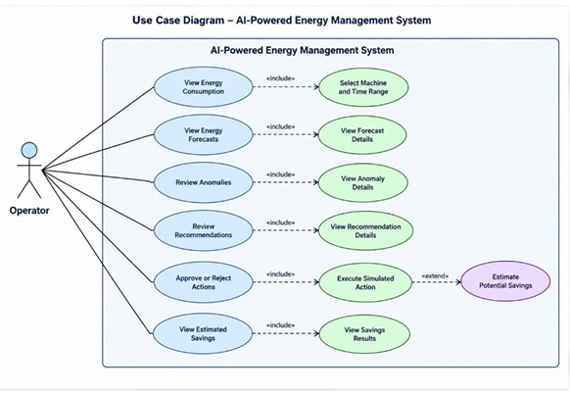
AETHER / 11
Use Case Diagram
Operator interactions with the AETHER application
AETHER · PROJECT REVIEW
11

Slide 12
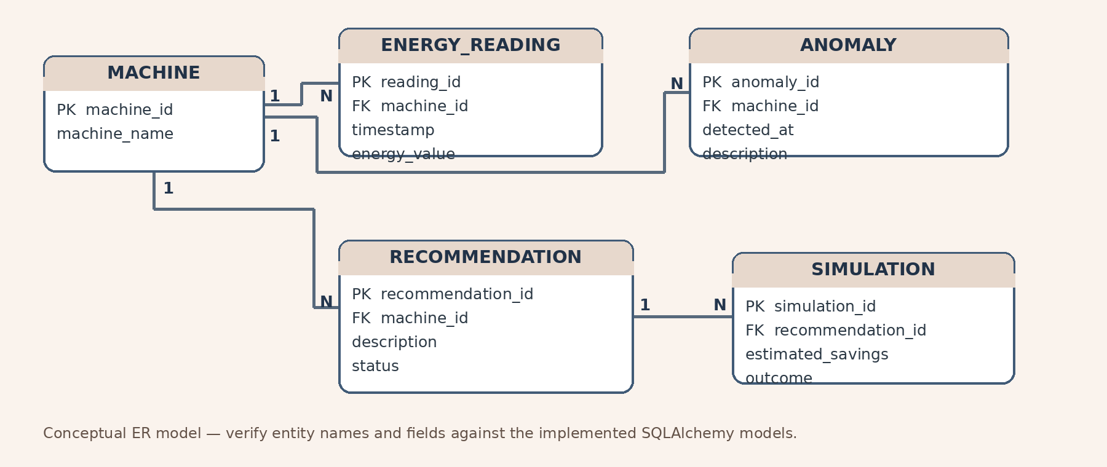
AETHER / 12
ER Diagram
Conceptual data model for energy readings, anomalies, recommendations and simulations
AETHER · PROJECT REVIEW
12

Slide 13
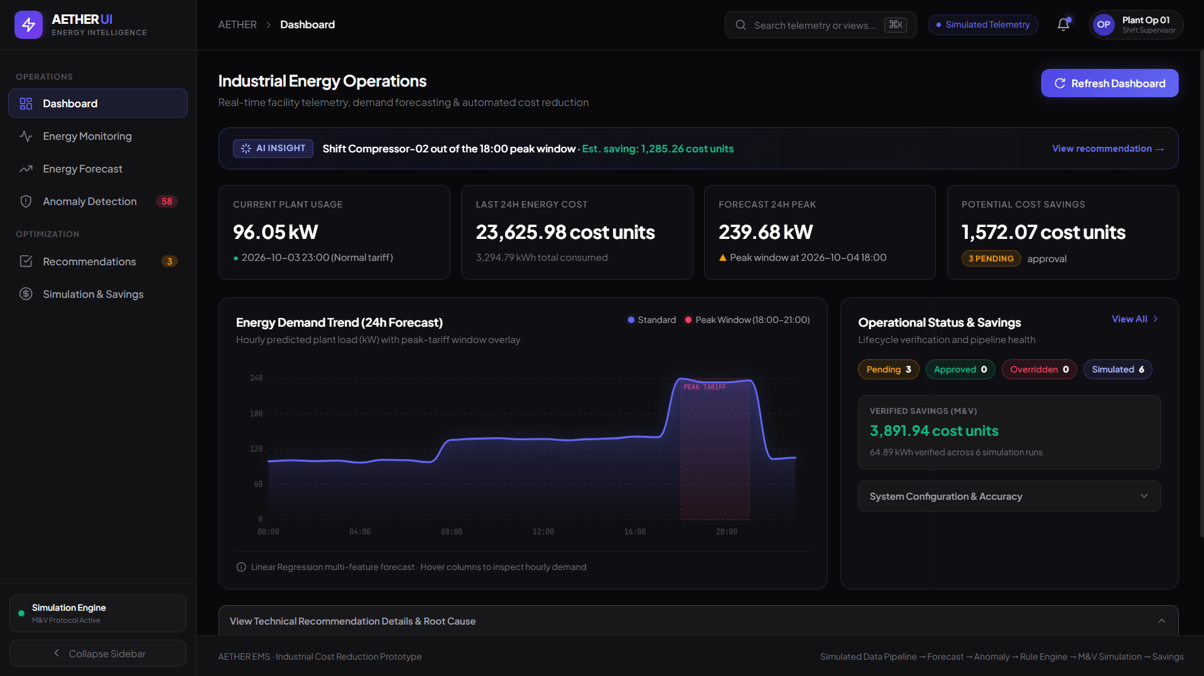
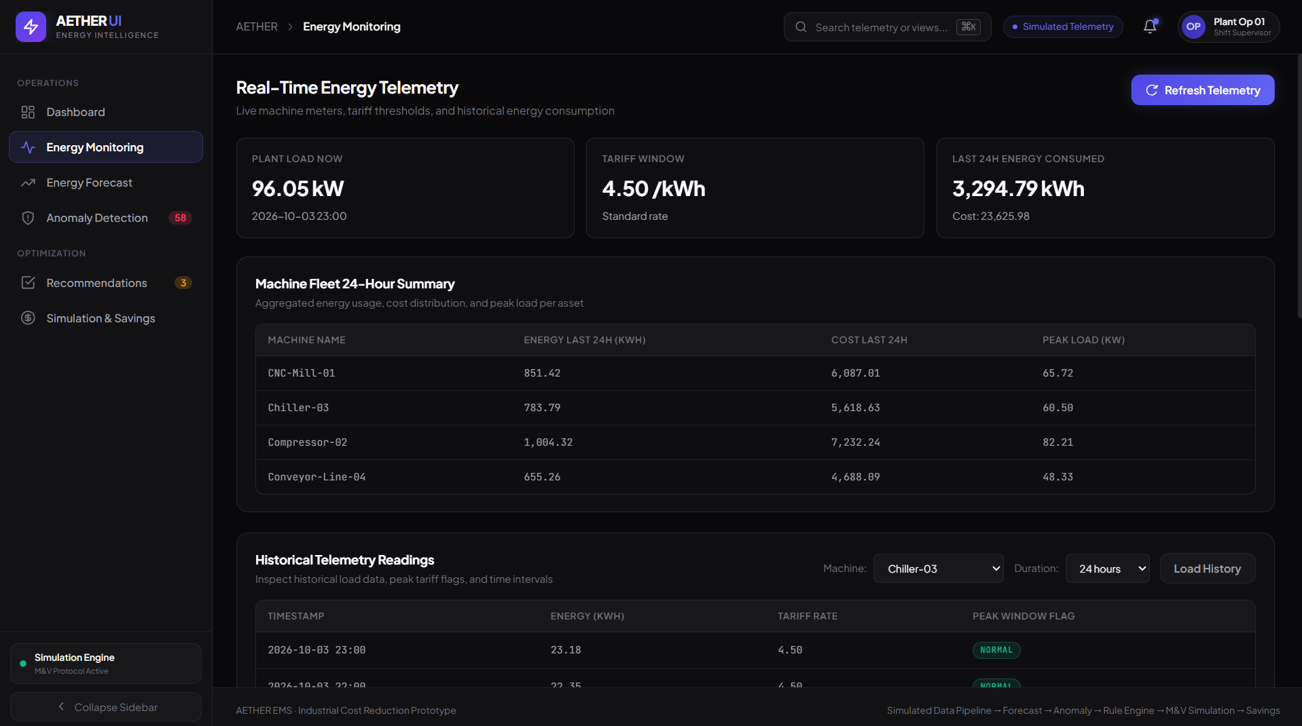
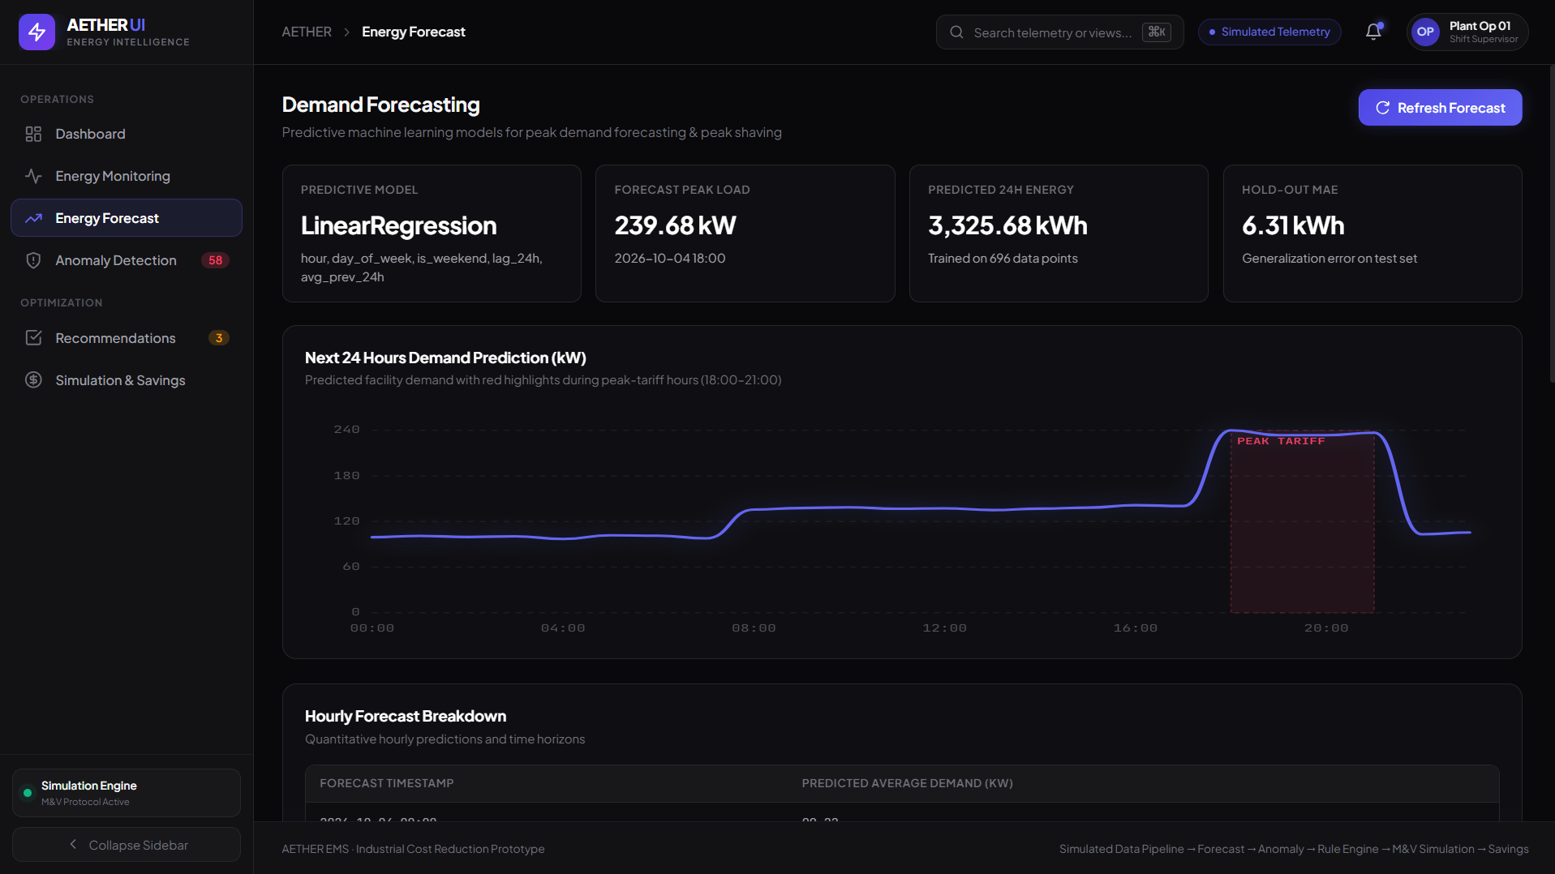
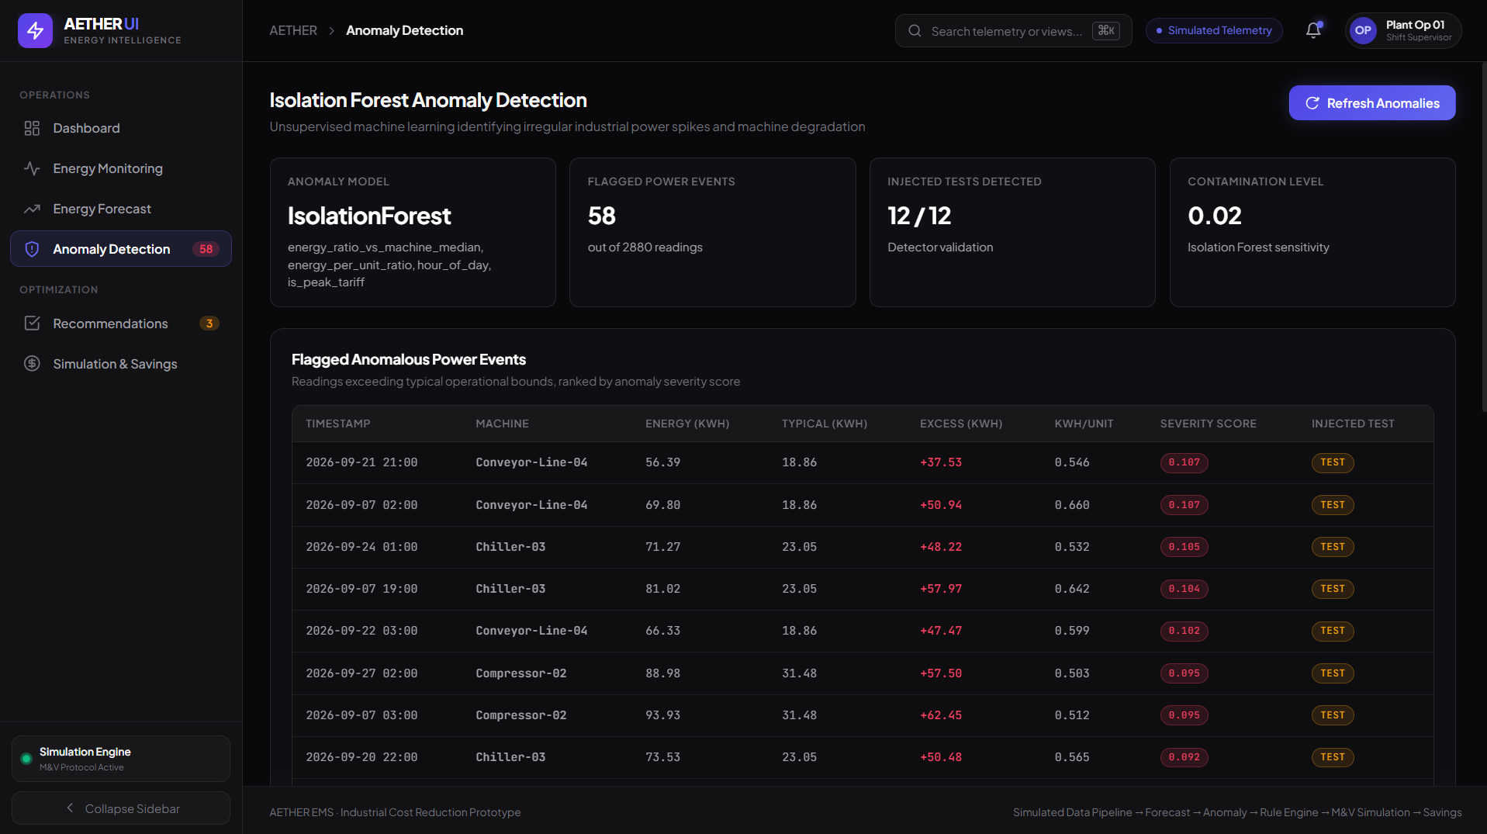
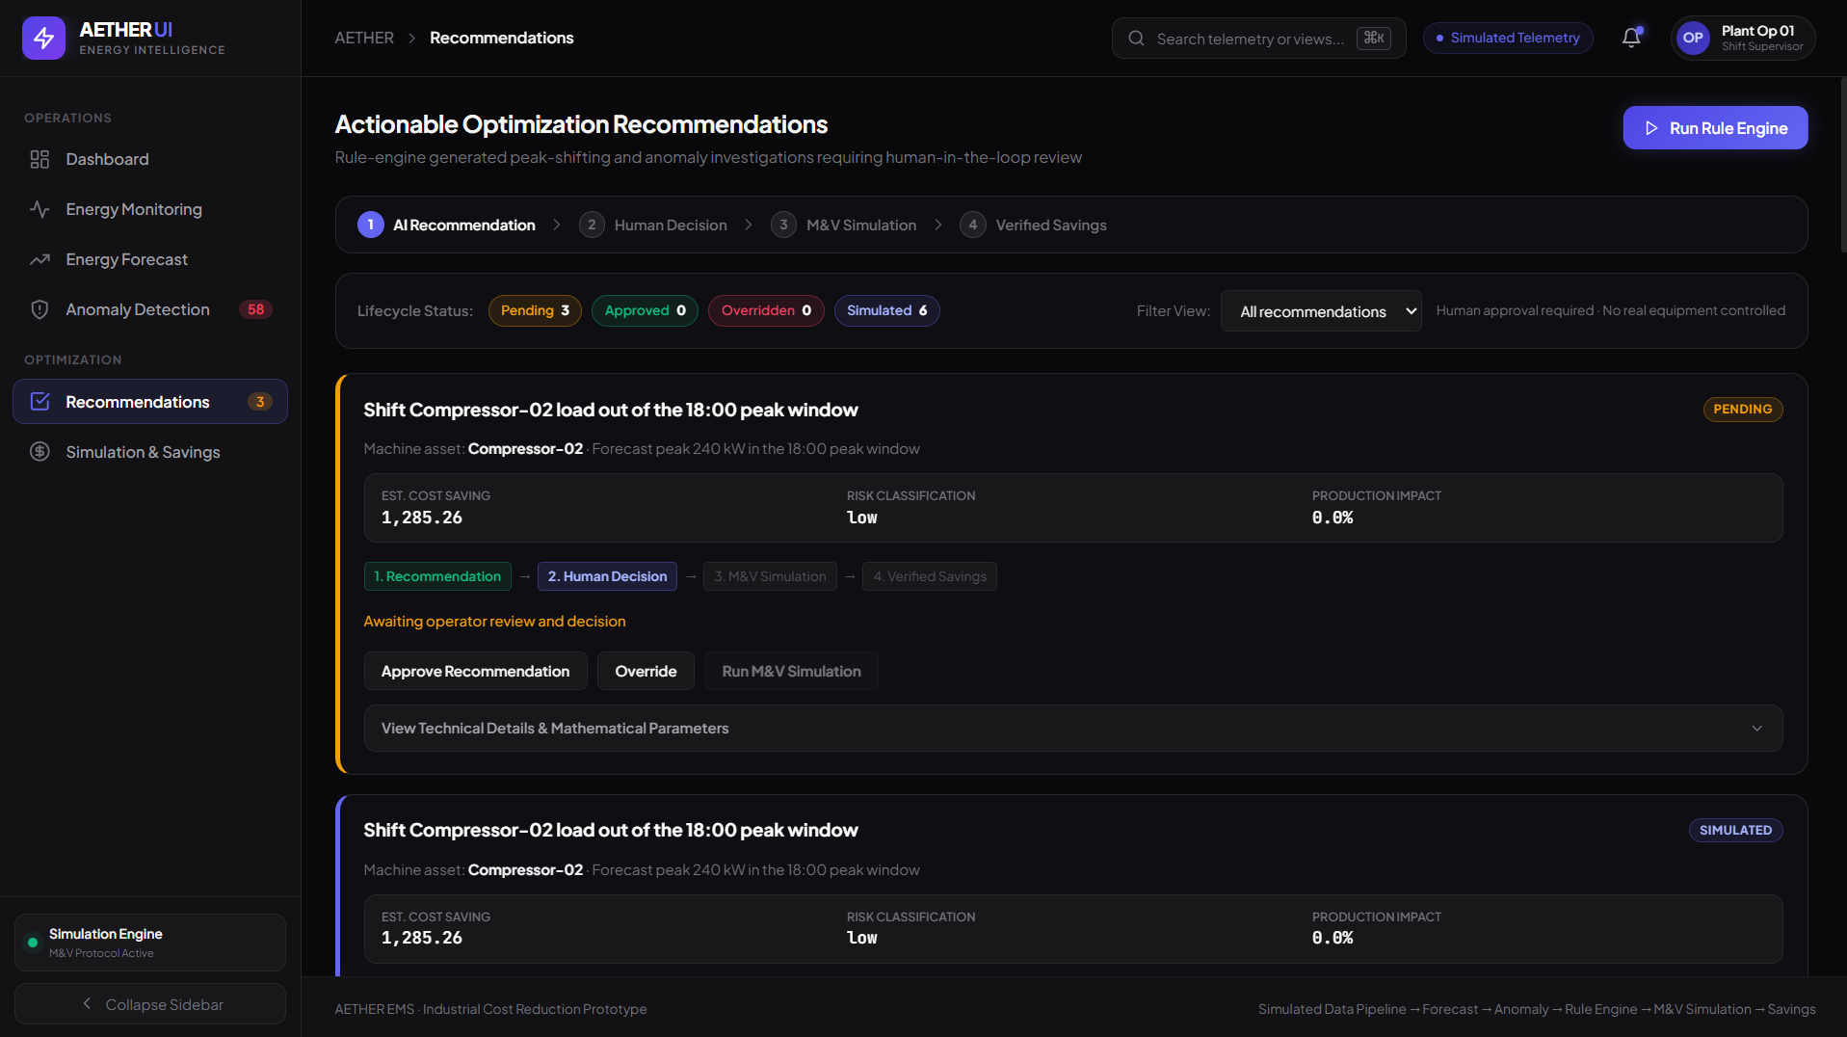
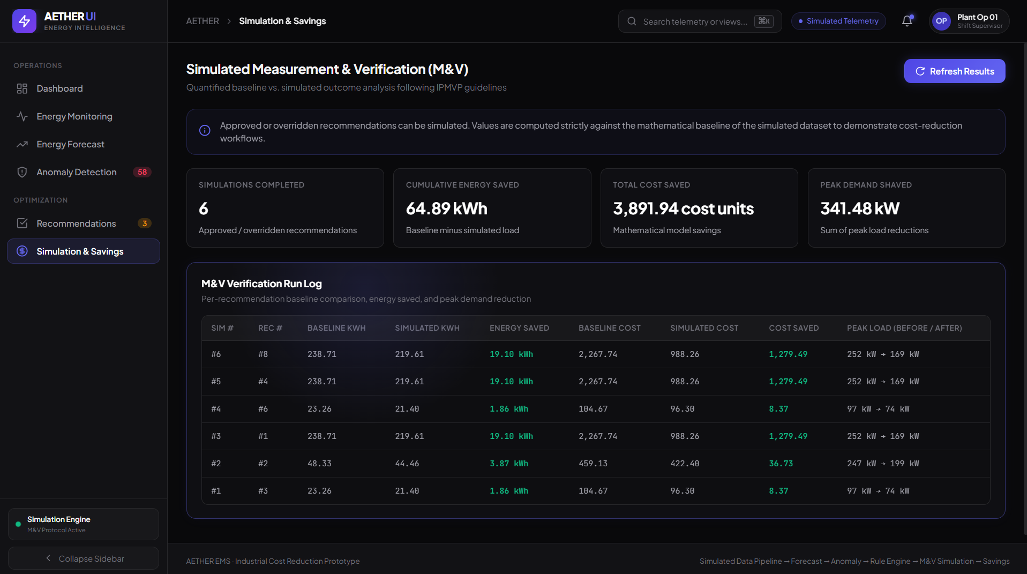
AETHER / 13
Application Screenshots
Replace placeholders with screenshots from the live AETHER deployment
INSERT SCREENSHOT
INSERT SCREENSHOT
INSERT SCREENSHOT
MAIN DASHBOARD
ENERGY MONITORING
FORECASTING
INSERT SCREENSHOT
INSERT SCREENSHOT
INSERT SCREENSHOT
ANOMALY DETECTION
RECOMMENDATIONS
SIMULATION & SAVINGS
Live deployment: https://ai-energy-management-system.onrender.com/
AETHER · PROJECT REVIEW
13

Slide 14
AETHER / 14
Challenges Faced
Technical challenges and the approaches used in the prototype
01
Energy pattern analysis
Organised simulated hourly readings across multiple machines.
02
Forecasting
Integrated Linear Regression for consumption estimates.
03
Anomaly detection
Integrated Isolation Forest to identify unusual patterns.
04
Actionable recommendations
Added rule-based recommendation logic.
05
Frontend/backend integration
Connected UI interactions with backend services through FastAPI.
06
Demonstration deployment
Published the app using Render's free web-service tier.
Current scope excludes live sensors, physical equipment control and validated real-world savings.
AETHER · PROJECT REVIEW
14

Slide 15
AETHER / 15
Conclusion & Future Enhancements
AETHER connects energy data with intelligent decision support
WHAT WE DELIVERED
FUTURE ENHANCEMENTS
Monitoring — simulated machine readings
Forecasting — Linear Regression estimates
Detection — Isolation Forest anomaly identification
Recommendations — rule-based suggestions
Evaluation — simulated actions and estimated savings
Deployment — public demonstration website
• Real energy meters and IoT integration
• Evaluation on real industrial datasets
• Advanced forecasting and constrained optimization
• Measurement of actual energy savings
• Secure authentication, roles and audit logs
• SCADA/BMS integration and persistent hosting
AETHER demonstrates how machine learning can support monitoring, forecasting, anomaly insights and recommendation-driven energy decisions.
AETHER · PROJECT REVIEW
15

Slide 16
THANK YOU
Questions & Feedback
AETHER · AI-Powered Energy Management System
Project Review · October 2026
https://ai-energy-management-system.onrender.com/
FASTAPI · PYTHON · SQLITE · SCIKIT-LEARN

