Slide 1

Tourism and GDF
Team Members: -
Sushma Chirra- 11558420
Achyutanand Mishra- 11542607
Ram Rallabandi – 11547220

Slide 2
Introduction
The importance of the international tourism sector and its impact on a country's economy, specifically its Gross Domestic Product (GDP). The project aims to analyze the correlation between inbound tourism and GDP using data and visualizations. The text also highlights the benefits of the tourism sector in providing jobs, finance, and economic growth, and how it was the largest source of economic growth before the COVID-19 pandemic. The text emphasizes the iterative process of data visualization to meet user requirements.

Slide 3

Methodology

Slide 4
Understanding the Business
Understand the business goals and objectives
Collecting Data
Collect data from the sources
Organize the data into a structured format
Data Preparation
To prepare the data for analysis, clean and convert it.
Data Validation
Identify any errors and anomalies in the data
Visualization
To represent the data, employ essential visualization approaches.
Utilized software such as Tableau, Viz Hub, or Python libraries to create the visualization.

Slide 5
Tools
Tableau
Viz Hub
Python

Slide 6
Dataset
https://github.com/Achyut2995/DataVisualization/blob/main/travel_data.xls

Slide 7

Analysis

Slide 8
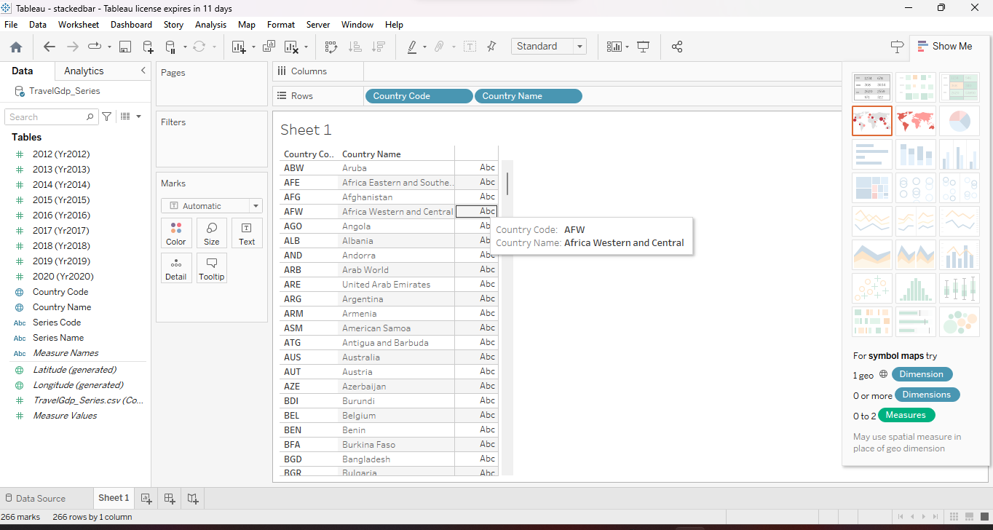

Slide 9
Tableau application is used to visualize the data.
From the dataset we took the Country name and Country code and put both the data into the Row shelf.
The output is displaying all the country names and Country code in the form of table.

Slide 10
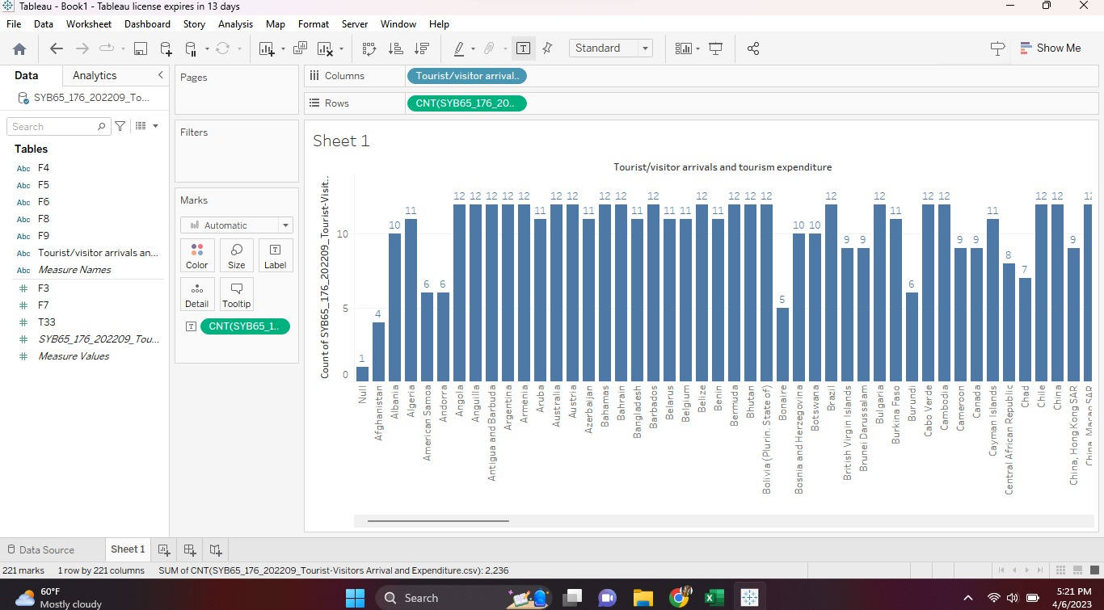

Slide 11
The bar graph is displayed in tableau application with the help of the dataset.
The bar graph represent the tourist arrival and tourist expenditure.
X-axis represent all the countries name and the Y-axis represent the count of international tourist receipt of each country.
In the Y-axis receipt data represent in 5 counts.
Most of the countries shows with the 12 counts of international tourist receipt.

Slide 12
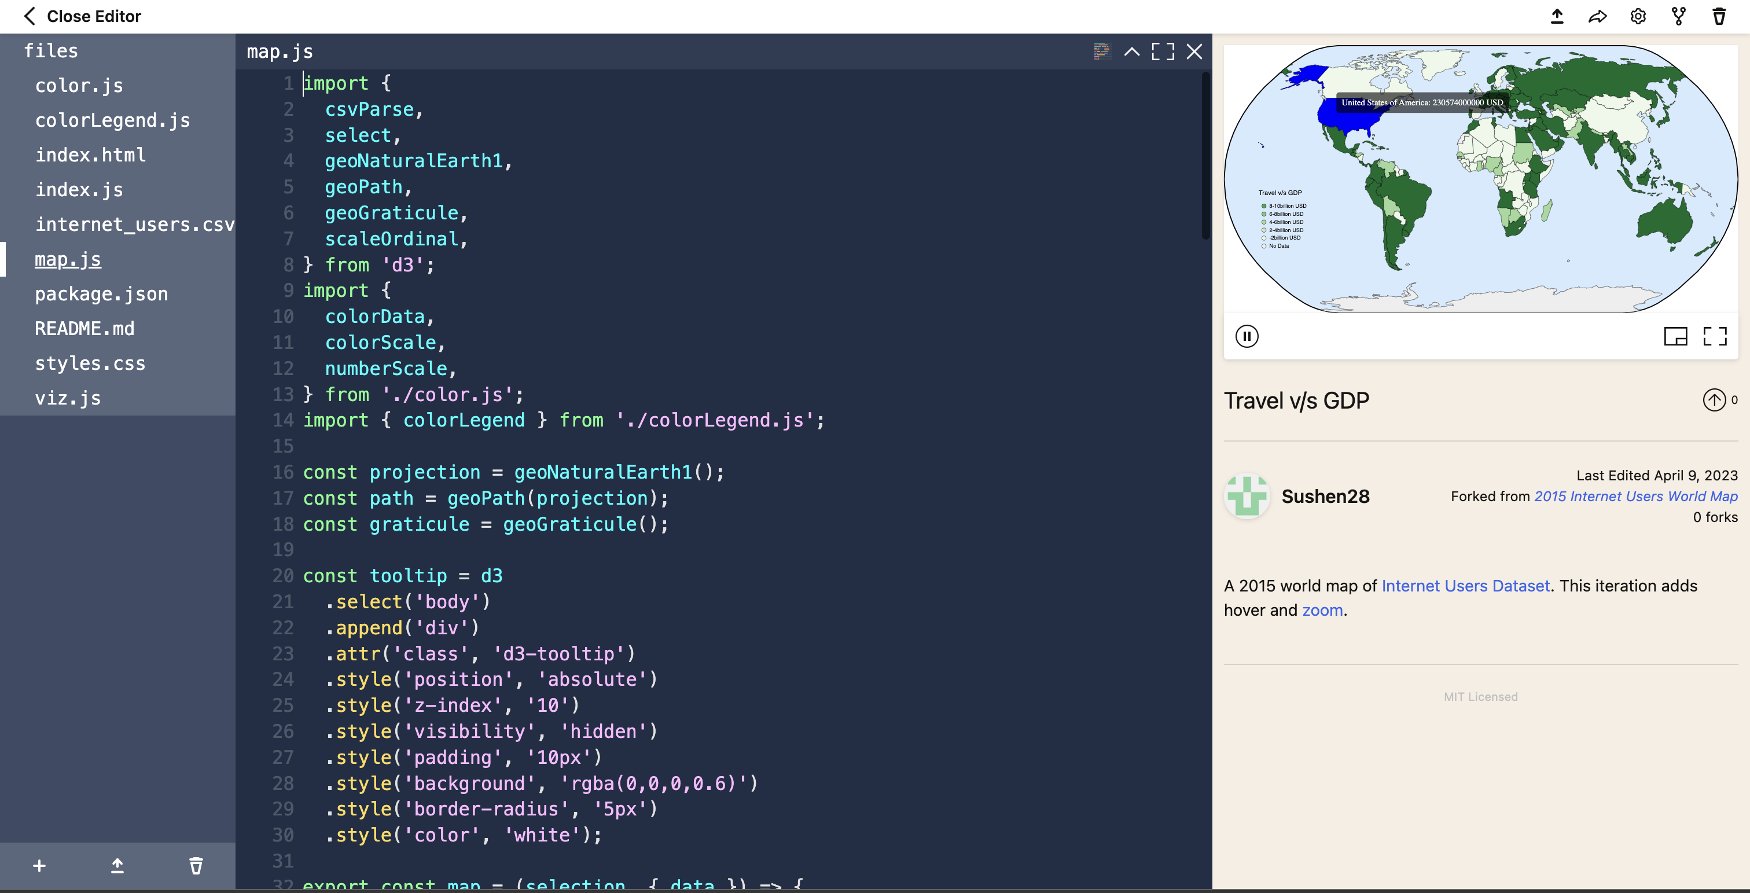

Slide 13
Viz hub is used to display the world map with the tourist data.
In this map we can see that the particular country’s GDP with the help of the tourism.
We can Hover to any country and see the GDP generated throughout the Tourism.

Slide 14
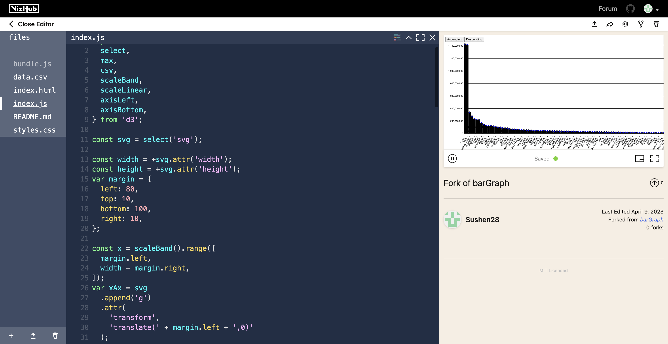

Slide 15
• China, US, India has the highest gross GDP from 2017
• Falkland Islands, Niueu,Vatican city have the least gross GDP
• The highest GDP was 14 billion $
• The least reported was less than 20 million $

Slide 16
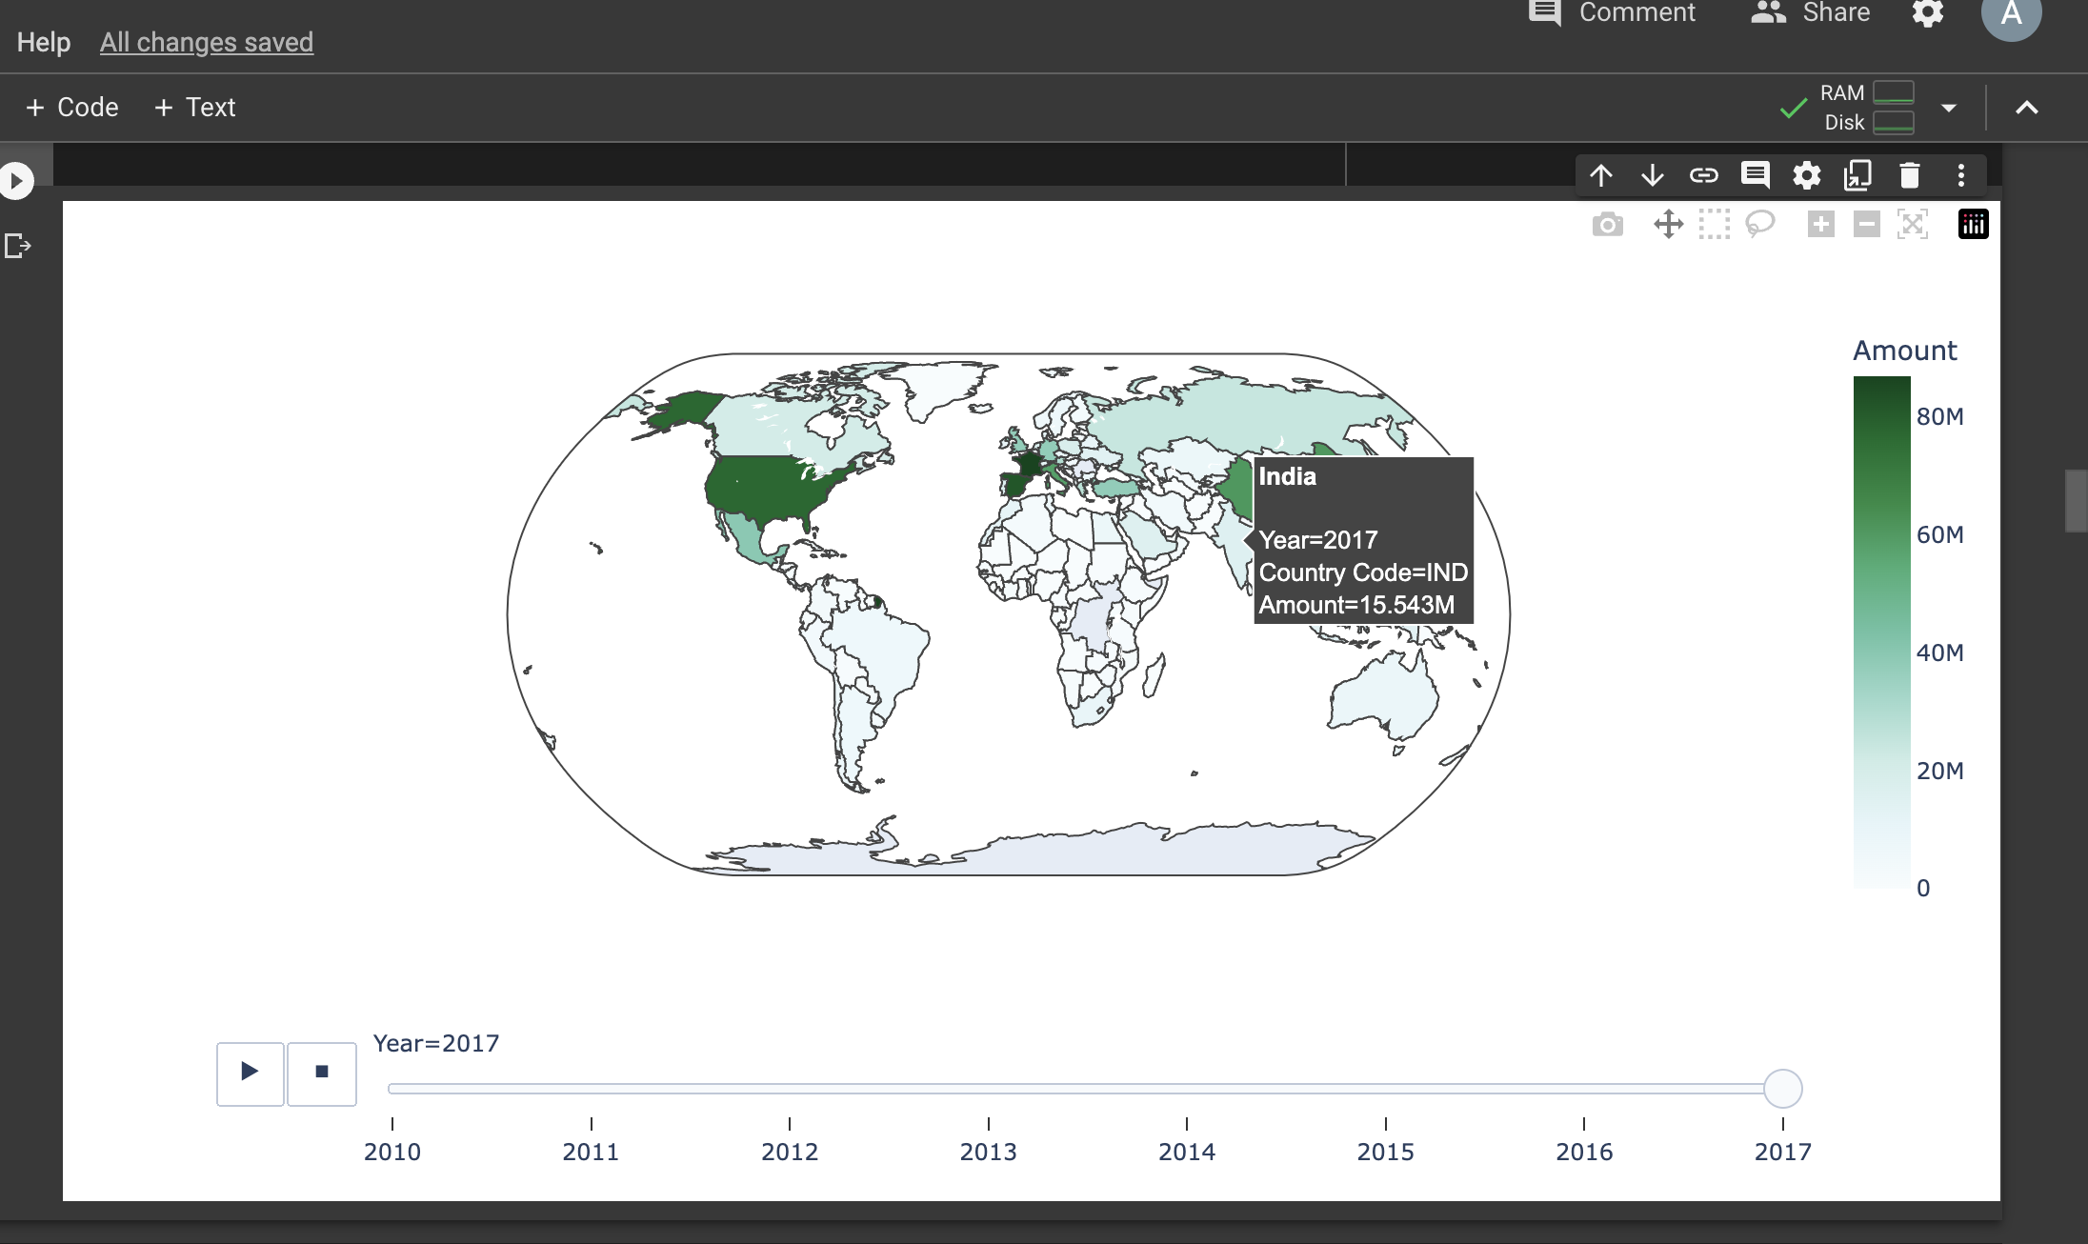

Slide 17
The World map chart represent the inbound tourists in all the countries.
We can hover in any countries and see the amount generated through the tourism in the particular year of any Country.
In the image we have hover the India tourism and see the data of year 2017 so we analyzed that the in the year 2017 the amount shows 15.543M and the country Code is IND.
We can give any year in the code and analyze any country GDP according to the tourism with the following Country code and Country Name.

Slide 18
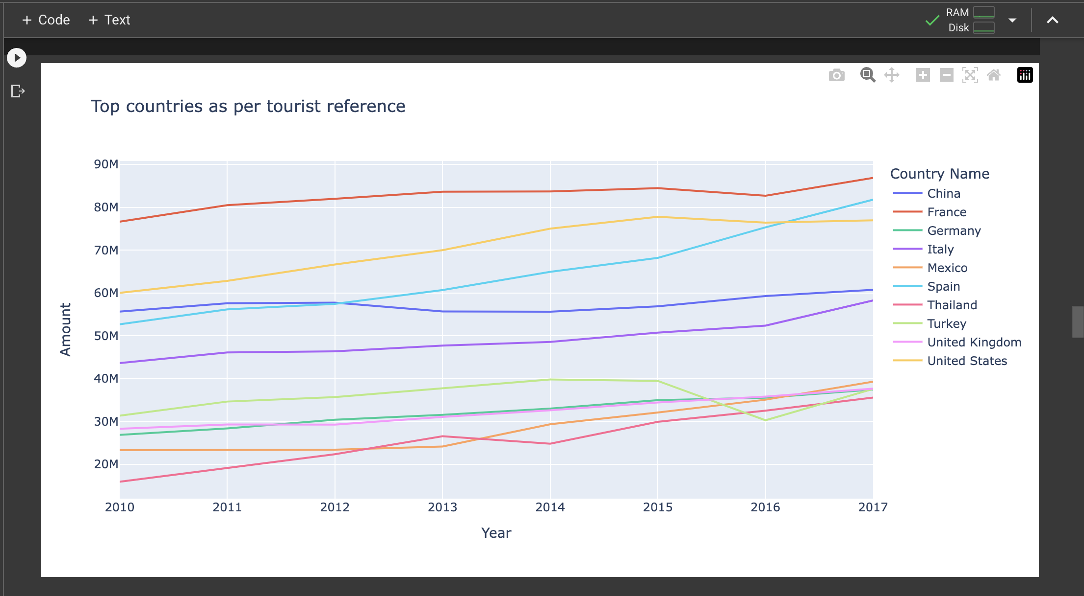

Slide 19
The Line graph represent the top countries which is most preferable by the tourist.
With the help of python code with plot the line graph and in this graph, we can see that the right side of the graph all the top 10 preferable countries are listed.
All countries are represented by some color. X-axis represent the Year(2010-2017) and the y-axis represent the Amount generated by the particular Country through out the year.
In the line graph we can see that the France is the most popular among all the countries.
Thailand is the least popular in this list.

Slide 20


Preliminary result

Slide 21
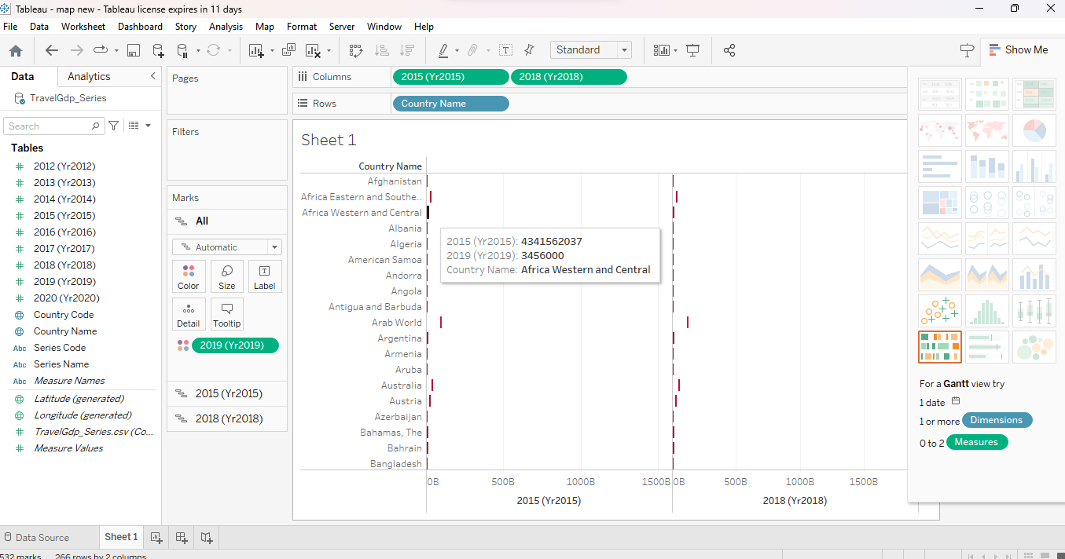
Tableau

Slide 22
Tableau

Slide 23
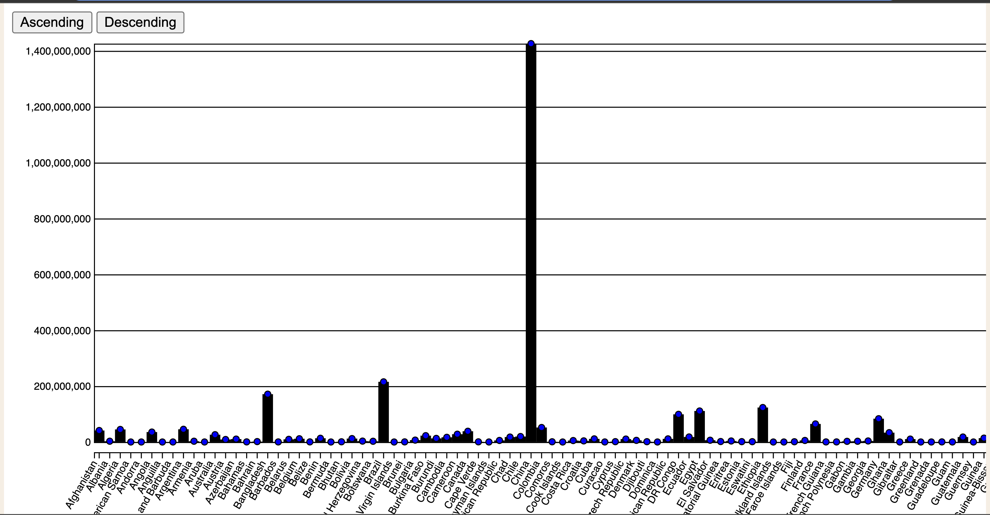
Viz Hub

Slide 24
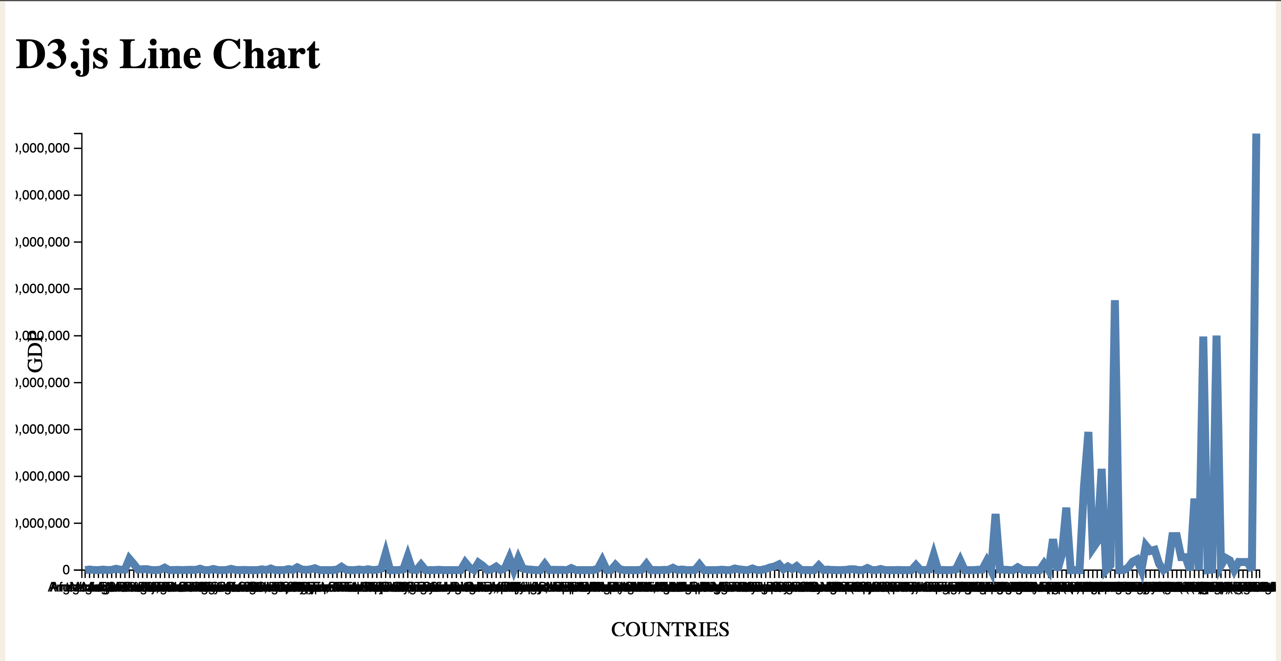
Viz Hub

Slide 25
Python

Slide 26
Python

Slide 27
REFERENCES:
Wikipedia: GDP vs tourism https://en.wikipedia.org/wiki/Impacts_of_tourism Python libraries: https://docs.python.org/3/library/
https://help.tableau.com/current/pro/desktop/en-us/reference_lines.htm

