Slide 1

RetailSense AI
Your AI Co-pilot for Smarter Retail.

Slide 2


The way we manage retail is longer working.
Running a successful retail business is harder than ever. You are surrounded by data from sales and stock systems, but starved of the simple insi•hts needed to make critical decisions.
Retailers consistently struggle with tracking sales, stock levels, and forecasting demand.

Slide 3




The Hidden Costs of ‘Good Enough’
Manual analysis is not just slow; it directly impacts your bottom line. These are the daily realities:
Lost Revenue
Unnoticed low-stock situations mean turning away customers who are ready to buy.
Wasted Hours
Valuable time is spent manually wading through spreadsheets to analyse sales and stock.
Missed Opportunities
Top-selling items are not identified quickly enough to maximise their potential.
Reactive Firefighting
Without forecasting, you're constantly reacting to shifts in demand instead of preparing for them.

Slide 4
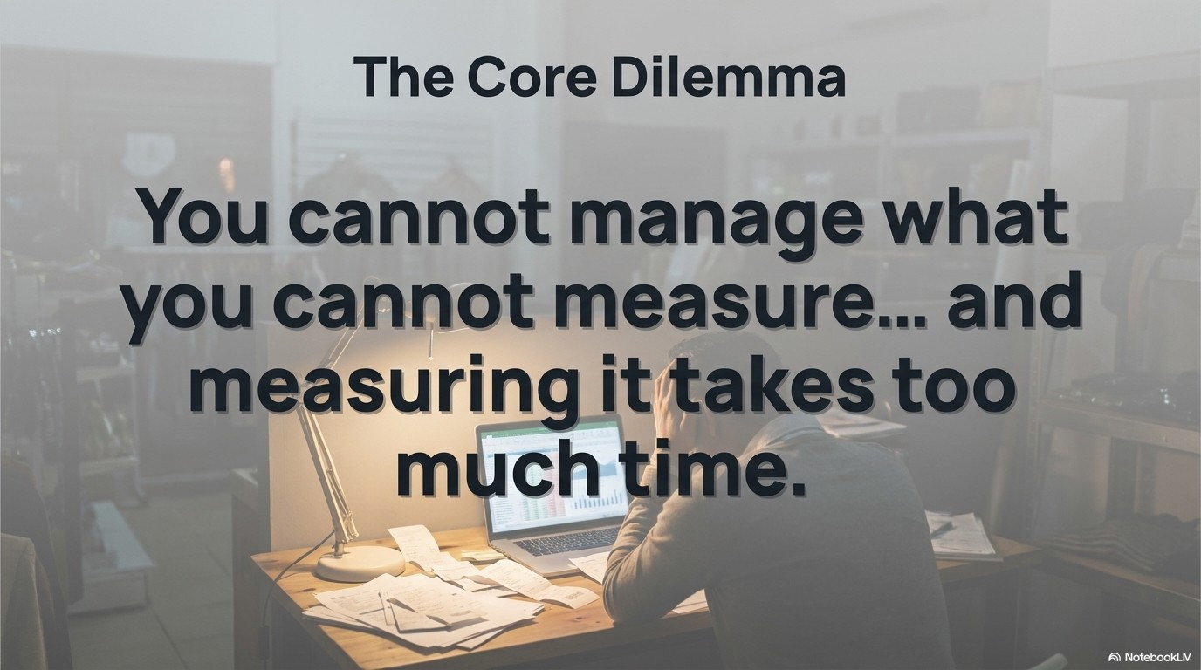

Slide 5

Introducing
RetailSense AI
The intelligent agent that automates your
analysis and simplifies your decisions.
RetailSense Al uses Agentic automation and analytics to assist retailers, turning complex data into clear actions. It automates and simplifies the essential tasks that hold your business back.
W NotebookLM

Slide 6














How It Works: Your On-Premise Al Analyst
Inputs Outputs
Smart Alerts
1 2 3 7
Sales Data
RetailSense AI
Local Agent
Performance Reports
Demand
Forecasts
Stock Levels
l N I Need d
Your data stays with you, on your machine. We provide the intelligence locally, eliminating cloud privacy risks and reliance on external connections.

Slide 7




Core Capabilities, Reimagined for Retail
Automated Insights
Instantly understand your sales, stock levels, and emerging trends with automatic data analysis.
Live Intelligence
Ask plain-English questions directly to the agent, such as “What were our top products this week?” or “Show me low stock items”.
Proactive Forecasting
(Optional) Use Prophet-powered forecasting to anticipate future demand and prepare your inventory accordingly.
Smart Alerts
Receive automatic email alerts for low-stock items, allowing you to act before you lose a sale.

Slide 8

Designed for Trust and Control
The ’Safe Agent’ Principle
We provide the insight; you make the call. RetailSense AI is designed to support, not replace, your expertise. Critical actions, such as placing a new stock order, always require your explicit user approval. You are always in command.

Slide 9


The New Reality:
_› Data-Driven,
Efiortless, Profitable.
Shift your focus from managing spreadsheets to growing your business. With RetailSense AI, you gain the ctarity and efficiency to run a smarter, more successfut retail operation.

Slide 10

The RetailSense AI Advantage
Before
Inventory Nanagement: Guesswork
and stock-outs.
Sales Analysis: Hours of manual
spreadsheet work.
Decision Naking: Based on gut-feel and old data.
Operations: Reactive scrambling and
lost sales.
After with RetailSense AI
Inventory Management: Optimised
stock levels and timely alerts.
Sales Analysis: Instant performance
analytics.
Decision Naking: Intelligent, data-
backed restocking decisions.
Operations: Efficient, automated workflow and loss prevention.

Slide 11

Empowering the
Modern Retailer
Built for the individuals at the heart of retail. Our solution is designed for:
Retail Shop Owners
Inventory Managers
Small to Nedium-sized Enterprises
(SNEs)
Speciality stores like boutiques, grocery stores, and electronics shops.
Anyone who wants simple, automated
retail insights without complex tools.

Slide 12



Your Business, Supercharged
Save Time | Increase Revenue | Gain Clarity
Automate hours of manual | Prevent lost sales with | Make smarter, faster
analysis and data entry. | proactive, intelti;¿ent low- stock alerts. | decisions with powerful insights at your fingertips.

Slide 13




See RetailSense Action
Request a personalised demo today to see how intelligent automation can transform your retail business.

