Slide 2
VIDEO GAMES SALES
PREDICTION
TEAM MEMBERS:
2103A52150-L.NAGARAJ
2203A52L04-K.ACHYUTH
2203A52L05-N.SANJAY

Slide 3

INTRODUCTION
In today's digital era, video games have become an integral part of the entertainment industry, with the global video game market expected to reach $300 billion by 2025.
With such a significant market size, understanding the sales trends and consumer behavior of video games is crucial for game developers, publishers, and marketers to make informed decisions.
In this presentation, we will explore how AI&ML techniques can be used to analyze and visualize video game sales data to uncover insights and trends that can aid in decision-making.
We will examine different types of data, such as sales data, user engagement data, and demographic data, and show how these can be analyzed to provide valuable insights on the video game market.
The use of AI&ML in video game sales analysis has numerous benefits, such as improved accuracy and speed of analysis, which can ultimately lead to better decision-making and increased profitability for game developers, publishers, and marketers.
We hope that this presentation will provide a deeper understanding of the value of using AI&ML techniques in the video game industry and its potential to drive innovation and growth in the sector.

Slide 4
DATA INSIGHTS
Year - Year of the game's release
NA_Sales - Sales in North America (in millions)
Global_Sales - Total worldwide sales.
EU_Sales - Sales in Europe (in millions)
JP_Sales - Sales in Japan (in millions)
Other_Sales - Sales in the rest of the world (in millions)

Slide 5

DATA INSIGHTS:
DATA INSIGHTS
YEAR
GLOBAL SALES
JAPAN SALES
NORTH AMERICA SALES
EUROPE SALES
RANK
Name - The games name
Platform - Platform of the games release(i.e. PC,PS4, etc.)
Year - Year of the game's release
Genre - Genre of the game
Publisher - Publisher of the game
NA_Sales - Sales in North America (in millions)
EU_Sales - Sales in Europe (in millions)
JP_Sales - Sales in Japan (in millions)
Other_Sales - Sales in the rest of the world (in millions)
Global_Sales - Total worldwide sales.

Slide 6
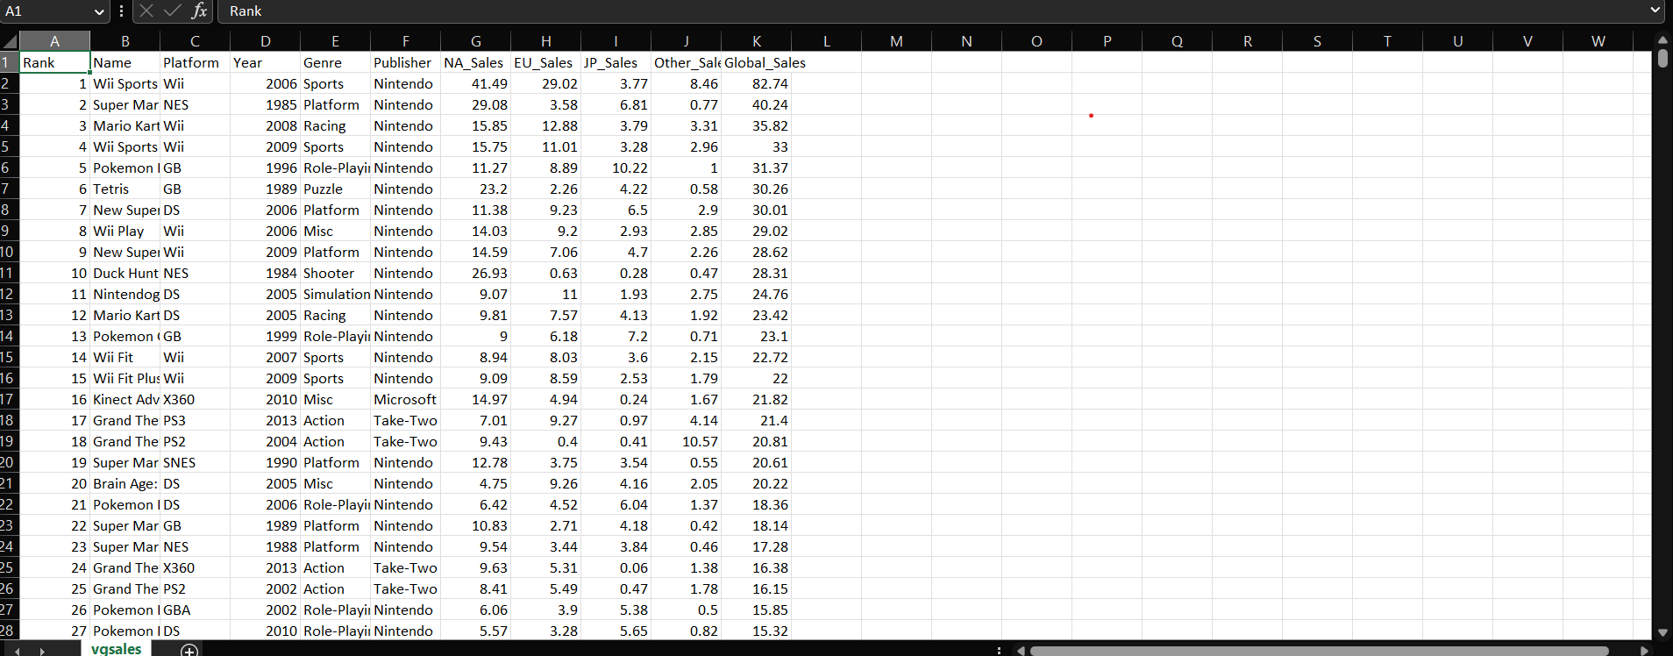
DATA SET

Slide 7
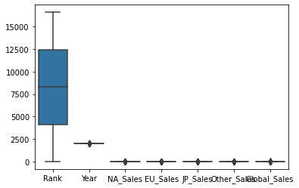
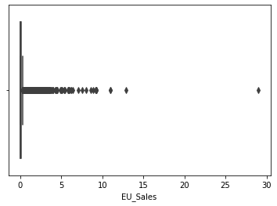
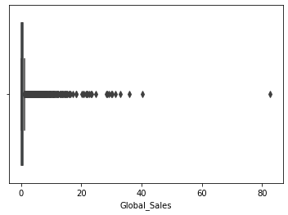
GRAPHS

Slide 8
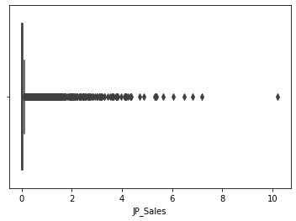
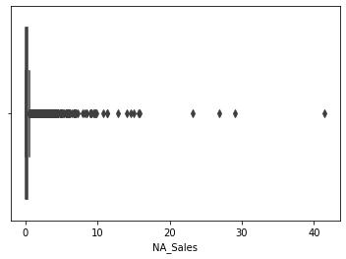
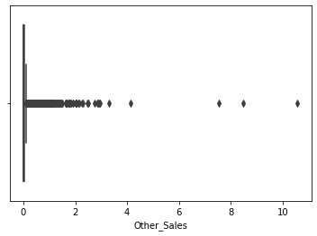

Slide 9
COVARIANCE MATRIX
A covariance matrix is a square matrix that summarizes the covariance between two or more variables in a dataset. It is a mathematical tool used in statistics, data science, and machine learning to understand the relationships between different variables and identify patterns in large datasets. The diagonal of the covariance matrix represents the variance of each variable, while the off-diagonal elements represent the covariance between each pair of variables. A positive covariance between two variables indicates that they tend to vary together, while a negative covariance indicates that they tend to vary in opposite directions. The covariance matrix is a fundamental tool used in many statistical and machine learning techniques, such as Principal Component Analysis (PCA) and Linear Discriminant Analysis (LDA), to reduce the dimensionality of large datasets and identify patterns in the data.

Slide 10
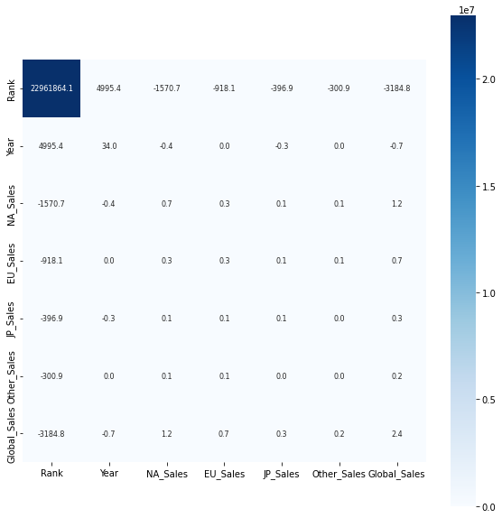
COVARIANCE MATRIX GRAPH
SYNTAX:
covariance=datas.cov()
plt.figure(figsize=(10,10))
sns.heatmap(covariance,cbar=True,square=True,fmt='.1f',annot=True,annot_kws={'size':8},cmap='Blues')

Slide 11
CORELATION MATRIX
A correlation matrix is a square matrix that shows the pairwise correlations between two or more variables in a dataset. It is a statistical tool used to examine the strength and direction of the linear relationship between different variables. The correlation matrix is often used in data analysis, research, and machine learning to identify patterns in large datasets.
In a correlation matrix, each variable is both correlated with itself (which results in a correlation of 1) and with all other variables in the dataset. The values in the matrix range from -1 to 1, where -1 represents a perfect negative correlation (when one variable decreases as the other increases), 0 represents no correlation, and 1 represents a perfect positive correlation (when one variable increases as the other increases).
The correlation matrix can be calculated using various statistical methods, such as Pearson's correlation coefficient, Spearman's rank correlation coefficient, and Kendall's tau correlation coefficient. The most commonly used method is Pearson's correlation coefficient, which measures the linear relationship between two variables.
Overall, the correlation matrix is a powerful tool for understanding the relationships between different variables and for analyzing large datasets in a wide range of fields.

Slide 12
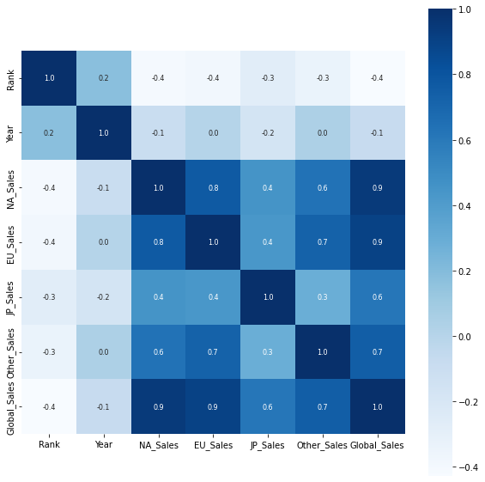
CORELATION MATRIX GRAPH
SYNTAX:
plt.figure(figsize=(10,10))
sns.heatmap(corelation,cbar=True,square=True,fmt='.1f',annot=True,annot_kws={'size':8},cmap='Blues')

Slide 13
LINEAR REGRESSION
Linear Regression is a classical statistical technique used for predicting the relationship between a dependent variable and one or more independent variables. The goal of linear regression is to fit a linear equation to the data that best represents the relationship between the variables. The equation can then be used to make predictions on new data points.

Slide 14
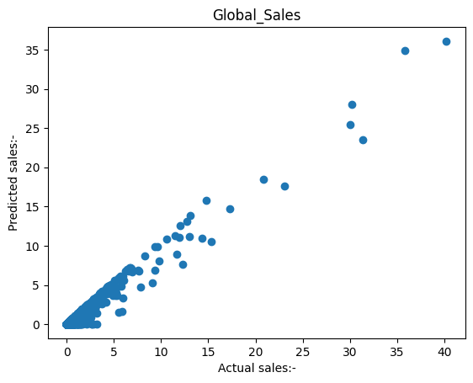
RSQUARE: 0.959438
INTERCEPT: 0.039040
MSE: 0.098596
MAE: 0.112119

Slide 15
SUPPORT VECTOR MACHINE(REGRESSOR)
Support Vector Machine or SVM is one of the most popular Supervised Learning algorithms, which is used for Classification as well as Regression problems. However, primarily, it is used for Classification problems in Machine Learning. The goal of the SVM algorithm is to create the best line or decision boundary that can segregate n-dimensional space into classes so that we can easily put the new data point in the correct category in the future. This best decision boundary is called a hyperplane’s chooses the extreme points/vectors that help in creating the hyperplane. These extreme cases are called as support vectors, and hence algorithm is termed as Support Vector Machine.

Slide 16
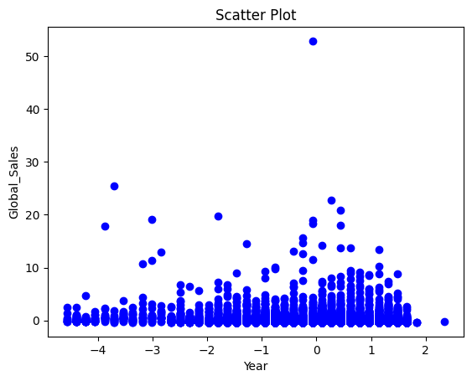
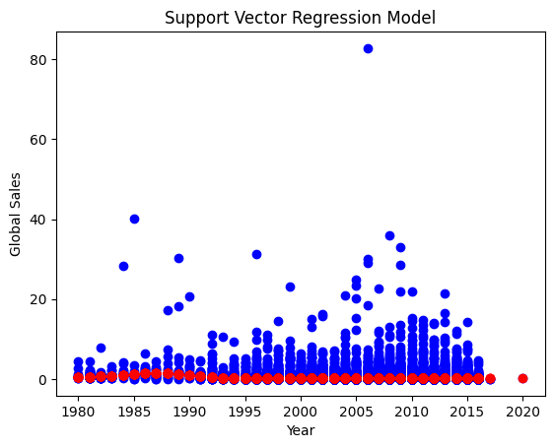
Rsquare: -0.013648
Intercept: -0.024773
mse: 1.019002
mae: 0.295377

Slide 17
K-NEAREST NEIGHBOR
K-Nearest Neighbors (KNN) is a non-parametric, instance-based learning technique used for classification and regression tasks. KNN predicts the target value of a new data point by finding the K nearest neighbors in the training dataset and taking a majority vote (for classification) or averaging the target values (for regression) of these neighbors.

Slide 18
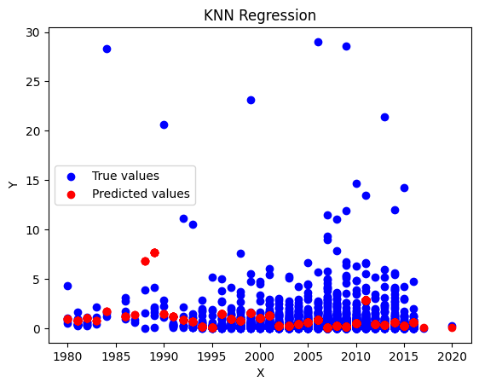
Mean squared error: 2.7498018903614456

Slide 19
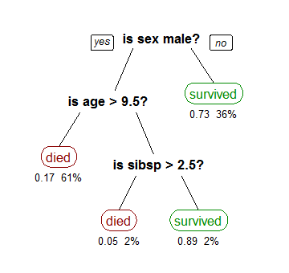
DECISION TREE
Decision tree algorithm falls under the category of supervised learning. They can be used to solve both regression and classification problems.
Decision tree uses the tree representation to solve the problem in which each leaf node corresponds to a class label and attributes are represented on the internal node of the tree.
We can represent any Boolean function on discrete attributes using the decision tree

Slide 20
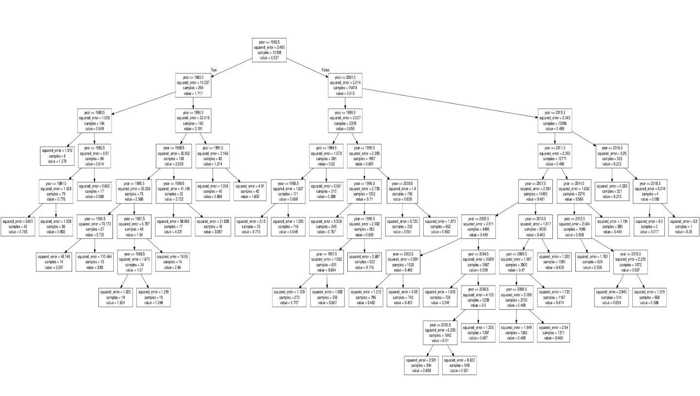
Rsquare: 0.017395
mse: 2.388455
mae: 0.579972

Slide 21
RESULTS
SUPERVISED MODEL | Error square
LINEAR REGRESSION | 0.098596
K NEAREST NEIGHBOUR | 2.7498018903614456
SUPORT VECTOR MACHINE(REGRESSOR) | 1.019002
DECISION TREE | 2.388455

Slide 22


