Slide 1

Mapping the educational landscape
A Comprehensive Data Analytics Study of Engineering Colleges in India
Presented By : Govindula Achyuth

Slide 2
Abstract
This project analyzes engineering colleges in India using data-driven insights on location, institution type, fees, courses, infrastructure, and ratings. Web scraping from Careers360, followed by data cleaning and visualization in Power BI, revealed that private colleges dominate, and Computer Science is the most popular course, while government institutions offer cost-effective alternatives. The study highlights the role of data analytics in education planning and decision-making.

Slide 3
Introduction
Choosing an engineering college in India is challenging due to unstructured data.
The project uses web scraping, data preprocessing, and Power BI for analysis.
Key insights cover college distribution, affordability, and course trends.
Aims to help students, educators, and policymakers make informed decisions.

Slide 4
Project objective
Comprehensive Data Analysis: Evaluates engineering colleges based on location, ownership (private/government), fees, ratings, courses, and infrastructure.
Informed Decision-Making: Helps students, educators, and policymakers compare institutions with structured insights.
Power BI Visualization: Utilizes interactive dashboards to simplify college selection and evaluation.
Enhanced Transparency & Accessibility: Supports strategic planning by making higher education data more accessible and comparable.

Slide 5
Problem statement
Student Challenge: Difficulty in finding the right engineering college due to unstructured data.
✔ Key Selection Factors:
Affordability
Location
Ratings
Course Availability
✔ Solution: Data-driven approach with structured analysis & visualization.

Slide 6
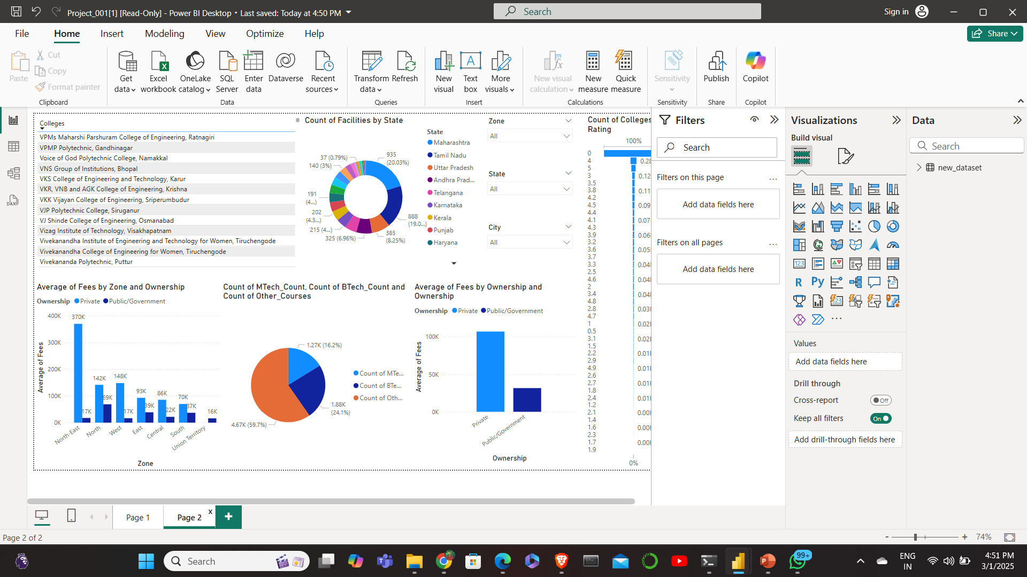
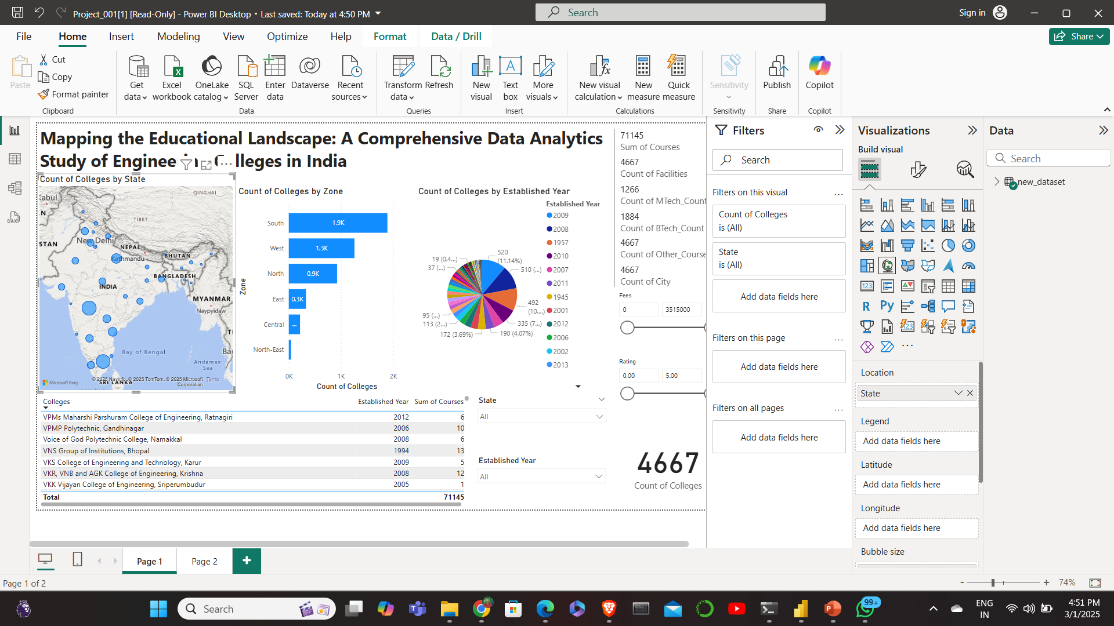
pRoject scope
Comparison of Government vs. Private Institutions
Affordability Analysis (Fee structures across states)
Geographical Distribution of colleges
Infrastructure & Course Offerings comparison

Slide 7

advantages
Structured & Comparable Data
Improved Transparency
Interactive Decision-Making
Comprehensive Insights
Supports Educators & Policymakers

Slide 8


Software used
Python (Jupyter Notebook)
Excel
Power BI

Slide 9
Data collection
Sources:
Careers360
Data Extracted:
College Name, Location, Ownership Type
Courses Offered, Fees, Ratings, Facilities
Tools Used:
Web Scraping (requests, BeautifulSoup)

Slide 10

Data cleaning and preprocessing
Handled Missing Data
Standardized Formats
Removed Duplicates
Data Saved in CSV Format

Slide 11
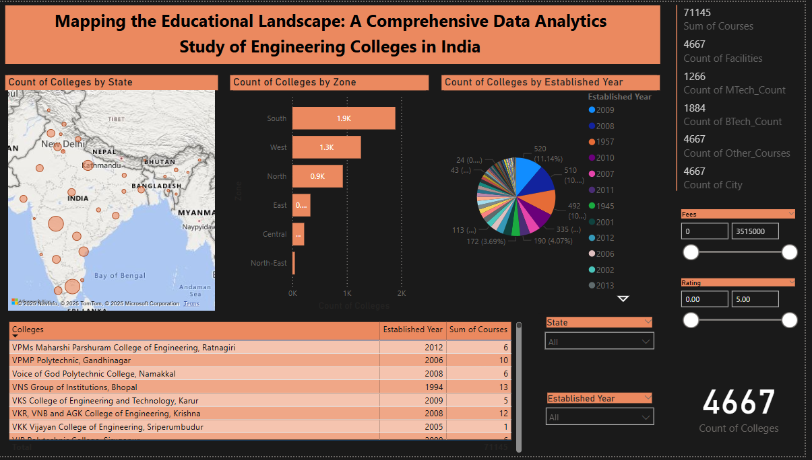
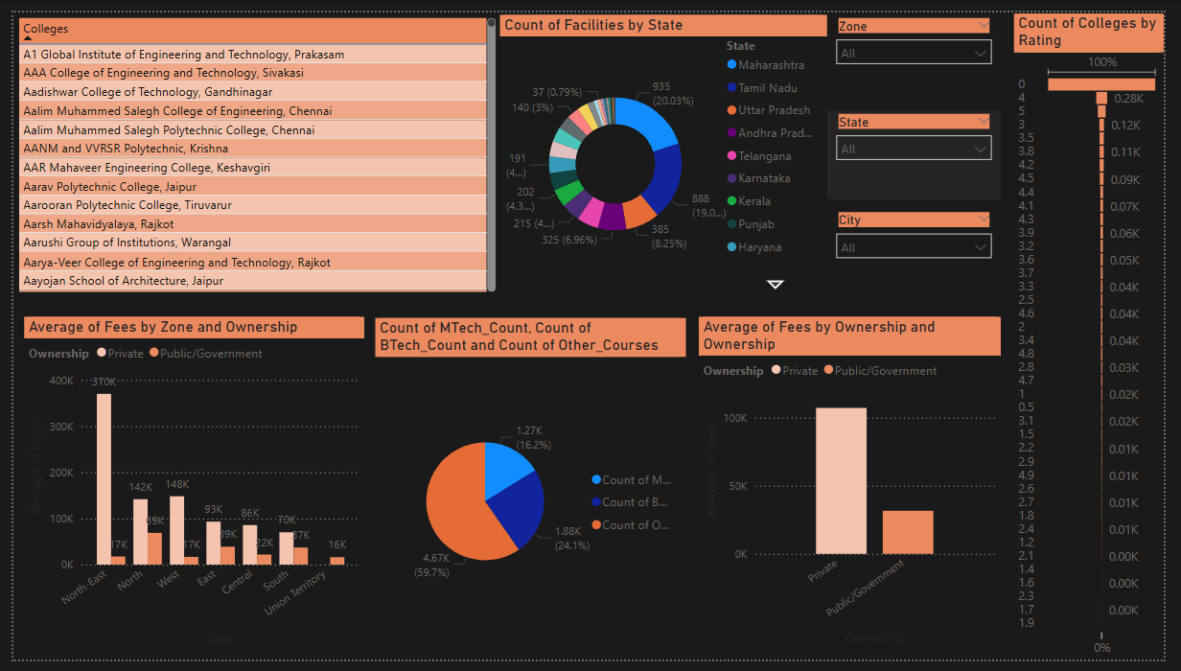
Data visualization & dashboards

Slide 12
Key findings
Private colleges dominate
Computer Science is the most in-demand course
Significant fee variations
Infrastructure impacts ratings
Geographical disparities
Power BI Dashboards improve decision-making

Slide 13
conclusion
This study provides valuable insights into India's engineering education landscape, highlighting key differences in affordability, infrastructure, and course demand. Government colleges offer cost-effective education, while private institutions provide diverse programs with modern facilities. The findings enable students, educators, and policymakers to make informed decisions.

Slide 14

Thank You

