Slide 1
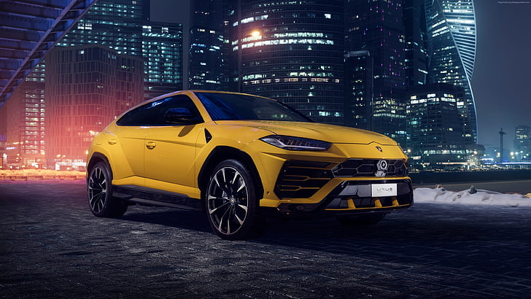

CARS24 USED CARs PRICE ANALYSIS
This Photo by Unknown Author is licensed under CC BY-SA-NC
Presented By : Govindula Achyuth

Slide 2

Abstract
This project analyzes used car data in India, offering insights into brand popularity, price distribution, and vehicle conditions.
Web scraping from Cars24, followed by data cleaning and visualization in Power BI, reveals brand trends and pricing dynamics.
The study underscores how data analytics can assist buyers, sellers, and automobile platforms in making informed decisions.

Slide 3

Introduction
Buying a used car in India can be challenging due to scattered and unstructured data.
This project scrapes real-time data, preprocesses it, and uses Power BI for visualization.
Key insights include price trends, brand popularity, and city-wise comparisons to support smarter vehicle purchases.

Slide 4
Project objective
Comprehensive Data Analysis:
Evaluate car brands, prices, Fuel Type, kilometers driven, etc.
User-Centric Insights:
Assist customers in making informed car-buying decisions.
Interactive Dashboards:
Power BI visualizations for easy comparisons and trends.
Market Understanding:
Help platforms and sellers analyze market behavior.

Slide 5
Problem statement
Buyer Challenge: Difficult to compare used car listings due to inconsistent data.
✔ Key Factors:
Brand
Price
Location
Year
Kilometer Driven
Fuel Type
✔ Solution: Web scraping + data processing + interactive visualization using Power BI

Slide 6
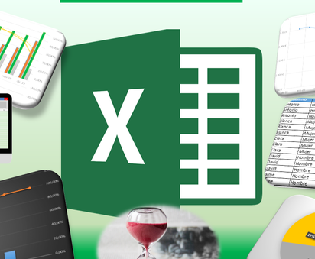

Software used
Python (Jupyter Notebook)
Excel
Power BI

Slide 7
Data collection
Sources:
Cars24
Data Extracted:
Model, Brand, Year, Kilometer Driven,
Fuel Type, Transmission, Location
Tools Used:
Web Scraping (Selenium, BeautifulSoup)

Slide 8
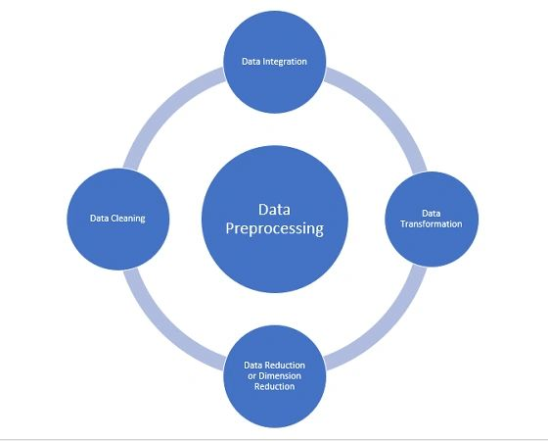
Data cleaning and preprocessing
Handled Missing Values (e.g., km driven)
Standardized Categorical Features (Fuel Type, Brand)
Removed Outliers and Duplicates
Saved Cleaned Data in CSV Format

Slide 9
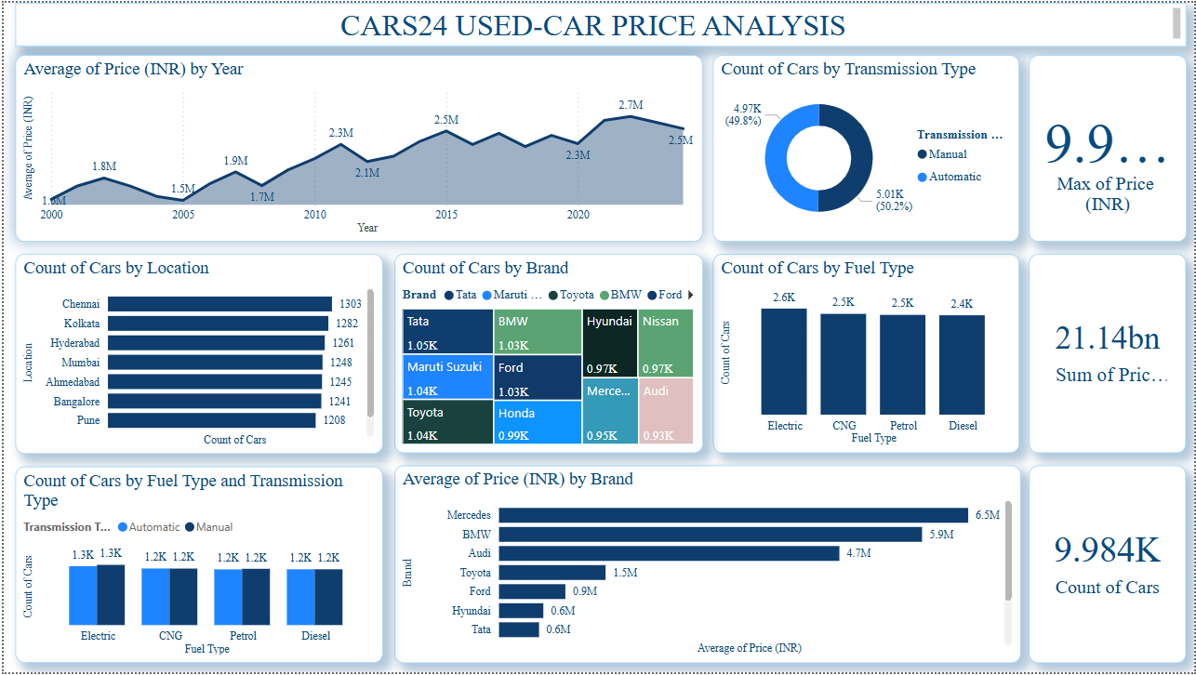
Data visualization & dashboards
Used Power BI for interactive dashboards
Visualizations: Brand distribution, price ranges, km driven, fuel type breakdown

Slide 10
Key findings
Maruti and Hyundai dominate the listings
Petrol vehicles are most common
Older cars have higher km driven and lower price
Premium brands like BMW have fewer listings but higher pricing
City-wise price trends show metropolitan premium

Slide 11
conclusion
This study provides insights into India's used car market.
Highlights key differences in price, year, and brand popularity.
Supports better buying and selling decisions for customers and platforms alike.
Data analytics proves valuable in navigating the second-hand automobile market.

Slide 12

Any queries ?

