Slide 1
RESEARCH BASED MINI PROJECT
SCHOOL OF COMPUTER SCIENCE AND ENGINEERING

Slide 2
DETECTION OF PHISHING WEBSITES USING ML
Guide Name:
Prof. Shwetha R
Team Details:
D KOUSHIK ROYAL(R21EF103)
G BHUVANESHWAR CHOWDARY(R21EF105)
G ACHYUTH(R21EF106)
K DINESH(R21EF108)

Slide 3
Content:
Abstract
Introduction
Technology and Domain
Front End and Back End Details
Literature Survey
Objectives
Methodology
Dataset
Modules Explanation
Sample code and output
Conclusion
References

Slide 4
Abstract
This project addresses the growing threat of phishing attacks by developing a robust system for detecting phishing websites. Leveraging machine learning techniques, the system extracts features from website URLs, content, and metadata to classify sites as legitimate or phishing. Data collection encompasses various sources, including phishing databases and legitimate repositories, with feature engineering techniques applied to extract domain age, SSL validity, and suspicious keyword presence. Machine learning algorithms like Random Forest, LightGBM Classifier, and XGBoost Classifier are trained and validated using cross-validation methods to create accurate classifiers.
The final system offers a user-friendly interface, allowing users to input URLs and receive instant feedback on potential phishing risks. By empowering users with informed decision-making tools, this project contributes significantly to online security, helping users avoid falling prey to phishing attacks.

Slide 5
Introduction
Phishing attacks have emerged as a critical cybersecurity concern, targeting users worldwide to steal sensitive information like passwords and financial details. These attacks often rely on deceptive websites that mimic legitimate ones, making detection challenging for users. In response, our project focuses on developing a robust system using advanced machine learning techniques to identify and thwart phishing attempts effectively.
Our approach involves analyzing various aspects of website URLs, content, and metadata to extract meaningful features for classification. Leveraging machine learning algorithms, we aim to accurately differentiate between benign websites and malicious phishing sites. This system empowers users by providing real-time alerts and insights, enabling them to navigate the internet securely and avoid falling victim to phishing scams. Through these efforts, we contribute to strengthening online security and safeguarding user privacy in the digital landscape.

Slide 6
Technology and Domain Front End and Back End Details
Tool Used:- VS CODE,JUPITER NOTEBOOK
DOMAIN:- CYBER SECURITY
FRONT END:- HTML ,CSS, STREAMLIT
BACKEND :- ML ALGORITHMS,PYTHON CODE
6

Slide 7
Frontend:
The frontend interface, we utilize HTML and CSS, Streamlit to create an intuitive and user-friendly experience. Through a simple text input, users can enter the URL and display the Output.
Backend:
The backend for your project on detecting phishing websites involves data preprocessing using Pandas and NumPy, feature engineering to extract meaningful website characteristics, and the implementation of machine learning algorithms like Random Forest, LightGBM, and XGBoost for classification. Model training, evaluation, and deployment are key stages in the backend process, along with the integration of Flask or Django frameworks for API creation and model inference.

Slide 8
Literature Survey
"Phishing websites detection based on machine learning algorithms" by Aljawarneh et al. (2018), explores the use of machine learning for phishing detection, highlighting its effectiveness in identifying malicious sites.
Mishra et al. (2019) conduct a systematic review on "Phishing website detection using machine learning," summarizing existing methodologies, challenges, and future directions in this area.
Kaur and Kumar (2020) present "Phishing Website Detection: A Machine Learning Approach," discussing the application of machine learning techniques for accurate detection of phishing websites.
Hsiao et al. (2020) propose "A Machine Learning Approach for Phishing Website Detection Using URL Features," emphasizing the importance of URL-based features in detecting phishing attempts.
8

Slide 9
objectives
Develop a Robust Phishing Detection System: Create a machine learning-based system capable of accurately distinguishing between benign and phishing websites.
Feature Engineering Optimization: Explore and implement advanced feature engineering techniques to extract relevant indicators of phishing activities from website data.
Model Performance Enhancement: Train and fine-tune machine learning models, including Random Forest, LightGBM, and XGBoost, to achieve high accuracy and robustness in phishing detection.
Real-time Detection Capability: Design the system to operate in real-time, providing instant feedback and alerts to users when visiting potentially malicious websites.
User Empowerment and Security: Empower users with tools and information to make informed decisions, enhancing overall online security and privacy.

Slide 10
Methodology
Data Collection and Preprocessing: Gather a diverse dataset of benign and phishing websites, clean the data, handle missing values, and prepare it for analysis.
Feature Engineering: Extract meaningful features from website URLs, content, and metadata using techniques like URL parsing, content analysis, and behavioral indicators.
Model Selection and Training: Evaluate and train machine learning models such as Random Forest, LightGBM, and XGBoost on the preprocessed dataset to build accurate classifiers.
Real-time Integration: Integrate the trained model into a real-time detection system, allowing users to input URLs and receive instant feedback on the likelihood of phishing attempts.
Testing, Validation, and Deployment: Conduct thorough testing and validation of the system to ensure its effectiveness and reliability before deploying it in a production environment. Regular maintenance and updates are implemented to keep the system adaptive to new phishing tactics.

Slide 11
DATASETS
Legitimate URLs are collected from the dataset provided by University of New Brunswick, https://www.unb.ca/cic/datasets/url-2016.html.
From the collection, 5000 U R Ls are randomly picked.
Phishing URLs are collected from opensource service called Phish Tank . This service provide a set of phishing URLs in multiple formats like csv, Json etc. that gets updated hourly.
Form the obtained collection, 5000 U R Ls are randomly picked.

Slide 12
Modules Explanation
This is a supervised machine learning task. There are two major types of supervised machine learning problems, called classification and regression.
This data set comes under classification problem, as the input URL is classified as phishing (1) or legitimate (0). The machine learning models (classification) considered to train the dataset in this notebook are:
Decision Tree
Random Forest
Multilayer Perceptron's
XG Boost
Support Vector Machines
12

Slide 13
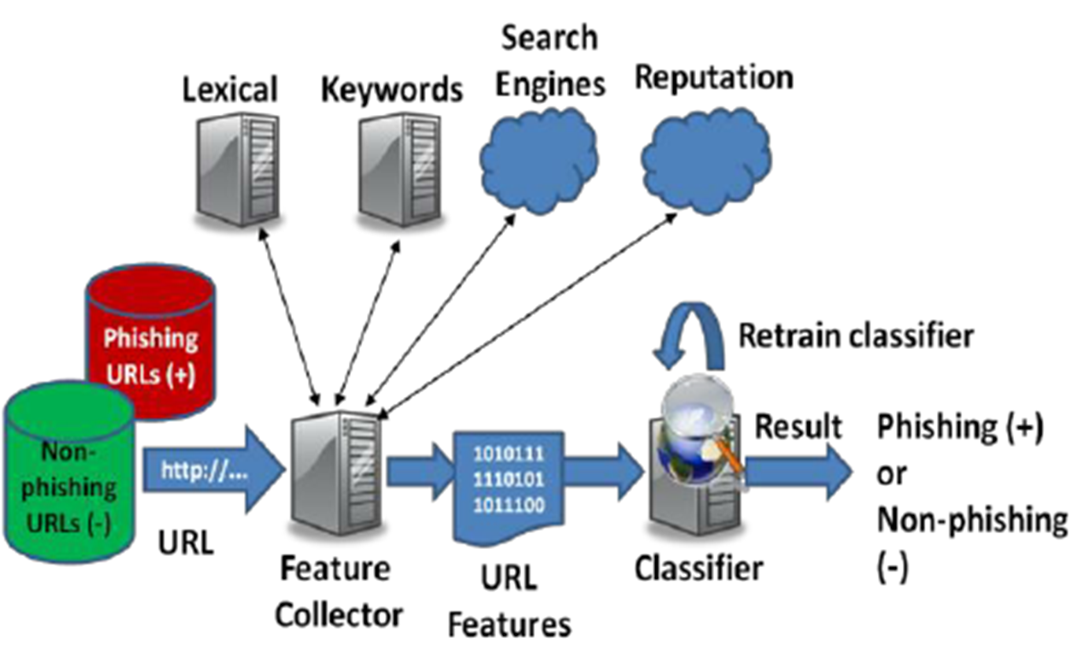
Work flow

Slide 14
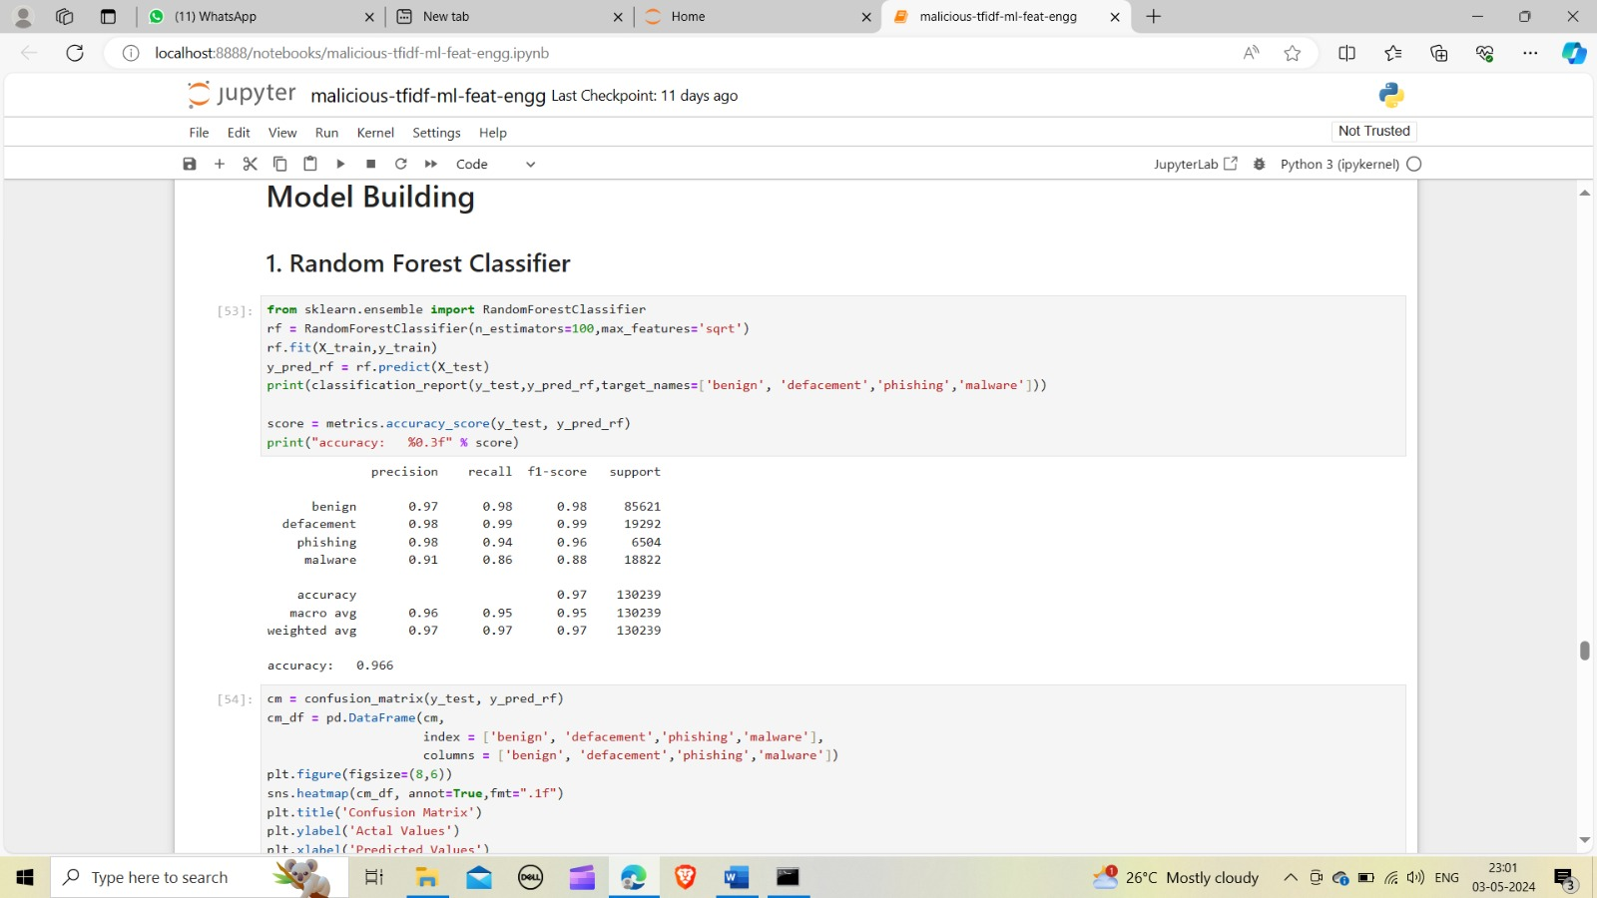
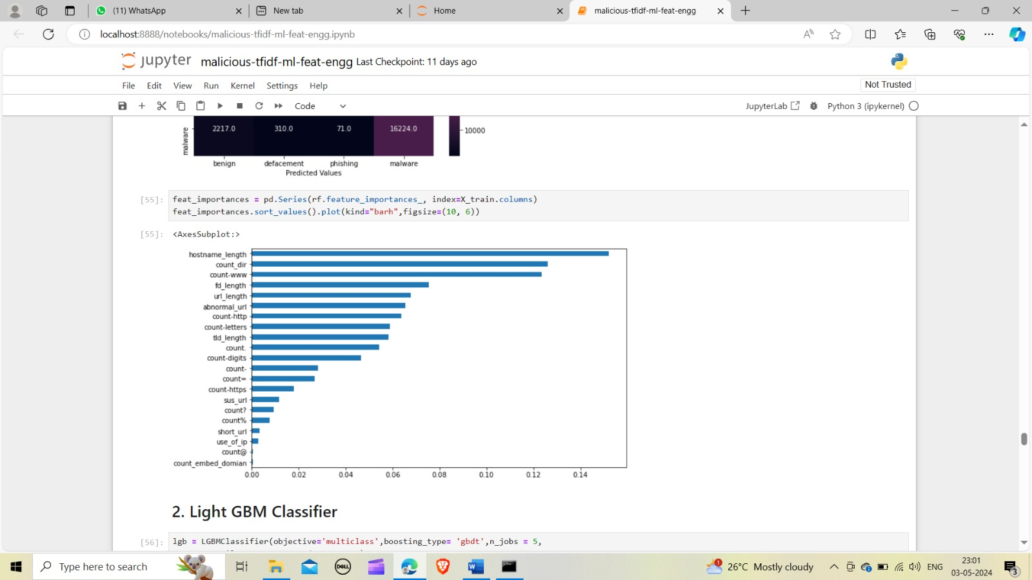
Sample Code
14

Slide 15
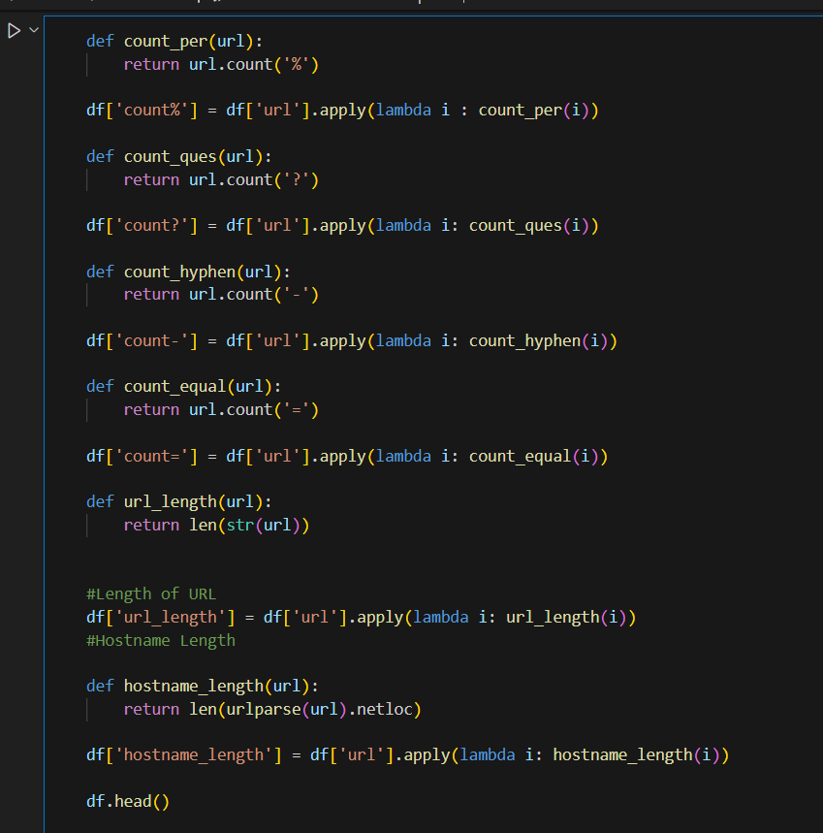
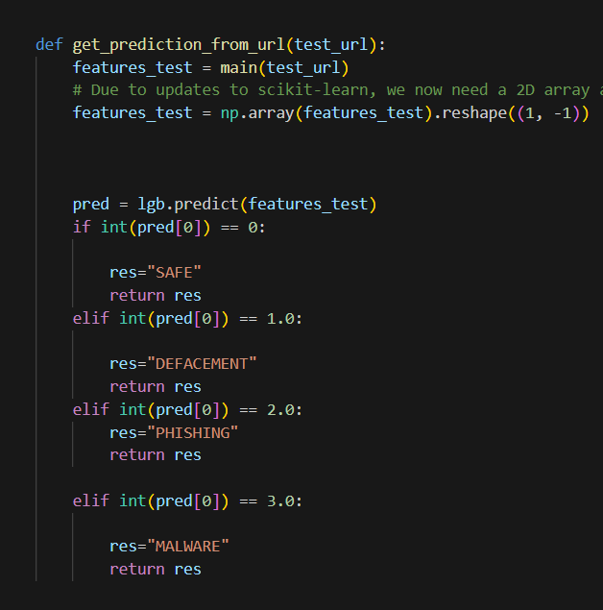

Slide 16


SCREENSHOTS OF FRONTEND:

Slide 18
CONCLUSION
In conclusion, our project on "Detection of Phishing Websites Using Machine Learning" represents a significant step forward in bolstering cybersecurity measures against the pervasive threat of phishing attacks. Through the implementation of advanced machine learning techniques and rigorous evaluation processes, we have developed a robust system capable of effectively identifying phishing websites by analyzing various features extracted from website content, structure, and behavior. By addressing challenges such as data preprocessing, feature engineering, and model optimization, we have ensured the reliability and scalability of the developed system across diverse datasets and real-world scenarios. The deployment of the system into a user-friendly interface further enhances its accessibility and usability for end-users and cybersecurity professionals. Overall, our project contributes valuable insights and solutions to the ongoing efforts in combating phishing attacks, with the potential to significantly improve online security and protect users from falling victim to fraudulent schemes.

Slide 19
References
Jagadeesan, S. V., & Nair, P. M. (2020). A Survey of Machine Learning Techniques for Phishing Detection. International Journal of Advanced Computer Science and Applications, 11(8), 61-68.
Aljawarneh, S., & Al-Kabi, M. N. (2019). Machine Learning Techniques for Phishing Detection. International Journal of Computer Applications, 181(2), 27-32.
Abualigah, L., & Khader, A. T. (2020). A Comprehensive Review of Machine Learning Techniques for Phishing Detection. Journal of King Saud University-Computer and Information Sciences.
Shetty, A., & Kumar, V. (2019). Feature Engineering Approaches in Phishing Website Detection: A Review. International Journal of Engineering Research & Technology, 8(5), 268-272.
Albladi, S., Al-Kabi, M. N., & Aljawarneh, S. (2020). A Comprehensive Review of Deep Learning Techniques for Phishing Detection. SN Computer Science, 1(3), 1-12.
Lu, Z., Li, B., & Zeng, X. (2020). Ensemble Learning Approaches for Phishing Detection: A Review. IEEE Access, 8, 103773-103783.

