Slide 1
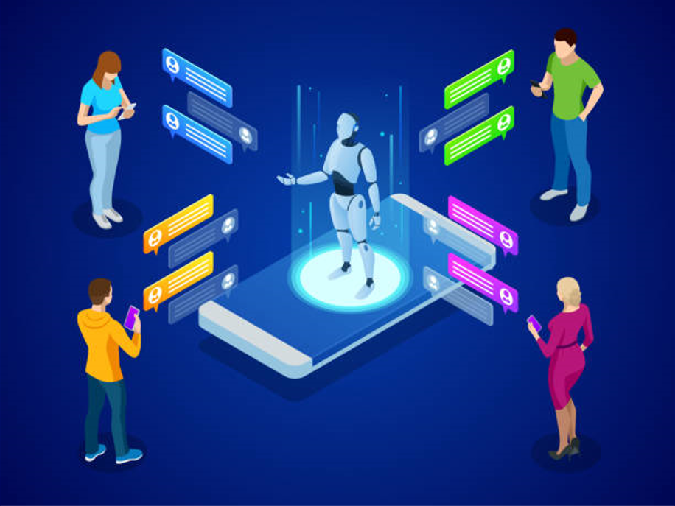
Python-Bot:
A Chatbot for Teaching Python Programming
Team: Achievers
Anusha Nelluri (16330313)
Achyuth Kumar Valeti (16330335)
Venu Babu Linga (16324939)

Slide 2
Overview
Introduction
Background
Design Implementation
Flow of Python-Bot
Evaluation
Application
Conclusion

Slide 3
Introduction:
A chatbot is a computer software/program that can speak with humans using Artificial intelligence in messaging platforms.
This paper aimed to implement online chatbot system to assist users in learning python programming.
In this work, a chatbot is presented for teaching programming and named it as Python-Bot.
Python-Bot supports inexperienced programmers to understand python basic syntactic structures and semantics.
Python-Bot provides support in following topics:
Programming concepts
Solving pre-defined problems
Support or Appointment
Python-Bot was created using SnatchBot, a chatbot development platform, and is now available as a mobile web application.
An Interface unit, a Knowledge unit and a Message bank are all provided by SnatchBot to the user.

Slide 4
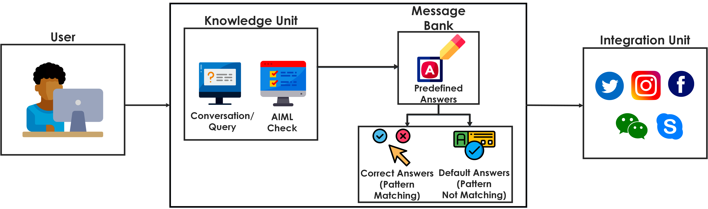
SnatchBot operating flow:
Knowledge unit is used for processing user messages.
Message bank stores all predefined answers.
Integration unit is used to post communication chat(interaction messages) with social media network.

Slide 5
Background:
A chatbot system is an AI technology that is used in a variety of areas, including healthcare, finance, social interactions, and education. IBM Watson, Microsoft Cortana, Apple Siri, and Facebook M are the tools which are used to create Chatbot APIs.
People are increasingly using computers and mobile devices, demanding the development of educational chatbot systems.
In education, chatbots are quite useful. Educators and administrators uses chatbots that simplifies teaching and learning procedures.
Unfortunately, students see Computer Programming courses as difficult to learn. To encourage student’s interest in programming, it is necessary to simplify the teaching and learning techniques of computer programming.
Thus, PythonBot designed, and it is a student-friendly Python programming learning tool.

Slide 6
Design Implementation of PythonBot:
Python-Bot was created using the SnatchBot API and its predefined tools, which are powered by various NLP algorithms.
Python-Bot is placed on a website via the SnatchBot Channel. Students may connect to the website with their smartphones or computers to communicate with the Chatbot, making Python-Bot accessible to inexperienced programmers in learning how to write in Python.
SnatchBot provides Natural Language Processing (NLP) capabilities that allow Python-Bot to understand and respond appropriately to a user's response or query. This is accomplished by dividing a sentence into basic components such as entity and intent.
Some predefined NLP models for each entity and intent were included in Python-Bot to recognize. The models use Machine Learning to make decisions in any new sentence they encounter, based on the samples provided.
Two NLP models were utilized in this study to provide support to learners: one that recognizes the date (entity) and another that detects the time (intent) for an appointment.
The following are the major operations that are performed in Python-Bot:
Introduction: It begins by introducing itself and then asking the user to do the same. This allows the Chatbot to keep track of the user's name and the duration of the conversation (starting time, ending time, and duration of the conversation).

Slide 7
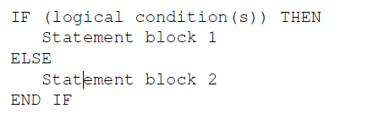
2. Programming Concepts: The Python-Bot provides detail explanation of Python programming concepts including Data Types, Expressions, Control Statements, Strings, Text Files, Lists, Dictionaries, Tuples, Problem Solving, and Algorithms.
Python-Bot can also talk about algorithms that aren't written in a programming language.
Python-Bot provides the support to new programmers to learn the grammatical structure of if statements as below:
3. Support Capability: Python-Bot also provides support capability to the users.
It assist students using NLP capability models by allowing them to schedule an appointment with a tutor or lecturer.
Python-Bot will generate the date and time of the meeting with respect to the user’s response to Python-Bot queries.

Slide 8
Flow of Python-Bot:

Slide 9
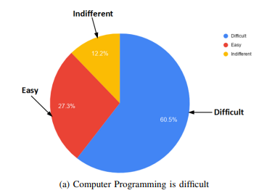
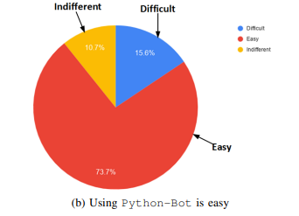
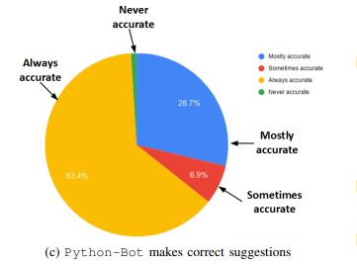
Evaluation of Python-Bot:
A survey was conducted at the University of Johannesburg in South Africa, with the target audience consisting of first-year students enrolling in the Python programming course as well as those who had finished the course previously. The following are the results.

Slide 10
Application of Python-Bot:
During the COVID-19 pandemic, Python-Bot was used to manage the teaching and learning of python course. Students were able to schedule appointments to have discussions with a tutor or lecturer for assistance when needed.
According to the student’s perception, Python-Bot was helpful in learning the subject with more interactive way or learning.
Conclusion:
In this paper, we presented a ChatBot system called as Python-Bot that helps new programmers in learning how to program in python. The Chatbot can be used on the website as well as on social networking sites. So, this tool was used to help students to learn basic programming especially during the COVID-19 pandemic.

