Slide 1
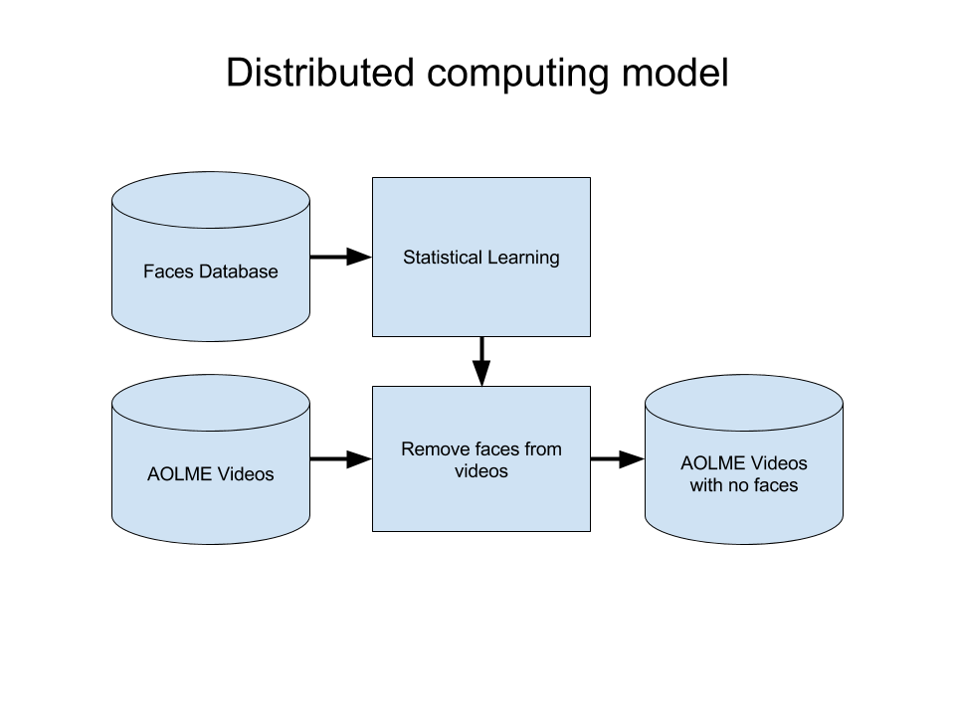
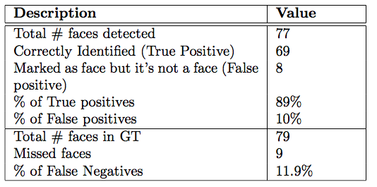
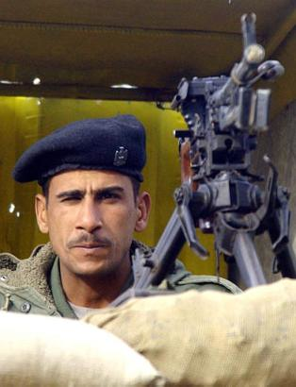
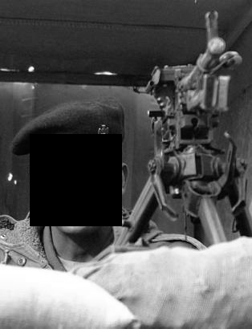
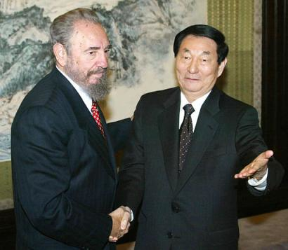
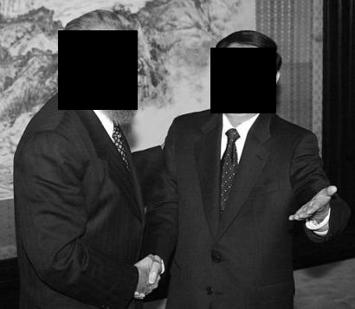

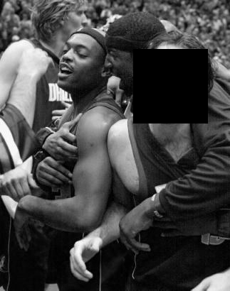
Face Obscuration Using Big-Data Processing Techniques
Cody W. Eilar [cweilar@unm.edu] & Venkatesh Jatla [venkatesh369@unm.edu] with the University of New Mexico
abstract
methods
results
With big data processing techniques and tools becoming ubiquitous, it is now more feasible than ever to process images and videos over distributed computing environments using tools such as Hadoop, Spark, Storm and others.
In this paper, we investigate using these big-data techniques to perform face obscuration on very large video and image datasets collected by the Advancing Out of School Learning in Mathematics and Engineering (AOLME) program so that these datasets can be safely redistributed. As ulterior motive, we also set in place a frame for which we would use to perform other types of detections and activity recognition studies. For the purpose of this paper, we do not use any images from the real AOLME dataset, but rather images to illustrate our intention. The images that we used for this were acquired from the Face Detection Data Set and Benchmark.
Video was too difficult to implement on existing big-data tools, so we start with Thunder
Use the faces database collected by the University of Massachusetts (FDDB)
Database consisted of faces that were manually annotated to benchmark results
Apply OpenCV’s Haar Cascade with predefined training files (we did not need to train the classifier ourselves)
Verify accuracy against face database
Basic API for loading modifying images using Thunder
Was able to apply OpenCV algorithms to images using Thunder
Haar Cascade was trained using frontal face, and hence didn’t do well in cases of side faces
Introduction
AOLME
Project to help establish better metrics for teaching under represented groups in mathematics and engineering
Very large video database of interactions between students and facilitators
Videos are currently hand annotated so that they can be studied by researchers
Faces in videos need to be obscured so that videos can be shared across domains without the need of an IRB
Face Detection and Recognition
Very well studied theory inside of the pattern recognition community
Wide variety algorithms for both face detection and face recognition available
Many software tools are available within MATLAB, Python, R, and Scala for processing images
Once face is detected, any type of filtering can be done to obscure the face
Big-Data
Where is the video support?
Very few options for images
Most applications of this are centered around text, not extremely large binary datasets
Niche tools like Thunder (based on spark) and StormCV (based on storm) exist
conclusions
Successfully created an API to use Thunder in combination with OpenCV at https://github.com/AcidLeroy/FaceObscuration
Loaded, classified, and wrote out obscured faces using a big data tool
Big data tools are still not particularly well suited for dense binary data such as images and video so there are plenty of potential research topics in this area.
Successful face obscurations
Future work
Theory
Improving face detection by training Haar Cascades on side face.
Exploring new tools that readily accept video data.
Objective analysis of the method is needed to analyze performance quickly.
Haar cascades
Long computing times for training
Fast detections (ideal for video)
High classificaiton rate
Eigen faces
Ideal for identifying to whom a face belongs
Difficult to implement in real time
Failed face obscurations.

