Slide 1
ArchiCop
List<Edge>
Source, Excel, Db
Meta Data
Excel*, Config
*Excel has been chosen for now
in order to reduce UI development
effort on metadata maintenance screens

Slide 2
deployment
namespaces
layer
ArchiCop
User Interface
ArchiCop.Dll
View
ArchiCop
ArchiCop.View ArchiCop.ViewModel
Core
ViewModel
Data
Core
ArchiCopCore.Dll
Data
ArchiCop.Core
ArchiCop.Data

Slide 4

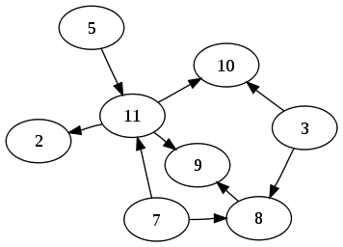
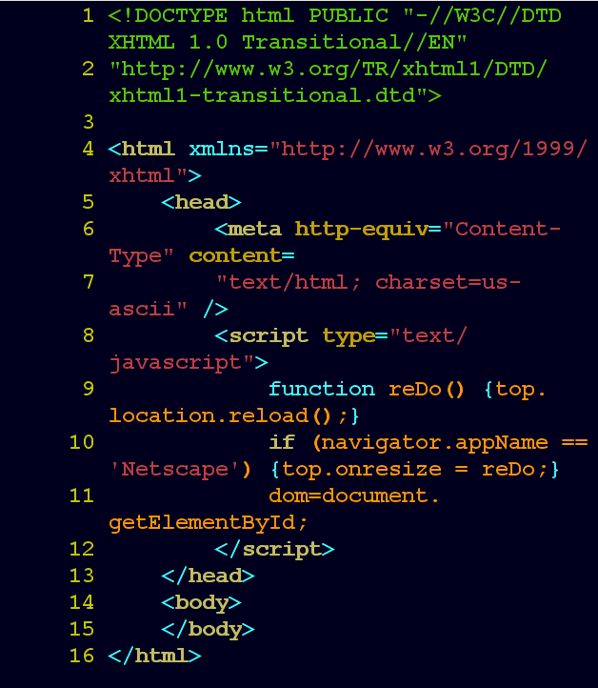

Stats Engine
Load Engine
Edge Engine
Graph Engine
Rule Engine

Slide 5
Load Engine
interface ILoadEngine {
IEnumerable<ArchiCopEdge> LoadEdges();
}
Loads from a given source a list of edges. Typical sources: source code, xml, db, excel…
Multiple Load Engines might be sequentially invoked. Used to merge lists of edges from multiple sources.

Slide 6
Edge Engine
interface IEdgeEngine {
IEnumerable<ArchiCopEdge> ConvertEdges(IEnumerable<ArchiCopEdge> edges, IEnumerable<VertexRegexRule> rules );
}
Converts a given list of edges into another list of edges. Typical conversions: regex-value, regex-regex, filter…
Multiple Edge Engines might be sequentially invoked.

Slide 7
Graph Engine
interface IGraphEngine {
ArchiCopGraph CreateGraph(IEnumerable<ArchicopEdge> edges);
}
Creates a graph from a given list of edges.
Invoked once per graph.

Slide 8
Rule Engine
interface IRuleEngine {
IEnumerable<string> GetInfos(IEnumerable<ArchicopEdge> edges);
IEnumerable<string> GetWarnings(IEnumerable<ArchicopEdge> edges);
IEnumerable<string> GetErrors(IEnumerable<ArchicopEdge> edges);
}
Runs rule check against a given list of edges. Typical rules: graph vs graph, cycles, regex…
Invoked once per ruleset.

Slide 9
Stats Engine
interface IStatsEngine {
string[,] GetStats(IEnumerable<ArchicopEdge> edges);
}
Creates a two dimensional array to be used for the generation of KPIs. Typical KPIs: LOC, edgesin, edgesout…
Invoked once per stat.
Note that the ArchiCopVertex needs to be able to carry all information needed for the supported stats. This information is only used for the Stats Engine.

