Slide 1

Welcome to join Harbor Community Conference Call
06:00-07:00 AM (PDT) /
21:00-22:00 (Beijing Time)
2018/09/05 Wednesday
https://zoom.us/j/491173185

Slide 2
Agenda
Harbor project latest updates BY Harbor team [5 min]
Harbor community updates [5 min]
V1.6 early preview part 2:
Demo: Replicate with label filter by Wenkai Yin from Harbor team [10 min]
Demo: LDAP group by Stone Zhang from Harbor team [15 min]
Technical proposal discussions [25 min]

Slide 3
Harbor Latest Updates
CNCF donation
[DONE] Change the go importing paths of code
[DONE] Move Harbor chart to a separate code repo under goharbor
[DONE] Clean up some deprecated artifacts like .ova or 3rd tools which are lack of maintenance
[ONGOING] Change copyrights header of code
[ONGOING] Investigating CI/CD pipeline refactoring to follow CNCF best practice
Harbor V1.6.0
rc3 is ready for downloading
GA: Early Sept.
Blocked by Clair too frequent updating cycles issue
Clair has released new version containing the fix
Harbor V1.7.0 (Plan ongoing)
Chart repository enhancements
Helm Chart supporting HA deployment
Online GC
Refactoring
Contributions from community

Slide 4
Community Updates
Community project Harbor.Tagd lead by @nlowe from HylandSoftware is onboarded
Automates the process of cleaning up old tags from your Harbor container registries.
Demo list is moved from README to a separate wiki page and will continuously updated if there are new ones created
We’ll show up at CEUC@HangZhou at 09/16/2018

Slide 5
Let’s work together to build Harbor
Call for more community contributors to make valuable contributions to Harbor
Looking for active contributors to participate more in Harbor community daily maintenances:
Answer questions in social channels
Pick up issues with “help_wanted” to make contributions
Assigned as reviewers of PRs from community

Slide 6
V1.6 early preview – Replicate with label filter
Welcome Wenkai Yin!

Slide 7
V1.6 early preview – LDAP group
Welcome Stone Zhang!

Slide 8
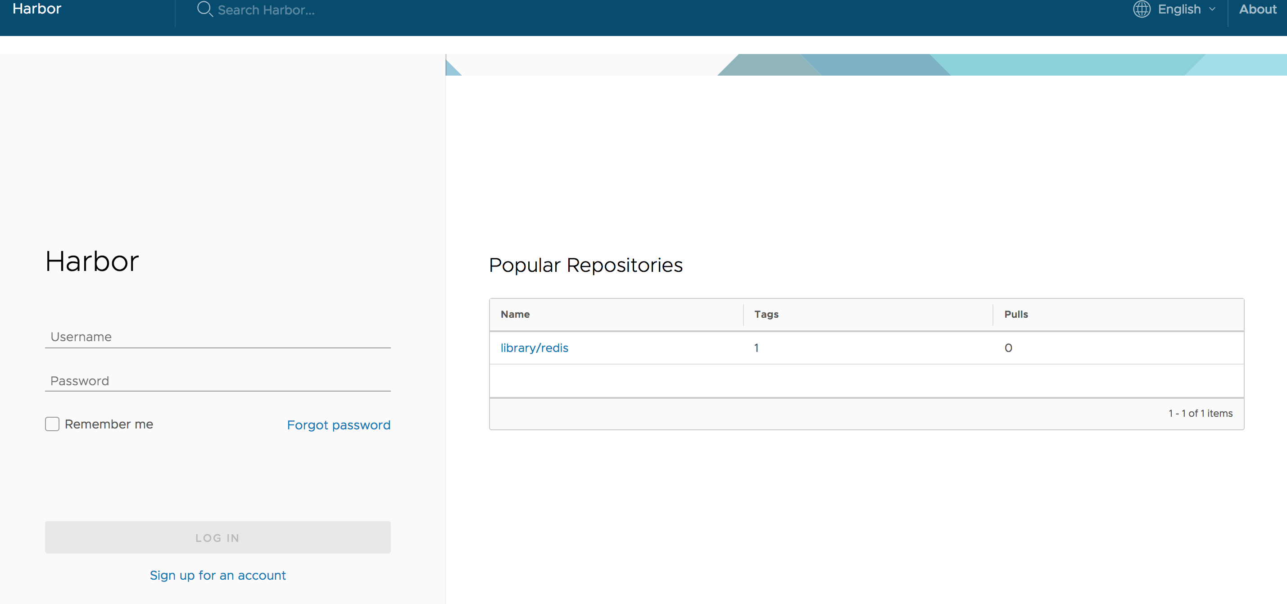
Technical proposal discussion and voting
Whether or not the top repositories on the login page should be hidden as default
YES/NO
Any different opinions about the migration to unified PostgreSQL DB?
Tag image on the portal

Slide 9
Meeting minutes
Meeting is recorded and the recording link will be updated to the wiki page later: https://github.com/goharbor/harbor/wiki/Community-Conference-Calls
The meeting slides will be uploaded to the community repo and put under the ‘conf-calls’ folder.

