Slide 1
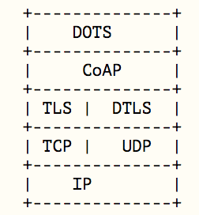
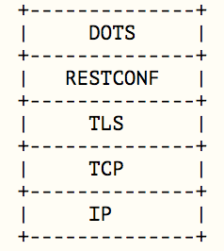
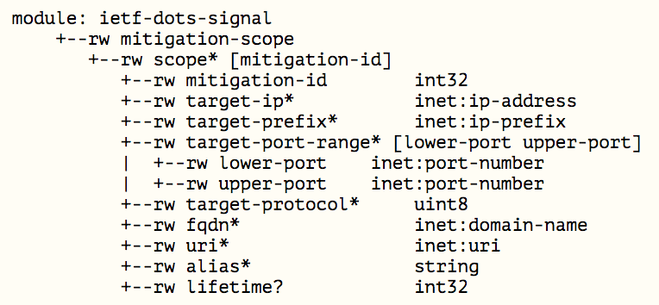


Demo: Go implementation of DOTS
Demo scenario:
Enabling DDoS Protection in an upstream network by DOTS protocol
DOTS is:
DDoS Open Threat Signaling
Automation and Standardization of signaling for DDoS protection
“ask for help!” from a victim to an upstream provider
- inter-organization / including authN and authX in spec
What you can see in this demo:
A DOTS client sends a mitigation request to a DOTS server over DOTS signal channel.
The DOTS server receives and validates the request, then starts mitigation by kicking a blocker
In this demo, the blocker is a gobgp server which triggers “blackhole routing” in a service operator's network
Signal Channel
Data Channel
Mitigation Request Model
target
IP/port
Service Provider’s Network
Signal Channel
DOTS
Client
DOTS
Server
gobgp
4. Stop DDoS Attack
Data Channel
1. send mitigation request
2. validate request
3.enable blackhole routing

