Slide 1
YANG Hackathon Achievements
IETF 99
July 2017

Slide 2
Team
Joe Clarke
Miroslav Kovac
William Lupton
Rob Wilton
Radek Krejci
Vladimir Vassilev
Mahesh Jethanandani
Kent Watsen
Pieter Lewyllie
Qin Wu
Dapeng Liu
Benoit Claise

Slide 3
Data Model-driven Management with YANG
www.yangcatalog.org
Automation is as good as your data models, your toolchain, and the data model metadata

Slide 4
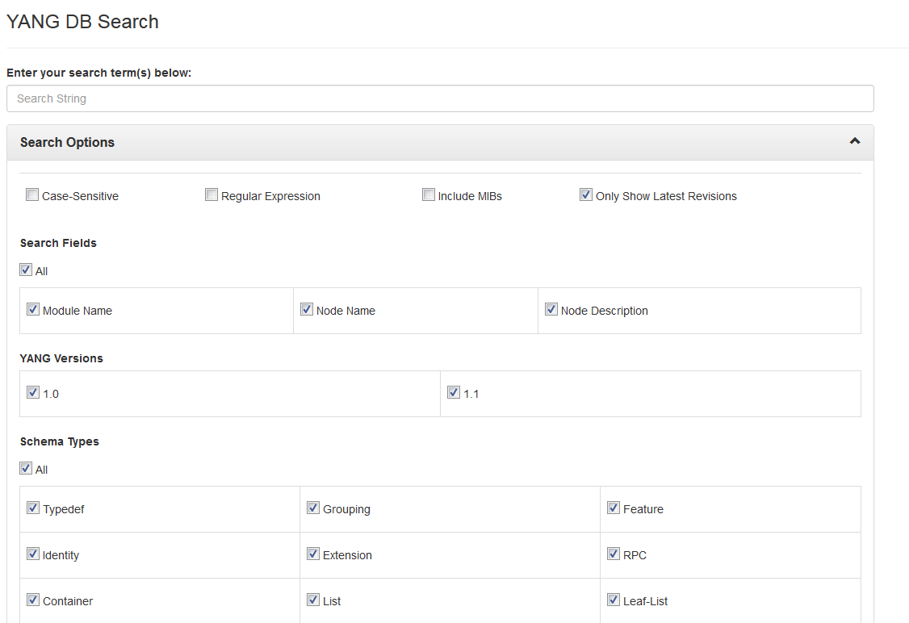
YANG DB Search

Slide 5
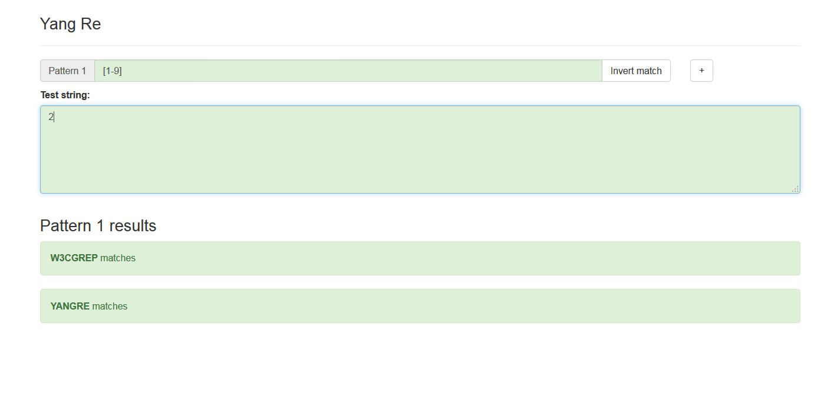

Slide 6
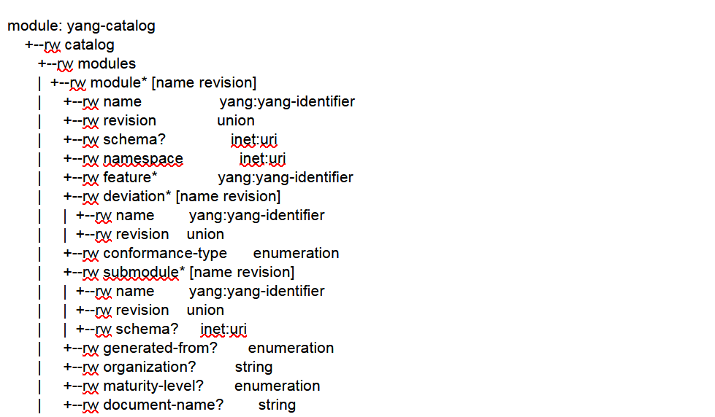
YANG Catalog APIs

Slide 7
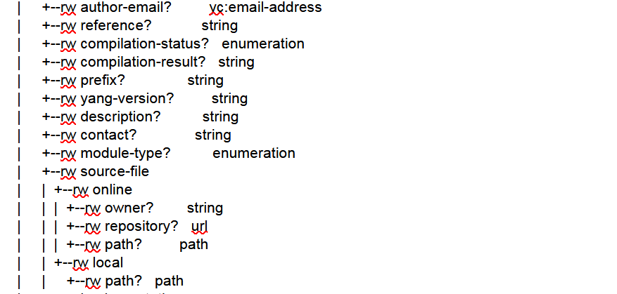
YANG Catalog APIs

Slide 8
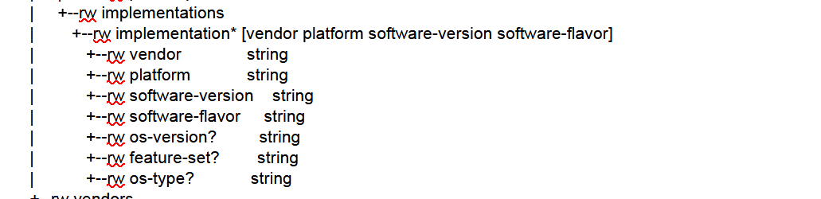
YANG Catalog APIs

Slide 9
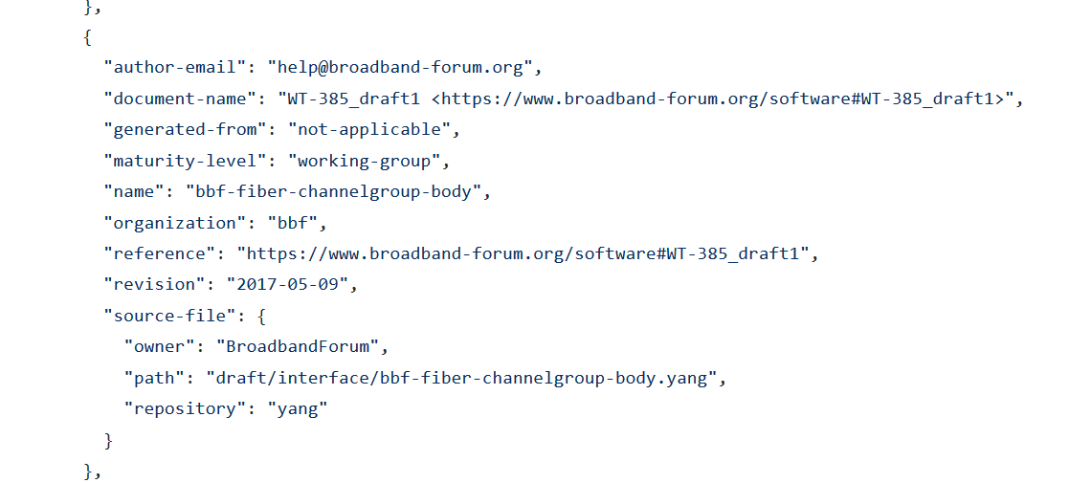
YANG Catalog APIs: Inserted all BBF Metadata
To push or get all information from the catalog
All BBF metadata pushed to the catalog

Slide 10
And Many others
Yangcatalog get APIs:
Ex: get me all modules and metadata for WG = <bla>
Improved the yanglint validator
Worked on the integration of YANG models (Huawei, Juniper)
Full inventory of the YANG models and full validation
Pieter Lewyllie
Working on a GUI for YANG => Code generation
Yuma123 (API, netconfd, yangcli)
Improved the yangvalidator.com
YANG tree type function
MEF YANG model validation

Slide 11
Next Steps
Continue improving the toolchain
Post a new version of draft-clacla-netmod-model-catalog-00 YANG module for yangcatalog.org
Based on the IETF hackathon

Slide 12
YANG Hackathon Achievements
IETF 96
Apr 2016

