Slide 1

How Low Can You Go: Balancing Performance with Anonymity in Tor’
DC-Area Anonymity,Privacy, and Security Seminar
May 10th, 2013
Rob Jansen
U.S. Naval Research Laboratory
rob.g.jansen@nrl.navy.mil
‘PETS 2013, joint w/ John Geddes and Nick Hopper, U of Minnesota

Slide 2
This Talk in a Nutshell
New class of induced throttling attacks
Drastically improves traffic correlation via “stealthy throughput” style attacks
Analyze attacks against
Traffic admission control algorithms
Congestion control algorithms
Notes:
Tor overview
How it provides anonymity
Why the focus on low latency
-interactive sessions are possible
-web browsing
-other things people use the internet for
-otherwise its unusable
Why users want this
-Freedom: speak their mind without worrying about political issues
-avoid censorship

Slide 3
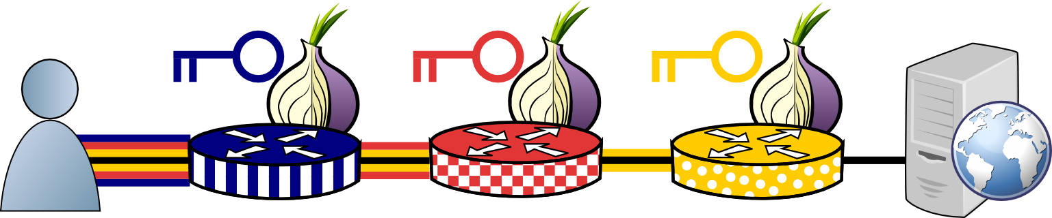
Anonymity with Onion Routing
Notes:
Tor overview
How it provides anonymity
Why the focus on low latency
-interactive sessions are possible
-web browsing
-other things people use the internet for
-otherwise its unusable
Why users want this
-Freedom: speak their mind without worrying about political issues
-avoid censorship

Slide 4




Traffic Correlation
Notes:
One of the biggest security concerns
Can be used to deanonymize users
-explain guard nodes (client are ‘locked in’ to their guards)
-want to see heartbeat on input and output link

Slide 5
Traffic Correlation
Notes:
One of the biggest security concerns
Can be used to deanonymize users
-explain guard nodes (client are ‘locked in’ to their guards)
-want to see heartbeat on input and output link

Slide 6
Traffic Correlation
Notes:
One of the biggest security concerns
Can be used to deanonymize users
-explain guard nodes (client are ‘locked in’ to their guards)
-want to see heartbeat on input and output link

Slide 7

Traffic Correlation
Notes:
One of the biggest security concerns
Can be used to deanonymize users
-explain guard nodes (client are ‘locked in’ to their guards)
-want to see heartbeat on input and output link

Slide 8

Traffic Correlation: Throughput
Mittal et.al. CCS’11
Notes:
How to do the stealthy throughput attack
-adversarial exit relay
-probe clients
-correlation

Slide 9

Traffic Correlation: Throughput
Mittal et.al. CCS’11
Notes:
How to do the stealthy throughput attack
-adversarial exit relay
-probe clients
-correlation

Slide 10
Traffic Correlation: Throughput
Mittal et.al. CCS’11
Notes:
How to do the stealthy throughput attack
-adversarial exit relay
-probe clients
-correlation

Slide 11
Traffic Correlation: Throughput
Induced throttling: improve correlation accuracy
Notes:
How to do the stealthy throughput attack
-adversarial exit relay
-probe clients
-correlation

Slide 12
Traffic Correlation: Latency
Hopper et.al. CCS’07
Notes:
How latency can be used to locate the client

Slide 13
Traffic Correlation: Latency
Inject redirect or javascript
Start timer
Hopper et.al. CCS’07
Notes:
How latency can be used to locate the client

Slide 14
Traffic Correlation: Latency
GET
Request redirected page
Hopper et.al. CCS’07
Notes:
How latency can be used to locate the client

Slide 15
Traffic Correlation: Latency
GET
Stop timer
Estimate latency
Hopper et.al. CCS’07
Notes:
How latency can be used to locate the client

Slide 16
Outline
Tor intro, traffic correlation
Why Tor is slow
Traffic admission control
Induced throttling attack
Effects of throughput vs induced throttling
Congestion control
Induced throttling attack
Effects of throughput vs induced throttling
Notes:
Metrics: correlation, entropy, client probability

Slide 17

Tor’s Current Status
~500,000 clients
~3000 relays

Slide 18
Tor’s Current Status
~500,000 clients
~3000 1200 relays

Slide 19
Tor’s Current Status

Slide 20
Bytes
Flows
3%
40%
2008'
58%
92%
11%
2010''
52%
36%
69%
' McCoy et al. PETS 2008, '' Chaabane et al. NSS 2010

Slide 21
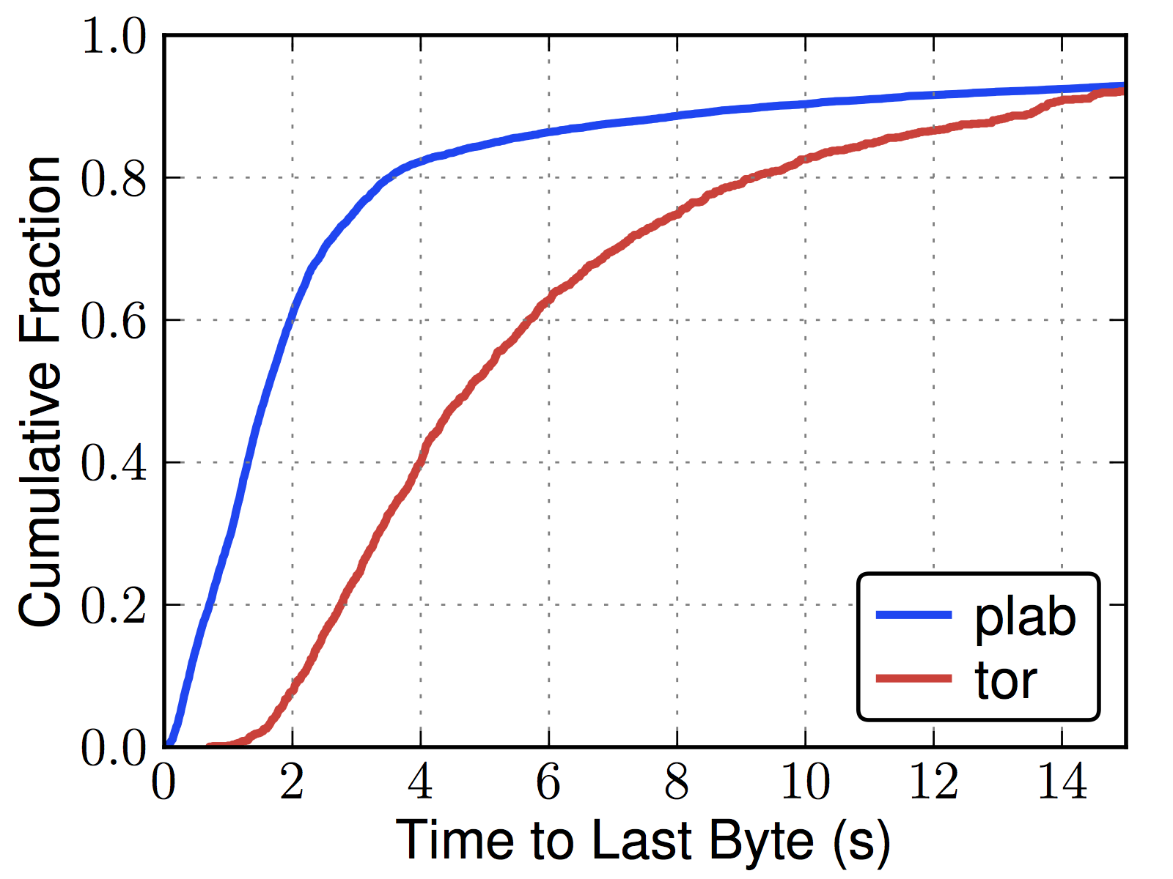
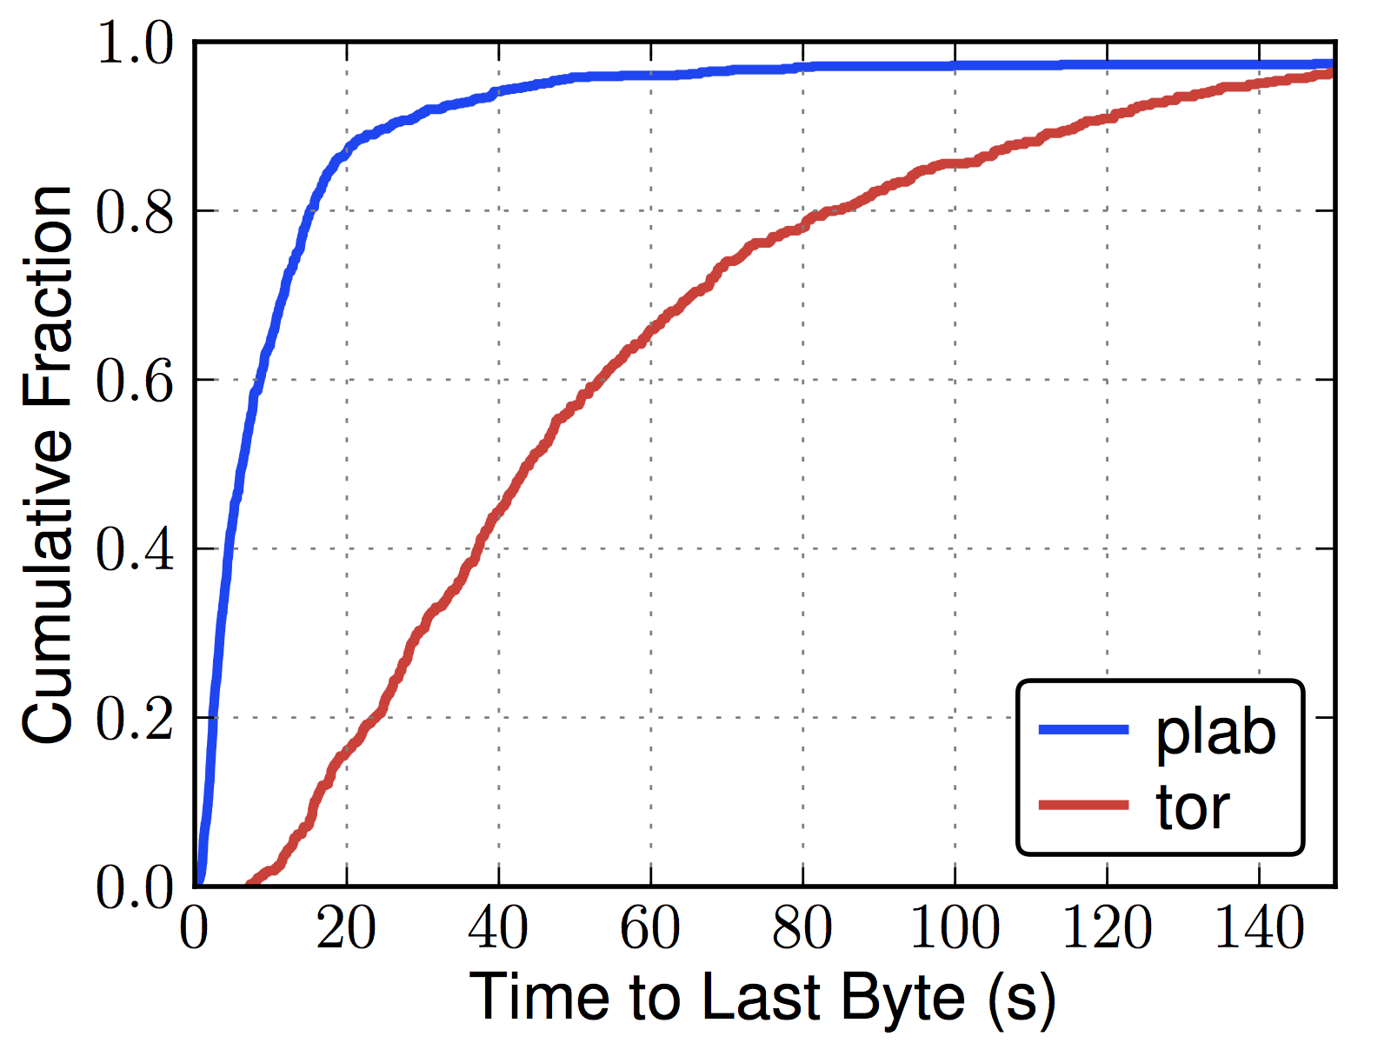
Tor is Slow[er]
Web (320 KiB)
Bulk (5 MiB)

Slide 22

Tor != Internet
Specialized Tor performance enhancements
Reducing load: traffic admission control
Reducing load, improving utilization: congestion control

Slide 23
Outline
Tor intro, traffic correlation
Why Tor is slow
Traffic admission control
Induced throttling attack
Effects of throughput vs induced throttling
Congestion control
Induced throttling attack
Effects of throughput vs induced throttling
Notes:
Metrics: correlation, entropy, client probability

Slide 24

Traffic Admission Control

Slide 25
Traffic Admission Control
Which connections?
At what rate?

Slide 26
Traffic Admission Control
Sybil attack!
Which connections?
At what rate?
Notes:
Algorithms that use the number of client connections to answer these questions are vulnerable to induced throttling via a sybil attack.

Slide 27
Traffic Admission Control

Slide 28
Traffic Admission Control
Sybil attack (connect only)
Notes:
Sybil nodes only connect, but don’t send any data

Slide 29
Traffic Admission Control
Throughput drops to throttle rate

Slide 30
Traffic Admission Control
Disconnect sybils

Slide 31
Traffic Admission Control
Throughput increases

Slide 32
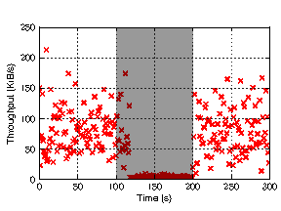
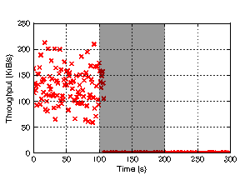
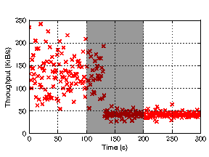
Induced Throttling Prototype
bitsplit
flag
threshold
Jansen et.al.
USENIX Sec’12

Slide 33
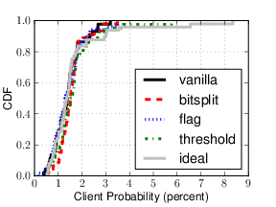
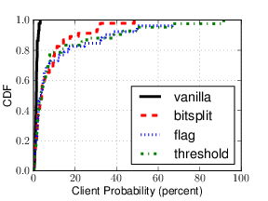
Induced Throttling Results
Throughput Attack
Induced Throttling Attack

Slide 34
Outline
Tor intro, traffic correlation
Why Tor is slow
Traffic admission control
Induced throttling attack
Effects of throughput vs induced throttling
Congestion control
Induced throttling attack
Effects of throughput vs induced throttling
Notes:
Metrics: correlation, entropy, client probability

Slide 35
Congestion Control
50 cells (max 500)

Slide 36
Congestion Control
SENDME
50 cells (max 500)

Slide 37
Congestion Control
500 cells

Slide 38
Congestion Control
500 cells
Throughput drops to 0

Slide 39
Congestion Control
SENDME
500 cells

Slide 40
Congestion Control
SENDME
500 cells
Throughput increases

Slide 41
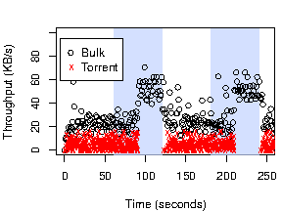
Induced Throttling Prototype

Slide 42
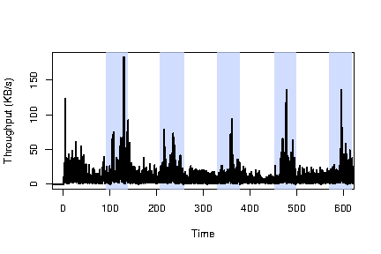
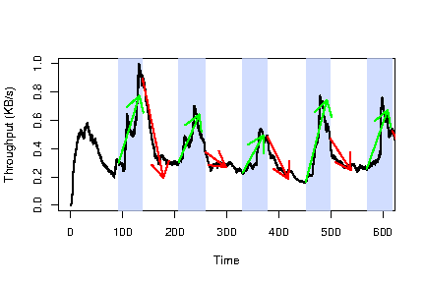
Induced Throttling Results
Raw throughput
Smoothed throughput
Notes:
Large scale attack:
-400 relays, 2600 clients

Slide 43
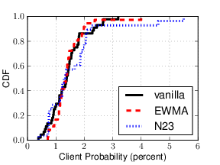
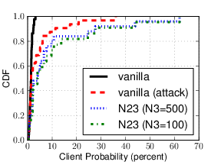
Induced Throttling Results
Throughput Attack
Induced Throttling Attack

Slide 44

Questions?
rob.g.jansen@nrl.navy.mil

