Slide 1

Memory-based DoS and Deanonymization Attacks on Tor
DCAPS Seminar
October 11th, 2013
Rob Jansen
U.S. Naval Research Laboratory
rob.g.jansen@nrl.navy.mil
*Joint with Aaron Johnson, Florian Tschorsch, Björn Scheuermann

Slide 2



The Tor Anonymity Network
torproject.org

Slide 3
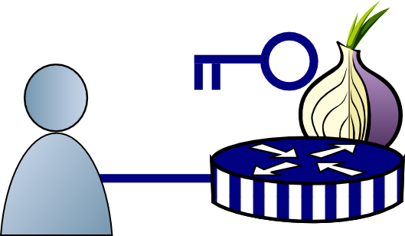
How Tor Works

Slide 4

How Tor Works

Slide 5

How Tor Works

Slide 6
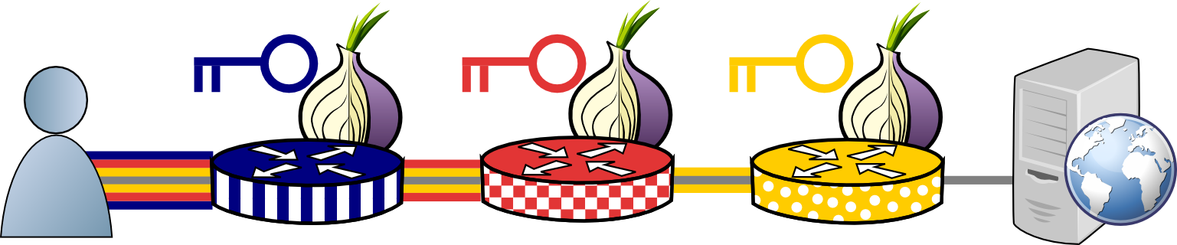
How Tor Works

Slide 7
How Tor Works
Tor protocol aware

Slide 8

Tor Flow Control
entry
exit

Slide 9
Tor Flow Control
One TCP Connection Between Each Relay, Multiple Circuits
entry
exit

Slide 10


Tor Flow Control
One TCP Connection Between Each Relay, Multiple Circuits
entry
exit
Multiple Application Streams

Slide 11
Tor Flow Control
entry
exit
No end-to-end TCP!

Slide 12
Tor Flow Control
Tor protocol aware
entry
exit

Slide 13
Tor Flow Control
Delivery
End
Packaging End
entry
exit

Slide 14
Tor Flow Control
Delivery
End
Packaging End
entry
exit

Slide 15
Tor Flow Control
SENDME Signal Every 100 Cells
1000 Cell Limit
entry
exit

Slide 16
Outline
The Sniper Attack
Low-cost memory consumption attack that disables arbitrary Tor relays
Deanonymizing Hidden Services
Using DoS attacks for deanonymization
Countermeasures

Slide 17

The Sniper Attack
Start Download
entry
exit
Request

Slide 18
The Sniper Attack
Reply
entry
exit
DATA

Slide 19
The Sniper Attack
Package and Relay DATA
DATA
entry
exit
DATA

Slide 20
The Sniper Attack
Stop Reading from Connection
DATA
DATA
R
entry
exit
DATA

Slide 21
The Sniper Attack
Flow Window Closed
DATA
DATA
DATA
DATA
DATA
DATA
R
entry
exit

Slide 22
The Sniper Attack
DATA
DATA
DATA
DATA
DATA
DATA
R
entry
exit
Periodically Send SENDME
SENDME

Slide 23
The Sniper Attack
DATA
DATA
DATA
DATA
Flow Window Opened
DATA
DATA
DATA
DATA
DATA
DATA
DATA
DATA
R
entry
exit
DATA
Periodically Send SENDME
SENDME

Slide 24
The Sniper Attack
DATA
DATA
DATA
DATA
DATA
DATA
DATA
DATA
DATA
DATA
DATA
DATA
DATA
DATA
DATA
DATA
DATA
DATA
DATA
DATA
DATA
DATA
R
entry
exit
DATA
Out of Memory, Killed by OS

Slide 25
The Sniper Attack
DATA
DATA
DATA
DATA
DATA
DATA
DATA
DATA
DATA
DATA
DATA
DATA
DATA
DATA
DATA
DATA
DATA
DATA
DATA
DATA
DATA
DATA
R
entry
exit
DATA
Use Tor to Hide

Slide 26
Memory Consumed over Time

Slide 27
Mean RAM Consumed, 50 Relays

Slide 28
Mean BW Consumed, 50 Relays

Slide 29
Speed of Sniper Attack
 |  | Direct |  | Anonymous
Relay Groups | Select % | 1 GiB | 8 GiB | 1 GiB | 8 GiB
Top Guard | 1.7
Top 5 Guards | 6.5
Top 20 Guards | 19
Top Exit | 3.2
Top 5 Exits | 13
Top 20 Exits | 35
Path Selection Probability
≈ Network Capacity

Slide 30
Speed of Sniper Attack
 |  | Direct |  | Anonymous
Relay Groups | Select % | 1 GiB | 8 GiB | 1 GiB | 8 GiB
Top Guard | 1.7 | 0:01 | 0:18 | 0:02 | 0:14
Top 5 Guards | 6.5 | 0:08 | 1:03 | 0:12 | 1:37
Top 20 Guards | 19 | 0:45 | 5:58 | 1:07 | 8:56
Top Exit | 3.2 | 0:01 | 0:08 | 0:01 | 0:12
Top 5 Exits | 13 | 0:05 | 0:37 | 0:07 | 0:57
Top 20 Exits | 35 | 0:29 | 3:50 | 0:44 | 5:52
Time (hours:minutes) to Consume RAM

Slide 31
Speed of Sniper Attack
 |  | Direct |  | Anonymous
Relay Groups | Select % | 1 GiB | 8 GiB | 1 GiB | 8 GiB
Top Guard | 1.7 | 0:01 | 0:18 | 0:02 | 0:14
Top 5 Guards | 6.5 | 0:08 | 1:03 | 0:12 | 1:37
Top 20 Guards | 19 | 0:45 | 5:58 | 1:07 | 8:56
Top Exit | 3.2 | 0:01 | 0:08 | 0:01 | 0:12
Top 5 Exits | 13 | 0:05 | 0:37 | 0:07 | 0:57
Top 20 Exits | 35 | 0:29 | 3:50 | 0:44 | 5:52
Time (hours:minutes) to Consume RAM

Slide 32
Speed of Sniper Attack
 |  | Direct |  | Anonymous
Relay Groups | Select % | 1 GiB | 8 GiB | 1 GiB | 8 GiB
Top Guard | 1.7 | 0:01 | 0:18 | 0:02 | 0:14
Top 5 Guards | 6.5 | 0:08 | 1:03 | 0:12 | 1:37
Top 20 Guards | 19 | 0:45 | 5:58 | 1:07 | 8:56
Top Exit | 3.2 | 0:01 | 0:08 | 0:01 | 0:12
Top 5 Exits | 13 | 0:05 | 0:37 | 0:07 | 0:57
Top 20 Exits | 35 | 0:29 | 3:50 | 0:44 | 5:52
Time (hours:minutes) to Consume RAM

Slide 33
Outline
The Sniper Attack
Low-cost memory consumption attack that disables arbitrary Tor relays
Deanonymizing Hidden Services
Using DoS attacks for deanonymization
Countermeasures

Slide 34
Hidden Services
User wants to hide service
HS

Slide 35
Hidden Services
HS chooses and publishes introduction point IP
HS
entry
IP

Slide 36
Hidden Services
Learns about HS on web
HS
entry
IP

Slide 37
Hidden Services
entry
RP
Builds Circuit to Chosen Rendezvous Point RP
HS
entry
IP

Slide 38
Hidden Services
Notifies HS of RP through IP
entry
RP
entry
RP
HS
entry
IP

Slide 39
Hidden Services
entry
RP
HS
entry
IP
RP

Slide 40
Hidden Services
entry
RP
Build New Circuit to RP
entry
HS
entry
IP
RP

Slide 41
Hidden Services
Communicate!
entry
RP
entry
HS
entry
IP
RP

Slide 42
Deanonymizing Hidden Services
entry
RP
HS

Slide 43

Deanonymizing Hidden Services
Also runs a guard relay
entry
RP
HS

Slide 44
Deanonymizing Hidden Services
entry
RP
Build New Circuit to RP
HS
entry
RP

Slide 45
Deanonymizing Hidden Services
entry
RP
HS
entry
RP
S&P 2006, S&P 2013

Slide 46
Deanonymizing Hidden Services
Send 50 Padding Cells
entry
RP
PADDING
HS
entry
RP
S&P 2013

Slide 47
Deanonymizing Hidden Services
entry
RP
Identify HS entry if
cell count = 52
HS
entry
RP
S&P 2013

Slide 48
Deanonymizing Hidden Services
entry
RP
Sniper Attack,
or any other DoS
HS
entry

Slide 49
Deanonymizing Hidden Services
entry
RP
HS
Choose new Entry Guard

Slide 50
Deanonymizing Hidden Services
entry
RP
HS
RP

Slide 51
Deanonymizing Hidden Services
entry
RP
HS
RP
S&P 2006, S&P 2013

Slide 52
Deanonymizing Hidden Services
Send 50 Padding Cells
entry
RP
PADDING
HS
RP
S&P 2013

Slide 53
Deanonymizing Hidden Services
entry
RP
Identify HS if
cell count = 53
HS
RP
S&P 2013

Slide 54
Outline
The Sniper Attack
Low-cost memory consumption attack that disables arbitrary Tor relays
Deanonymizing Hidden Services
Using DoS attacks for deanonymization
Countermeasures

Slide 55
Countermeasures
Sniper Attack Defenses
Authenticated SENDMEs
Queue Length Limit
Adaptive Circuit Killer
Deanonymization Defenses
Entry-guard Rate-limiting
Middle Guards

Slide 56

Questions?
cs.umn.edu/~jansen
rob.g.jansen@nrl.navy.mil
think like an adversary

Slide 57
Speed of Deanonymization
Guard BW (MiB/s) | Guard Probability (%) | Average # Rounds | Average # Sniped | Average Time (h) 1 GiB | Average Time (h) 8 GiB
8.41 | 0.48 | 66 | 133 | 46 | 279
16.65 | 0.97 | 39 | 79 | 23 | 149
31.65 | 1.9 | 24 | 48 | 13 | 84
66.04 | 3.8 | 13 | 26 | 6 | 44
96.61 | 5.4 | 9 | 19 | 5 | 31
1 GiB/s Relay Can Deanonymize HS in about a day

Slide 58
Circuit Killer Defense

Slide 59
The Sniper Attack
Single Adversary
exit
entry
entry
exit

Slide 60
The Sniper Attack
Anonymous Tunnel
exit
entry
entry
exit

Slide 61
The Sniper Attack
exit
entry
entry
exit

Slide 62
The Sniper Attack
exit
entry
DATA
entry
exit
DATA
DATA
DATA

Slide 63
The Sniper Attack
R
exit
entry
DATA
entry
exit
DATA
DATA
DATA

Slide 64
The Sniper Attack
R
exit
entry
Flow Window Closed
entry
exit
DATA
DATA
DATA

Slide 65
The Sniper Attack
R
exit
entry
R
entry
exit
DATA
DATA
DATA

Slide 66
The Sniper Attack
R
exit
entry
R
entry
exit
DATA
DATA
DATA
DATA
DATA
DATA

Slide 67
The Sniper Attack
R
exit
entry
R
entry
exit
Killed by OS
DATA
DATA
DATA
DATA
DATA
DATA

