Slide 1

The Sniper Attack: Anonymously Deanonymizing and Disabling the Tor Network
Network and Distributed System Security Symposium
February 25th, 2014
Rob Jansen¹, Florian Tschorsch², Aaron Johnson¹, Björn Scheuermann²
¹U.S. Naval Research Laboratory
²Humboldt University of Berlin

Slide 2



The Tor Anonymity Network
torproject.org

Slide 3
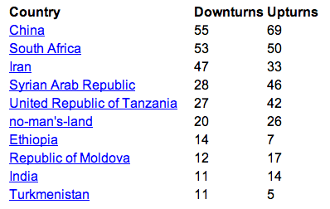
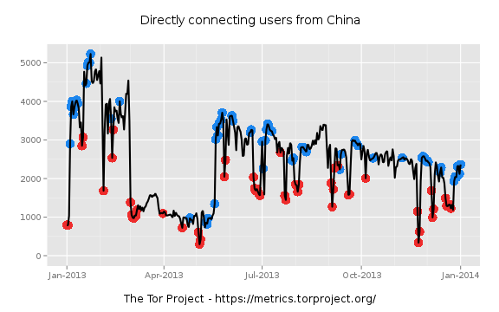
Censorship Arms Race

Slide 4


Censorship Arms Race
2013
2014

Slide 5
Beyond the Finish Line
As the cost to block access increases, a viable alternative is to degrade service
Active attacks are increasingly pervasive
Understanding the attack space and how to defend is vital to Tor’s continued resilience:
As adversaries become increasingly sophisticated
When attacks subvert explicit security goals

Slide 6
Outline
Background
The Sniper DoS Attack Against Tor’s Flow Control Protocol
How DoS Leads to Hidden Service Deanonymization

Slide 7

Tor Background
entry
exit

Slide 8
Tor Background
One TCP Connection Between Each Relay, Multiple Circuits
entry
exit

Slide 9
Tor Background
entry
exit
No end-to-end TCP!

Slide 10
Tor Flow Control
Delivery
End
Packaging End
entry
exit

Slide 11
Tor Flow Control
Delivery
End
Packaging End
entry
exit

Slide 12
Tor Flow Control
SENDME Signal Every 100 Cells
1000 Cell Limit
entry
exit

Slide 13
The Sniper Attack
Memory-based denial of service (DoS) attack
Exploits vulnerabilities in Tor’s flow control protocol
Can be used to disable arbitrary Tor relays

Slide 14

The Sniper Attack
Start Download
entry
exit
Request

Slide 15
The Sniper Attack
Reply
entry
exit
DATA

Slide 16
The Sniper Attack
Package and Relay DATA
DATA
entry
exit
DATA

Slide 17
The Sniper Attack
Stop Reading from Connection
DATA
DATA
R
entry
exit
DATA

Slide 18
The Sniper Attack
Flow Window Closed
DATA
DATA
DATA
DATA
DATA
DATA
R
entry
exit

Slide 19
The Sniper Attack
DATA
DATA
DATA
DATA
DATA
DATA
R
entry
exit
Periodically Send SENDME
SENDME

Slide 20
The Sniper Attack
DATA
DATA
DATA
DATA
Flow Window Opened
DATA
DATA
DATA
DATA
DATA
DATA
DATA
DATA
R
entry
exit
DATA
Periodically Send SENDME
SENDME

Slide 21
The Sniper Attack
DATA
DATA
DATA
DATA
DATA
DATA
DATA
DATA
DATA
DATA
DATA
DATA
DATA
DATA
DATA
DATA
DATA
DATA
DATA
DATA
DATA
DATA
R
entry
exit
DATA
Out of Memory, Killed by OS

Slide 22
The Sniper Attack
DATA
DATA
DATA
DATA
DATA
DATA
DATA
DATA
DATA
DATA
DATA
DATA
DATA
DATA
DATA
DATA
DATA
DATA
DATA
DATA
DATA
DATA
R
entry
exit
DATA
Use Tor to Hide

Slide 23
The Sniper Attack: Results
Implemented Sniper Attack Prototype
Control Sybils via Tor Control Protocol
Tested in Shadow (shadow.github.io)
Measured:
Victim Memory Consumption Rate
Adversary Bandwidth Usage

Slide 24
Mean RAM Consumed at Victim

Slide 25
Mean BW Consumed at Adversary

Slide 26
Speed of Sniper Attack
 |  | Direct |  | Anonymous
Relay Groups | Select % | 1 GiB | 8 GiB | 1 GiB | 8 GiB
Top Guard | 1.7
Top 5 Guards | 6.5
Top 20 Guards | 19
Top Exit | 3.2
Top 5 Exits | 13
Top 20 Exits | 35
Path Selection Probability
≈ Network Capacity

Slide 27
Speed of Sniper Attack
 |  | Direct |  | Anonymous
Relay Groups | Select % | 1 GiB | 8 GiB | 1 GiB | 8 GiB
Top Guard | 1.7 | 0:01 | 0:18 | 0:02 | 0:14
Top 5 Guards | 6.5 | 0:08 | 1:03 | 0:12 | 1:37
Top 20 Guards | 19 | 0:45 | 5:58 | 1:07 | 8:56
Top Exit | 3.2 | 0:01 | 0:08 | 0:01 | 0:12
Top 5 Exits | 13 | 0:05 | 0:37 | 0:07 | 0:57
Top 20 Exits | 35 | 0:29 | 3:50 | 0:44 | 5:52
Time (hours:minutes) to Consume RAM

Slide 28
Speed of Sniper Attack
 |  | Direct |  | Anonymous
Relay Groups | Select % | 1 GiB | 8 GiB | 1 GiB | 8 GiB
Top Guard | 1.7 | 0:01 | 0:18 | 0:02 | 0:14
Top 5 Guards | 6.5 | 0:08 | 1:03 | 0:12 | 1:37
Top 20 Guards | 19 | 0:45 | 5:58 | 1:07 | 8:56
Top Exit | 3.2 | 0:01 | 0:08 | 0:01 | 0:12
Top 5 Exits | 13 | 0:05 | 0:37 | 0:07 | 0:57
Top 20 Exits | 35 | 0:29 | 3:50 | 0:44 | 5:52
Time (hours:minutes) to Consume RAM

Slide 29
Speed of Sniper Attack
 |  | Direct |  | Anonymous
Relay Groups | Select % | 1 GiB | 8 GiB | 1 GiB | 8 GiB
Top Guard | 1.7 | 0:01 | 0:18 | 0:02 | 0:14
Top 5 Guards | 6.5 | 0:08 | 1:03 | 0:12 | 1:37
Top 20 Guards | 19 | 0:45 | 5:58 | 1:07 | 8:56
Top Exit | 3.2 | 0:01 | 0:08 | 0:01 | 0:12
Top 5 Exits | 13 | 0:05 | 0:37 | 0:07 | 0:57
Top 20 Exits | 35 | 0:29 | 3:50 | 0:44 | 5:52
Time (hours:minutes) to Consume RAM

Slide 30
Speed of Sniper Attack
 |  | Direct |  | Anonymous
Relay Groups | Select % | 1 GiB | 8 GiB | 1 GiB | 8 GiB
Top Guard | 1.7 | 0:01 | 0:18 | 0:02 | 0:14
Top 5 Guards | 6.5 | 0:08 | 1:03 | 0:12 | 1:37
Top 20 Guards | 19 | 0:45 | 5:58 | 1:07 | 8:56
Top Exit | 3.2 | 0:01 | 0:08 | 0:01 | 0:12
Top 5 Exits | 13 | 0:05 | 0:37 | 0:07 | 0:57
Top 20 Exits | 35 | 0:29 | 3:50 | 0:44 | 5:52
< 1 GiB RAM < 50 KiB/s Downstream BW
< 100 KiB/s Upstream BW
Time (hours:minutes) to Consume RAM

Slide 31
Deanonymizing Hidden Services
Cause HS to build new rendezvous circuits to learn its guard
Snipe HS guard to force reselection
Repeat until HS chooses adversarial guard

Slide 32
Hidden Services
Rendezvous Point RP
entry
RP
Introduction Point IP
HS
entry
IP

Slide 33
Hidden Services
Notifies HS of RP via IP
entry
RP
entry
RP
HS
entry
IP

Slide 34
Hidden Services
entry
RP
HS
entry
IP
RP

Slide 35
Hidden Services
entry
RP
Build New Circuit to RP
entry
HS
entry
IP
RP

Slide 36

Deanonymizing Hidden Services
entry
RP
Build New Circuit to RP
entry
HS
RP
S&P 2006, S&P 2013

Slide 37
Deanonymizing Hidden Services
PADDING
Send 50 Padding Cells
entry
RP
entry
HS
RP
S&P 2013

Slide 38
Deanonymizing Hidden Services
PADDING
Send 50 Padding Cells
entry
RP
entry
HS
Identify HS entry if
cell count == 52
RP
S&P 2013

Slide 39
Deanonymizing Hidden Services
Sniper Attack,
or any other DoS
entry
HS
RP

Slide 40
Deanonymizing Hidden Services
PADDING
Send 50 Padding Cells
entry
RP
HS
Identify HS if
cell count == 53
RP
S&P 2013

Slide 41
Speed of Deanonymization
Guard BW (MiB/s) | Guard Probability (%) | Average # Rounds | Average # Sniped | Average Time (h) 1 GiB | Average Time (h) 8 GiB
8.41 | 0.48
16.65 | 0.97
31.65 | 1.9
66.04 | 3.8
96.61 | 5.4

Slide 42
Speed of Deanonymization
Guard BW (MiB/s) | Guard Probability (%) | Average # Rounds | Average # Sniped | Average Time (h) 1 GiB | Average Time (h) 8 GiB
8.41 | 0.48 | 66 | 133 | 46 | 279
16.65 | 0.97 | 39 | 79 | 23 | 149
31.65 | 1.9 | 24 | 48 | 13 | 84
66.04 | 3.8 | 13 | 26 | 6 | 44
96.61 | 5.4 | 9 | 19 | 5 | 31

Slide 43
Speed of Deanonymization
Guard BW (MiB/s) | Guard Probability (%) | Average # Rounds | Average # Sniped | Average Time (h) 1 GiB | Average Time (h) 8 GiB
8.41 | 0.48 | 66 | 133 | 46 | 279
16.65 | 0.97 | 39 | 79 | 23 | 149
31.65 | 1.9 | 24 | 48 | 13 | 84
66.04 | 3.8 | 13 | 26 | 6 | 44
96.61 | 5.4 | 9 | 19 | 5 | 31
1 GiB/s Relay Can Deanonymize HS in about a day

Slide 44
Countermeasures
Sniper Attack Defenses
Authenticated SENDMEs
Queue Length Limit
Adaptive Circuit Killer
Deanonymization Defenses
Entry-guard Rate-limiting
Middle Guards
Countermeasure deployed in Tor!

Slide 45

Questions?
cs.umn.edu/~jansen
rob.g.jansen@nrl.navy.mil
think like an adversary

Slide 46
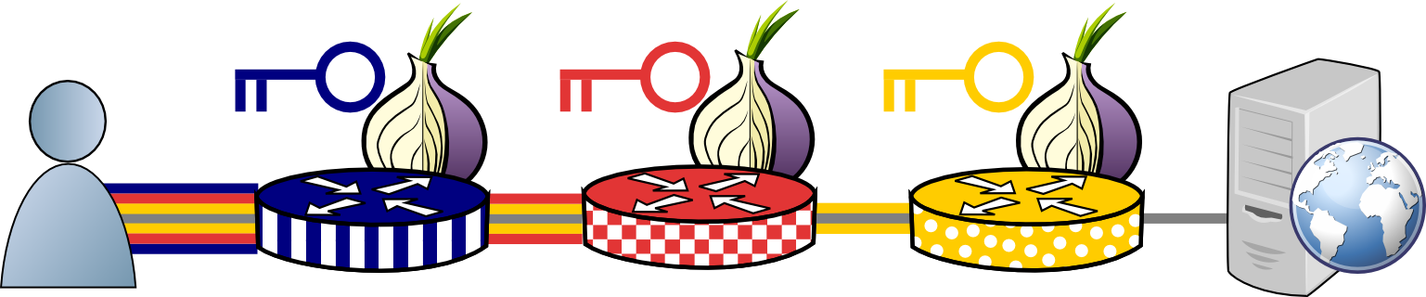
How Tor Works
Tor protocol aware

Slide 47
Sniper Attack Experimental Results

Slide 48
Sniper Resource Usage
 | Direct |  |  | Anonymous
Config | RAM (MiB) | Tx (KiB/s) | Rx (KiB/s) | RAM (MiB) | Tx (KiB/s) | Rx (KiB/s)
1 team, 5 circuits | 28 | 4.0 | 2.3 | 56 | 3.6 | 1.8
1 team, 10 circuits | 28 | 6.1 | 2.6 | 57 | 9.4 | 2.1
5 teams, 50 circuits | 141 | 30.0 | 9.5 | 283 | 27.7 | 8.5
10 teams, 100 circuits | 283 | 56.0 | 20.9 | 564 | 56.6 | 17.0

Slide 49
Memory Consumed over Time

Slide 50
Sniper Attack Through Tor

Slide 51
The Sniper Attack
Single Adversary
exit
entry
entry
exit

Slide 52
The Sniper Attack
Anonymous Tunnel
exit
entry
entry
exit

Slide 53
The Sniper Attack
exit
entry
entry
exit

Slide 54
The Sniper Attack
exit
entry
DATA
entry
exit
DATA
DATA
DATA

Slide 55
The Sniper Attack
R
exit
entry
DATA
entry
exit
DATA
DATA
DATA

Slide 56
The Sniper Attack
R
exit
entry
Flow Window Closed
entry
exit
DATA
DATA
DATA

Slide 57
The Sniper Attack
R
exit
entry
R
entry
exit
DATA
DATA
DATA

Slide 58
The Sniper Attack
R
exit
entry
R
entry
exit
DATA
DATA
DATA
DATA
DATA
DATA

Slide 59
The Sniper Attack
R
exit
entry
R
entry
exit
Killed by OS
DATA
DATA
DATA
DATA
DATA
DATA

Slide 60
Tor Hidden Services Background

Slide 61
Hidden Services
User wants to hide service
HS

Slide 62
Hidden Services
HS chooses and publishes introduction point IP
HS
entry
IP

Slide 63
Hidden Services
Learns about HS on web
HS
entry
IP

Slide 64
Hidden Services
entry
RP
Builds Circuit to Chosen Rendezvous Point RP
HS
entry
IP

Slide 65
Hidden Services
Notifies HS of RP through IP
entry
RP
entry
RP
HS
entry
IP

Slide 66
Hidden Services
entry
RP
HS
entry
IP
RP

Slide 67
Hidden Services
entry
RP
Build New Circuit to RP
entry
HS
entry
IP
RP

Slide 68
Hidden Services
Communicate!
entry
RP
entry
HS
entry
IP
RP

