Slide 1

Toward Understanding Congestion in Tor
DC-area Anonymity, Privacy, and Security Seminar
January 24th, 2014
Rob Jansen
U.S. Naval Research Laboratory
*Joint with John Geddes, Chris Wacek, Micah Sherr, Paul Syverson

Slide 2
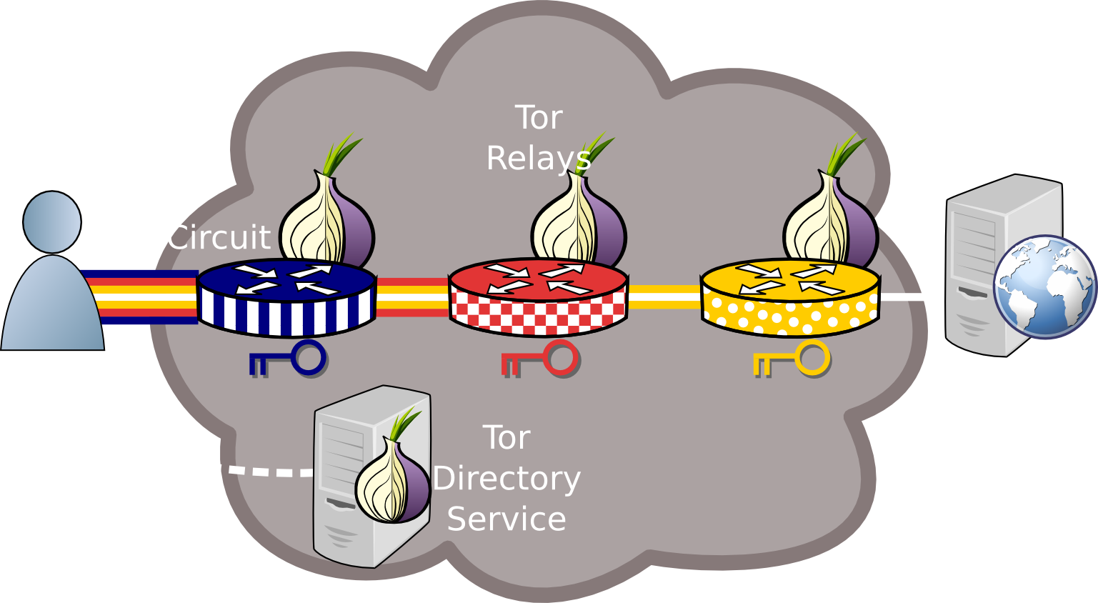
Tor for Awesomeness Anonymity

Slide 3
Tor is Slow!!! Research*
PCTCP: Per-Circuit TCP-over-IPsec Transport for Anonymous Communication Overlay Networks (CCS ‘13)
Reducing Latency in Tor Circuits with Unordered Delivery (FOCI ‘13)
How Low Can You Go: Balancing Performance with Anonymity in Tor (PETS ‘13)
The Path Less Travelled: Overcoming Tor's Bottlenecks with Traffic Splitting (PETS ’13)
An Empirical Evaluation of Relay Selection in Tor (NDSS ‘13)
LIRA: Lightweight Incentivized Routing for Anonymity (NDSS ‘13)
Improving Performance and Anonymity in the Tor Network (IPCCC ‘12)
Enhancing Tor's Performance using Real-time Traffic Classification (CCS ’12)
Torchestra: Reducing interactive traffic delays over Tor (WPES ‘12)
Throttling Tor Bandwidth Parasites (USENIX Sec ‘12)
LASTor: A Low-Latency AS-Aware Tor Client (Oakland ‘12)
Congestion-aware Path Selection for Tor (FC ‘12)
*Not a comprehensive list

Slide 4
Tor is Slow!!! Research*
PCTCP: Per-Circuit TCP-over-IPsec Transport for Anonymous Communication Overlay Networks (CCS ‘13)
Reducing Latency in Tor Circuits with Unordered Delivery (FOCI ‘13)
How Low Can You Go: Balancing Performance with Anonymity in Tor (PETS ‘13)
The Path Less Travelled: Overcoming Tor's Bottlenecks with Traffic Splitting (PETS ’13)
An Empirical Evaluation of Relay Selection in Tor (NDSS ‘13)
LIRA: Lightweight Incentivized Routing for Anonymity (NDSS ‘13)
Improving Performance and Anonymity in the Tor Network (IPCCC ‘12)
Enhancing Tor's Performance using Real-time Traffic Classification (CCS ’12)
Torchestra: Reducing interactive traffic delays over Tor (WPES ‘12)
Throttling Tor Bandwidth Parasites (USENIX Sec ‘12)
LASTor: A Low-Latency AS-Aware Tor Client (Oakland ‘12)
Congestion-aware Path Selection for Tor (FC ‘12)
Where?
*Not a comprehensive list

Slide 5
Outline
Where is Tor slow?
Understand Tor relay architecture
Measure and analyze relay congestion in realistic Tor networks
Design focused solutions

Slide 6
Outline
Where is Tor slow?
Understand Tor relay architecture
Measure and analyze relay congestion in realistic Tor networks
Design focused solutions

Slide 7

The Tor Network

Slide 8

Relay Overview

Slide 9
Relay Overview

Slide 10

Relay Overview
Onion routing connections

Slide 11
Relay Overview
TCP
TCP
TCP
TCP
TCP
TCP Transport

Slide 12



Relay Overview
TCP
TCP
TCP
TCP
TCP
TCP
TCP
Multiplexed Circuits and Streams

Slide 13
Relay Overview
TCP
TCP
TCP
TCP
TCP
TCP
TCP

Slide 14
Relay Internals
Kernel Input
Tor Input
Tor Output
Kernel Output
Tor Circuits
Network Input

Slide 15
Relay Internals
Kernel Input
Tor Input
Tor Output
Kernel Output
Tor Circuits
Split data into socket buffers

Slide 16
Relay Internals
Kernel Input
Tor Input
Tor Output
Kernel Output
Tor Circuits
Read data from sockets into Tor

Slide 17
Relay Internals
Kernel Input
Tor Input
Tor Output
Kernel Output
Tor Circuits
Process data (encrypt/decrypt)

Slide 18
Relay Internals
Kernel Input
Tor Input
Tor Output
Kernel Output
Tor Circuits
Split cells into circuit queues

Slide 19
Relay Internals
Kernel Input
Tor Input
Tor Output
Kernel Output
Tor Circuits
Circuits linked to outgoing connection

Slide 20
Relay Internals
Kernel Input
Tor Input
Tor Output
Kernel Output
Tor Circuits
Schedule cells

Slide 21
Relay Internals
Kernel Input
Tor Input
Tor Output
Kernel Output
Tor Circuits
Write data from Tor into sockets

Slide 22
Relay Internals
Kernel Input
Tor Input
Tor Output
Kernel Output
Tor Circuits
Schedule data for sending

Slide 23
Relay Internals
Kernel Input
Tor Input
Tor Output
Kernel Output
Tor Circuits
Opportunities for traffic management

Slide 24
Outline
Where is Tor slow?
Understand Tor relay architecture
Measure and analyze relay congestion in realistic Tor networks
Design focused solutions

Slide 25
Kernel Congestion: libkqtime
Kernel Input
Tor Input
Tor Output
Kernel Output
Tor Circuits

Slide 26
Kernel Congestion: libkqtime
Kernel Input
Tor Input
Tor Output
Kernel Output
Tor Circuits
tag
match

Slide 27
Kernel Congestion: libkqtime
Kernel Input
Tor Input
Tor Output
Kernel Output
Tor Circuits
tag
match
tag
match

Slide 28
Kernel Congestion: libkqtime
Kernel Input
Tor Input
Tor Output
Kernel Output
Tor Circuits
tag
match
tag
match
track cells

Slide 29
Congestion Analysis

Slide 30
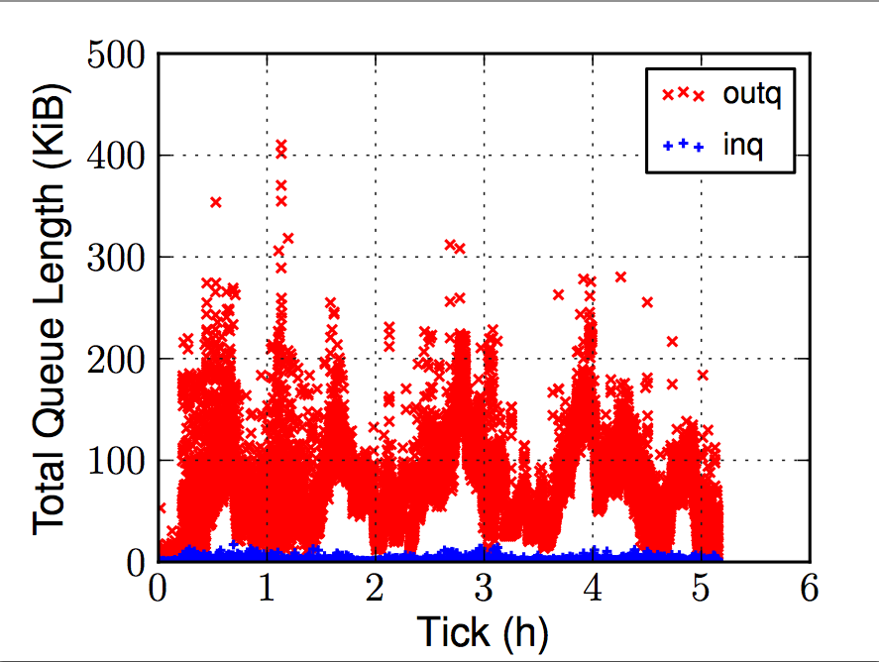
Congestion Analysis

Slide 31
Analyzing the Design
Kernel Input
Tor Input
Tor Output
Kernel Output
Tor Circuits

Slide 32
Analyzing the Design
Kernel Input
Tor Input
Tor Output
Kernel Output
Tor Circuits
Queuing delays in kernel output buffer

Slide 33
Analyzing the Design
Kernel Input
Tor Input
Tor Output
Kernel Output
Tor Circuits
Circuit scheduling design flaws
Queuing delays in kernel output buffer

Slide 34
Outline
Where is Tor slow?
Understand Tor relay architecture
Measure and analyze relay congestion in realistic Tor networks
Design focused solutions

Slide 35
Ineffective Priority
Tor Output
Kernel Output
Tor Circuits
Circuit schedulers are ineffective at prioritization

Slide 36
Ineffective Priority
Tor Output
Kernel Output
Tor Circuits
Libevent schedules one connection at a time

Slide 37
Ineffective Priority
Tor Output
Kernel Output
Tor Circuits
Tor only considers a subset of writable circuits
Libevent schedules one connection at a time

Slide 38
Ineffective Priority
Tor Output
Kernel Output
Tor Circuits
Tor only considers a subset of writable circuits
Circuits from different connections are not prioritized correctly
Libevent schedules one connection at a time

Slide 39
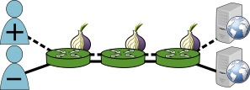
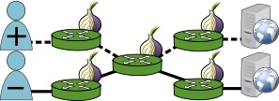
Scheduling Problems
Scenario A
Scenario B
Shared Connection
No Shared Connection

Slide 40
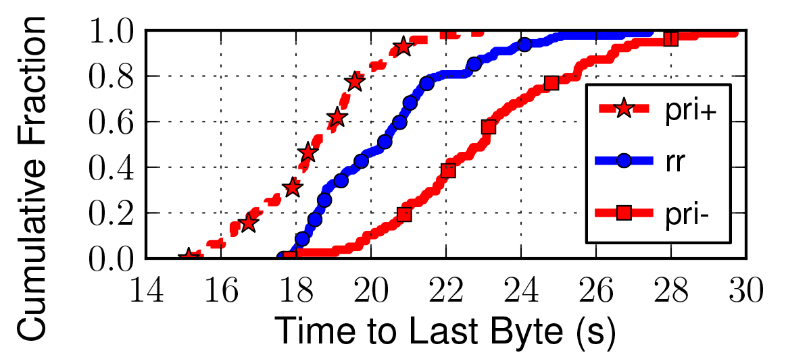
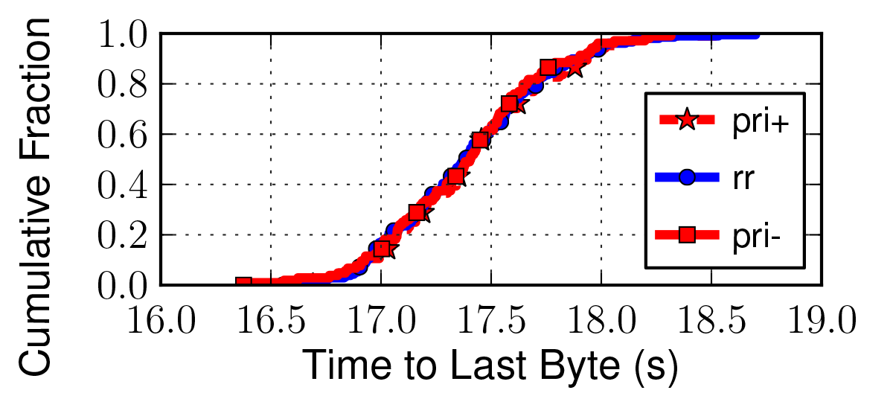
Scheduling Problems
Scenario A
Scenario B

Slide 41
Global Circuit Scheduling
Tor Output
Kernel Output
Tor Circuits
Choose among ALL writable circuits

Slide 42
Kernel Buffer Bloat
Tor Output
Kernel Output
Tor Circuits
Queuing delays in kernel output buffer

Slide 43
Kernel Buffer Bloat
Tor Output
Kernel Output
Too many large kernel queues
More data in kernel than it can send
Circuit scheduler timing issues
Tor Circuits
Queuing delays in kernel output buffer

Slide 44
Tor Output Auto-tuning
Don’t write what the kernel can’t send
Smartly write to kernel using
Socket queue lengths and sizes
TCP windows
Node bandwidth capacity
Check again before kernel starvation
Increase effectiveness of circuit scheduler

Slide 45

Questions?
cs.umn.edu/~jansen
rob.g.jansen@nrl.navy.mil
think like an adversary

Slide 46
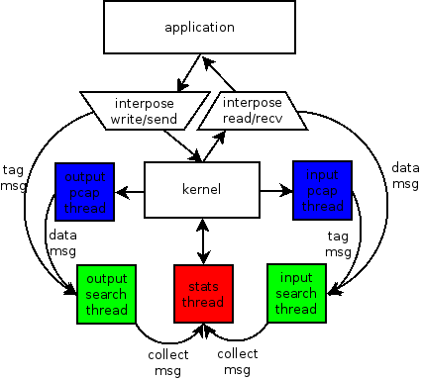
libkqtime

