Slide 1
Safely Measuring Tor
“Safely Measuring Tor”, Rob Jansen and Aaron Johnson, In the Proceedings of the 23rd ACM Conference on Computer and Communication Security (CCS 2016).
Rob Jansen
U.S. Naval Research Laboratory
Center for High Assurance Computer Systems
Seminar Talk, October 21st, 2016
DC-Area Anonymity, Privacy, and Security Seminar
The George Washington University

Slide 2



Talk Overview
Estimated ~1.75 M. Users/Day (metrics.torproject.org)
Tor: an anonymous communication, censorship resistant, privacy-enhancing communication system
How is Tor being used? being misused? performing?

Slide 3
Talk Overview
Estimated ~1.75 M. Users/Day (metrics.torproject.org)
Tor: an anonymous communication, censorship resistant, privacy-enhancing communication system
How is Tor being used? being misused? performing?
Objective: To safely gather Tor network usage statistics
Approach: Use distributed measurement, secure multiparty computation, and differential privacy

Slide 4
Background and Motivation
How Tor works
Why measurements are needed and what to measure
Measurement challenges

Slide 5


Background: Onion Routing
Users
Relays
Destinations
Circuit
Stream

Slide 6
Background: Using Circuits

Slide 7

Background: Using Circuits
Clients begin all circuits with a selected guard

Slide 8

Background: Using Circuits
Clients begin all circuits with a selected guard
Relays define individual exit policies

Slide 9
Background: Using Circuits
Clients begin all circuits with a selected guard
Relays define individual exit policies
Clients multiplex streams over a circuit

Slide 10
Background: Using Circuits
Clients begin all circuits with a selected guard
Relays define individual exit policies
Clients multiplex streams over a circuit
New circuits replace existing ones periodically

Slide 11
Background: Using Circuits
Clients begin all circuits with a selected guard
Relays define individual exit policies
Clients multiplex streams over a circuit
New circuits replace existing ones periodically
Clients randomly choose relays, weighted by bandwidth

Slide 12


Background: Directory Authorities
Directory Authorities
Hourly network consensus by majority vote
Relay info (IPs, pub keys, bandwidths, etc.)
Parameters (performance thresholds, etc.)

Slide 13
Motivation: Why Measure Tor?
Why are Tor network measurements needed?
To understand usage behaviors to focus effort and resources
To understand network protocols and calibrate parameters
To inform policy discussion

Slide 14
Motivation: Why Measure Tor?
Why are Tor network measurements needed?
To understand usage behaviors to focus effort and resources
To understand network protocols and calibrate parameters
To inform policy discussion
“Tor metrics are the ammunition that lets Tor and other security advocates argue for a more private and secure Internet from a position of data, rather than just dogma or perspective.”
– Bruce Schneier (2016-06-01)

Slide 15


Motivation: Measurement Challenges
https://metrics.torproject.org
Some Existing Measurements
Data Published | Privacy Techniques | Unsafe | Inaccurate
Relay BW available | Test measurements |  | ✖
Relay BW used | Aggregated ~ 4 hours | ✖
Total # daily users | Inferred (consensus fetches) |  | ✖
# users per country | Aggregated ~ 24 hours, rounded, opt-in | ✖
Exit traffic per port | Aggregated ~ 24 hours, opt-in | ✖

Slide 16
Motivation: Measurement Challenges
Safety concerns:
Per-relay outputs
Data stored locally
No privacy proofs
https://metrics.torproject.org
Some Existing Measurements
Data Published | Privacy Techniques | Unsafe | Inaccurate
Relay BW available | Test measurements |  | ✖
Relay BW used | Aggregated ~ 4 hours | ✖
Total # daily users | Inferred (consensus fetches) |  | ✖
# users per country | Aggregated ~ 24 hours, rounded, opt-in | ✖
Exit traffic per port | Aggregated ~ 24 hours, opt-in | ✖

Slide 17
Motivation: Measurement Challenges
Accuracy concerns:
Per-relay noise
Opt-in and inconsistent sampling
https://metrics.torproject.org
Some Existing Measurements
Data Published | Privacy Techniques | Unsafe | Inaccurate
Relay BW available | Test measurements |  | ✖
Relay BW used | Aggregated ~ 4 hours | ✖
Total # daily users | Inferred (consensus fetches) |  | ✖
# users per country | Aggregated ~ 24 hours, rounded, opt-in | ✖
Exit traffic per port | Aggregated ~ 24 hours, opt-in | ✖

Slide 18
Motivation: Missing Measurements
Many useful statistics are not collected for safety
Users
Total number of unique users at any time, how long they stay online, how often they join and leave, usage behavior
Relays
Total bandwidth capacity, congestion and queuing delays, circuit and other failures, denial of service and other attacks
Destinations
Popular destinations, popular applications, effects of DNS, properties of traffic (bytes and connections per page, etc.)

Slide 19
Previous Measurement Studies
Shining Light in Dark Places: Understanding the Tor Network
McCoy et. al., PETS 2008
tcpdump of first 150 packet bytes (including 96 payload)
Collected, stored, manually analyzed sensitive data
Digging into anonymous traffic: A deep analysis of the Tor anonymizing network
Repeated by Chaabane et. al., NSS 2010
Also used customized DPI software (OpenDPI)
Similar ethical issues

Slide 20
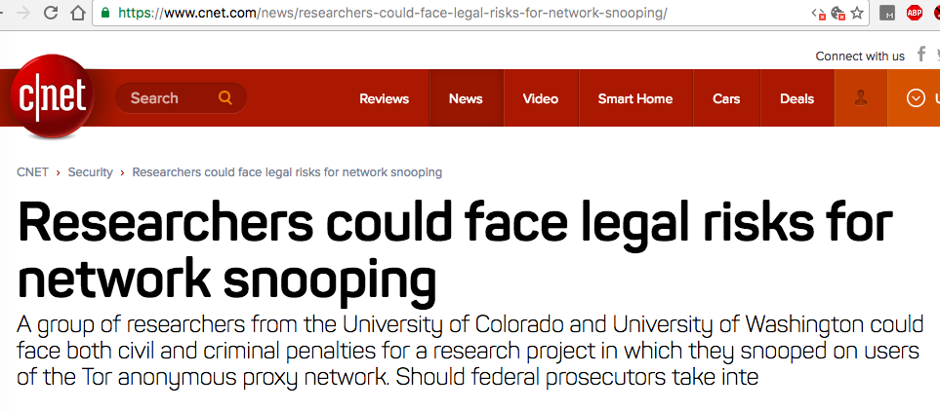
Previous Measurement Studies
Shining Light in Dark Places: Understanding the Tor Network
McCoy et. al., PETS 2008
tcpdump of first 150 packet bytes (including 96 payload)
Collected, stored, manually analyzed sensitive data
Digging into anonymous traffic: A deep analysis of the Tor anonymizing network
Chaabane et. al., NSS 2010
Customized DPI software (OpenDPI)
Similar ethical issues

Slide 21
The PrivCount Measurement System
PrivCount system architecture
Distributed measurement and aggregation protocol
Secure computation and private output

Slide 22


PrivCount: Overview
Distributed measurement system
“Privacy-preserving counting” system
Tracks various types of Tor events, computes statistics from those events
Based on PrivEx-S2 by Elahi et al. (CCS 2014)
Distributes trust using secret sharing across many operators
Achieves forward privacy during measurement
the adversary cannot learn the state of the measurement before time of compromise
Provides differential privacy of the results
prevents confirmation of the actions of a specific user given the output

Slide 23
PrivCount: Architecture
Data Collectors (DCs)
Collect events
Increment counters
DC1
DC2

Slide 24
PrivCount: Architecture
Data Collectors (DCs)
Collect events
Increment counters
Tally Server (TS)
Central, untrusted proxy
Collection facilitator
DC1
DC2
TS

Slide 25
PrivCount: Architecture
Data Collectors (DCs)
Collect events
Increment counters
Tally Server (TS)
Central, untrusted proxy
Collection facilitator
Share Keepers (SKs)
Stores DC secrets, sum for aggregation
DC1
DC2
TS
SK1
SK2

Slide 26
PrivCount: Initialization
DC1
DC2
Create deployment document
Privacy parameters ε and δ
Sensitivity for each statistic (max change due to single client)
Noise weight ω (relative noise added by each DC)
TS
Deploy
SK1
SK2

Slide 27
PrivCount: Initialization
DC1
DC2
Deploy
Deploy
Send to all DCs and SKs
DCs and SKs accept only on unanimous consensus
TS
SK1
SK2
Deploy
Deploy

Slide 28
PrivCount: Configuration
DC1
DC2
Create configuration document
Collection start and end times
Statistics to collect
Estimated value for each statistic (maximize relative per-statistic accuracy while providing (ε, δ)-differential privacy)
TS
Config
SK1
SK2

Slide 29
PrivCount: Configuration
DC1
DC2
Config
Config
Send to all DCs and SKs
DCs and SKs check for consistency
TS
SK1
SK2
Config
Config

Slide 30
PrivCount: Execution - Setup
DC1
DC2
N_DC1
N_DC2
Generate noise for each counter
N ~ Normal(0,ωσ) mod q
Contributes to differential privacy of the outputs
TS
SK1
SK2

Slide 31
PrivCount: Execution - Setup
S1_DC1
S1_DC2
DC1
DC2
S2_DC2
S2_DC1
N_DC1
N_DC2
Generate random share for each SK
S ~ Uniform({0, …, q-1})
“Blinds” the actual counts for forward privacy at the DCs
TS
SK1
SK2

Slide 32
PrivCount: Execution - Setup
S1_DC1
S1_DC2
DC1
DC2
S2_DC2
S2_DC1
N_DC1
N_DC2
TS
DCs send shares to SKs
SK1
SK2
S2_DC1
S1_DC1
S2_DC2
S1_DC2

Slide 33
PrivCount: Collection
C_DC1
C_DC2
S1_DC1
S1_DC2
DC1
DC2
S2_DC2
S2_DC1
N_DC1
N_DC2
TS
DCs collect events and increment counters
SK1
SK2
S2_DC1
S1_DC1
S2_DC2
S1_DC2

Slide 34
PrivCount: Collection
C_DC1
C_DC2
S1_DC1
S1_DC2
DC1
DC2
S2_DC2
S2_DC1
N_DC1
N_DC2
TS
Send Counters to TS
No privacy lost as long as 1 SK is honest
SK1
SK2
S2_DC1
S1_DC1
S2_DC2
S1_DC2

Slide 35
PrivCount: Aggregation
DC1
DC2
C_DC1
C_DC2
S1_DC1
-
TS
S1_DC2
TS combines all counter values from DCs and SKs
Subtracts SK-held values from DC-held values
+
S1_DC2
S1_DC1
S2_DC2
S2_DC1
S2_DC1
-
S2_DC2
N_DC1
N_DC2
SK1
SK2

Slide 36
PrivCount: Aggregation
DC1
DC2
C_DC1
C_DC2
S1_DC1
TS
S1_DC2
TS combines all counter values from DCs and SKs
Subtracts SK-held values from DC-held values
+
S1_DC2
-
S1_DC1
S2_DC2
S2_DC1
S2_DC1
S2_DC2
N_DC1
N_DC2
SK1
SK2

Slide 37
PrivCount: Aggregation
DC1
DC2
C_DC1
TS
Results are differentially private and safe to publish
C_DC2
N_DC1
N_DC2
SK1
SK2

Slide 38
Deployment and Measurement Results
Configuring and running Tor relays
“Exploratory” measurements using various exit policies
“In-depth” measurements of most popular usage
Network-wide measurement inference

Slide 39
Deploying PrivCount
DC1
DC2
DC3
DC4
DC5
DC6
DC7
0.163% entry bandwidth
TS
1.099% exit bandwidth
SK1
SK2
SK3
SK4
SK5
SK6

Slide 40
Collection Phases
Exploratory phases
Explore various exit policies (strict, default, open)
Explore various applications (web, interactive, other)
Gather only totals (circuits, streams, bytes)
Use Tor metrics to estimate input parameters
Run for 1 day, iterate
In-depth phases
Focus on most popular exit policy and applications
Gather totals and histograms
Use exploratory results to estimate input parameters
Run for 4 days for client stats, 21 days for exit stats

Slide 41
Results: Exit Policies
Open file sharing ports reduce web data transferred

Slide 42
Results: Amount and Types of Traffic
Increase in web traffic

Slide 43
Results: Number of Unique Users
710,000 total users
550,000 active users
In an average 10 mins.

Slide 44
Results: Number of Unique Users
710,000 total users
550,000 active users
In an average 10 mins.
~1,750,000 daily users (Consensus downloads – https://metrics.torproject.org)

Slide 45
Results: Number of Unique Users
710,000 total users
550,000 active users
In an average 10 mins.
~1,750,000 daily users (Consensus downloads – https://metrics.torproject.org)
~800,000 – ~1,600,000 average concurrent users
(Tor Browser update pings - https://tor-metrics.shinyapps.io/webstats2/)

Slide 46
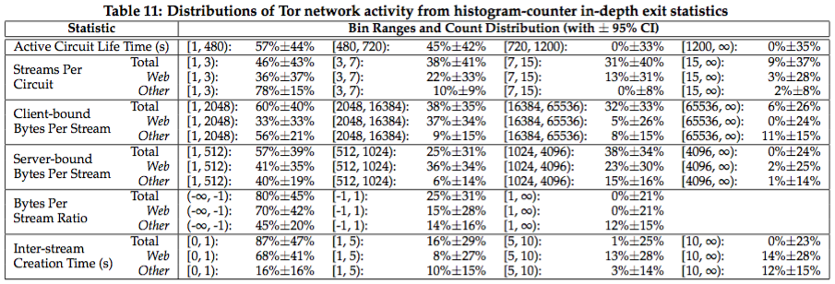
Results: Traffic Modeling Statistics

Slide 47
Conclusion
Distributed measurement for Tor
Improve accuracy, safety, security
Allow us to collect more statistics
Open source: https://github.com/privcount
Future measurement plans
Network traffic to produce models that can be used to generate realistic traffic
Onion services to improve reliability and scalability
Better techniques for cardinality (e.g., # unique users)
Detecting denial of service attacks and other misbehavior
Contact
rob.g.jansen@nrl.navy.mil, robgjansen.com, @robgjansen

Slide 48
Questions

Slide 49
Privacy
Parameters for (ε, δ)-differential privacy
ε = 0.3 : same as used by Tor onion service stats
δ = 10⁻³ : upper bound on prob. of choosing noise value that violates ε-differential privacy
DCs on 3 machines, add 3x noise
User action bounds
Action | Bound
Simultaneous open entry connections | 1
Entry connection open time | 24 hours
New entry connections | 12
New circuits | 146
New streams | 30,000
Data sent or received | 10 MiB

Slide 50
PrivCount vs PrivEx
How does PrivCount enhance PrivEx
Multi-phase iterative measurement
Expanded privacy notion that simultaneously handles multiple types of measurements
Optimal allocation of the ε privacy budget across multiple statistics
Composable security definition and proof
More capable and reliable tool
Supports over 30 different types of Tor statistics
Resilience to node failures and reboots
Simpler configuration and setup

