Slide 1

On Traffic Analysis in Tor
Guest Lecture, ELE 574
Communications Security and Privacy
Princeton University
April 3rd, 2014
Dr. Rob Jansen
U.S. Naval Research Laboratory
rob.g.jansen@nrl.navy.mil

Slide 2



Anonymity with Tor
www.torproject.org
Internet overlay network

Slide 3
Anonymity with Tor
Low latency system
~1 million daily users, ~5000 relays

Slide 4
Traffic Correlation

Slide 5
Traffic Correlation

Slide 6

Traffic Correlation

Slide 7
Traffic Correlation

Slide 8

Traffic Correlation

Slide 9
Traffic Correlation
The biggest threat to Tor’s anonymity

Slide 10
Traffic Correlation
Is traffic correlation realistic?
Who might be in these positions?
Would a nation-state be willing to launch correlation attacks?
The biggest threat to Tor’s anonymity

Slide 11
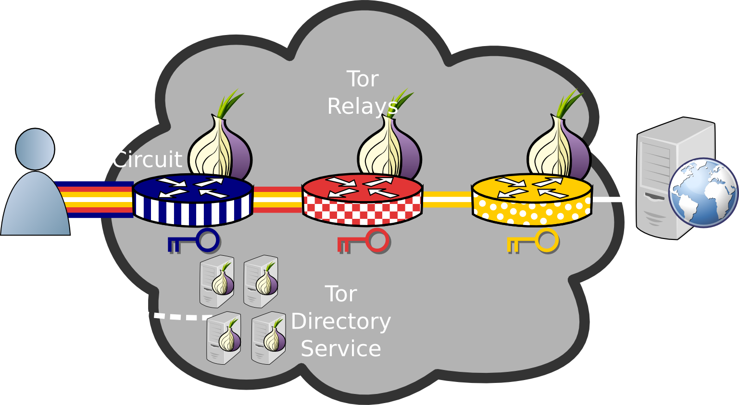
Anonymity with Onion Routing
Notes:
Tor overview
How it provides anonymity
Why the focus on low latency
-interactive sessions are possible
-web browsing
-other things people use the internet for
-otherwise its unusable
Why users want this
-Freedom: speak their mind without worrying about political issues
-avoid censorship

Slide 12


Traffic Correlation
Entry,
a.k.a. guard
Middle
Exit
Notes:
One of the biggest security concerns
Can be used to deanonymize users
-explain guard nodes (client are ‘locked in’ to their guards)
-want to see heartbeat on input and output link

Slide 13
Traffic Correlation
Entry,
a.k.a. guard
Middle
Exit
Clients are ‘locked in’ to guard relays
Notes:
One of the biggest security concerns
Can be used to deanonymize users
-explain guard nodes (client are ‘locked in’ to their guards)
-want to see heartbeat on input and output link

Slide 14
Traffic Correlation
Entry,
a.k.a. guard
Middle
Exit
Exit relays support various exit policies
Notes:
One of the biggest security concerns
Can be used to deanonymize users
-explain guard nodes (client are ‘locked in’ to their guards)
-want to see heartbeat on input and output link

Slide 15
Traffic Correlation
Notes:
One of the biggest security concerns
Can be used to deanonymize users
-explain guard nodes (client are ‘locked in’ to their guards)
-want to see heartbeat on input and output link

Slide 16
Traffic Correlation
Notes:
One of the biggest security concerns
Can be used to deanonymize users
-explain guard nodes (client are ‘locked in’ to their guards)
-want to see heartbeat on input and output link

Slide 17
Traffic Correlation
How does the volunteer resource model affect the vulnerability to correlation attacks?
Notes:
One of the biggest security concerns
Can be used to deanonymize users
-explain guard nodes (client are ‘locked in’ to their guards)
-want to see heartbeat on input and output link

Slide 18
Outline
Background
Security against correlation (end-to-end)
Metrics and methodology
Node adversaries
Link adversaries
Correlation attacks (partial)
Stealthy throughput
Induced throttling
Traffic admission control
Congestion control

Slide 19
Traffic Correlation
How can one measure how vulnerable real clients on the real network are to traffic correlation?

Slide 20
Traffic Correlation
Is there a difference between targeted correlation and general surveillance?

Slide 21
Security Metrics
Principles
Probability distribution
Measured on human timescales
Based on real network and adversaries

Slide 22
Security Metrics
Principles
Probability distribution
Measured on human timescales
Based on real network and adversaries
Metrics (Probability distributions)
Time until first path compromise
Number of path compromises for a given user over given time period

Slide 23
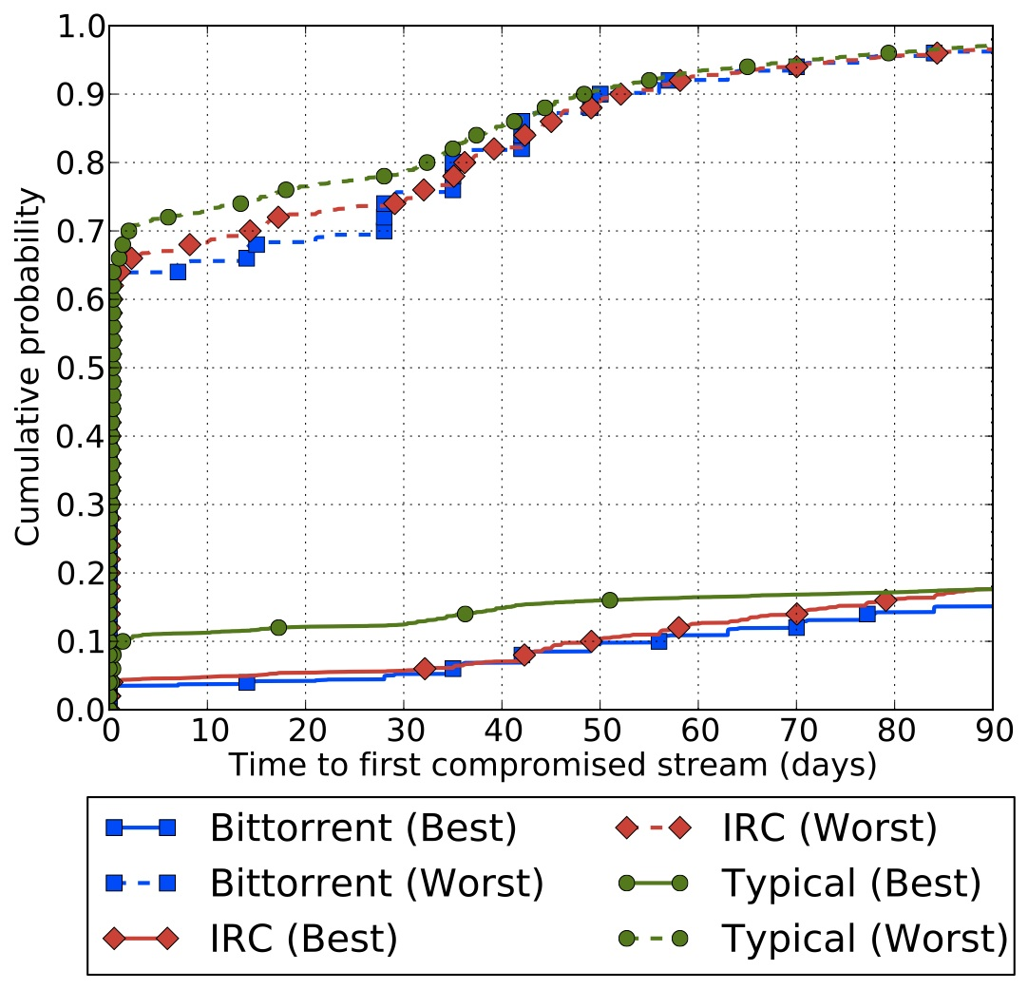
Approach: Overview
Tor Network Data
PS
Path
Simulator
Attack Analysis
User
Profiles

Slide 24






Approach: User Profiles
Consider how users actually use Tor
Typical
Chat
File Sharing
Gmail/GChat
IRC
BitTorrent
GCal/GDocs
Build a 20-minute trace of each activity. Capture destinations/ports visited
Facebook
Web search

Slide 25
Approach: User Profiles
“Replay” traces to generate streams based on user behavior
Typical
Chat
File Sharing
2632 traces per week
205 destinations
2 ports
135 traces per week
1 destinations
1 port
6768 traces per week
171 destinations
118 ports

Slide 26
Approach: User Profiles
“Replay” traces to generate streams based on user behavior
Typical
Chat
File Sharing
2632 traces per week
205 destinations
2 ports
135 traces per week
1 destinations
1 port
6768 traces per week
171 destinations
118 ports
Is the user model accurate?
What are the challenges?

Slide 27
User Behavior Affects Relay Selection
Some applications are not well-supported
by Tor due to exit policies
BAD GOOD
Port 6523
Gobby Collaborative Editor
Permitted by 20% of exits measured by bandwidth
Port 443
HTTPS
Permitted by 93% of exits measured by bandwidth

Slide 28

Approach: Tor Network Data
Consider the Tor network as it changes over a long period of time:
Relays join and leave
Bandwidth changes
Exit/Guard designations change
Hourly consensuses
Use Tor Project archives to obtain state of network over 3 to 6 months
Monthly server descriptors

Slide 29
Approach: Simulate Tor with TorPS
Combine User and Tor Network models using TorPS to produce the circuits Tor would use
Tor Network Data & User Profiles
Re-implements path selection
Based on Tor stable version (0.2.3.25)
Considers:
Bandwidth weighting
Exit policies
Guards and guard rotation
Hibernation
/16 and family conflicts
Omits effects of network performance
PS
Generated Tor circuits
Notes:
TorPS is open-source and available. Come find me after if you want to find out how

Slide 30
Approach: Overview
Tor Network Data
PS
Path
Simulator
Attack Analysis
User
Profiles

Slide 31
Outline
Background
Security against correlation (end-to-end)
Metrics and methodology
Node adversaries
Link adversaries
Correlation attacks (partial)
Stealthy throughput
Induced throttling
Traffic admission control
Congestion control

Slide 32

Node Adversary

Slide 33
Node Adversary
Controls a fixed allotment of relays based on bandwidth budget
We assume adversary has 100 MiB/s – comparable to large family of relays
Adversaries apply 5/6th of bandwidth to guard relays and the rest to exit relays. (We found this to be the most effective allocation we tested.)

Slide 34
Node Adversary
Controls a fixed allotment of relays based on bandwidth budget
We assume adversary has 100 MiB/s – comparable to large family of relays
Adversaries apply 5/6th of bandwidth to guard relays and the rest to exit relays. (We found this to be the most effective allocation we tested.)
Is 100 MiB/s realistic for an adversary?

Slide 35
Time to First Compromised Circuit
50% of clients use a compromised circuit in less than 70 days
October 2012 – March 2013

Slide 36
Fraction of Compromised Streams
User behavior significantly affects anonymity
October 2012 – March 2013

Slide 37
Outline
Background
Security against correlation (end-to-end)
Metrics and methodology
Node adversaries
Link adversaries
Correlation attacks (partial)
Stealthy throughput
Induced throttling
Traffic admission control
Congestion control

Slide 38
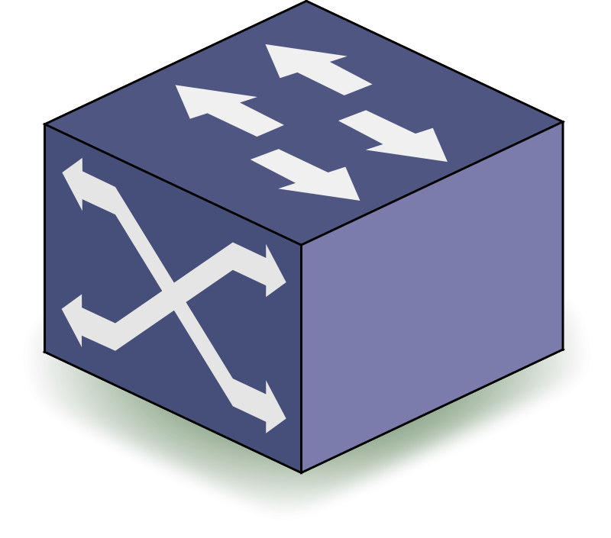
Network Adversary
AS8
AS9
AS6
AS7
AS1
AS2
AS3
AS4
AS5

Slide 39
Network Adversary
Autonomous Systems (ASes)
AS8
AS9
AS6
AS7
AS1
AS2
AS3
AS4
AS5

Slide 40
Network Adversary
Internet Exchange Points (IXPs)
AS8
AS9
AS6
AS7
AS1
AS2
AS3
AS4
AS5

Slide 41
Network Adversary
AS8
AS9
AS6
AS7
AS1
AS2
AS3
AS4
AS5
Adversary has fixed location
Adversary may control multiple entitites

Slide 42
Network Adversary
AS8
AS9
AS6
AS7
AS1
AS2
AS3
AS4
AS5
Should most users be concerned with a network adversary?
Adversary has fixed location
Adversary may control multiple entitites

Slide 43
Simulating a Network Adversary
1
44
23
2
11
Build AS-level Graph
(CAIDA)
Notes:
-Build AS-level graph from CAIDA data
-Place points of interest within the graph:
--Tor relays using MaxMind IP-to-ASN mappings
--5 clients based on popular client ASes; 4 German, 1 Italian (Edman&Syverson’09)
--Destinations based on trace destination (e.g., Google)
-Determine AS-level routes using heuristics (Gao’03, CAIDA)

Slide 44
Simulating a Network Adversary
1
44
23
2
11
Build AS-level Graph
(CAIDA)
Place points of interest (Maxmind, traces)
Notes:
-Build AS-level graph from CAIDA data
-Place points of interest within the graph:
--Tor relays using MaxMind IP-to-ASN mappings
--5 clients based on popular client ASes; 4 German, 1 Italian (Edman&Syverson’09)
--Destinations based on trace destination (e.g., Google)
-Determine AS-level routes using heuristics (Gao’03, CAIDA)

Slide 45
Simulating a Network Adversary
1
44
23
2
11
Build AS-level Graph
(CAIDA)
Place points of interest (Maxmind, traces)
Find AS-level routes
(Gao’02, CAIDA)
Notes:
-Build AS-level graph from CAIDA data
-Place points of interest within the graph:
--Tor relays using MaxMind IP-to-ASN mappings
--5 clients based on popular client ASes; 4 German, 1 Italian (Edman&Syverson’09)
--Destinations based on trace destination (e.g., Google)
-Determine AS-level routes using heuristics (Gao’03, CAIDA)

Slide 46
Selecting Network Adversaries
Rank each AS/IXP for each client location by frequency on entry or exit paths;
Exclude src/dst ASes (compromises nearly all paths); and
Assign adversary to top k ASes or IXPs

Slide 47
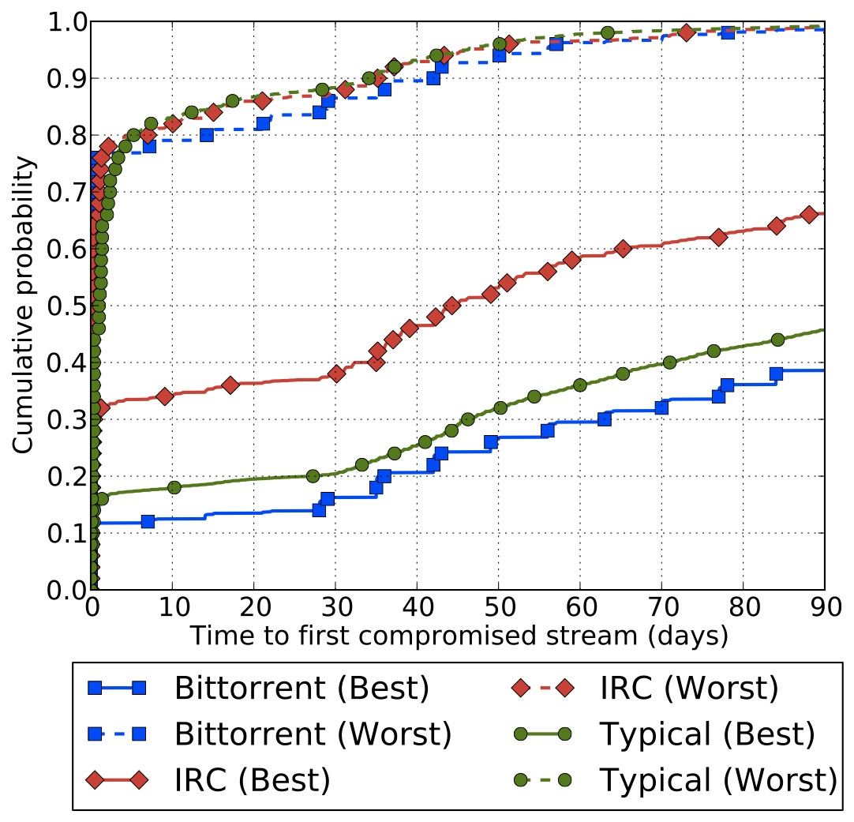
Adversary Controls One AS
Location matters.
“best”/“worst” denote most/least secure client
January 2013 – March 2013

Slide 48
Adversary Controls One IXP Organization
“best”/“worst” denote most/least secure client
January 2013 – March 2013

Slide 49
Adversary Controls One IXP Organization
“best”/“worst” denote most/least secure client
How can a user determine their safety? How can they become safer?
January 2013 – March 2013

Slide 50
Traffic Correlation
What if the adversary only controls one of the ends?

Slide 51
Outline
Background
Security against correlation (end-to-end)
Metrics and methodology
Node adversaries
Link adversaries
Correlation attacks (partial)
Stealthy throughput
Induced throttling
Traffic admission control
Congestion control

Slide 52

Traffic Correlation: Throughput
Adversary runs malicious exit
Mittal et.al. CCS’11
Notes:
How to do the stealthy throughput attack
-adversarial exit relay
-probe clients
-correlation

Slide 53
Traffic Correlation: Throughput
Client downloads through circuit
Mittal et.al. CCS’11
Notes:
How to do the stealthy throughput attack
-adversarial exit relay
-probe clients
-correlation

Slide 54

Traffic Correlation: Throughput
Probes download through all guards
Mittal et.al. CCS’11
Notes:
How to do the stealthy throughput attack
-adversarial exit relay
-probe clients
-correlation

Slide 55
Traffic Correlation: Throughput
Correlate change in throughput at exit with change in throughput at probes
Mittal et.al. CCS’11
Notes:
How to do the stealthy throughput attack
-adversarial exit relay
-probe clients
-correlation

Slide 56
Traffic Correlation: Throughput
How is this attack “stealthy”?
Correlate change in throughput at exit with change in throughput at probes
Mittal et.al. CCS’11
Notes:
How to do the stealthy throughput attack
-adversarial exit relay
-probe clients
-correlation

Slide 57
Outline
Background
Security against correlation (end-to-end)
Metrics and methodology
Node adversaries
Link adversaries
Correlation attacks (partial)
Stealthy throughput
Induced throttling
Traffic admission control
Congestion control

Slide 58

Tor != Internet
Specialized Tor performance enhancements
Reducing load: traffic admission control
Reducing load, improving utilization: congestion control

Slide 59

Traffic Admission Control

Slide 60
Traffic Admission Control
Which connections?
At what rate?

Slide 61
Traffic Admission Control
Sybil attack!
Which connections?
At what rate?
Notes:
Algorithms that use the number of client connections to answer these questions are vulnerable to induced throttling via a sybil attack.

Slide 62
Traffic Admission Control

Slide 63
Traffic Admission Control
Sybil attack (connect only)
Geddes et.al.
PETS’13
Notes:
Sybil nodes only connect, but don’t send any data

Slide 64
Traffic Admission Control
Throughput drops to throttle rate
Geddes et.al.
PETS’13

Slide 65
Traffic Admission Control
Disconnect sybils
Geddes et.al.
PETS’13

Slide 66
Traffic Admission Control
Throughput increases
Geddes et.al.
PETS’13

Slide 67
Traffic Admission Control
Is this attack “stealthy”?
Throughput increases
Geddes et.al.
PETS’13

Slide 68
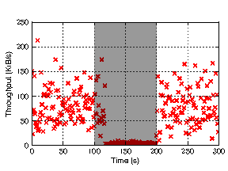
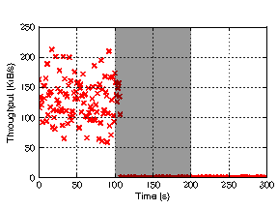
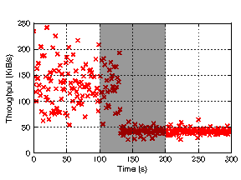
Induced Throttling Prototype
bitsplit
flag
threshold
Geddes et.al.
PETS’13

Slide 69
Tor != Internet
Specialized Tor performance enhancements
Reducing load: traffic admission control
Reducing load, improving utilization: congestion control

Slide 70
Congestion Control
50 cells (max 500)

Slide 71
Congestion Control
SENDME
50 cells (max 500)

Slide 72
Congestion Control
500 cells
Geddes et.al.
PETS’13

Slide 73
Congestion Control
500 cells
Throughput drops to 0
Geddes et.al.
PETS’13

Slide 74
Congestion Control
SENDME
500 cells
Geddes et.al.
PETS’13

Slide 75
Congestion Control
SENDME
500 cells
Throughput increases
Geddes et.al.
PETS’13

Slide 76
Congestion Control
Is this attack “stealthy”?
SENDME
500 cells
Throughput increases
Geddes et.al.
PETS’13

Slide 77
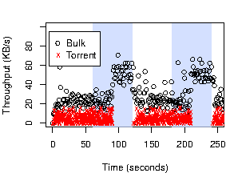
Induced Throttling Prototype
Geddes et.al.
PETS’13

Slide 78
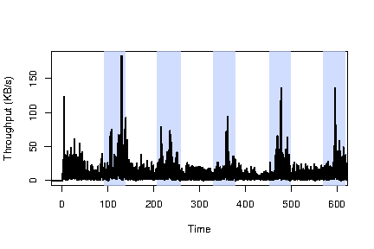
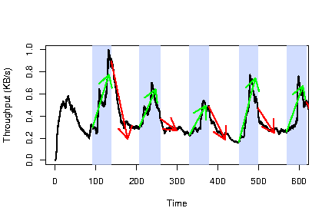
Induced Throttling Results
Raw throughput
Smoothed throughput
Geddes et.al.
PETS’13
Notes:
Large scale attack:
-400 relays, 2600 clients

Slide 79
Outline
Background
Security against correlation (end-to-end)
Metrics and methodology
Node adversaries
Link adversaries
Correlation attacks (partial)
Stealthy throughput
Induced throttling
Traffic admission control
Congestion control

Slide 80
Traffic Correlation
How might we defend against ALL traffic correlation attacks?

Slide 81

Questions?
rob.g.jansen@nrl.navy.mil

Slide 82
Conclusion
Presented a realistic and comprehensive analysis of Tor’s security against traffic correlation
User behavior/location heavily affects anonymity against realistic adversaries
An adversary with 100 MiB/s of bandwidth has a >50% probability of de-anonymizing the average Tor user within 3 months
Open Questions:
Does the current Tor guard rotation period hurt anonymity?
Are there ways to select relays that can avoid adversaries?

Slide 83
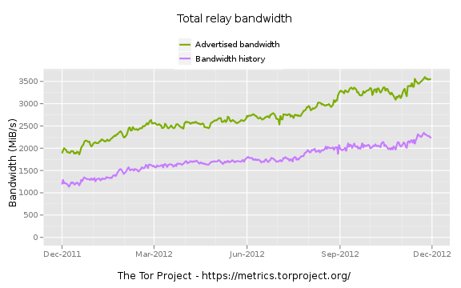
Tor is Efficient: ~65% Utilization
Notes:
Proposals that improve Tor performance
-Reducing load: traffic admission control
-Reducing load, improving utilization: congestion control

