Slide 1
Figures for TCE tutorial
December 2012
Erno Salminen
Tampere University of Technology

Slide 2
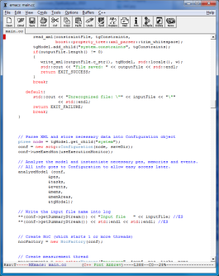
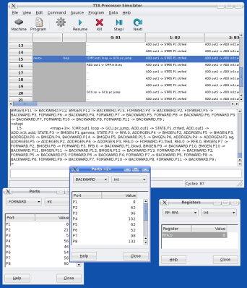
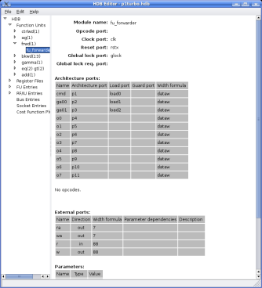
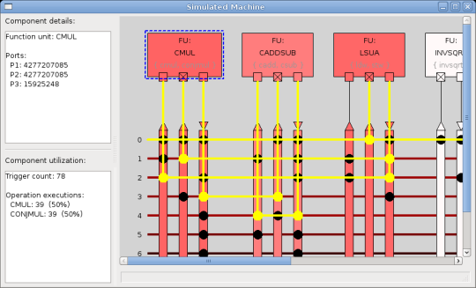
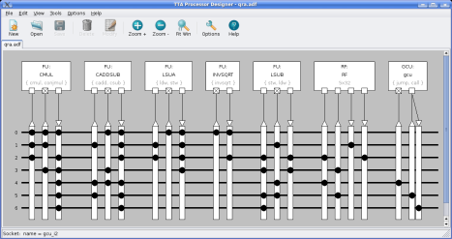
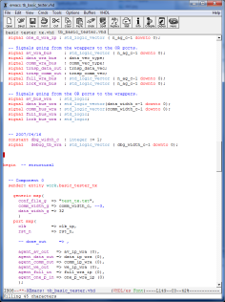
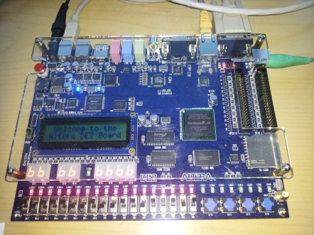
C/C++/
OpenCL
TCE toolset
Design TTA
Compile + debug
Generate HDL
Analyze
Program image
VHDL
FGPA

