Slide 1

Memento: Time Travel for the Web
Herbert Van de Sompel
Michael L. Nelson
Robert Sanderson
Lyudmila Balakireva
Harihar Shankar
Scott Ainsworth
Memento is partially funded by the Library of Congress

Slide 2
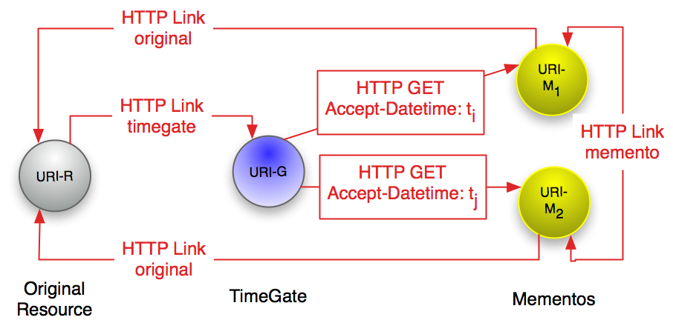
The Memento Framework

Slide 3




Memento HTTP Flow
HEAD R
200, Link➔G
GET G, Accept-Datetime
302➔M, Vary, TCN, Link➔R,M
GET M
200, Content-Datetime, Link➔R,M

Slide 4
Memento wants to make navigating the Web’s Past Easy
http://www.mementoweb.org
http://groups.google.com/group/memento-dev
Notes:
4

