Slide 1
GETTRIPPY TRAVEL SITE
Team members Dustin Owen, Carishea Frame, Bryan Haskell

Slide 2
Links
https://github.com/Acilyn/SyntaxError
lamp.cse.fau.edu/~owend2014
SyntaxError.someone.io

Slide 3
GETTRippy
Develop a website to view the place before they go there
GetTrippy is a website that brings people together towards the travel industry and lets them know what are the best amusements and museums near them with giving them a visualization on what the place looks like too.

Slide 4
GetTrippy
GetTrippy is for all ages that want to explore new places.
GetTrippy is using the travel industry to bring all types of individuals together.
Companies can also benefit from being on GetTrippy.

Slide 5
System implementation infrastructure
Languages
PHP – server side language used for web development
HTML – used for structuring content on the web site
CSS – used for mark ups such as formatting a document
Database
MySQL – stores the data structures for the web site
Framework
BootStrap – design templates and used to make web development faster and easier

Slide 6
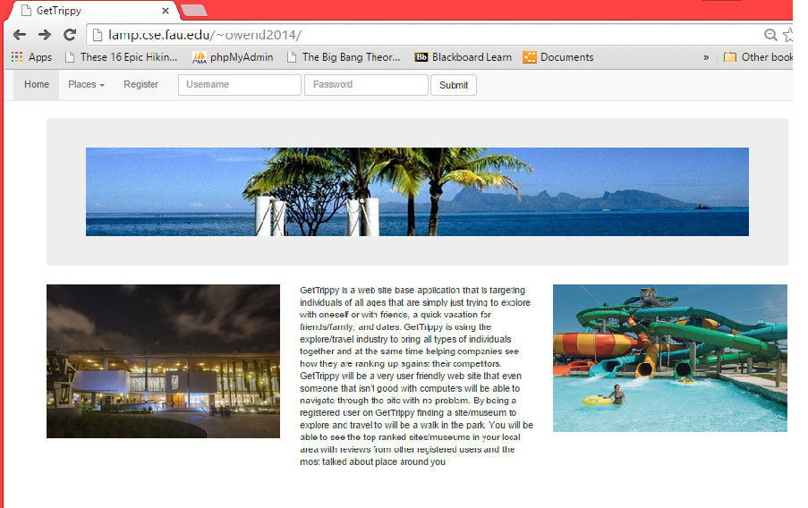
Gettrippy main screen
Main screen consists of 3 tabs on top
Register, places, home
A textEdit field for username and password for registered users
A brief summary on what exactly GetTrippy is about

Slide 7
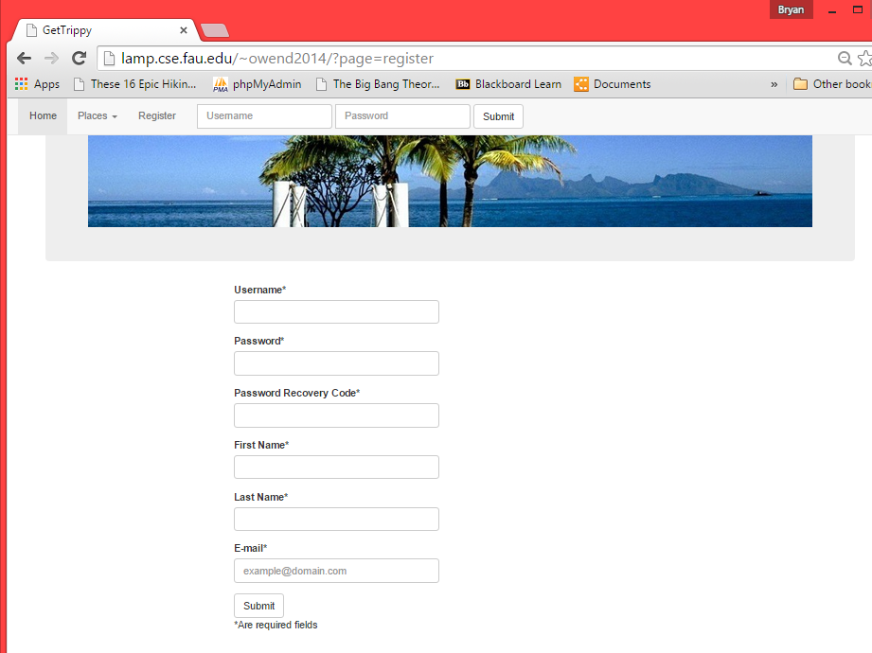
Register screen
Register Screen consists of 3 tabs on top
TextFields for the following info
User name
Password
Password Recovery Code
Frist name
Last name
Email

Slide 8
Gettrippy present and future
Features on this version
A user can register and log into website with username and password
A registered user can rate a post
Password recovery
Features on the next version
A registered user will be able to post info on a place with a photo
A registered user will be able to comment on a post and be able to interact with other users on the site
Google maps
Current location
directions

Slide 9
Gettrippy team members
Dustin Owen – Product Owner
Bryan Haskell – Scrum Master
Development Team – Carishea Frame, Dustin Owen, Bryan Haskell

Slide 10
Lessons Learned
That being organized is important on a fast pace project
Communication with one another makes working on the project flowing smoothly
Having roles helps concentrate on what task should be done from each individual

