Slide 1
Vouch.
Your social life, ranked.
Investor Leave-Behind · April 2026
01 / 24

Slide 2
EXECUTIVE SUMMARY
Vouch is the friend-first discovery layer for everywhere you go — built on one-tap ratings instead of reviews nobody writes.
WHAT
WHY NOW
A consumer app where you rate every place 0–10 in two seconds. Your history is searchable; your friends' ratings shape what you discover next.
Yelp & Google reviews have collapsed in trust. Beli proved one-tap rating works for food. Nobody owns the broader graph.
TRACTION
ASK
2.4K active raters · 41K ratings · 64% W4 retention in NYC beta after 3 months — no paid acquisition.
$1.5M seed for 18-month runway to 50K MAU across 4 cities and Series A metrics.
Vouch.
Summary
02 / 24

Slide 3
THE PITCH IN ONE LINE
Rate every place you go. Get recs from friends you actually trust.
A living record of your taste — searchable, rankable, shareable. Built on one-tap ratings instead of reviews nobody writes.
Vouch.
Demo Day 2026
03 / 24

Slide 4
THE PROBLEM
You've been to hundreds of places. You remember twenty.
NOTES.APP
GOOGLE MAPS
GROUP CHAT
A graveyard of half-typed restaurant names.
A wall of pins. No context. No ranking.
"Where should we eat?" Mind goes blank.
Your taste deserves better than this.
Vouch.
Problem
04 / 24

Slide 5
THE INSIGHT
Reviews are a writing problem. Ratings are a memory problem.
Reviews failed
Ratings work
Asking strangers to write paragraphs is friction. The result: 2% of customers write 90% of reviews — almost all extremes.
A single tap, in the moment, taken from anyone — not just the loudest voices. Density grows linearly with usage instead of a power-law tail.
Beli proved this for restaurants. We're applying it to everywhere — bars, hikes, shows, classes, trips.
Vouch.
Insight
05 / 24

Slide 6
THE SOLUTION
Your experiences, ranked
One tap. That's it.
47 experiences · 12 categories
All
Food
Drinks
Activities
🍜
Siam Garden
8
Thai · East Village · Oct 4
🍸
The Violet Hour
10
Speakeasy · Wicker Park · Sep 28
📸
Times Square Wax
4
No review. No paragraph. No photo required. After any experience, rate it 0–10. Vouch builds a living record of your taste over time.
Attraction · Midtown · Sep 15
🥾
Breakneck Ridge
9
Hike · Hudson Valley · Sep 8
🎭
Sleep No More
7
Show · Chelsea · Aug 30
🍕
Lucali
9
8/10
4/10
10/10
Pizza · Carroll Gdns · Aug 22
Your Thai place
Tourist trap
The speakeasy
RELIABLE
AVOID
TELL EVERYONE
Vouch.
Solution
06 / 24

Slide 7
HOW IT WORKS
Three steps. Two seconds each.
01
02
03
Rate
Build
Discover
Tap a number. One to ten. No review required.
Every rating compounds into a clear record of what you love.
See what's highly rated by people you trust. No strangers. No ads.
Vouch.
Product
07 / 24

Slide 8
BEYOND THE RATING
The rating is the hook. The graph is the moat.
RATE
TAG
CONNECT
DISCOVER
Score + label
Optional context
Taste-match
Friend-weighted
Numeric 0–10 paired with a five-tier qualitative label (AVOID → TELL EVERYONE).
"Hidden gem", "Bring cash", "Worth the hype" — fast taps that compound into search filters.
Per-friend overlap score. The more you both rate, the sharper the match.
Map and feed prioritize ratings from friends weighted by taste-match — not strangers.
HOOK → HABIT
A new user rates ~7 places in their first session (back-rating restaurants from memory). Habit forms by week 2.
Vouch.
Product
08 / 24

Slide 9
THE NETWORK EFFECT
Your friends are rating too.
P
Priya
rated just now
Café Integral
Coffee · near you
9
Their ratings shape what you discover — not algorithms guessing from strangers, but the people you actually trust.
J
Jordan
Lucali
M
Mika
Pizza
10
Breakneck Ridge
Hike
8
Dive bar finder
Restaurant expert
Their top-rated spots in your neighborhood.
Their 9s and 10s when you need somewhere new.
New-city explorer
Works solo on day one
↑ From people you trust
Their discoveries become yours.
Your history is useful before a single friend joins.
Vouch.
Network
09 / 24

Slide 10
THE MARKET
A $47B discovery market, mis-served by ads and strangers.
TAM
SAM
SOM (YEAR 3)
$47B
$8.2B
$240M
Global local-discovery ad & platform spend across food, travel, events, wellness.
US millennials & Gen Z who actively save, rate, or share going-out recs.
2M active raters across 12 cities at a $10 ARPU / 1.5% take rate blend.
Sources: eMarketer 2025 · Yelp 10-K · U.S. Census · internal model
Vouch.
Market
10 / 24

Slide 11
WHY NOW
Review culture is collapsing. Trust is moving to networks.
72%
4×
61%
of Gen Z don't trust Yelp or Google reviews.
Beli's user growth YoY validates one-tap rating behavior.
ask friends first for recs — yet no app captures that loop.
Morning Consult, 2024
TechCrunch, 2025
Pew Research, 2024
Instagram ate photos. TikTok ate video. Nobody's eaten the rec yet.
Vouch.
Timing
11 / 24

Slide 12
COMPETITION
Beli — but for everything.
ONE-TAP RATING
FRIEND-FIRST FEED
BEYOND RESTAURANTS
PERSONAL HISTORY
Yelp
✕
✕
Partial
✕
Google Maps
✕
✕
Partial
Saves only
Beli
✓
✓
Food only
Food only
Notes / Sheets
Manual
✕
✓
Manual
Vouch.
✓
✓
✓
✓
Vouch.
Competition
12 / 24

Slide 13
BUSINESS MODEL
Free today, compounding tomorrow.
PHASE 1 · NOW
PHASE 2 · YEAR 2
PHASE 3 · YEAR 3
Free consumer app
Vouch+ subscription
Reservations API
Grow the rating graph. No ads. Ever. Density is the moat.
$5/mo · trip planning, advanced filters, taste recaps, offline.
1.5% take on bookings routed through trusted-friend ratings.
Year-3 blended ARPU target
$12 / user / yr
Vouch.
Monetization
13 / 24

Slide 14
EARLY SIGNAL
3 months. One city. Signal everywhere.
2.4K
41K
64%
17
active raters in NYC beta
experiences rated to date
W4 retention (Beli: ~38%)
ratings per active user / mo
"I used to keep a Google Sheet of every restaurant. This replaced it in a day."
"I've tried five apps like this. This is the only one I opened a second time."
Mika · Brooklyn
Dante · LA
Vouch.
Traction
14 / 24

Slide 15
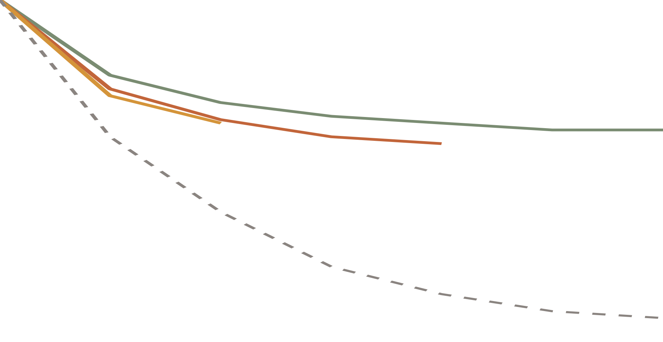
RETENTION CURVES
Curves flatten — the sign of a habit.
100%
75%
Aug cohort · 62% W6
Sep cohort · 58% W4
Oct cohort · 64% W2
50%
Consumer-app benchmark (Andreessen)
WHY IT FLATTENS
25%
Each rating compounds the user's personal history. By W4, opening Vouch is faster than opening Notes.
0%
W0
W1
W2
W3
W4
W5
W6
Weeks since signup
Vouch.
Retention
15 / 24

Slide 16
UNIT ECONOMICS
Organic acquisition. Compounding retention.
CAC
LTV (Y3)
LTV : CAC
PAYBACK
$2.40
$36
15×
4 mo
Blended NYC beta — driven by friend invites + tastemaker referrals.
Blended ARPU × 3yr retention — Vouch+ + reservations take.
Healthy headroom for paid expansion if needed in years 2–3.
Once Vouch+ launches; pre-monetization the model runs on retention alone.
K-FACTOR
MARGINAL COST
1.4 — every active user invites ~1.4 net new users in their first 30 days.
$0.18 / MAU / month — Mapbox + Postgres + media. Drops at scale.
Vouch.
Economics
16 / 24

Slide 17
GO-TO-MARKET
City by city. Friend by friend.
STEP 1 — SEED
STEP 2 — SPREAD
STEP 3 — SATURATE
Tastemakers
Friend invites
Vertical playbooks
Recruit 100 high-volume raters per city — food writers, local creators, scene regulars. Their ratings seed density.
Every user has a shareable profile. Sending a profile is how you answer "where should we eat?"
Replicate the food playbook for bars, hikes, shows, trips. Each vertical = its own flywheel on the same graph.
City rollout
NYC
Chicago
LA · Q2
Austin · Q3
+ 8 by Y2
Vouch.
GTM
17 / 24

Slide 18
3-YEAR PROJECTION
From density to revenue.
YEAR 1 (2026)
YEAR 2 (2027)
YEAR 3 (2028)
Active raters (MAU)
50K
340K
1.6M
Cities live
4
10
22
Ratings in graph
2.0M
18M
96M
Paying (Vouch+ + bookings)
—
22K
180K
Net revenue
$0
$1.6M
$19M
Conservative case. Assumes no enterprise / city-tourism revenue (additional upside). Full model in data room.
Vouch.
Financials
18 / 24

Slide 19
ROADMAP
From a rating app to a taste graph.
NOW
Q3 2026
Q1 2027
Q3 2027
NYC beta
Public launch
Vouch+
Reservations
One-tap rating, friend feed, personal history.
Vertical expansion — bars, hikes, shows. 4 cities.
Trip planning, taste recaps, premium filters.
API layer. Revenue on bookings routed through trust.
Vouch.
Roadmap
19 / 24

Slide 20
THE TEAM
Shipped it ourselves. Live today.
[ founder headshot ]
[ founder headshot ]
[ founder headshot ]
Founder One
Founder Two
Founder Three
CEO · PRODUCT
CTO · ENGINEERING
DESIGN · GTM
Previously product at a consumer social app. Columbia CS. Shipped the NYC beta.
Full-stack, infra, and ML. Built the rating graph + friend feed end-to-end.
Brand + growth. Ran tastemaker recruiting in NYC. Columbia Business.
Vouch.
Team
20 / 24

Slide 21
RISKS & MITIGATIONS
We've thought hard about what could go wrong.
RISK · COLD START
RISK · BELI EXPANDS
Empty feed in new cities
Incumbent moves laterally
Tastemaker recruiting (100 high-volume raters / city) seeds density before public launch. Personal history works solo on day one.
Beli is locked into restaurants by brand and rating UX. Going horizontal would dilute their core. We start horizontal.
RISK · HABIT DECAY
RISK · MONETIZATION
Users stop rating
Subs don't convert
Weekly recaps + friend nudges + back-rating prompts. Cohort curves already flatten at 60%+ — well above benchmark.
Reservations API is the bigger lever (1.5% of $80B+ booking flow). Vouch+ is upside, not the base case.
Vouch.
Risks
21 / 24

Slide 22
THE ASK
Raising $1.5M seed to saturate 4 cities.
USE OF FUNDS
45%
Engineering & product
18-MONTH MILESTONES
3 full-stack hires. Friend feed, Vouch+, recsys v2.
50K
Active raters
35%
City launches
Tastemaker budgets + launch ops for Chicago, LA, Austin.
Cities live
4
20%
Runway & ops
18 months to 50K MAU + Series A metrics.
Ratings in graph
2M
W4 retention
≥ 55%
Vouch.
Ask
22 / 24

Slide 23
FAQ FOR THE READ-ALONG
The questions we get asked most.
Why won't Beli win this?
Why now and not 5 years ago?
Beli is a restaurant brand. Going horizontal dilutes it. We're horizontal-native, with a graph designed for any vertical.
Review trust collapsed in the last 24 months. Gen Z defaulted to friends. Beli proved the format. The window is open.
What stops a copycat?
Why no ads, ever?
Density. The first city to 50K raters wins it. We're at 2.4K in NYC after 3 months with no paid acquisition.
Trust is the only thing we sell. The moment a sponsored 9 appears, the graph dies. Reservations + subs are aligned with users.
What about international?
What does a Series A need?
English-speaking metros first (London, Toronto, Sydney). Year 3+. Vertical density transfers across cities.
50K MAU across 4 cities, 55% W4 retention, $1.6M ARR run-rate, two cities with revenue product live. 18 months from now.
Vouch.
FAQ
23 / 24

Slide 24
VOUCH.
Less mediocre. More you.
Your best experiences already exist — scattered across memory, notes apps, and group chats. Vouch puts them in one place.
hello@vouch.app · vouch.app
24 / 24

