Slide 1

Social Media and Well being
Data Analysis
Nikoleta Xenaki
HY-484
Fall 2024

Slide 2
INTRODUCTION
Σε αυτό το project θα αναλύσουμε το πως τα social media και τα activities σε αυτά επηρεάζουν το well being μας,δηλαδή τα συναισθήματα μας, ένα γεγονός που όλοι ξέρουμε πως ισχυέι και εμπειρικά και λόγω διάφορων μελετών.Για αυτόν τον σκόπο χρησιμοποίησα μια βάση πραγματικών παγκόσμιων δεδομένων απο την Kaggle που συντάχθηκε το 2024 από έναν AI ερευνητή ονόματι EMİRHAN BULUT. Η ανάλυση έγινε με χρήση της Python και της βιβλιοθήκης της networkX.

Slide 3
Our Data set (103 rows)
User_ID: Unique identifier for each user.
Age: Age of the user in years.
Gender: Gender identity of the user (Female, Male, Non-binary).
Platform: The social media platform used by the user (e.g., Instagram, Twitter, Facebook, LinkedIn, Snapchat, Whatsapp, Telegram).
Daily_Usage_Time (minutes): Total minutes spent daily on the specified platform.
Posts_Per_Day: Number of posts made per day.
Likes_Received_Per_Day: Number of likes received per day.
Comments_Received_Per_Day: Number of comments received per day.
Messages_Exchanged_Per_Day: Number of exchanged sent per day.
Dominant_Emotion: The dominant emotional state of the user during the day (e.g., Happiness, Sadness, Anger, Anxiety, Boredom, Neutral).

Slide 4
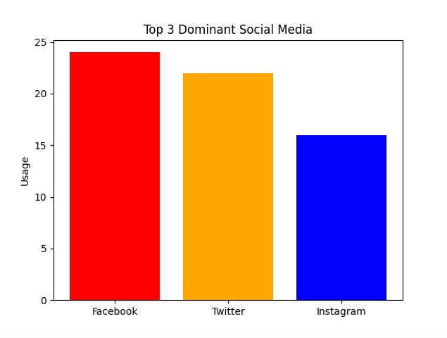

Slide 5
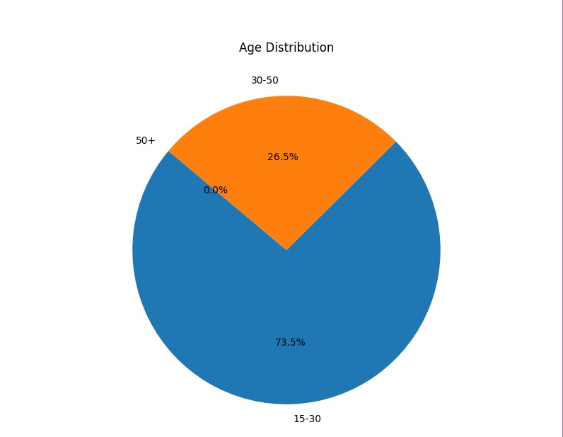

Slide 6
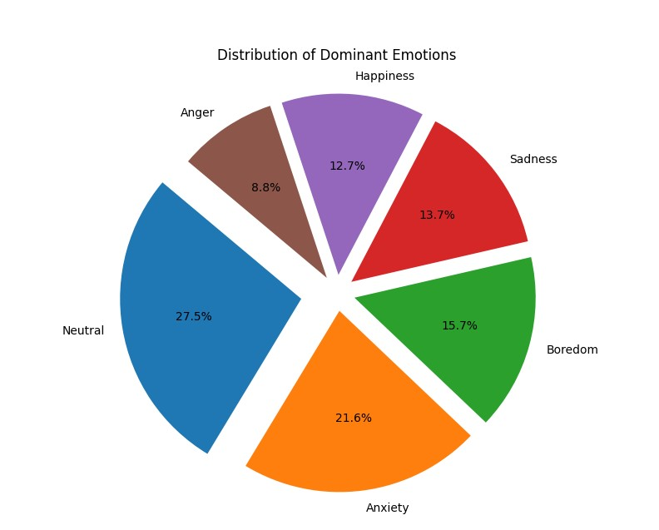

Slide 7
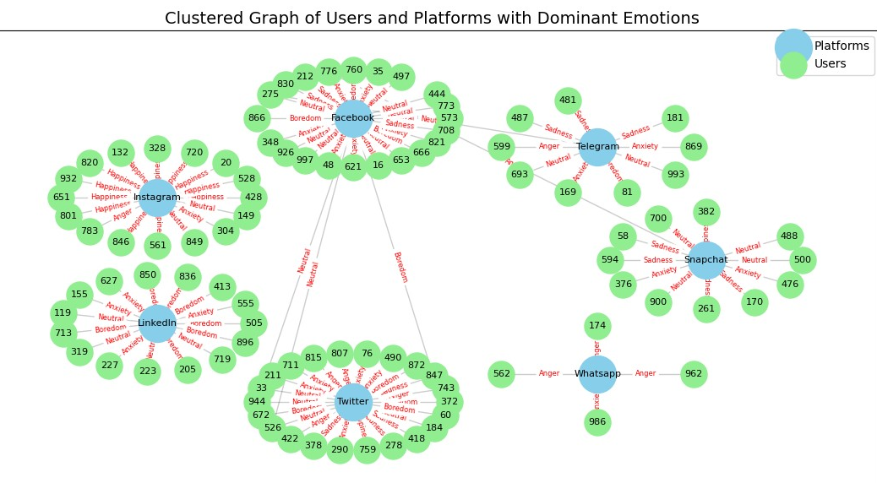

Slide 8
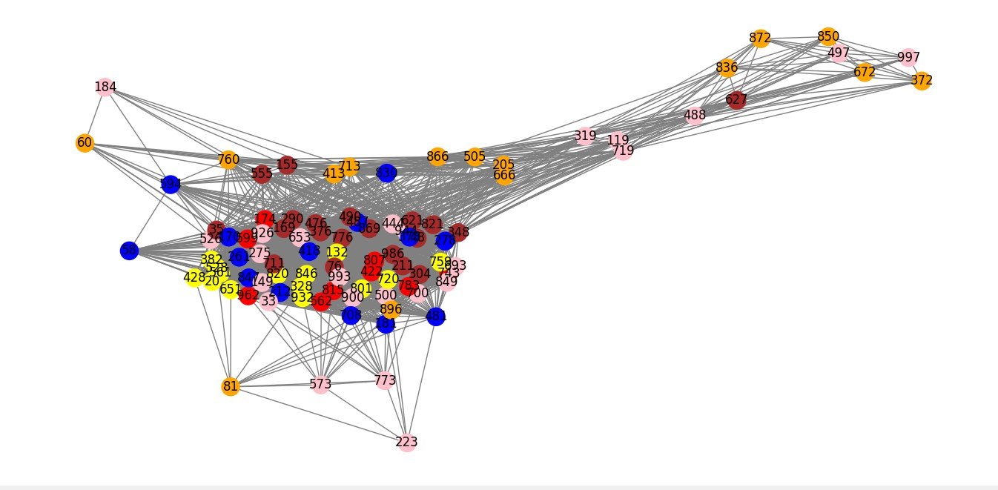
Emotional Homophily in terms of same activity (high/low) among users
Here,the graph concerns individuals who are connected to each other due to their same activity patterns.The homophily index, measures how similar individuals are to each other, based on their emotions.In particular if they share poritive emotions or negative ones.

Slide 10
RESULTS
Homophily index: 0.39
Formula: Homophily index= (e_{same} - a_{same}) / (1 - a_{same})
This indicates a moderate level of positive homophily, meaning that users with alike dominant emotions are more likely to connect with each other. In other words, there is indeed a tendency for people with similar emotions to interact, but it’s not an overwhelmingly strong effect.

Slide 11
Clustering Coefficient of nodes in the previous activity graph
The average clustering coefficient of the previous activity graph is
0.873421107727383, meaning that users not only do they connect with others of similar activity patterns but they also form tightly knit communities due to their activities. Thus we can deduce the importance of social media in matters of human connections and interactions through social media activities.

Slide 12
Shortest path to Happiness and Sadness through social media activities per day and for any platform
For Happiness:
Likes_Received: 33 → Messages_Exchanged: 18 → Comments_Received:20 → Posts/Stories_Made: 3
For Sadness:
Likes_Received: 8 → Messages_Exchanged: 12 → Comments_Received:4 → Posts/Stories_Made: 1

Slide 13
Betweenness Centrality of nodes
In a unweighted graph where users are connected with their activities, many have almost ,if not exactly, the same social media activities. Nodes with the highest betweeness centralities are activity and user nodes, indicating the most important social media activities and users of the network.Appart from that, based on these important nodes, I examined the dominant emotions these nodes hold, to see if they are mainly good/neutral emotions (happiness,neutral,boredom) or bad (anger,sadness,anxiety).
Out of 189 nodes of the graph, we will examine the nodes whose betweenness centrality is greater than 75% of all nodes (47 nodes in total). Thus we examine the most central and important nodes in the network, the ones that control the flow of information across the network.

Slide 14
Results
Top 10 nodes of highest betweenness:
Posts/Stories_2, Posts/Stories_3, Posts/Stories_1, Comments_5, Comments_7, Comments_20, Posts/Stories_4, Messages_28, Posts/Stories_6, Comments_11, Posts/Stories_5.
The majority of them holds positive emotions, meaning that the cornerstones of this network,which control the activity flow among users ,are associated with a good feedback.Such a result indicates that, in general, a person’s well being is enhanced rather than deteriorated .

Slide 15
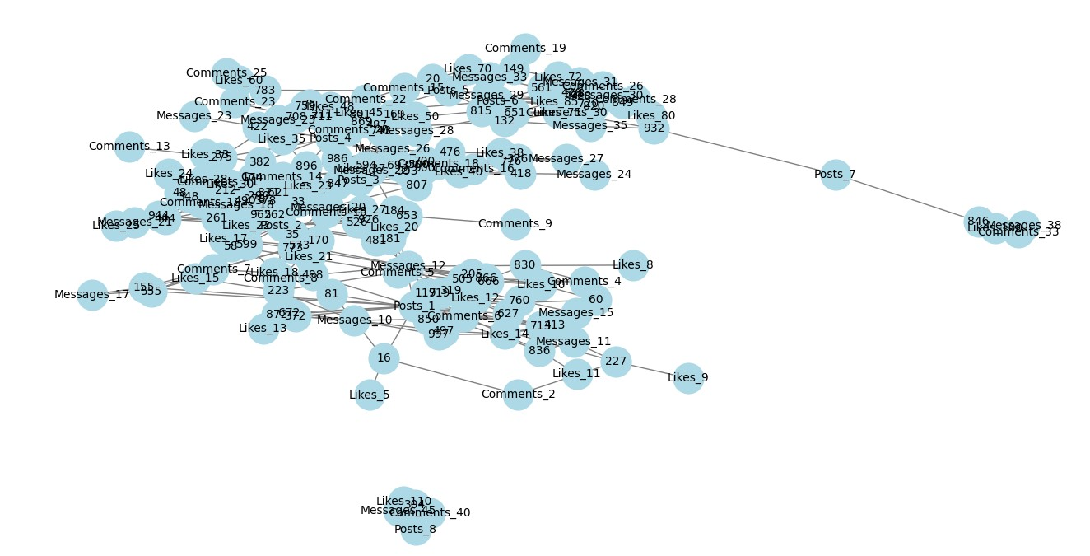

Slide 16
Age matching to Social Media according to Emotions
Now according to data set’s users’ ages, we match each age flanctuation with the social media, which provokes a certain emotion to the majority of these users. In this way we can see which social media platform most users turn to (and at what ages) in order to feel certain emorions.
Below I present 5 matchings according to some emotions.

Slide 17
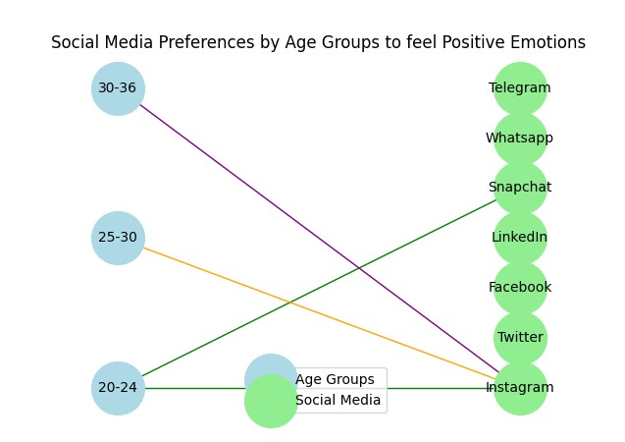
For Happiness only

Slide 18
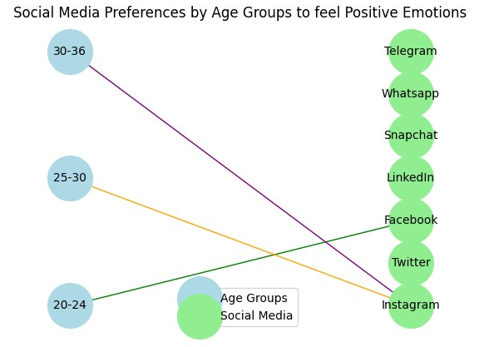
For the other two similar Positive Emotions
(Neutral,Boredom)
Here we see that when Neutral and Boredom feelings are involved, only ages between 20-24 tend to find mostly Facebook a dull “place” and Instagram a happy “place” as we saw above.

Slide 19
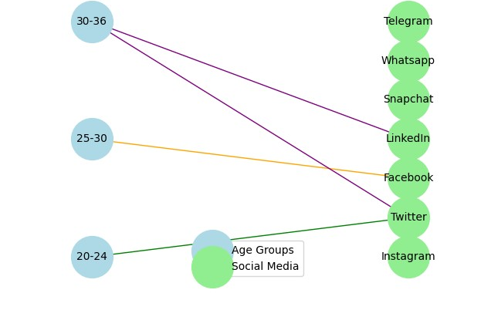
For Anxiety only

Slide 20
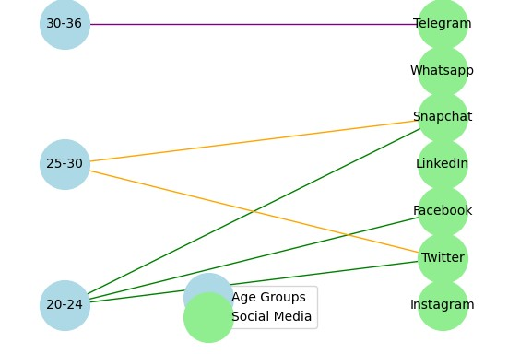
For Sadness only

Slide 21
For Sadness only

Slide 22
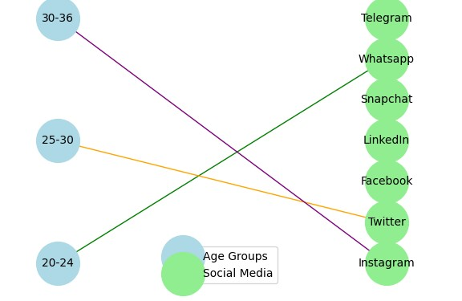
For Anger only

Slide 23
Sources
https://www.cs.cornell.edu/home/kleinber/networks-book/networks-book.pdf
Slides from Course hy-380
https://www.kaggle.com/datasets/emirhanai/social-media-usage-and-emotional-well-being?resource=download

