Slide 1
Linux:
A short introduction

Slide 2
Introduction

Slide 3
Where is Linux?
Mobile devices
Internet of Things
Networking Devices
Server Software
Single Board Computers

Slide 4
Mobile Devices:
Android:
  Tablets
  Phones
  Set top boxes

Slide 5
Internet Of Things:
Smart Watches
Smart thermostat
Smart Glasses
Fitness Tracking

Slide 6
Networking Devices:
Routers
Firewalls
Intrusion Detection Systems

Slide 7


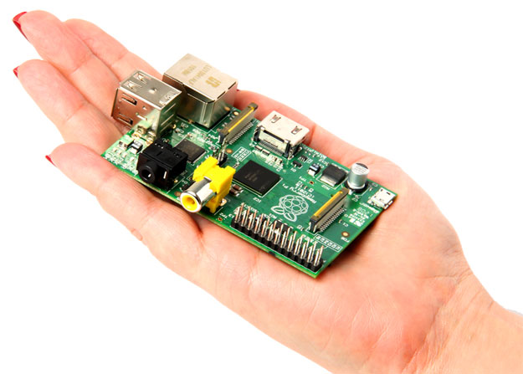
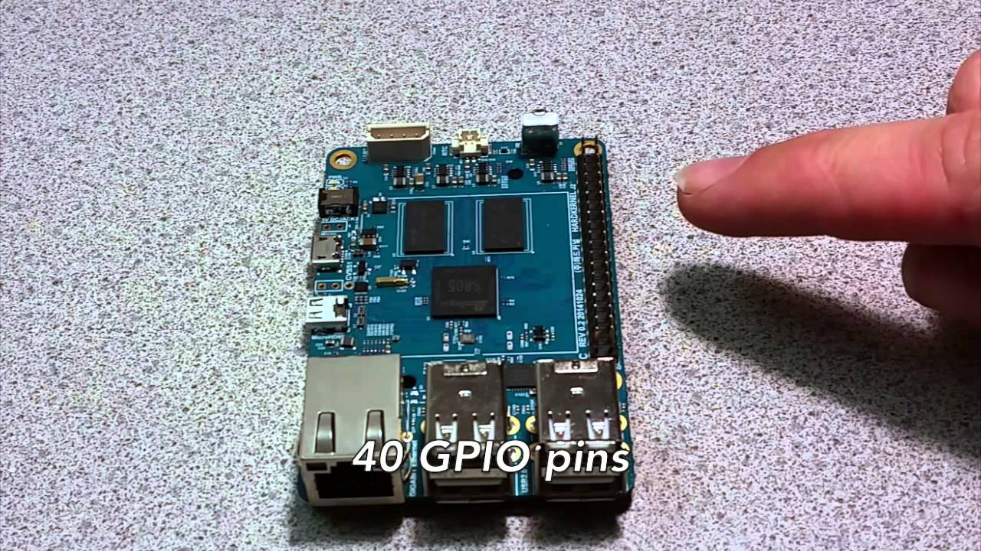
Single Board Computers:
Raspberry Pi
Odroid

Slide 8
Server Software:
Web:
  Apache
  NGINX
  Ruby on Rails
  PHP
  Django
Database:
PostgreSQL
MySQL
SQLite

Slide 9
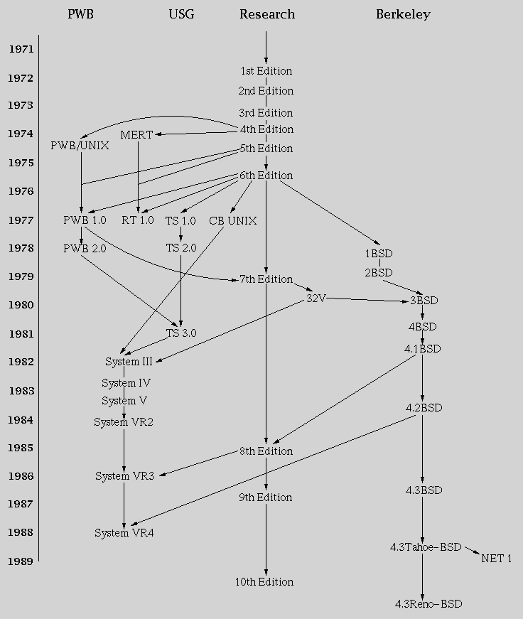
History

Slide 10
Versatility
Linux is only a kernel
The linux environment is highly modular
There are many specialized linux distrobutions
Linux is free software
  It costs nothing
  It can be modified
  It can be customized and redistributed

Slide 11
Main Branches
Redhat
Debian
Arch

Slide 12


Slide 13


Slide 14


Slide 15



Other Uses for Linux:
Cloud Services Platform as a Service Linux virtual machines

Slide 16

Thanks!
Any Questions?

