Slide 1

Networking With Python

Slide 2
What is Python?
Python is a powerful yet easy to use programming language
An Object-Oriented and High Level Language
Developed from the C Programming language but easier to learn syntax
Created by Guido van Rossum as a Christmas project because he was bored that week. It was named after his favorite show, “Monty Python’s Flying Circus”

Slide 3

Why learn Python?
Automate manual tasks
Easy to learn
Widely Supported
All-Purpose use

Slide 4
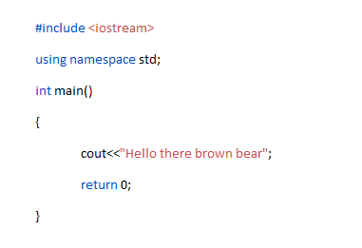
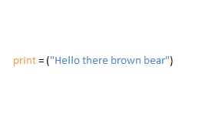
Python vs C++

Slide 5

Automate Manual Tasks
Build easy scripts that enter routine data for you
Use API’s to help automate tasks for employers
Create programs to communicate with larger networks and save time
Your imagination is the limit

Slide 6
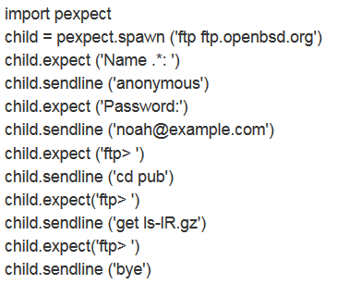
Expect Scripts
Legacy scripts that input pre-written commands into a console or SSH Session.

Slide 7
Some Things to Keep in Mind
The bigger the networks are, it may be required to automate tasks
If you learn Python you will have greater flexibility and ability to work with programs and networks in general.
Nearly all SND vendors offer Python API’s or software Dev Kits for their products
Having coding knowledge will increase your value to an employer

Slide 8




Where Do I Learn Python?
Udemy.com
Codecademy.com
Coursera.org
Youtube.com
As well as courses offered at your learning institution

Slide 9

Thanks For Joining us!

