Slide 1


Steganography: Hiding in plain sight
Notes:
Ctc

Slide 2
Steganography
“The art or practice of concealing a message, image, or file within another message, image, or file” – Merriam-Webster
Steganography Tools
Notes:
Ancient Greece. The most common file type where you’ll find steganography used would probably be in jpegs, cause they’re small image files, and you want to keep the file size down to keep it from looking suspicious

Slide 3

How does it work?
Notes:
Well it does this by using what’s referred to as the least significant bit. Let’s take a look.

Slide 4
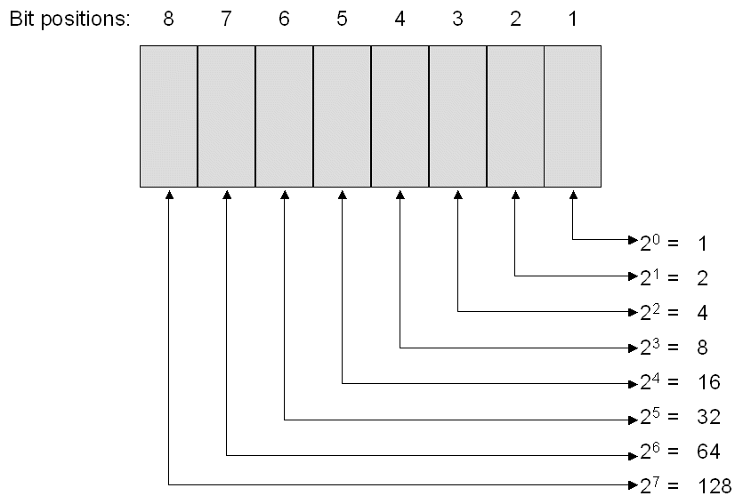
Least Significant bit
Notes:
The least significant bit is “usually” the farthest right bit in a sequence. For example changing 11111111 (255) to 11111110 (254) has the least effect on the value.

Slide 5
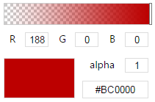
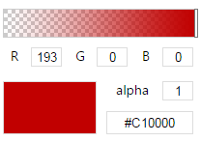
Color codes
10111100.0.0.0
11000001.0.0.0
Notes:
As you can see, we can change a value slightly by borrowing some bits and nobody would really notice anything

Slide 6
Steganography Online Tool
Algorithm Example
Code Sample – C

Slide 7

But can you hack with it?
Notes:
Yes, malware can be found using steganography. It hides the malicious code inside an image, then the seemingly “safe” code extracts it and decrypts it. How to prevent? Just look out for abnormally large files.

Slide 8
Thank you for joining us!

